Slide 1
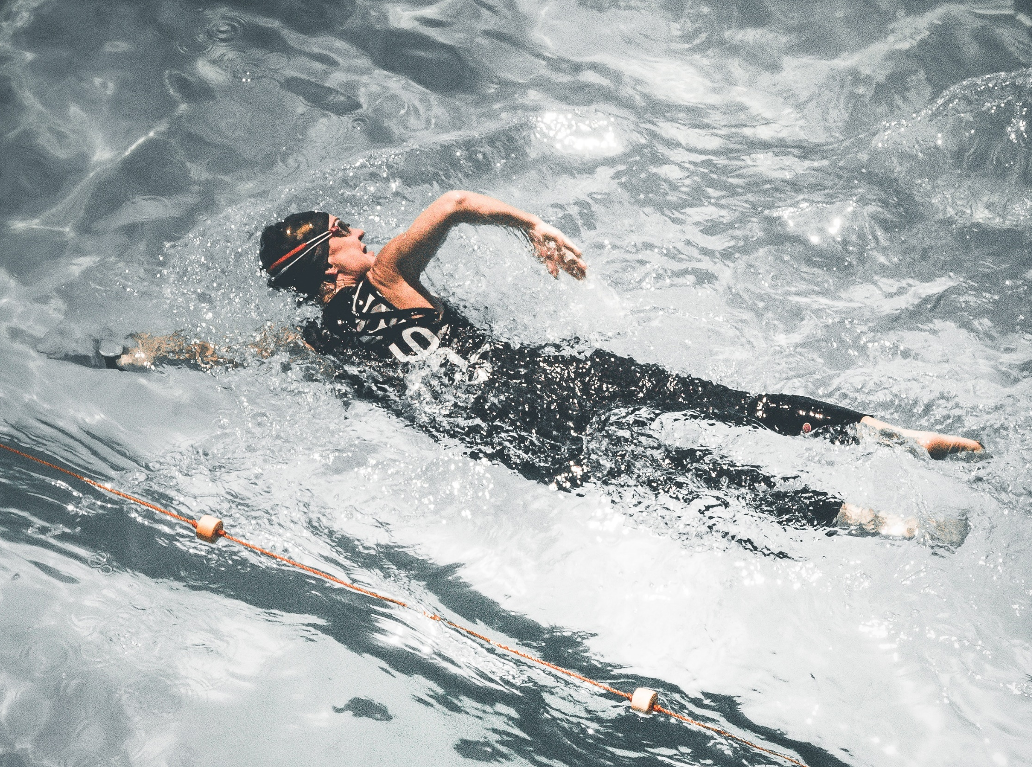
Section A
Applied Anatomy and Physiology
3.1.1.3 Respiratory Systems
Respiratory System During Exercise
© ZigZag Education, 2019

Slide 2

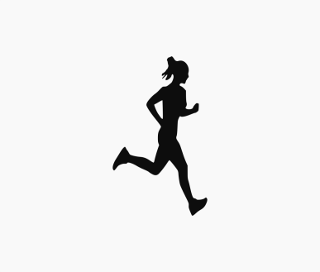

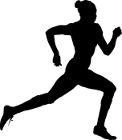
Learn
Respiratory System During Exercise
Effect of Different Intensities of Exercise
In order to support different intensities of exercise, the breathing volumes will need to change. This will allow the required amount of oxygen to be delivered to the working muscle.
Click on each section of the table to reveal the answer
Moderate-intensity exercise such as light jogging:
Respiratory measurements | At rest | Typical value at moderate-intensity exercise | Difference | Effect
Breathing frequency (per minute) | 12 | 28 | 16 | Increased
Tidal volume (ml) | 500 | 3000 | 2500 | Increased
Minute ventilation (l/min) | 6 | 8.4 | 2.4 | Increased
The breathing frequency, tidal volume and minute ventilation all increase from rest to exercise. However, the intensity of your work will determine how much they increase!
High-intensity exercise such as an 800 m race:
Respiratory measurements | At rest | Typical value at high-intensity exercise | Difference | Effect
Breathing frequency (per minute) | 12 | 40 | 28 | Increased significantly
Tidal volume (ml) | 500 | ~4500 | 4000 | Increased significantly
Minute ventilation (l/min) | 6 | ~18 | 13 | Increased significantly
© ZigZag Education, 2019
Notes:
Ask students to identify the typical measurements and then see whether they can calculate the differences as you progress through this slide.

Slide 3
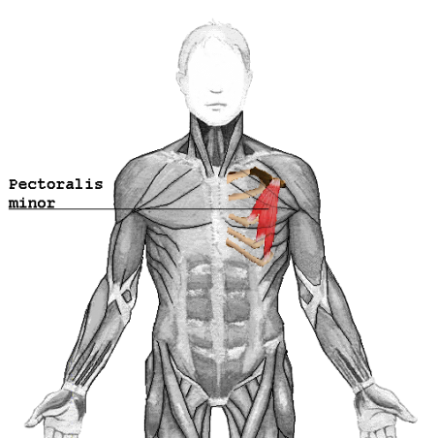
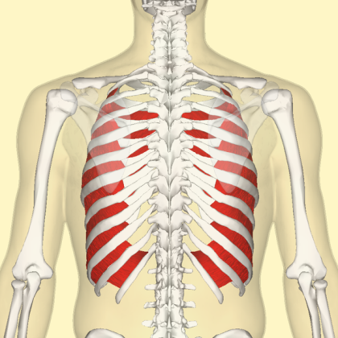
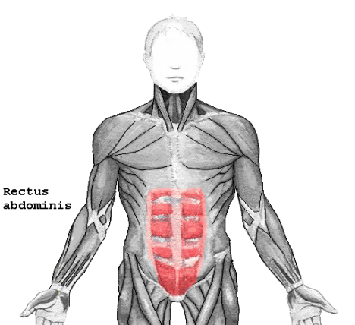
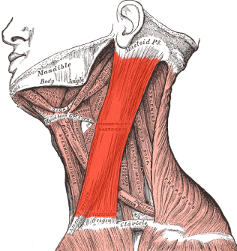
Learn
Respiratory System During Exercise
Mechanics of Breathing
Click on the muscles to reveal their role in breathing during exercise
You have already learnt that the diaphragm and external intercostals are responsible for breathing at rest. However, during exercise, the following muscles also play a role:
Increase inspiration
Increase expiration
Sternocleidomastoid
Further increases the thoracic cavity by lifting the sternum and ribcage
Pectoralis minor
Further increases the thoracic cavity by lifting the sternum and ribcage
Internal intercostals
Become activated during exercise to pull the ribs downwards and inwards more forcefully to force air out of the lungs
Rectus abdominis
Aids expiration by contracting and increasing the intra-abdominal pressure and forcing the diaphragm into a dome shape
© ZigZag Education, 2019
Notes:
This is optional, but may help students to understand that other muscles aid inspiration and expiration during exercise.

Slide 4


Learn
Respiratory System During Exercise
INSPECTION COPY
Regulation of Breathing
Our breathing frequency increases as we exercise, to be able to increase minute ventilation. This is regulated by chemical and neural factors… let’s take a look!
Sympathetic
nervous system
Increases breathing rate, which helps in preparation for exercise and physical activity
Medulla oblongata
This is where the respiratory control centre is located
Inspiratory control centre
Controls the rate and depth of inspiration
Expiratory control centre
Controls the rate and depth of expiration
Parasympathetic nervous system
Decreases breathing rate, which helps in preparation for returning the body to resting levels
Chemoreceptors
ICC
Medulla oblongata
ECC
Stretch receptors
Proprioceptors
Baroreceptors
Inspiration
COPYRIGHT
PROTECTED
Chemical control
Chemoreceptors detect changes in blood pH in the aorta and medulla oblongata. They stimulate the inspiratory control centre to increase inspiration when carbon dioxide levels increase.
Neural control
Proprioceptors detect changes in joint movement and stimulate the inspiratory control centre to increase inspiration when moving
Expiration
Baroreceptors detect changes in blood pressure. When blood pressure drops, this initiates an increase in HR.
Stretch receptors detect the stretch of the lungs which accompanies exercise and stimulates the expiratory control centre to increase expiration
© ZigZag Education, 2019

Slide 5
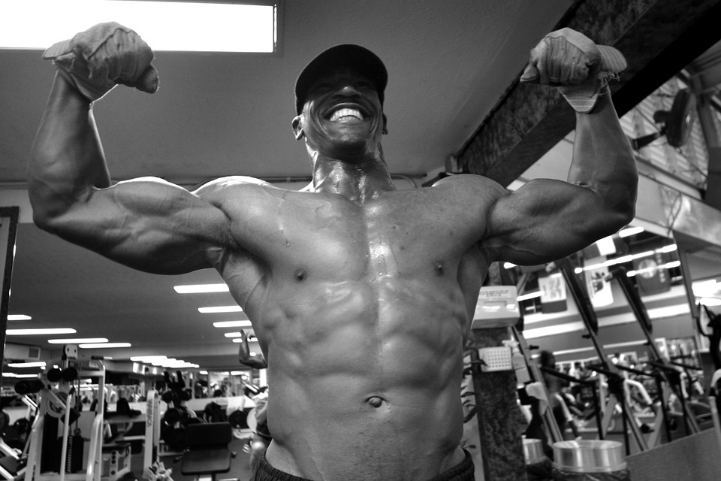
Learn
Respiratory System During Exercise
INSPECTION COPY
Arterio-Venous Oxygen Difference
Described as the difference between the amount of oxygen in the arterial blood going to the muscles, and the amount of oxygen in the venous blood going away from the muscles.
When exercising, muscles need more oxygen; therefore, the arterio-venous difference is higher compared to when at rest.
The benefit of this is that more oxygen can come into – and more carbon dioxide can be removed from – the muscles.
COPYRIGHT
PROTECTED
Trained individuals have a greater arterio-venous difference than untrained individuals.
Training increases this difference as a result of adaptations.
© ZigZag Education, 2019
Notes:
Recap A-VO2 diff.
Highlight the importance of training to improve this difference as a result of adaptations

Slide 6
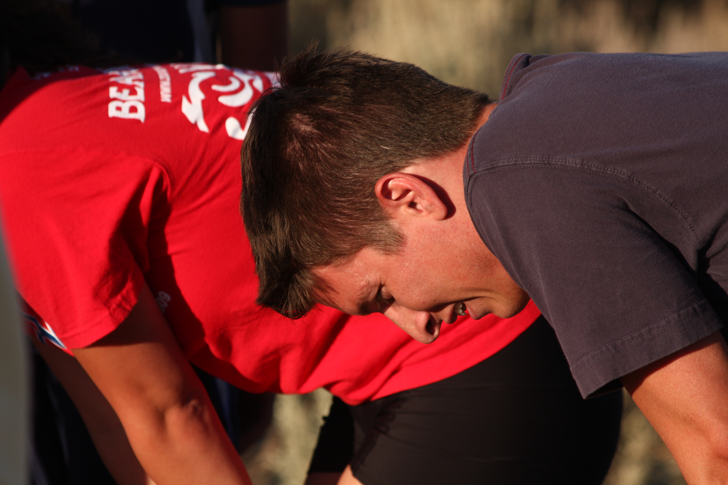
Respiratory System During Exercise
INSPECTION COPY
X
How does an increase in lung volume aid exercise performance?
discuss
What impact does exercise have on lung volume?
How does the a-vO₂ difference differ between trained and untrained athletes?
COPYRIGHT
PROTECTED
© ZigZag Education, 2019
Notes:
Take this opportunity to reflect on what has been learnt and how it impacts sport in a wider context.

Slide 7
Respiratory System During Exercise
Click on each of the muscles to reveal its role
activity
Match each receptor to the role it performs.
Detects changes in muscle movement to increase heart rate via the inspiratory centre
Chemoreceptor
Detects the increase in lung volume and initiates the expiratory centre
Baroreceptor
Detects changes in blood pressure to increase heart rate via the inspiratory centre
Stretch receptor
Detects increases in carbon dioxide and pH levels of the blood to increase heart rate via the inspiratory centre
Proprioceptor
© ZigZag Education, 2019
Notes:
Ask students to identify which receptor is responsible for which action.
Students can click on the names of the receptors to reveal the correct answers.

Slide 8
Respiratory System During Exercise
INSPECTION COPY
Exam-style Question
Explain the role of proprioceptors during exercise. (2 marks)
Click to reveal answer!
2 marks for:
Proprioceptors detect movement in the muscles and joints.
They send impulses to the respiratory centre to increase breathing rate.
COPYRIGHT
PROTECTED
© ZigZag Education, 2019
Notes:
Students to write answers to question on paper and check their answers.
Click to reveal answer. Students to peer-mark or self-mark answers.

