Slide 1

Component 1 Physiological factors affecting performance
1.2.c. Injury prevention and the rehabilitation of injury
Injuries and injury prevention

Slide 2


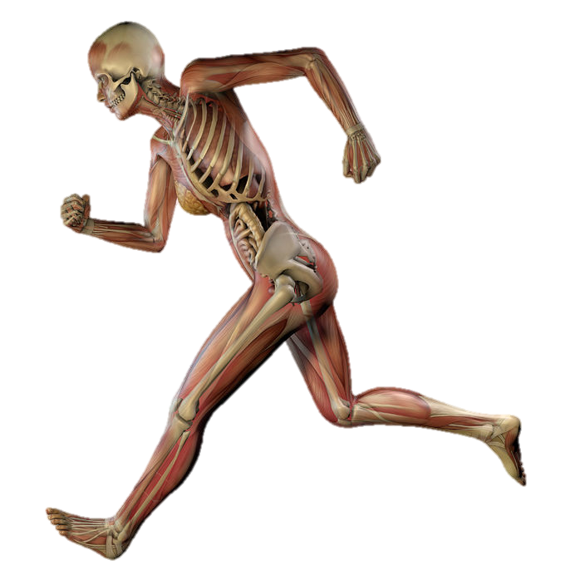
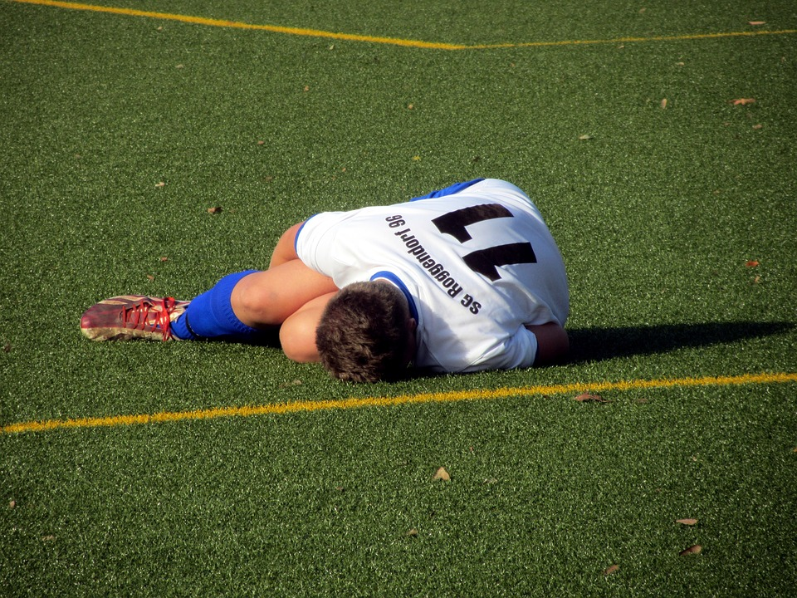


Learn
Injuries and injury prevention
INSPECTION COPY
Acute injuries
Concussion
An acute injury is an injury which occurs when part of the body is subjected to a sudden stress.
Soft tissue injuries
For example, if a hockey player is hit by the ball anywhere on the body, this could cause an acute injury.
Hard tissue injuries
COPYRIGHT
PROTECTED
Move onto chronic injuries
Click on the three different types of acute injury to reveal more about them.
Notes:
Explain what an acute injury is.
Get students to think of examples of each type of injury, before heading to each relevant page.

Slide 3

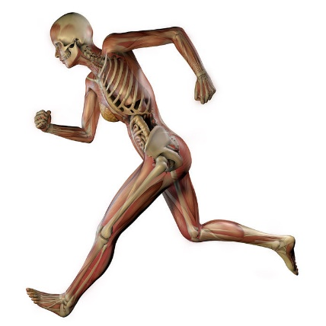

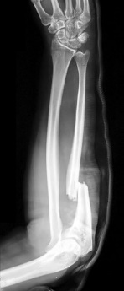
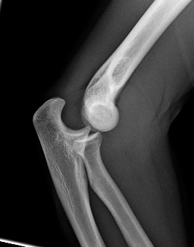
Learn
Injuries and injury prevention
INSPECTION COPY
Acute injuries:
Hard tissue
Hard tissue injuries
Soft tissue injuries
These affect hard tissue such as bone.
They result from sudden impacts or stresses placed on the tissue.
Sudden stress can result in a fracture (break in the bone) or a dislocation (movement of the bone from its normal position within the joint).
Both of these hard tissue injuries can occur through direct force being applied, e.g. being tackled, or through indirect force such as twisting after a slip.
Concussion
COPYRIGHT
PROTECTED
Click on the other two types of acute injury to reveal more about them.
Click here to go back to Acute injuries home page.
Notes:
Discuss acute hard tissue injuries.
Get students to think of examples of how some of these injuries could be picked up in different sports.

Slide 4

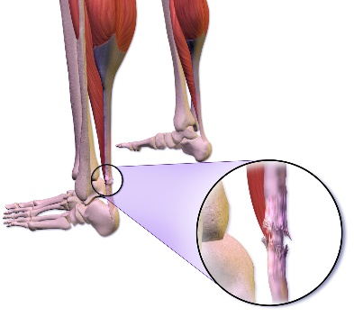
Learn
Injuries and injury prevention
INSPECTION COPY
Acute injuries:
Soft tissue
Soft tissue injuries
Concussion
These affect the muscles, tendons, ligaments and cartilage.
They are often caused by twisting motions which can result in the following:
Hard Tissue injuries
Strains – tearing of the muscle or tendon tissue caused by overstretching at a joint or rapid contraction
Sprains – overstretching of the ligaments as a result of a sudden twist
COPYRIGHT
PROTECTED
The following soft tissue injuries can be caused by direct contact:
Abrasion – damage to the skin caused by friction when the athlete’s skin rubs against another surface, e.g. after falling off a bike
Contusion – damage to the blood vessels following a direct impact which results in the release of blood (bruising) within a confined area
Blister – the development of a fluid-filled sac following
repeated friction between the skin and another surface
Click on the other two types of acute injury to reveal more about them.
Click here to go back to Acute injuries home page.
Notes:
Discuss acute soft tissue injuries.
Get students to think of examples of how some of these injuries could be picked up in different sports.

Slide 5

Learn
Injuries and injury prevention
INSPECTION COPY
Acute injuries:
Concussion
Concussion
Soft tissue injuries
Concussion results from sudden movement of the head which results in the brain impacting against the skull.
The impact can disrupt the normal function of the brain and lead to a loss of consciousness.
Less-traumatic outcomes from this type of injury include confusion, nausea and loss of balance.
It is important that athletes do not continue to participate in sport following a suspected concussion, and instead seek out medical supervision as quickly as possible.
Hard tissue injuries
COPYRIGHT
PROTECTED
Click on the other two types of acute injury to reveal more about them.
Click here to go back to Acute injuries home page.
Notes:
Discuss concussion.
Get students to think of examples of how concussion could be caused in different sports.
You can begin to consider how concussion can be prevented.

Slide 6

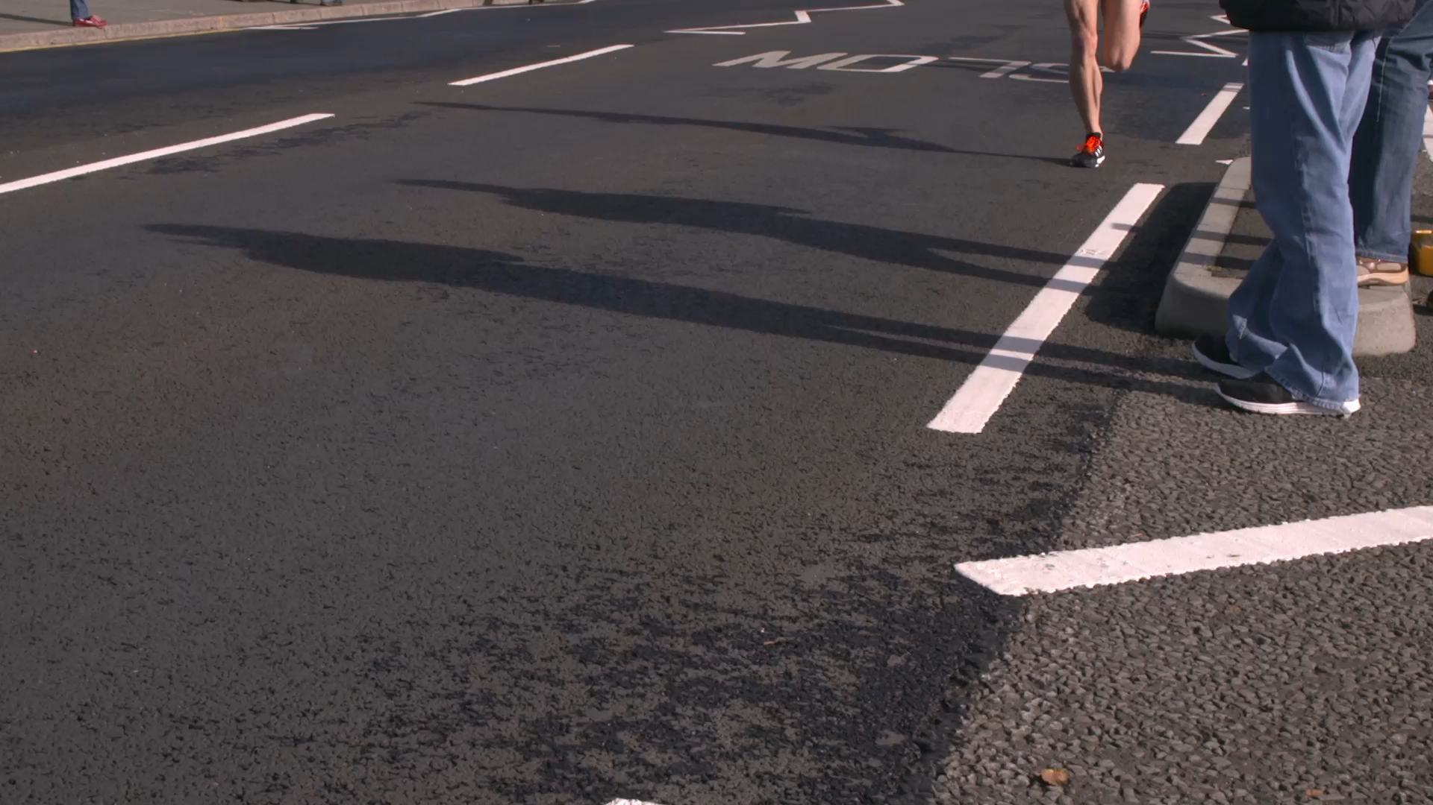
Learn
Injuries and injury prevention
INSPECTION COPY
Chronic injuries
Soft tissue injuries
A chronic injury is an injury which occurs when part of the body is subjected to repeated stresses which lead to a breakdown in tissue integrity.
For example, the amount of training completed and the load placed on the body during preparation for a marathon might result in the gradual breakdown of bone tissue – leading to a stress fracture.
Hard tissue injuries
COPYRIGHT
PROTECTED
Move on to injury prevention
Click on the two different types of chronic injury to reveal more about them.
Notes:
Explain what a chronic injury is.
Get students to think of examples of each type of injury, before heading to each relevant page.

Slide 7

Learn
Injuries and injury prevention
INSPECTION COPY
Chronic injuries:
Hard tissue
Hard tissue injuries
Soft tissue injuries
A Stress fracture can occur when a bone is repeatedly loaded over prolonged periods of time.
A stress fracture is a small fracture within the bone which compromises its ability to be loaded.
Stress fractures often occur in bones which play a role in weight bearing, such as the femur and the tibia.
Sports which repeatedly place large loads on the bones are most likely to cause stress fractures, e.g. running events.
It is important that athletes have adequate rest between exercise sessions so that bone remodelling and adaptation can occur.
COPYRIGHT
PROTECTED
Click on the other type of chronic injury to reveal more about it.
Click here to go back to Chronic injuries home page.
Notes:
Discuss chronic hard tissue injuries.
Get students to think of examples of how some of these injuries could be picked up in different sports.

Slide 8
Learn
Injuries and injury prevention
INSPECTION COPY
Chronic injuries:
Soft tissue
Soft tissue injuries
Sports which repeatedly stretch the ligaments, tendons and cartilage can lead to chronic soft tissue injuries.
For example, repeatedly overstretching the hamstrings when sprinting, without adequate recovery time, can lead to a chronic muscle strain or tear.
Overuse injuries such as tennis elbow and golfer’s elbow are good examples of chronic injuries. The tendons which attach the muscles of the lower arm to the elbow can be torn by the repeated twisting motion that is required to strike a tennis or golf ball.
Hard tissue injuries
COPYRIGHT
PROTECTED
Click on the other type of chronic injury to reveal more about it.
Click here to go back to Chronic injuries home page.
Notes:
Discuss chronic soft tissue injuries.
Get students to think of examples of how some of these injuries could be picked up in different sports.

Slide 9




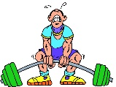
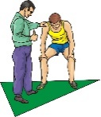

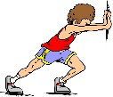
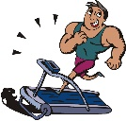
Learn
Injuries and injury prevention
INSPECTION COPY
Intrinsic risk factors
There is a range of factors which determine how susceptible an athlete is to becoming injured. Intrinsic risk factors relate to those factors which are directly related to the characteristics of the individual.
  The more flexible an individual is, the less likely they are to become injured.
  This is because they can stretch their muscles, ligaments and tendons to a greater degree before overstretching occurs.
  As an individual gets older, their risk of injury becomes greater.
  The wear and tear on their soft and hard tissue increases the risk of a chronic injury occurring.
  The strength of their tissues is also reduced which increases the risk of an acute injury occurring.
  The higher an individual’s body mass, the more stress is being placed on their weight-bearing bones and connective tissue.
  This can increase the risk of injuries – particularly chronic injuries.
  Suffering an injury in the past increases an athlete’s risk of suffering from the same injury in the future.
  e.g. those who suffer from ACL tears are far more likely to suffer another ACL tear in the future.
  The body needs to be accustomed to the demands being placed upon it.
  Therefore it is important that the body gradually builds up the amount of stress being placed upon it so that it can adapt.
Flexibility
Age
Body mass
Injury history
Underprepared
COPYRIGHT
PROTECTED
  A low fitness level can increase the risk of injury.
  Low levels of fitness can result in poor technique being displayed when the athlete becomes fatigued, which can increase the risk of an injury occurring.
  Performing a warm-up reduces the risk of injury by allowing the muscles and tendons to gradually become accustomed to contracting.
  A cool-down allows the body to effectively recover from exercise.
  This speeds up the recovery process and, therefore, ensures that the body is fully recovered before the next exercise session.
  Repeatedly loading the same bones, muscles or tendons can increase the risk of injury.
  This can be hard to avoid in sports such as golf and tennis so it is important that athletes take other steps to reduce their risk of injury.
Click on each of the following intrinsic risk factors to reveal their effects.
Fitness level
Warm-up
Cool-down
Overuse
Notes:
Explain that intrinsic means ‘from within’ (e.g. factors associated with their bodies).
Reveal each of the relevant intrinsic factors.

Slide 10
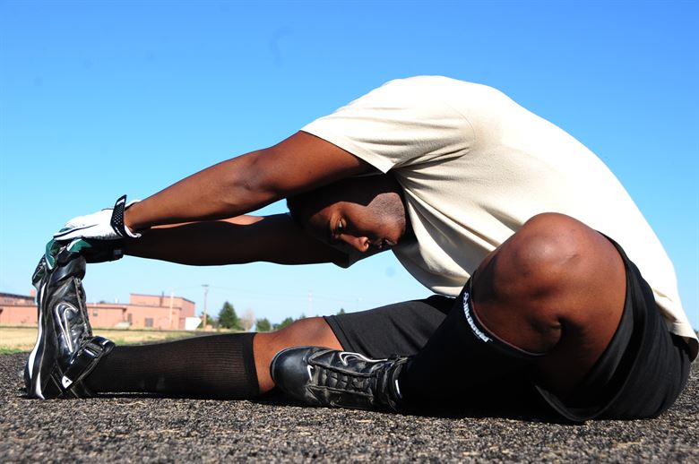
Learn
Injuries and injury prevention
INSPECTION COPY
Training effects
Athletes can prevent picking up injuries through careful preparation during training.
Prepare, prepare, prepare!
Athletes should ensure they consume proper nutrition, build training up gradually, complete appropriate warm-ups and have correct work : rest ratio.
Train to your own fitness level
Athletes should also apply the FITT principle of training effectively, so as not to train too frequently or at an intensity that is too high.
COPYRIGHT
PROTECTED
Get flexible before training
Athletes should improve the flexibility of their muscles and connective tissues prior to training, with a suitable warm-up, reducing the risk of soft tissue injuries.
Notes:
Discuss how athletes can control their training to prevent injuries.

Slide 11

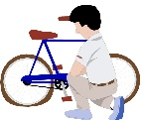



Learn
Injuries and injury prevention
INSPECTION COPY
Extrinsic risk factors
There are also extrinsic risk factors which increase the chance of an injury occurring. These risk factors are those which are not directly related to the athlete.
  Having a poor technique can place limbs in vulnerable positions and increase the risk of acute injuries.
  It can also place greater strain on the muscles and tendons and, therefore, increase the risk of chronic injuries occurring.
  By not wearing the necessary safety equipment, an athlete is placing themselves at risk of acute contact injuries.
  They can also increase the risk of chronic injuries occurring if they are wearing inappropriate clothing, e.g. running shoes without enough cushioning.
  Exercising at an intensity which the athlete is not prepared for will increase their risk of injury.
  This is because the body has not had time to adapt to this exercise load and will, therefore, be broken down.
Poor technique
Incorrect equipment
Inappropriate intensity
COPYRIGHT
PROTECTED
  An inappropriate length of exercise can increase the risk of chronic injuries as the tissues are repeatedly loaded and my not be able to handle the stress that they are put under.
  Exercising too often can prevent the tissues from adequately recovering and adapting to the exercise load, which increases the risk of an injury occurring.
Click on each of the following extrinsic risk factors to reveal their effects.
Inappropriate duration
Inappropriate frequency
Notes:
Explain that extrinsic means ‘from outside of the body’ (e.g. not associated with their bodies).
Reveal each of the relevant extrinsic factors.

Slide 12
Learn
Injuries and injury prevention
INSPECTION COPY
Warming up and cooling down
Warming up and cooling down have always been a main part of any exercise programme and are often widely used, especially at elite level, to prevent injuries and support recovery from exercise.
But, is a warm-up even effective? Check out this video and then discuss the effectiveness of warming up and cooling down.
COPYRIGHT
PROTECTED
Notes:
Watch the video about warm-ups.
Engage the class in a discussion about the effectiveness of warming up before taking part in physical activity.

Slide 13
Injuries and injury prevention
INSPECTION COPY
Think of some injuries that you have sustained; identify what type of injury they were and what you think led to them occurring.
Discuss
What steps do you think professional sports teams take in order to ensure that their athletes are able to remain injury-free?
Why does American football have such a big issue with athletes sustaining concussions? What could be done to reduce the occurrence of concussions within the sport?
COPYRIGHT
PROTECTED
Notes:
Take this opportunity to reflect on what has been learnt and how it impacts on the wider context of sport.

Slide 14
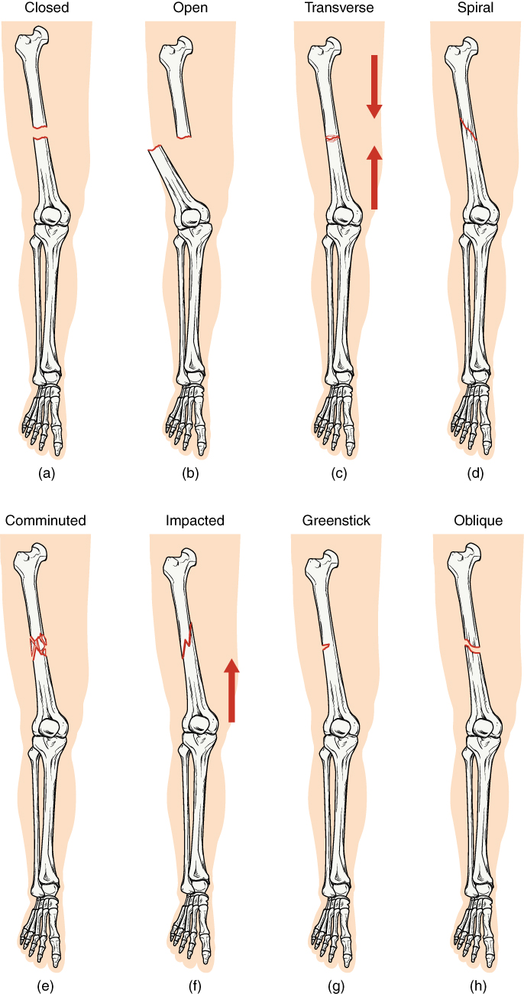
Injuries and injury prevention
There are multiple different fractures that can be sustained. Can you identify what type of fracture each of the following images represents?
Activity
Click on the injuries to reveal the correct answers.
Closed
Open
Transverse
Spiral
Comminuted
Impacted
Greenstick
Oblique

Slide 15
Injuries and injury prevention
INSPECTION COPY
Exam-style question
Identify two extrinsic risk factors which increase the risk of injury for an athlete.
(2 marks)
Click to reveal answer!
Any two from:
poor technique
incorrect use of equipment
inappropriate clothing or footwear
inappropriate intensity of exercise
inappropriate duration of exercise
inappropriate frequency of exercise
COPYRIGHT
PROTECTED
Notes:
Students to write answers to questions on paper and check answers.
Click to reveal answers. Students to peer-mark or self-mark answers.

