Slide 1
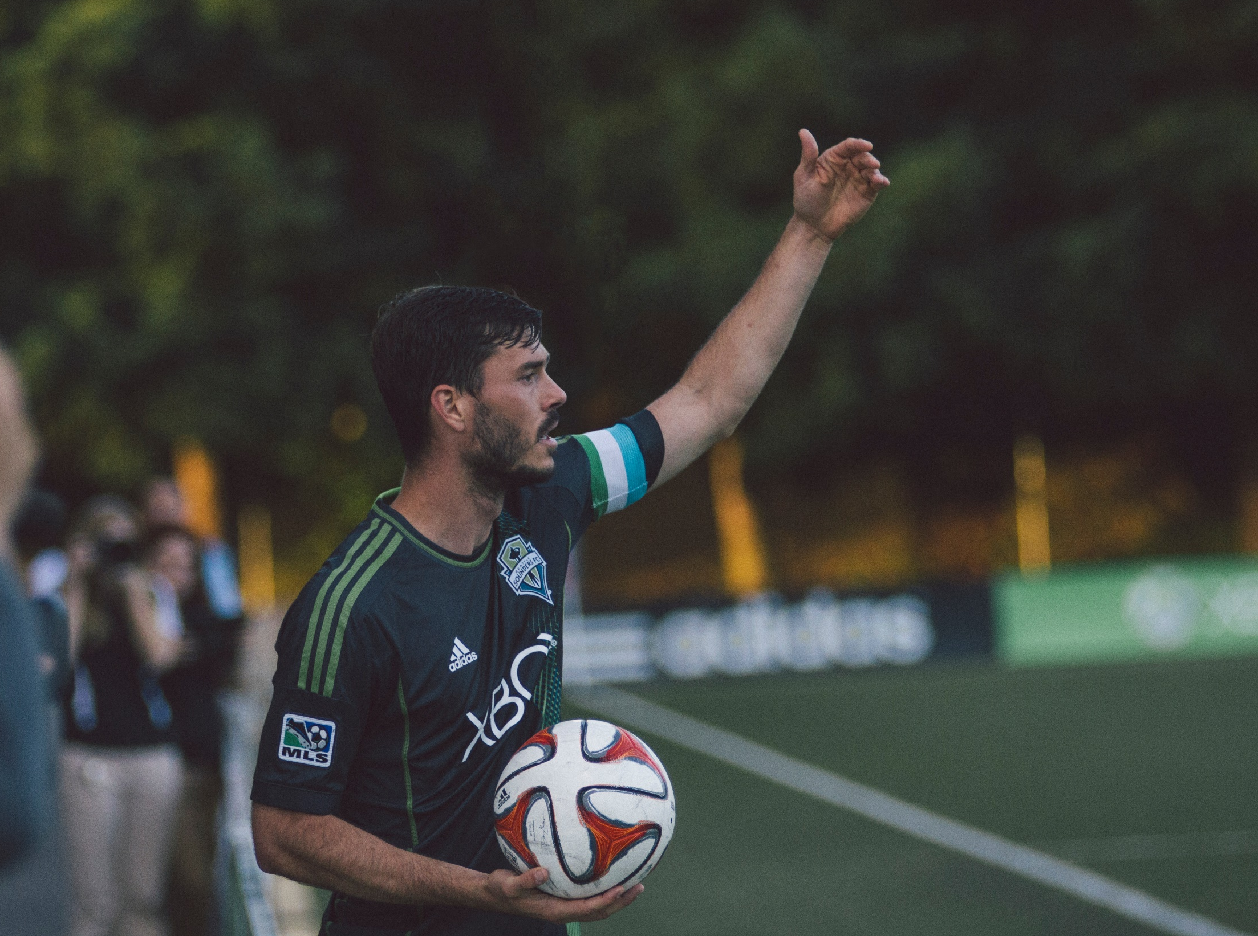
Component 2 Psychological factors affecting performance
2.1. Skill acquisition
Leadership

Slide 2

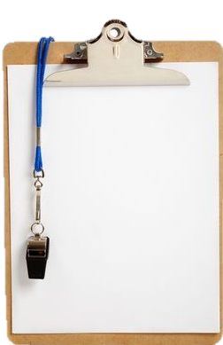
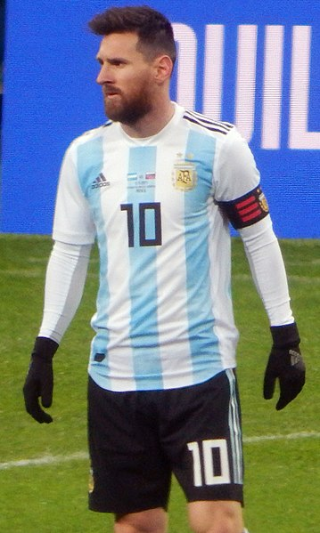
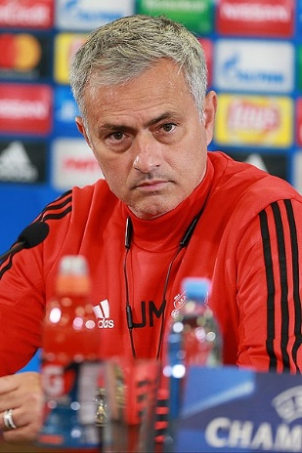


Learn
Leadership
INSPECTION COPY
Introduction
There are two ways that an individual can become a leader of a group:
Emergent leader – this is a leader who emerges from within the group, usually due to their performance level and their close connections to other members of the team.
Although there are different types of leader, effective ones usually share these similar characteristics:
High levels of motivation
Inspirational
Approachable
Organised
Highly skilled
Empathetic
Enthusiastic
Good decision-maker
COPYRIGHT
PROTECTED
Prescribed leader – this is a leader who is appointed from outside the group due to their managerial abilities and status.
Notes:
Introduce the concept of leadership.
Explain the difference between an emergent leader and a prescribed leader.
Get the students to identify different examples of emergent leaders and prescribed leaders within sport.
Identify the characteristics that effective leaders tend to share.

Slide 3

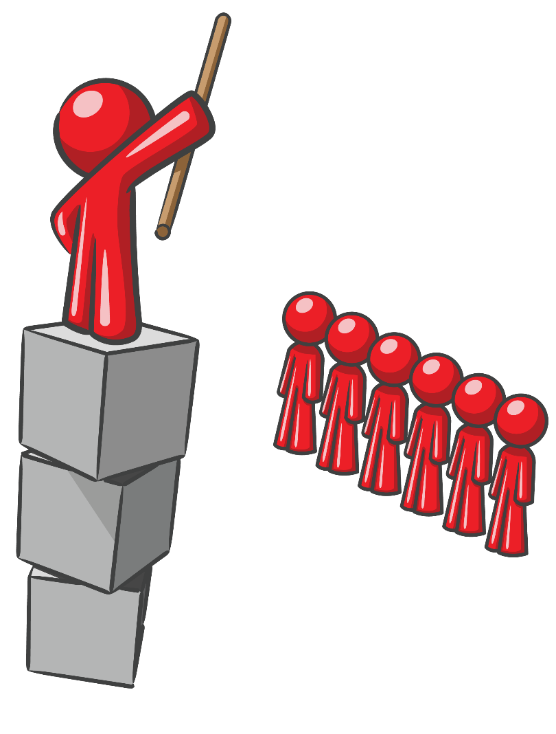
Learn
Leadership
Leadership styles – autocratic
Autocratic leaders display great levels of authority by providing all direction for the team without room for input from individual team members
Click to reveal more information about this style of leadership
Characteristics
The leader has total control, dictating the team’s strategies and goals
Sole decision-maker
Task-oriented
Not approachable
Does not encourage contributions from others
Do what I say
Yes, boss
Suited to
Team sports
When a quick decision is needed
Poorly organised groups
Disadvantages
Perceived as controlling
Stifles creativity
Notes:
Explain the autocratic style of leadership.
Identify the characteristics of an autocratic leader.
Explain what types of athlete tend to respond well to this style of leadership.
Explain the disadvantages of this style of leadership.

Slide 4

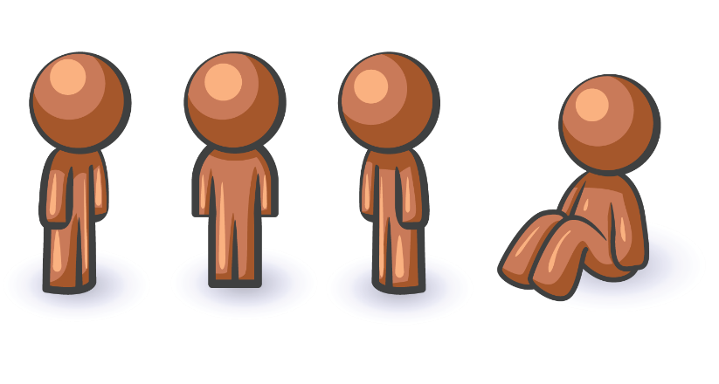
Learn
Leadership
INSPECTION COPY
Leadership styles - democratic
Democratic leaders take the opinions of their athletes into account when making any decision.
Characteristics
Open style of leadership, taking on board the opinions of others
People-centred, focusing on building team relationships
Allows decision-making by others
Good communicator
Creative
Click to reveal more information about this style of leadership.
So we lost our last game. How can we improve?
I think our attack was lacking; our defence was good.
We could work on our defensive line.
Suited to
Individual sports
When creativity is required
When the group consists of good communicators
COPYRIGHT
PROTECTED
Disadvantages
Can lead to teammates being unsure of their roles
Time-consuming
Notes:
Explain the democratic style of leadership.
Identify the characteristics of a democratic leader.
Explain what types of athlete tend to respond well to this style of leadership.
Explain the disadvantages of this style of leadership.

Slide 5
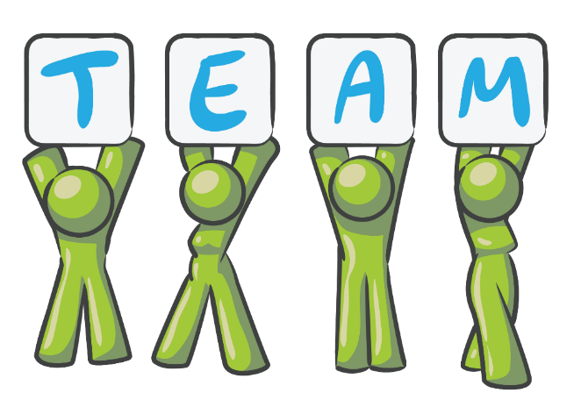
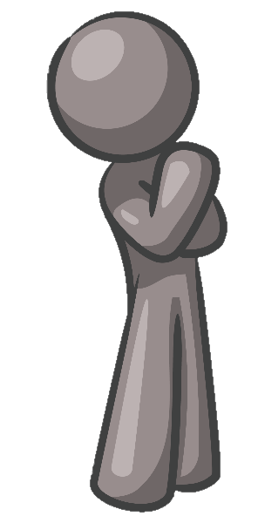
Learn
Leadership
INSPECTION COPY
Leadership styles – laissez-faire
Laissez-faire leaders take a back seat and let the team members make most of the decisions. The leader is primarily there in a consultant role when the team needs advice.
Click to reveal more information about this style of leadership
Characteristics
Leaders take a back seat, without adding input
Sessions are governed by the other team members
There is a focus on problem-solving
Lets just see what happens…
Suited to
COPYRIGHT
PROTECTED
Groups in which all team members have the capability of working without guidance
Disadvantages
Low productivity
Lack of guidance leads to confusion
Lack of organisation
Lack of team cohesion
Notes:
Explain the laissez-faire style of leadership.
Identify the characteristics of a laissez-faire leader.
Explain what types of athlete tend to respond well to this style of leadership.
Explain the disadvantages of this style of leadership.

Slide 6
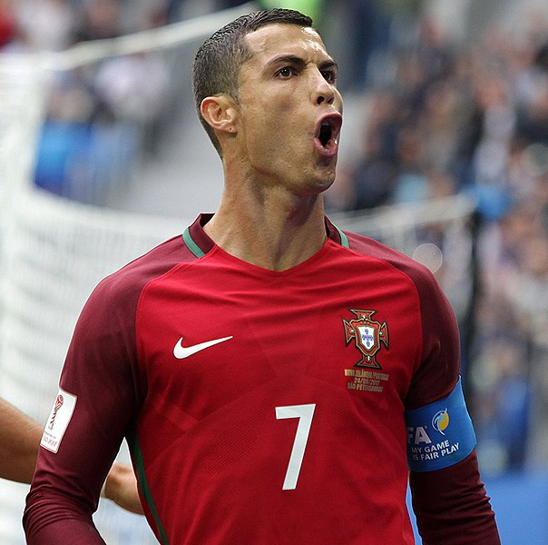
Learn
Leadership
INSPECTION COPY
Theories of leadership: trait perspective
There are three major theories of leadership which try to explain how a leader develops their characteristics. The first we will look at is trait perspective.
A leader’s innate characteristics will determine whether or not they are an effective leader.
This theory suggests that there are certain leadership characteristics which suit all situations and you are either born with them or not.
Some leaders, such as Cristiano Ronaldo, have been described as natural leaders who demand respect from others no matter what situation they are in.
This certainly seems to be true for Ronaldo, who has held influential roles for two of the largest clubs in the world, along with his own national team.
However, this theory does not explain why some sporting managers can be successful in one team and then not be able to replicate the same level of managerial success when they move to a new team.
COPYRIGHT
PROTECTED
Maybe not everyone responds positively to the same type of leadership?
Notes:
Introduce the trait perspective of leadership.
Apply trait perspective of leadership to the example of Ronaldo.
Explain the limitations of this theory of leadership.

Slide 7
Learn
Leadership
INSPECTION COPY
Theories of leadership: social learning theory
Now we will look at social learning theory.
This theory is based on the idea that leaders are not born but they learn the personal and professional skills required to be effective leaders in different situations.
This theory explains why some athletes become leaders within a group as they get older. Through social learning, they are able to observe and learn the behaviour of other leaders and then replicate these behaviours.
As a younger player, Messi did not have the leadership role that he now has for club and country.
Social learning theory would indicate that he has learnt from other influential leaders who played for Barcelona and Argentina, and, in recent times, he has been able to replicate these behaviours himself.
COPYRIGHT
PROTECTED
However, not everybody is able to successfully learn the techniques required to be an effective leader.
Maybe leadership qualities are developed through a combination of trait characteristics and social learning?
Notes:
Introduce the social learning theory of leadership.
Apply the social learning theory of leadership to the example of Messi.
Explain the limitations of this theory of leadership.

Slide 8

Learn
Leadership
INSPECTION COPY
Theories of leadership: interactionist theory
Now we will look at interactionist theory.
This theory combines elements of trait perspective and social learning theory by proposing that a leader’s behaviour is influenced by both their innate traits and their social experiences.
Although José Mourinho appears to have a number of traits which make him a good leader, we also know that he spent a lot of his early coaching career working under established leaders Bobby Robson (Sporting CP, Porto and Barcelona) and Louis van Gaal (Barcelona).
He has stated himself that he learnt a lot from these two managers, indicating that he was able to develop his innate leadership characteristics.
COPYRIGHT
PROTECTED
Notes:
Introduce the interactionist theory of leadership.
Apply the interactionist theory of leadership to the example of Mourinho.

Slide 9
Learn
Leadership
Chelladurai’s multidimensional model
Chelladurai’s multidimensional model of sports leadership illustrates the impact that different factors have on the leader’s behaviour and the outcome.
The model shows that the required behaviour and preferred behaviour are influenced by situational and member characteristics.
How far the leader’s actual behaviour is from the required and preferred behaviours of the team will determine the quality of the group’s performance and the level of member satisfaction.
Situational characteristic
e.g. the hockey team is playing in a preseason friendly
Required behaviour
The behaviours expected of the manager such as making important decisions
Group performance
Member satisfaction
Leader characteristic
e.g. the actions of the coach are not appreciated by the players and, therefore, they do not perform well
e.g. the autocratic leadership style of the coach
Actual behaviour
e.g. the coach displays autocratic qualities by not listening to the players
Member characteristic
e.g. the hockey team is made up of experienced adult female athletes
Preferred behaviour
e.g. the team would like the coach to listen to them and be democratic
Click on each component to see how it relates to a hockey team.
Notes:
Introduce and explain Chelladurai’s multidimensional model of leadership.
Get the students to click on each component of the model to reveal an example of it in sport.

Slide 10
Leadership
INSPECTION COPY
Think of some successful leaders from your favourite sport – what made them so effective?
Discuss
What types of sport would a laissez-faire leader be suited to?
Why would the required and preferred leadership behaviours be different in different situations?
COPYRIGHT
PROTECTED
Notes:
Take this opportunity to reflect on what has been learnt and how it impacts on the wider context of sport.

Slide 11
Leadership
Indicate whether the following characteristics are most related to autocratic, democratic or laissez-faire leaders by placing an A, a D or an L next to each characteristic.
Activity
Encourages problem-solving
L
Not approachable
A
Click on each characteristic to reveal the answer.
Personable approach
D
Builds personal relationships
D
Very controlling
A
Open to input
D
Takes a back seat
L
Notes:
Get students to identify whether the characteristics are representative of an autocratic, democratic or laissez-fair leader.
They can click on each characteristic to discover the correct answer.

Slide 12
Leadership
INSPECTION COPY
Exam-style question
Using examples, describe two factors which can influence a group’s preferred leader behaviour. (4 marks)
Click to reveal answer!
4 marks for:
(Member characteristic) The individual personalities of the team members will influence what type of leader they prefer.
e.g. introverted team members may prefer a more approachable leader
(Situational characteristics) Team members will prefer a certain type of leadership behaviour to be displayed in different situations.
e.g. preferring a more autocratic leadership style in highly stressful situations, such as during extra time of a competition final
COPYRIGHT
PROTECTED
Notes:
Students to write answers to questions on paper and check answers.
Click to reveal answers. Students to peer-mark or self-mark answers.

