Slide 1

Component 1 Physiological factors affecting performance
1.1b Cardiovascular and Respiratory Systems
Respiratory System During Exercise
© ZigZag Education, 2018

Slide 2



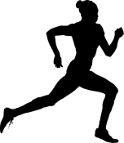
Learn
Respiratory System During Exercise
Effect of Different Intensities of Exercise
In order to support different intensities of exercise, the breathing volumes will need to change. This will allow the required amount of oxygen to be delivered to the working muscle.
Click on each section of the table to reveal the answer
Moderate-intensity exercise such as jogging:
Respiratory measurements | At rest | Typical value at moderate-intensity exercise | Difference | Effect
Breathing frequency (per minute) | 12 | 28 | 16 | Increased
Tidal volume (ml) | 500 | 3000 | 2500 | Increased
Minute ventilation (l/min) | 6 | 8.4 | 2.4 | Increased
The breathing frequency, tidal volume and minute ventilation all increase from rest to exercise. However, the intensity of your work will determine how much they increase!
High-intensity exercise such as an 800 m race:
Respiratory measurements | At rest | Typical value at high-intensity exercise | Difference | Effect
Breathing frequency (per minute) | 12 | 40 | 28 | Increased significantly
Tidal volume (ml) | 500 | ~4500 | 4000 | Increased significantly
Minute ventilation (l/min) | 6 | ~18 | 13 | Increased significantly
© ZigZag Education, 2018
Notes:
Ask the students to identify the typical measurements and then see whether they can calculate the differences as you progress through this slide.

Slide 3
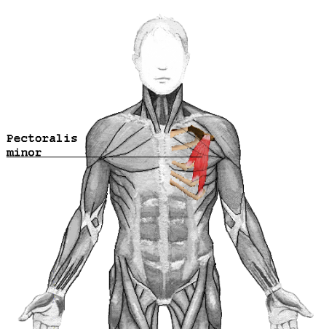
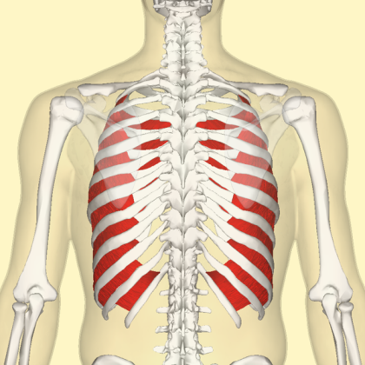
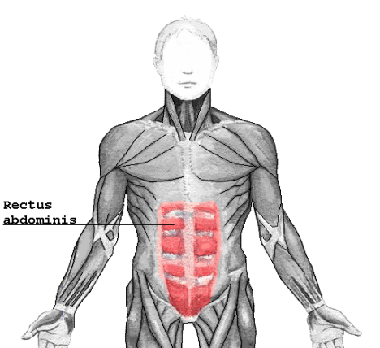
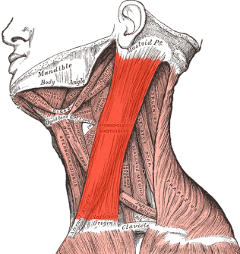
Learn
Respiratory System During Exercise
Mechanics of Breathing
Click on the muscles to reveal their role in breathing during exercise
You have already learnt that the diaphragm and external intercostals are responsible for breathing at rest. However, during exercise, the following muscles also play a role:
Increase inspiration
Increase expiration
Sternocleidomastoid
Further increases the thoracic cavity by lifting the sternum and ribcage
Pectoralis minor
Further increases the thoracic cavity by lifting the sternum and ribcage
Internal intercostals
Become activated during exercise to pull the ribs downwards and inwards more forcefully to force air out of the lungs
Rectus abdominis
Aids expiration by contracting and increasing the intra-abdominal pressure and forcing the diaphragm into a dome shape
© ZigZag Education, 2018

Slide 4


Learn
Respiratory System During Exercise
INSPECTION COPY
Regulation of Breathing
Our breathing frequency increases as we exercise, to be able to increase minute ventilation. This is regulated by chemical and neural factors… let’s take a look!
Medulla oblongata
This is the section of the brain which contains the respiratory control centre
Inspiratory Control Centre
Controls the rate and depth of inspiration
Expiratory Control Centre
Controls the rate and depth of expiration
Chemoreceptors
ICC
Medulla Oblongata
ECC
Baroreceptors (stretch receptors)
Proprioceptors
Thermoreceptors
Inspiration
COPYRIGHT
PROTECTED
Neural control
Proprioceptors detect changes in joint movement and stimulate the inspiratory control centre to increase inspiration when moving
Expiration
Chemical control
Chemoreceptors detect changes in blood pH in the aorta and medulla oblongata. They stimulate the inspiratory control centre to increase inspiration when carbon dioxide levels increase.
Thermoreceptors detect changes in temperature which occur during exercise and increase the respiratory rate
Baroreceptors (stretch receptors) detect the stretch of the lungs which accompanies exercise and stimulates the expiratory control centre to increase expiration
© ZigZag Education, 2018

Slide 5
Learn
Respiratory System During Exercise
INSPECTION COPY
Gas Exchange at the Alveoli and Muscles
Oxygen is transported around the body in combination with haemoglobin but how does it separate itself and how does it know where to do this?
% saturation of haemoglobin
This can be displayed on an oxyhaemoglobin dissociation curve
The affinity of haemoglobin for oxygen is reduced as the partial pressure of oxygen decreases.
100
80
This means oxygen is closely combined to haemoglobin near the alveoli (high partial pressure of O₂) and less closely combined near the muscles (low partial pressure of O₂).
This allows oxygen to be taken into the blood near the lungs and released from the blood to the muscles.
60
This reduced affinity for oxygen is called the Bohr shift and can be displayed by a shift of the line to the right
Bohr effect
40
20
Partial pressure of oxygen (mmHg)
COPYRIGHT
PROTECTED
20
40
60
80
100
When we exercise, the reduction in blood pH (due to increased CO₂ and lactic acid levels) and increased temperature reduces the affinity of haemoglobin for oxygen.
This allows oxygen to be released to the muscles more readily when we exercise.
© ZigZag Education, 2018

Slide 6
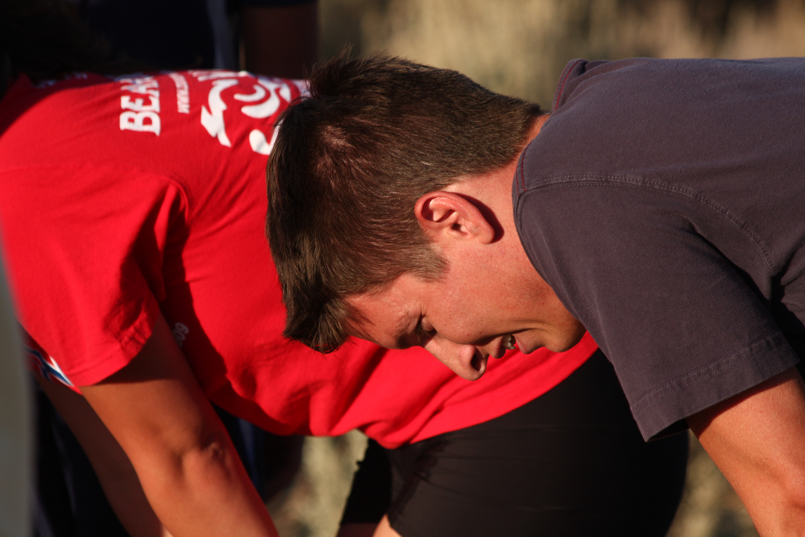
Respiratory System During Exercise
INSPECTION COPY
X
How does an increase in lung volume aid exercise performance?
discuss
Why is the Bohr shift important?
How does the a-vO₂ difference differ between trained and untrained athletes?
COPYRIGHT
PROTECTED
© ZigZag Education, 2018
Notes:
Take this opportunity to reflect on what has been learnt and how it impacts on sport in a wider sport.

Slide 7
Respiratory System During Exercise
INSPECTION COPY
activity
Match each respiratory muscle to its function during exercise.
Increases the intra-abdominal pressure to force the diaphragm upwards
Sternocleidomastoid
Pectoralis minor
Pull the ribs downwards and inwards more forcefully to force air out of the lungs
Internal intercostals
COPYRIGHT
PROTECTED
Lifts the ribcage and sternum to further increase the thoracic cavity
Rectus abdominis
Click on each of the muscles to reveal its role
© ZigZag Education, 2018
Notes:
Ask the students to identify which muscle is responsible for which action.
Students can click on the muscles to reveal the correct answers.

Slide 8
Respiratory System During Exercise
INSPECTION COPY
Exam-style Question
Explain how an oxyhaemoglobin curve would change as an athlete moves
from jogging to sprinting. (4 marks)
Click to reveal answer!
4 marks from:
Sprinting involves anaerobic work, which increases the CO₂ levels in the blood.
The increase in lactic acid build-up would decrease the pH (increase acidity) of the blood in the muscles.
Sprinting would result in an increase in muscle temperature.
Reduced blood pH and increased temperature would reduce the affinity of haemoglobin for oxygen.
Oxygen would be released more readily to the muscles during exercise.
The curve would shift to the right.
This shift is called the Bohr effect.
COPYRIGHT
PROTECTED
© ZigZag Education, 2018
Notes:
Students to write answers to question on paper and check their answers.
Click to reveal answer. Students to peer-mark or self-mark answers.

