Slide 1
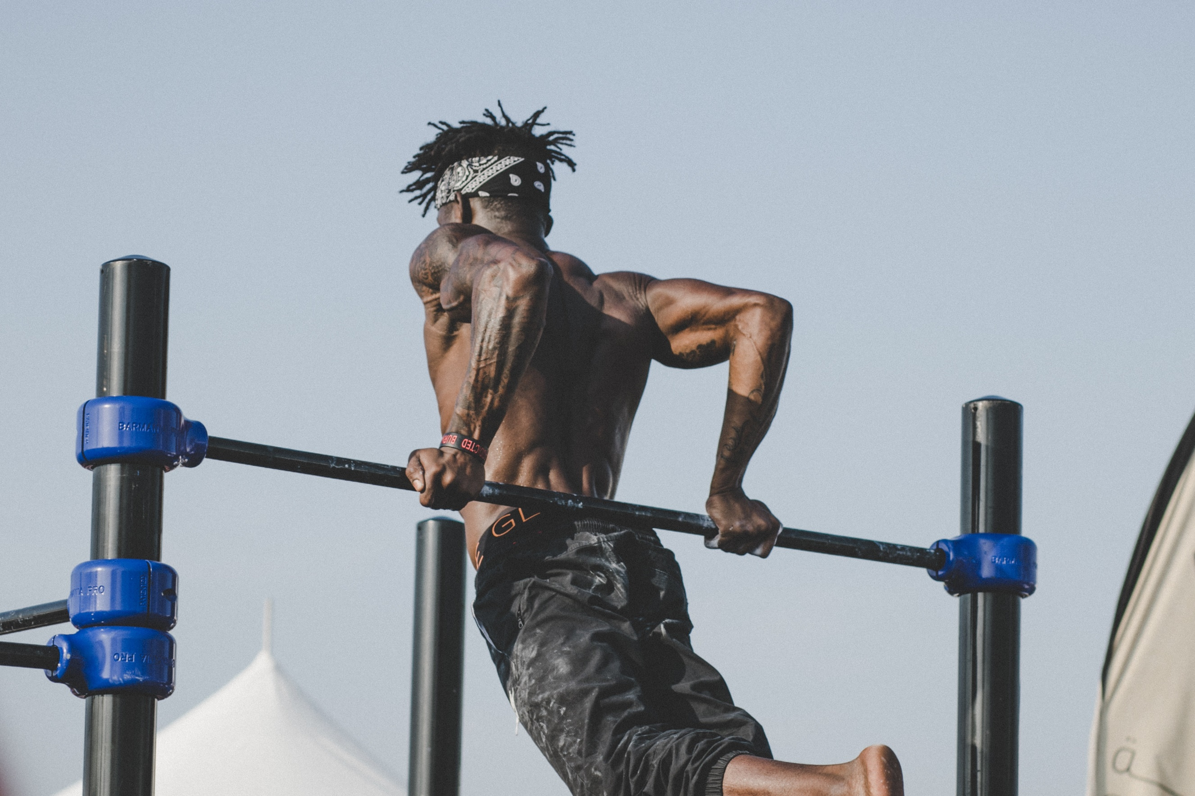
Component 1 Physiological factors affecting performance
1.3a Biomechanical Principles
Levers
© ZigZag Education, 2018

Slide 2



Learn
Levers
INSPECTION COPY
Levers
Levers are formed when we try to move objects by contracting the muscles in order to move the bones at a joint.
This function makes them very important during sporting performance as we are constantly moving our joints in order to perform specific actions!
There are four components of a lever:
The order of these four components will determine what type of lever system it is and what function it plays
The lever arm
Fulcrum
Load
Effort
COPYRIGHT
PROTECTED
Bones act as levers within the body
The joints act as the fulcrum within the body
The load is the object which needs to be moved
The muscles provide the effort that is needed to move the load
© ZigZag Education, 2018
Notes:
The students should watch the video in order to develop an overall understanding of the different types of lever and their components.

Slide 3
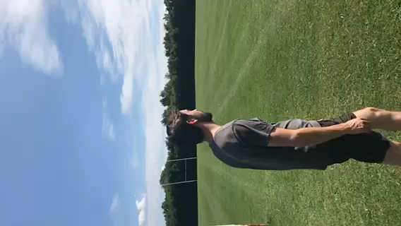
Learn
Levers
First Class
Let’s take a look at first-class levers and see how they operate during sporting performance.
A first-class lever system can be represented by the following diagram:
Effort
Load
Fulcrum
Effort arm
Load arm
The forces are evenly balanced and a wide range of movement can be produced
© ZigZag Education, 2018
Notes:
Ask students whether they can remember what makes a first-class lever system.
Allow them to reveal the diagram to see whether they remembered it correctly.
Students can watch the video to see a real-world example of a first-class lever system.

Slide 4
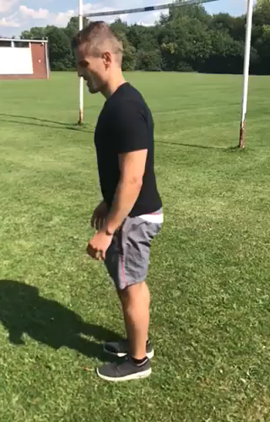
Learn
Levers
INSPECTION COPY
Second Class
Let’s take a look at second-class levers and see how they operate during sporting performance.
A second-class lever system can be represented by the following diagram:
Load
Effort
However, this occurs slowly and within a limited range of motion!
Fulcrum
COPYRIGHT
PROTECTED
Effort arm
Load arm
These levers are at a mechanical advantage because the effort arm is greater than the load arm. This allows large loads to be moved with minimal effort.
© ZigZag Education, 2018
Notes:
Ask students whether they can remember what makes a second-class lever system.
Allow them to reveal the diagram to see whether they remembered it correctly.
Students can watch the video to see a real-world example of a second-class lever system.

Slide 5
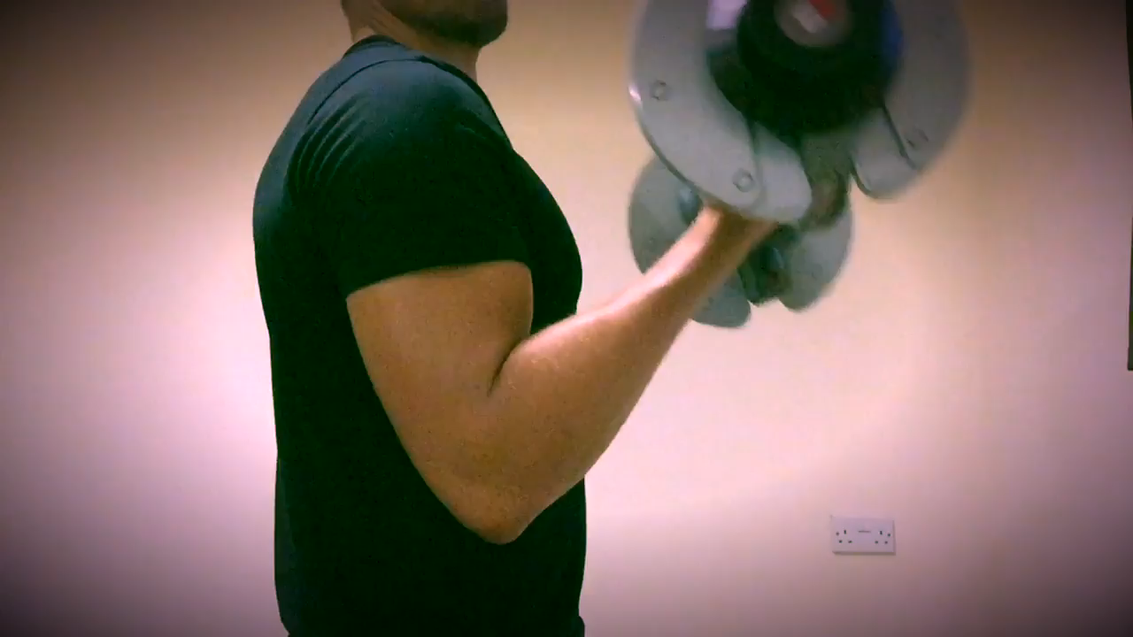
Learn
Levers
INSPECTION COPY
Third Class
Let’s take a look at third-class levers and see how they operate during sporting performance.
A third-class lever system can be represented by the following diagram:
Effort
Load
Fulcrum
COPYRIGHT
PROTECTED
Effort arm
Load arm
However, this requires a large effort in order to move a small load!
These levers are at a mechanical disadvantage because the load arm is larger than the effort arm. This allows loads to be moved at a high velocity over a large range of motion.
© ZigZag Education, 2018
Notes:
Ask students whether they can remember what makes a third-class lever system.
Allow them to reveal the diagram to see whether they remembered it correctly.
Students can watch the video to see a real-world example of a third-class lever system.

Slide 6
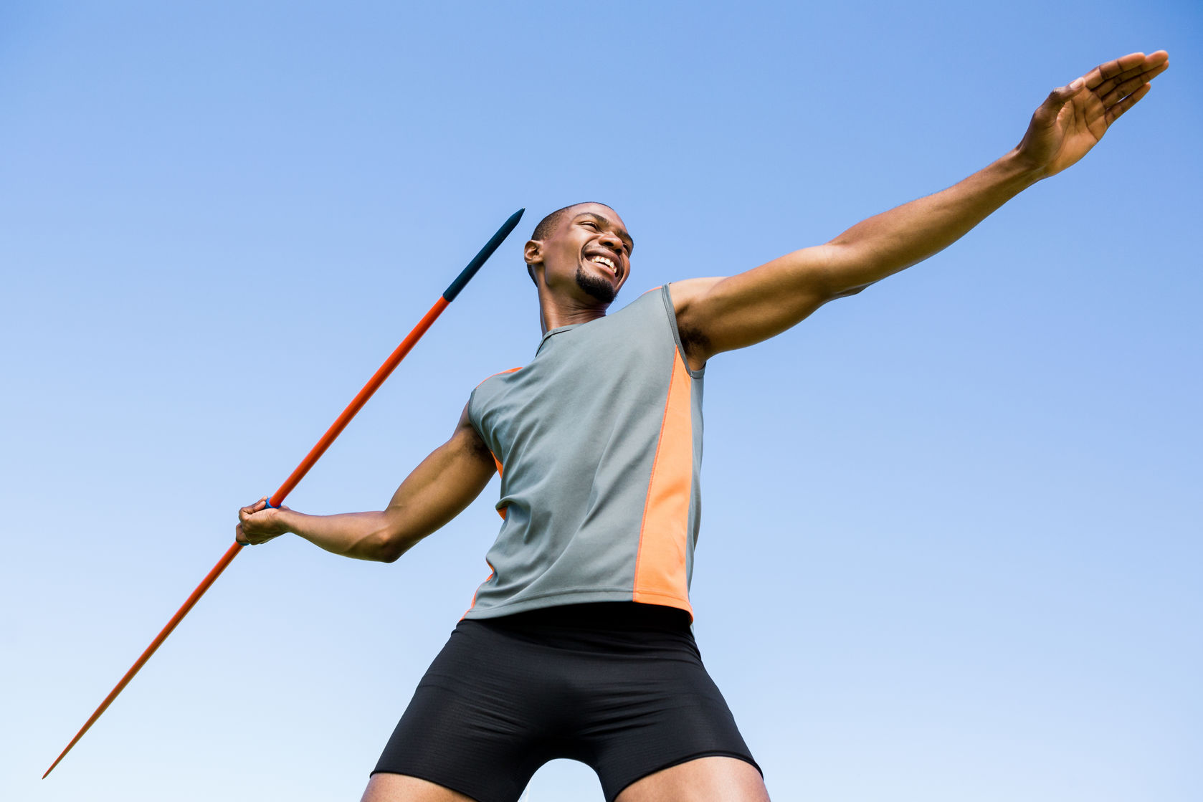
Levers
INSPECTION COPY
How does an athlete’s height improve the effectiveness of a lever system, and how would this benefit performance in a sport such as tennis?
discuss
What type of lever system occurs when a bat is used to strike a ball, and how does this affect performance?
What are the benefits of having a mechanical advantage at the foot during a long-distance run?
COPYRIGHT
PROTECTED
© ZigZag Education, 2018
Notes:
Take this opportunity to reflect on what has been learnt and how it impacts on sport in a wider context.

Slide 7

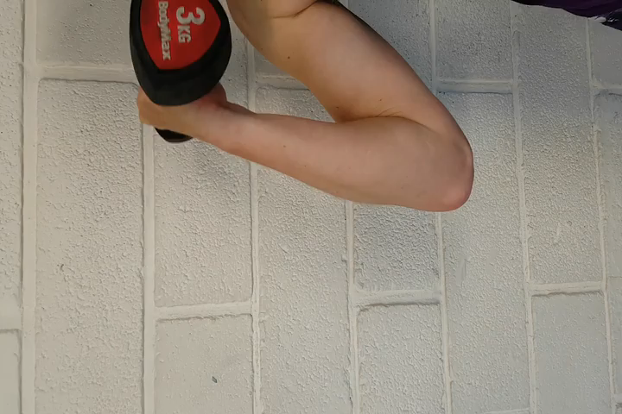
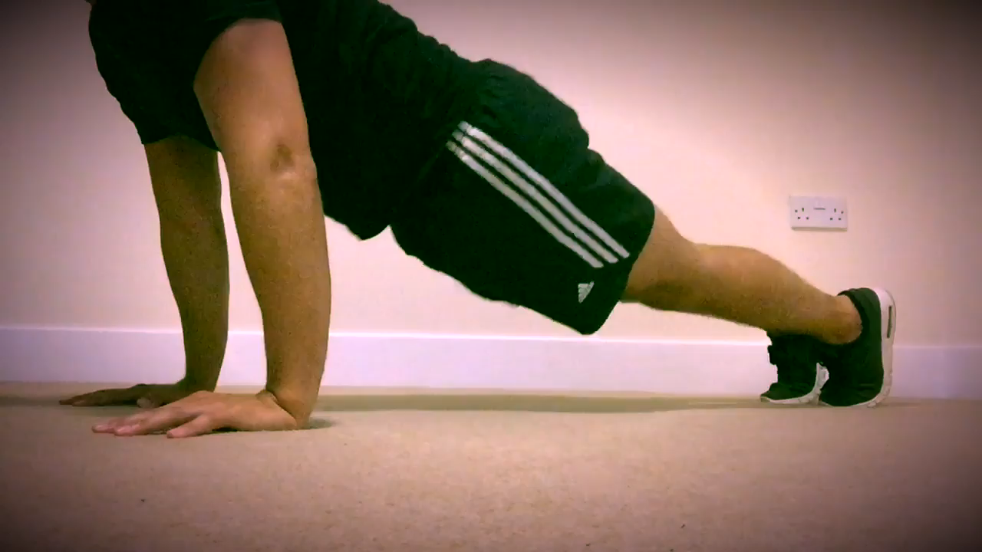

Levers
Identify which of the following videos is showing a first-, second- and third-class lever system, and then draw the load, effort and fulcrum onto the screenshot of each action on your worksheet.
Click on the answer buttons to reveal the answers
activity
Answer
Answer
Answer
Load
Effort
Load
Fulcrum
Effort
Effort
Fulcrum
Fulcrum
Load
First-class lever system
Second-class lever system
Third-class lever system
© ZigZag Education, 2018
Notes:
Students should watch the three sporting movements.
They should identify which is a first-, second- and third-class lever system.
They should annotate the images of these sporting actions on their worksheets with the fulcrum, load and effort.

Slide 8


Levers
INSPECTION COPY
Read the following statements.
‘A bicep curl is at a mechanical advantage.’
‘A mechanical disadvantage allows large loads to be moved quickly.’
Which statement is true? (1 mark)
Exam-style Question
Click on the answer that you think is correct
A. Both are true
B. The first is true, the second is false
C. The second is true, the first is false
D. Both are false
That’s incorrect; have another go.
That’s incorrect; have another go.
That’s incorrect; have another go.
COPYRIGHT
PROTECTED
That’s correct!
© ZigZag Education, 2018
Notes:
Students to write answers to question on paper and check their answers.
Click to reveal answer. Students to peer-mark or self-mark answers.

