Slide 1
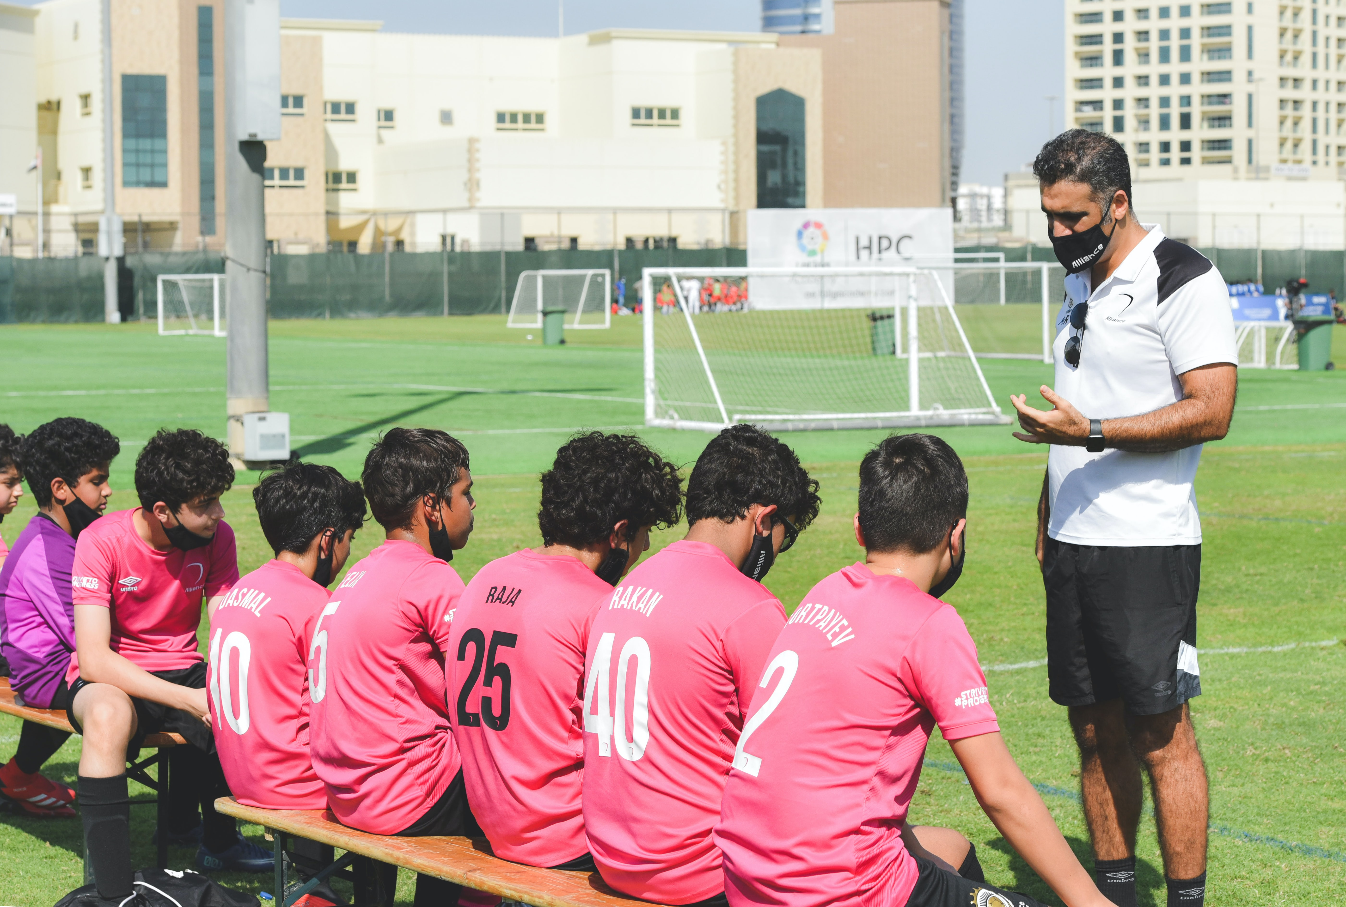
Photocopiable/digital resources may only be copied by the purchasing institution on a single site and for their own use
Guidance and Feedback
on Performance
Paper 2
Sports Psychology
2.3

Slide 2

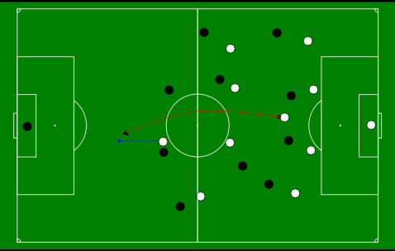
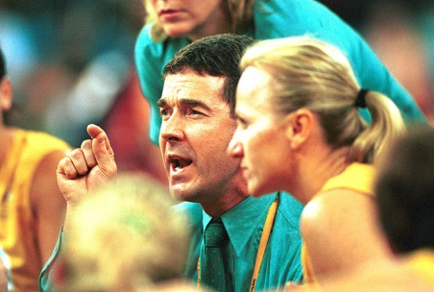
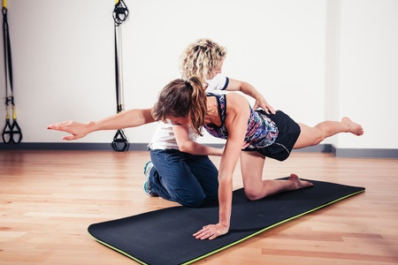
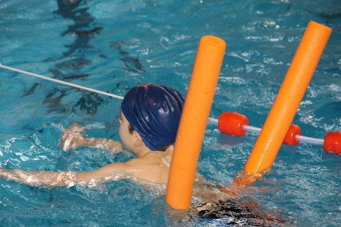


INSPECTION COPY
Introduction to guidance
Learn
Guidance is the way in which information is conveyed to a performer to help them learn a new skill.
There are four types of guidance:
Visual
Verbal
Manual
Mechanical
COPYRIGHT
PROTECTED
The effectiveness and appropriateness of the type of guidance used is dependent on the ability level of the performer.
Click on each button (below each image) to explore more on each type of guidance.
© ZigZag Education, 2023
Notes:
Introduce the concept of guidance.
Click through the slide to reveal the four different types of guidance.
Identify which type of guidance is being displayed in each picture.
Click on the pictures to go to each type of guidance and learn more about its evaluation and examples.

Slide 3
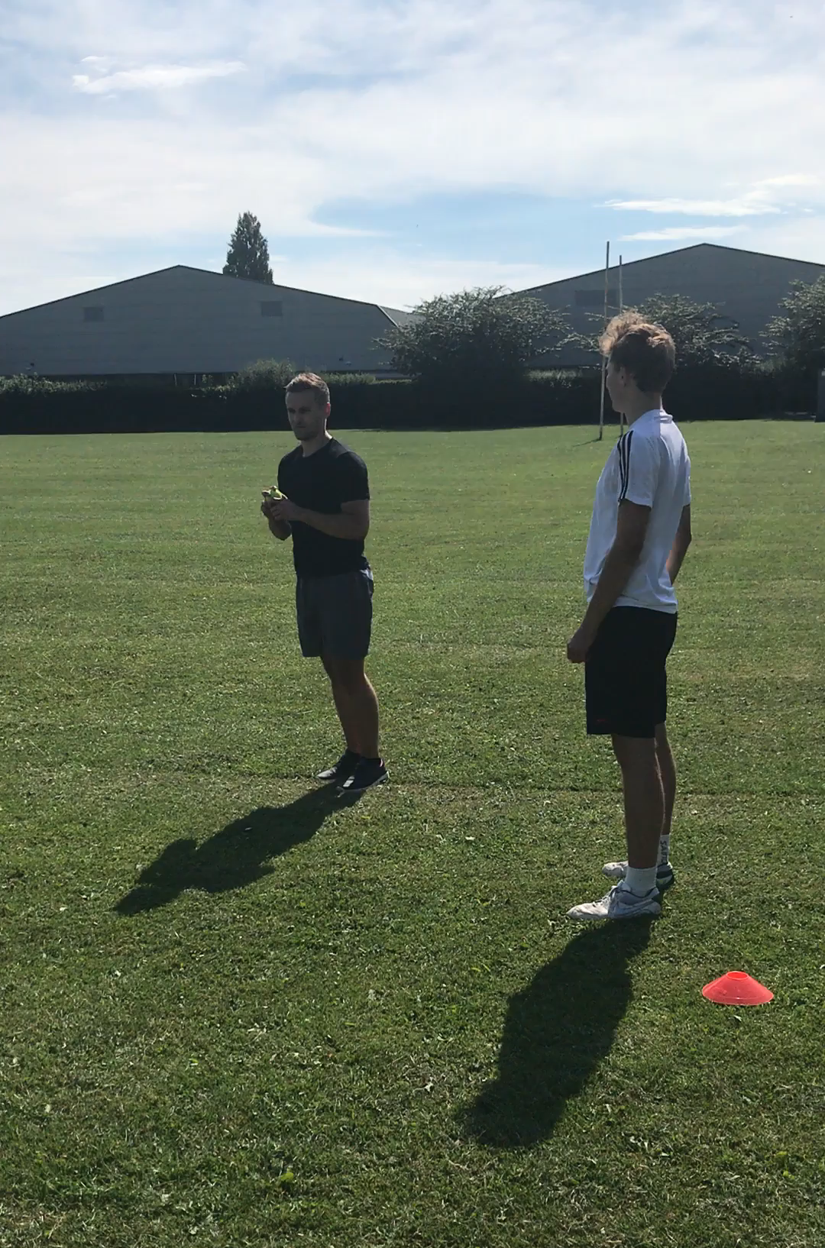
INSPECTION COPY
Visual guidance
Learn
Visual guidance involves the coach providing a demonstration of how to perform a skill, or use of a visual aid to outline performance.
Click on the video to show how a visual demonstration can be used by a coach.
Examples:
A gymnastics coach showing their performer how to safely dismount from the high bar.
A football coach displaying the team’s formation on a whiteboard so it is clear in which positions everyone will play.
Advantages | Disadvantages
Allows performers to see how a skill should be performed (i.e. a perfect model)
Performers are able to mimic the movement being performed
Can be used alongside verbal guidance for cues and tips
Difficult to mimic complex skills which need breaking down
Ineffective if used alone without verbal guidance
The correct technique must be shown, otherwise learners pick up bad habits
COPYRIGHT
PROTECTED
Beginner performers will benefit from seeing a skill demonstrated by a coach or performer as they can create a mental image of how it is meant to be performed.
Expert performers already know how a skill should look so seeing it performed by another person would have limited added value.
Back to intro page
© ZigZag Education, 2023
Notes:
Click on the video to see a demonstration of visual guidance used by a coach.
Click through the slide to see an evaluation of visual guidance in sport and why it is most suited to beginners.
Identify different examples of visual guidance, then click to reveal examples within the slide.
Return to the intro page by clicking the back button.

Slide 4
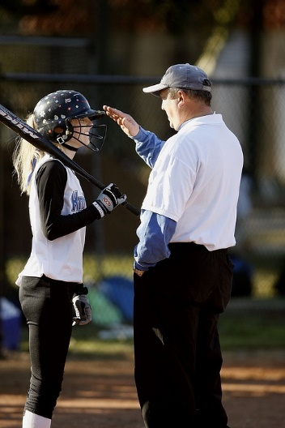
INSPECTION COPY
Verbal guidance
Learn
Verbal guidance involves the use of words to talk the learner through a skill.
Examples:
A track cycling coach informing their athletes how far the opposition team is behind them in the team pursuit.
A boxing coach guiding their performer through different combinations by calling out commands such as ‘jab, jab, cross’.
Advantages | Disadvantages
Allows explanations to be given to the performer
Effective alongside visual guidance
Can be used to give cues and tips
May result in information overload for the performer
Beginner performers may struggle to understand complex instructions and terminology
Assumes the performer knows what the skill should look like
COPYRIGHT
PROTECTED
Beginner performers don’t have a clear understanding of how movements should look or feel so may struggle to understand the use of verbal guidance on its own.
The style of verbal guidance can be adapted to suit expert performers, e.g. through use of specialist terminology which they will understand.
Back to intro page
4
© ZigZag Education, 2023
Notes:
Click through the slide to see an evaluation of verbal guidance in sport and why it is most suited to expert performers.
Identify different examples of verbal guidance, then click to reveal examples within the slide.
Return to the intro page by clicking the back button.

Slide 5
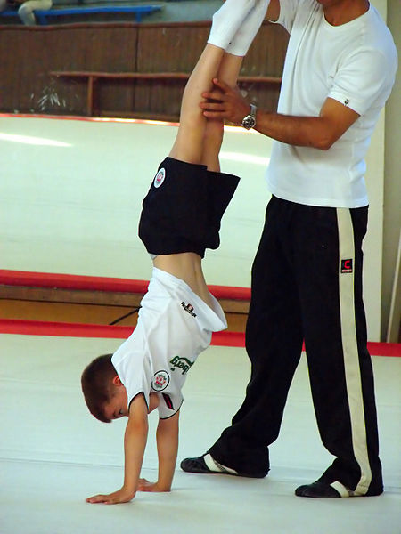
Guidance and Feedback
Manual guidance
INSPECTION COPY
Learn
Manual guidance involves a ‘hands-on’ approach to providing assistance to the performer when performing a skill.
Examples:
A fitness trainer helping their client to perform a pull-up.
A swimming coach holding their performer’s body at the top of the water to show how they should keep their body from sinking.
Advantages | Disadvantages
Helps to build confidence with a skill
Allows performers to get a feel for how the skill is performed (kinaesthetic learning)
Reduces fear with a skill
Performer may become reliant on another’s support to perform the skill
Too much assistance may be given which makes it difficult to ‘feel’ the movement
COPYRIGHT
PROTECTED
Beginner performers are unaware of how a movement should feel, so having a coach manually guide them through the movement will give them a good understanding of how they should perform the skill on their own.
Expert performers already know how the skill should feel, and so will obtain no further benefit from manual guidance.
Back to intro page
© ZigZag Education, 2023
Notes:
Click through the slide to see an evaluation of manual guidance in sport and why it is most suited to beginners.
Identify different examples of manual guidance, then click to reveal examples within the slide.
Return to the intro page by clicking the back button.

Slide 6
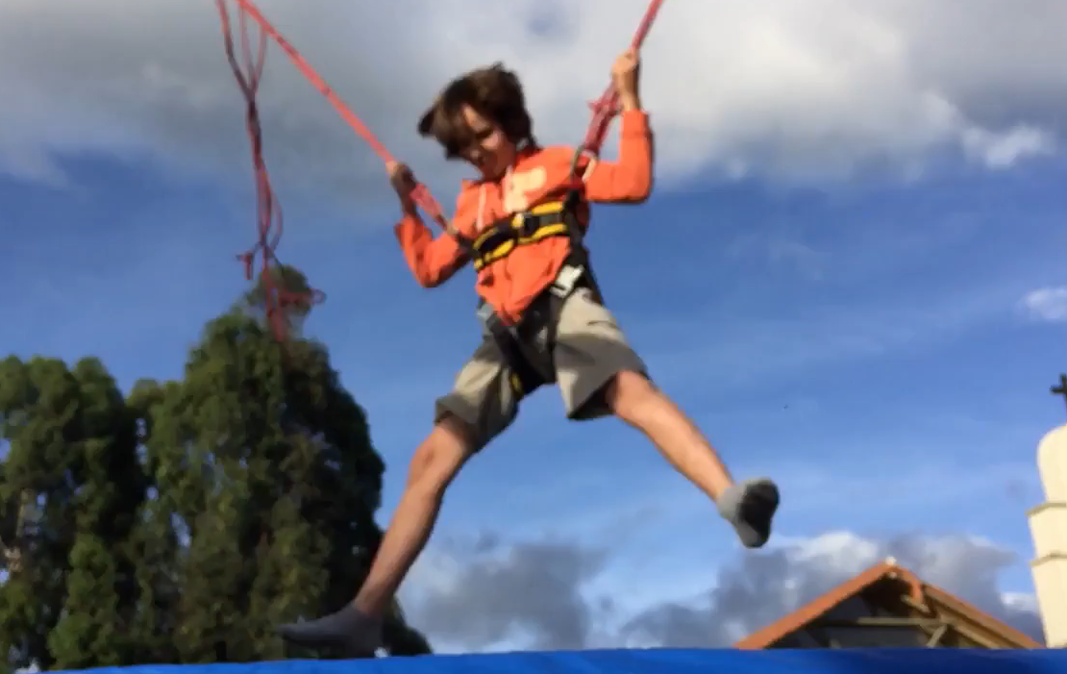
Guidance and Feedback
Mechanical guidance
INSPECTION COPY
Learn
Mechanical guidance involves the use of equipment to provide support to the learner as they perform a skill.
Examples:
Using a hoist/harness to practise somersaulting on the trampoline.
Using armbands to allow a beginner swimmer to stay afloat and practise their technique.
Advantages | Disadvantages
Helps to build confidence with a skill
Allows performers to practise difficult skills safely
Allows performers to get a feel for how complex skills are performed
Coaches and performers may not have access to assistive equipment
Takes way the natural feel for the movement
Performers may become dependent on support
COPYRIGHT
PROTECTED
Click on the video to show how equipment can be used to guide a learner.
Mechanical guidance can be beneficial for beginners by allowing them to build up their confidence in performing a movement in a safe manner.
Expert performers should already be able to safely perform most skills, so mechanical guidance will be of limited use.
Back to intro page
© ZigZag Education, 2023
Notes:
Click on the video to see a demonstration of mechanical guidance used by a coach.
Click through the slide to see an evaluation of mechanical guidance in sport and why it is most suited to beginners.
Identify different examples of mechanical guidance, then click to reveal examples within the slide.
Return to the intro page by clicking the back button.

Slide 7
INSPECTION COPY
Categorise each of the different examples into the correct type of guidance.
The use of demonstrations to show how a skill should be performed.
Providing a float to focus on kicking technique in swimming.
Holding a performer in a handstand position.
Activity
Reminding a performer to wrap their arms when tackling in rugby.
Watching a video of a perfect model executing a skill.
Using stabilisers on a bike in order to practise how to ride.
Can you list any further examples?
Click on the different examples to see how they are categorised.
Visual
Verbal
Manual
COPYRIGHT
PROTECTED
Mechanical
© ZigZag Education, 2023
Notes:
Categorise the examples given.
Students to write down any further examples they can think of.

Slide 8
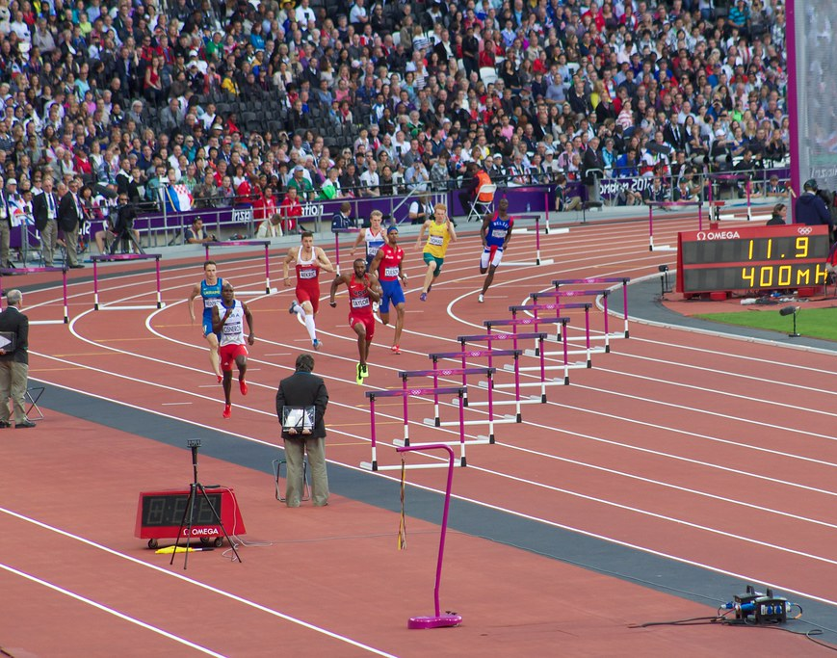
INSPECTION COPY
Introduction to feedback
Learn
Athletes can gain different types of feedback from various sources in order to improve their performance.
What examples of the following types of feedback can the 400 m hurdlers in the image use to optimise their performance?
Extrinsic – from outside sources
Intrinsic – obtained from within
Concurrent – received during performance
Terminal – occurring after performance
COPYRIGHT
PROTECTED
© ZigZag Education, 2023
Notes:
Introduce the concept of feedback.
Identify different examples of extrinsic, intrinsic, concurrent and terminal feedback in the image.

Slide 9
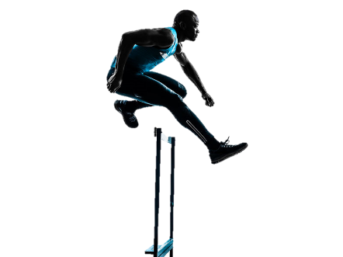
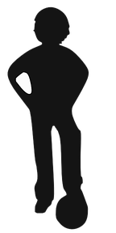
Guidance and Feedback
INSPECTION COPY
Extrinsic feedback
Learn
Extrinsic feedback is received from a source external to the athlete.
Additional example: a cricket coach who informs their young athlete that they have scored six runs by playing the ball over the boundary without it touching the floor.
In the example of the 400 m hurdles, the performer can use the noise from the crowd to spur them on in the race.
Most common type of feedback
Can come from:
  Multiple external sources, e.g. coaches, spectators, teammates
  The form of trophies, prize money and awards.
It is essential for beginner performers as they are not experienced enough to feed back on their own performance.
COPYRIGHT
PROTECTED
Most suited to beginners
© ZigZag Education, 2023
Notes:
Click through the slide to see an evaluation of extrinsic feedback in sport and why it is most suited to beginners.
Identify different examples of extrinsic feedback, then click to reveal an example within the slide.

Slide 10
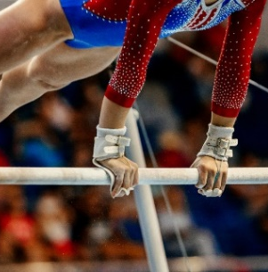

Guidance and Feedback
INSPECTION COPY
Intrinsic feedback
Learn
Intrinsic feedback is received from within the athlete themselves and is based on the feel of movement.
In the example of the 400 m hurdles, the performer is
able to judge how much energy they have left to give by judging how their body is feeling.
Additional example: a gymnast who is able to
judge their orientation in the air in order to
land safely on their feet.
Leads to more sustained progress with skills.
Involves:
  Internal monologue
  Constant reflection on how a skill feels
Mostly used by expert performers who have built their experience, as it requires experience to know how a skill should feel.
COPYRIGHT
PROTECTED
Most suited to expert performers
© ZigZag Education, 2023
Notes:
Click through the slide to see an evaluation of intrinsic feedback in sport and why it is most suited to expert performers.
Identify different examples of intrinsic feedback, then click to reveal an example within the slide.

Slide 11
Guidance and Feedback
INSPECTION COPY
Concurrent feedback
Learn
Concurrent feedback is provided while a skill is being performed.
In the example of the 400 m hurdles, the performer can use extrinsic feedback from the crowd and intrinsic feedback from how they are feeling to determine whether to push on during the race.
Additional example: a football player is able to use feedback from a coach during their performance to change their style of play, e.g. an offensive or defensive tactic.
Effective with performers of all ability levels
Used to guide performers during participation
It is very effective in sports where the support team is in direct communication with the performer. For example:
Over the radio in Formula One
A coach at the side of the court in basketball
COPYRIGHT
PROTECTED
© ZigZag Education, 2023
Notes:
Identify different examples of concurrent feedback, then click to reveal an example within the slide.
Discuss where concurrent feedback may be best used in sport.

Slide 12
Guidance and Feedback
INSPECTION COPY
Terminal feedback
Learn
Terminal feedback is given to the performer after a skill or performance.
In the example of the 400 m hurdles, the performer will be able to see their time once they have finished the race and will be able to receive feedback from their coach.
Additional example: a long jumper who sees the white flag shown to them to indicate a valid jump.
In some sports and events, the coach is unable to provide feedback during performance. For example:
During a gymnastics routine
In the middle of a tennis rally
Terminal feedback is, therefore, used after performance or during breaks. Examples may include:
The scoreboard at the end of a rally in tennis
At half-time in the form of a team talk in sports like football
COPYRIGHT
PROTECTED
© ZigZag Education, 2023
Notes:
Identify different examples of terminal feedback, then click to reveal an example within the slide.
Discuss where terminal feedback may be best used in sport.

Slide 13

Watch the video on Australian swim coach Dean Boxall and note down the examples of extrinsic and terminal feedback he gives to his swimmers. Give specific examples from the video of where he uses each.
INSPECTION COPY
Click to play.
Activity
Example: (0:30)
Telling the swimmer to watch that they don’t turn their head drastically.
Example: (1:57)
‘A little bit more underwater…it’s probably taken a 0.15 [seconds] off you’
Example: (2:26)
‘1:28:07, great job’
COPYRIGHT
PROTECTED
Example: (1:02)
‘Great job, 2:58, great decision, much better, very good’
Example: (2:55)
‘Great job, easily your best’
© ZigZag Education, 2023
Notes:
Click on the play button to watch the video.
Write down examples of terminal feedback provided by the coach during the video. (You may pause and rewind where needed.)
Discuss why concurrent feedback might not be given in swimming.
Come up with examples of where intrinsic feedback may be used in swimming.

Slide 14
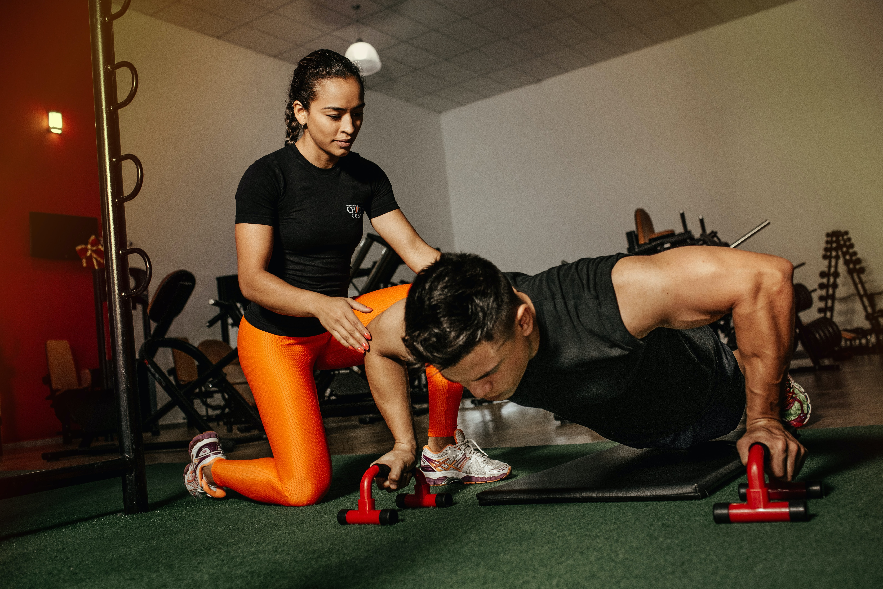
INSPECTION COPY
Discuss
Which types of guidance would you use for a beginner in gymnastics, and why?
Identify different types of mechanical aids that can be used to guide performers in sport.
What examples of concurrent and terminal feedback could you give to a performer in the same sport?
Identify different examples of feedback that are both terminal and extrinsic.
COPYRIGHT
PROTECTED
© ZigZag Education, 2023
Notes:
Take this opportunity to reflect on what has been learnt about guidance and feedback and how it impacts sport in a wider context.
Students can discuss these questions with their peers or respond individually by writing down their answers.

Slide 15
INSPECTION COPY
Exam-style questions
Answer the following exam-style questions and check your answers.
1. Which one of the following is an example of concurrent feedback?
a) A coach telling their athlete that their 100 m time was 15.4 seconds
b) A player reviewing their performance after a game using video footage
c) A runner checking other athletes during a race on the big screen in the stadium
d) A coach giving their players a run-down of their stats after a game
(1 mark)
1 × AO2 mark:
c) A runner checking other athletes during a race on the big screen in the stadium
Click to reveal answer!
COPYRIGHT
PROTECTED
© ZigZag Education, 2023
Notes:
Students to answer each exam-style question under exam conditions (approx. 1 minute per mark).
Click to reveal answers. Students to peer-mark or self-mark answers.

Slide 16
INSPECTION COPY
Exam-style questions
Answer the following exam-style question and check your answer.
2. Rachael is a gymnastics coach who has just taken on a group of new gymnasts in her recreational group for 10–12-year-olds.
Explain two advantages of Rachael using mechanical guidance when teaching.
(4 marks)
2 × AO1 marks for identifying advantages:
Useful for novice performers
Improves the safety of performing skills
Effective alongside visual guidance
2 × AO2 marks for explaining advantages:
(Useful for novices) 10–12-year-olds may be new to the sport, so mechanical guidance could be useful for an introduction with movements (1)
(Improved safety) allows performers to attempt high-risk skills in a safe environment, e.g. by using a harness when trampolining (1)
(Effectiveness alongside visual guidance) so that the performer can build up an understanding of what movements should look like (1)
Accept any other suitable answers.
☞ Click to reveal answer!
COPYRIGHT
PROTECTED
© ZigZag Education, 2023
Notes:
Students to answer each exam-style question under exam conditions (approx. 1 minute per mark).
Click to reveal answers. Students to peer-mark or self-mark answers.

