Slide 1
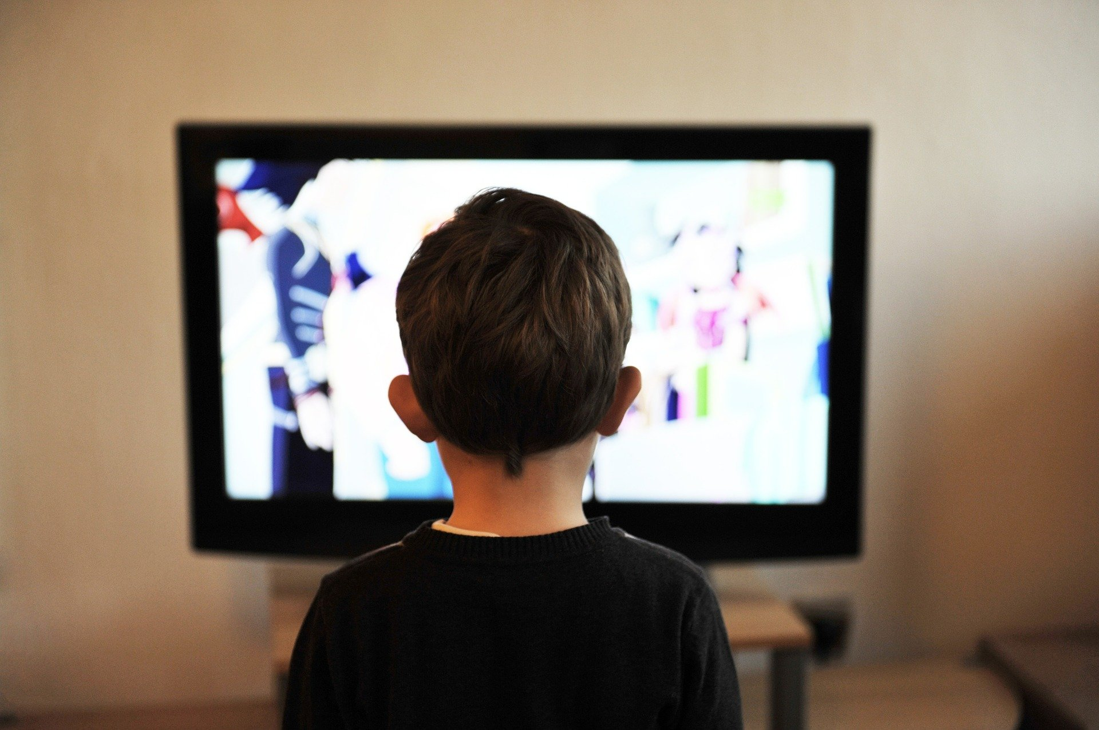
Photocopiable/digital resources may only be copied by the purchasing institution on a single site and for their own use
Consequences of a Sedentary Lifestyle
Paper 2
Health, Fitness and Well-being
1.2

Slide 2

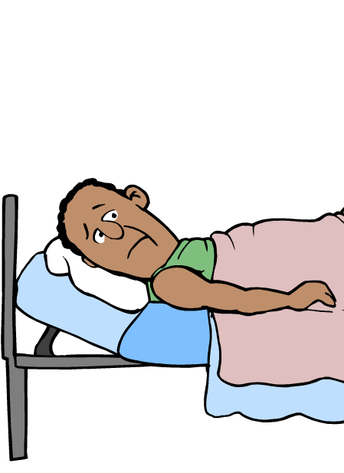
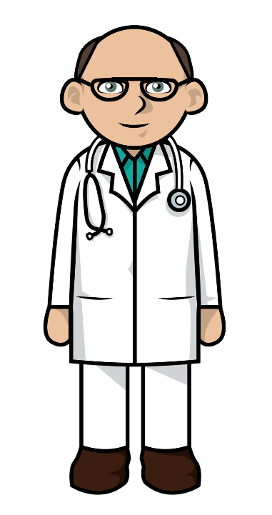

Sedentary lifestyle
INSPECTION COPY
Learn
Lifestyle is the way in which an individual lives their life.
‘What is a sedentary lifestyle?’
‘A sedentary lifestyle is one that consists of little or no exercise and prolonged sitting or lying down.’
COPYRIGHT
PROTECTED
Watch this video which looks at the hidden health risks of prolonged sitting, before moving on to look at the different consequences in more detail:
‘Driving to work, sitting at a desk all day and watching TV all contribute to a sedentary lifestyle’
© ZigZag Education, 2023
Notes:
Identify the definition of a sedentary lifestyle, then click through the slide to learn the definition.
Click on the play button to watch the video on the health risks of prolonged sitting.

Slide 3
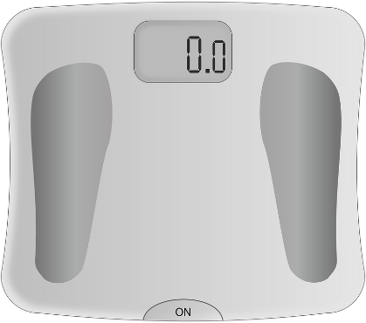
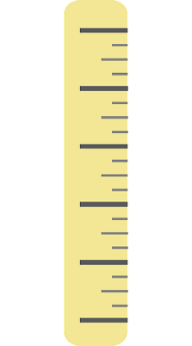
INSPECTION COPY
Overweight and obesity
Learn
One of the main consequences of a sedentary lifestyle is an increase in body weight, predominantly through fat mass.
Body mass index (BMI) is the universal scale used to classify individuals’ body weight.
Overweight is clinically defined as a BMI of 25.0–29.9 kg/m²
Obesity is clinically defined as a BMI of 30 kg/m² and over.
You can also use a BMI calculator
This can be calculated very simply using an individual’s body weight and height.
For example…
90.0 KG
1.7 m
This is classified as obese!
÷
=
COPYRIGHT
PROTECTED
Weight
Height²
(1.7 m × 1.7 m)
BMI of 31.1 kg/m²
Overfat is a term that is becoming increasingly used to describe a high body weight with high fat mass, as someone with a high body weight through muscle mass can be classed overweight but not necessarily at risk of long-term health complications.
Watch this video for more info about the issues with BMI:
© ZigZag Education, 2023
Notes:
Identify what is meant by overweight and obesity and click through the slide to see how they are defined.
Calculate the BMI of the individual displayed – what does this show?
(Optional) Use a BMI calculator to calculate some other examples (or students’ own BMIs, if appropriate).
Introduce the term overfat and discuss why it is used.
Watch the video and discuss the issues with BMI.

Slide 4
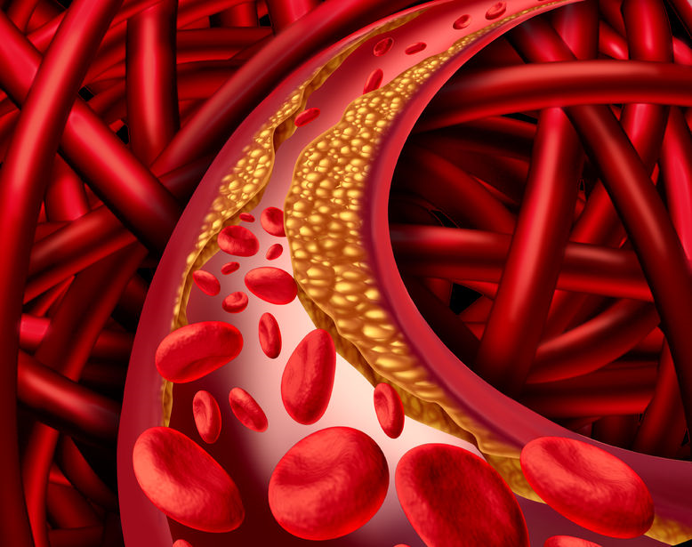
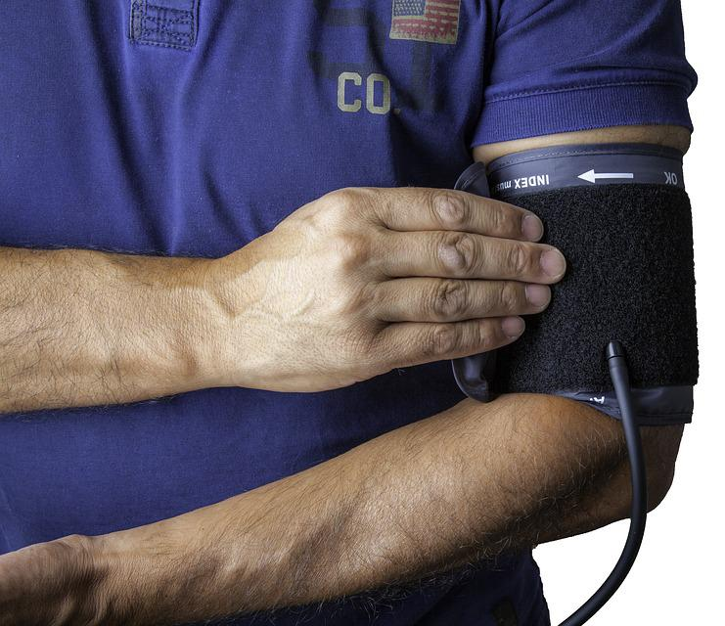
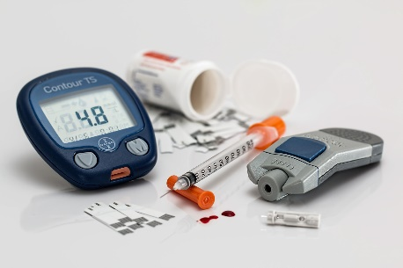
INSPECTION COPY
Consequences of a sedentary lifestyle
on long-term health
Learn
Obesity is associated with a range of other long-term health consequences that are brought on by leading a sedentary lifestyle…
CORONARY HEART DISEASE
Blood flow through the coronary arteries supplying the heart becomes blocked by fatty deposits, starving the heart of oxygen.
COPYRIGHT
PROTECTED
TYPE 2 DIABETES
Lack of exercise reduces the sensitivity of the body’s cells to insulin. Insulin is needed to clear glucose from the blood.
BLOOD PRESSURE
An accumulation of fatty deposits restricts blood flow and increases the pressure on the artery walls, increasing their risk of bursting.
© ZigZag Education, 2023
Notes:
Identify the different effects that obesity and a sedentary lifestyle can have on physical health.

Slide 5
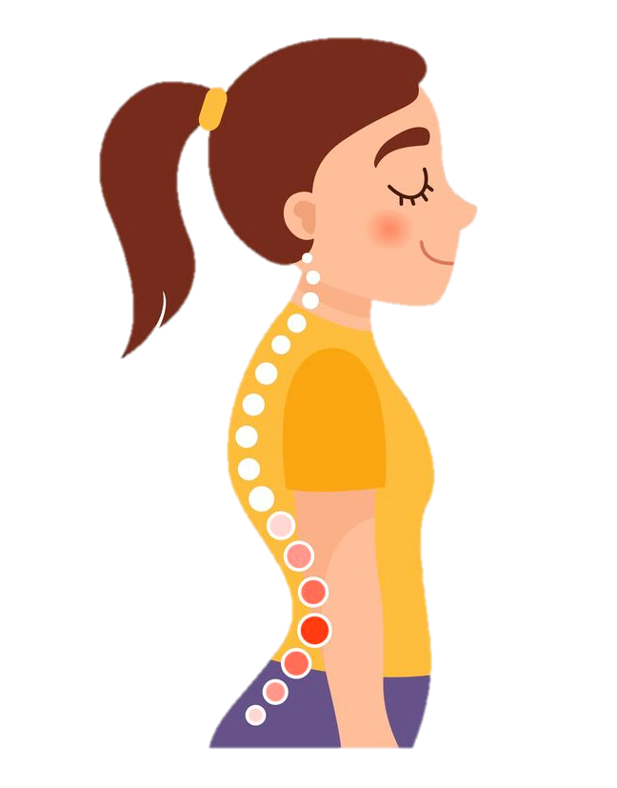
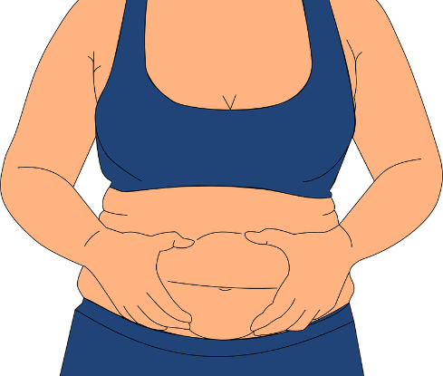
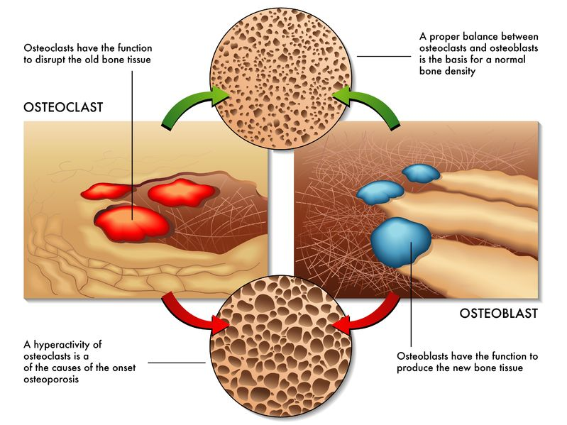

INSPECTION COPY
Consequences of a sedentary lifestyle
on physical health
Learn
Other physical health consequences of leading a sedentary lifestyle include…
Poor posture
Reduced muscle tone
Reduced bone density
COPYRIGHT
PROTECTED
Physical activity is important for stimulating the uptake of bone minerals and building new bone tissue. Sedentary activity increases the risk of osteoporosis (weakened bones that
are at a greater risk of fracture).
A lack of activity leads to a loss of muscle mass (muscle atrophy). This, in combination with increased fat stores, reduces the toned appearance of muscles. Muscles must work harder to carry around the excess weight.
Sedentary activity involves a lot of slouching. A poor sitting position, such as slouching, can make the individual develop postural conditions such as kyphosis, characterised by a rounding of the lower spine.
© ZigZag Education, 2023
Notes:
Click through the slide to reveal more information about the different consequences of a sedentary lifestyle.
See whether you can recall how a sedentary lifestyle leads to each consequence.

Slide 6
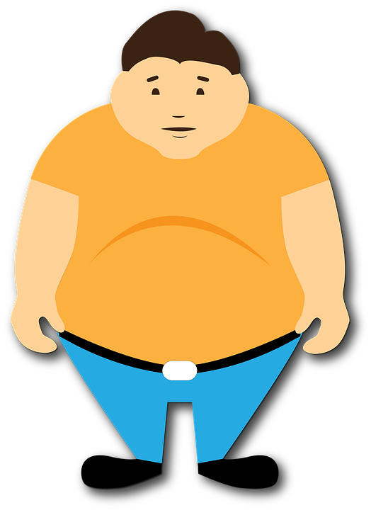
INSPECTION COPY
Effects of obesity on mental health
Learn
It is clear that a sedentary lifestyle impairs physical health, but it may be less known that it is also associated with emotional health issues.
An obese person may be dissatisfied with the way their body looks, especially if they compare themselves with others or what they themselves looked like in the past. This can lead to mental health issues such as anxiety and depression.
Check out this short blog post on the complex relationship between obesity and mental health:
A sedentary lifestyle can lead to a loss of confidence, both in general life and in sports participation. Body shaming is an issue inherent in society which can impact self-esteem.
It is important it is addressed in order to help sedentary individuals to regain confidence in themselves.
COPYRIGHT
PROTECTED
© ZigZag Education, 2023
Notes:
Identify the different effects that leading a sedentary lifestyle can have on mental health.
Click through the slide to reveal more information about the different effects that a sedentary lifestyle can have.
Click on the info button to reveal a short blog post on the relationship between obesity and mental health.

Slide 7
INSPECTION COPY
Effects of obesity on components of fitness
Learn
A sedentary lifestyle can affect a number of different fitness components important for success in sport and physical activity.
Reduces aerobic capacity, meaning the cardiorespiratory system has to work harder to deliver oxygen to the muscles.
Carrying excess weight from leading a sedentary lifestyle also provides an added resistance for muscles to overcome in order to move the body.
Cardiovascular endurance / stamina
Flexibility
Lack of movement leads to tight muscles and a limited range of motion at the joints. Excess body weight can also prevent a range of motion at the joints.
COPYRIGHT
PROTECTED
Agility
Excess body weight from a sedentary lifestyle makes the performer more sluggish, hindering their ability to change direction quickly.
Speed and power
It is important that performers requiring speed and power have a high proportion of muscle to fat. Sedentary individuals tend to have the opposite, limiting the speed and power they are able to generate.
© ZigZag Education, 2023
Notes:
Identify different components of fitness that may be affected by a sedentary lifestyle, and why.
Click through the slide to reveal some of these components and the reasons they are affected.
Identify other aspects of fitness that may be affected by a sedentary lifestyle.

Slide 8

INSPECTION COPY
Trends in physical health issues
Learn
Physical health trends can be tracked over time to allow for a greater understanding of how population health is changing and the factors that may be contributing towards any change.
What does the graph show?
Number of admissions is significantly higher for females than for males
Number of admissions for females has been steadily increasing from 2014/15
Number of admissions for males has been roughly the same since 2008/09
Click here to reveal the answer.
COPYRIGHT
PROTECTED
Check out other data by downloading the full report from The NHS Health Survey for England 2021:
The graph here shows the number of hospital admissions from the years 2008/09 to 2018/19 where the primary diagnosis is obesity.
© ZigZag Education, 2023
Notes:
Describe the trend in hospital admissions owing to obesity from 2008/09 to 2018/19.
Click the info button to see other data from the NHS Health Survey for England 2021. Students could work together to analyse and interpret the graphical data shown.

Slide 9
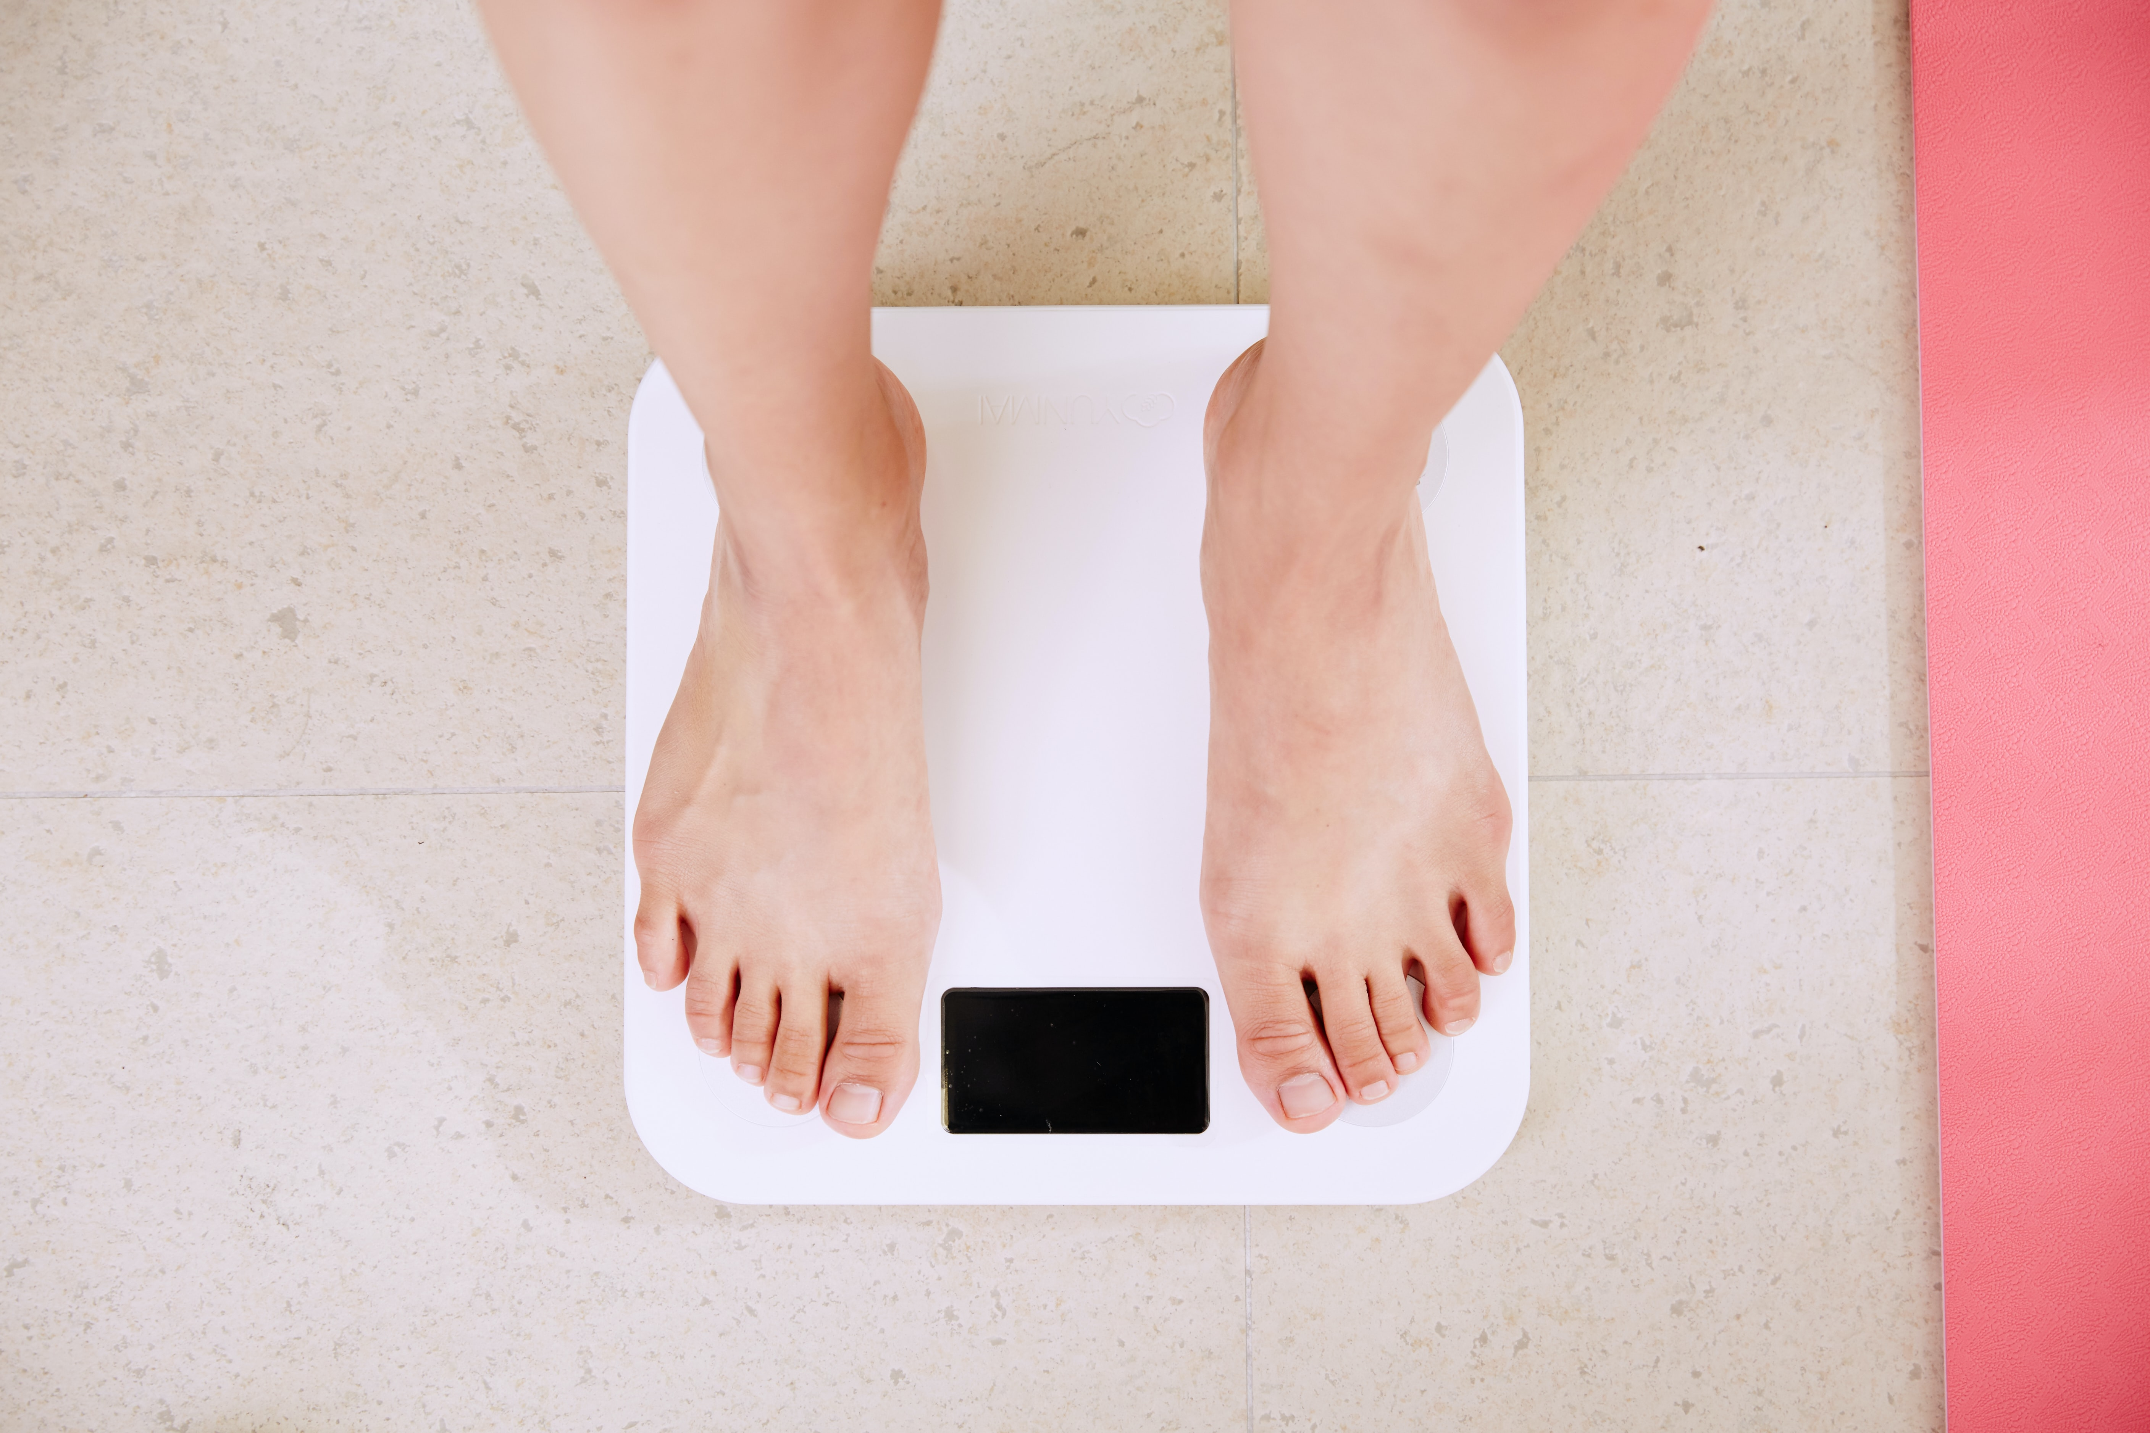
Discuss
What are the wider implications of obesity on society and the economy?
What reasons might individuals have for leading a sedentary lifestyle?
How are calorie intake and expenditure likely to be influenced by a sedentary lifestyle?
© ZigZag Education, 2023
Notes:
Take this opportunity to reflect on what has been learnt about obesity and somatotypes and how they impact sport in a wider context.
Students can discuss these questions with their peers or respond individually by writing down their answers.

Slide 10
INSPECTION COPY
Exam-style questions
Answer the following exam-style questions and check your answers.
1. Describe the difference between being overweight and overfat. (2 marks)
2 × AO1 marks for:
Being overweight means that a person’s body weight is excessive for their height / overweight is a BMI classification where weight / height² is in the range of 25.0–29.9 kg/m² (1)
Overfat describes a person who has excess levels of fat beyond that considered healthy (1)
☞ Click to reveal answer!
2. State two possible consequences of a sedentary lifestyle for
long-term health. (2 marks)
2 × AO1 marks from:
Coronary heart disease
Depression
High blood pressure (hypertension)
Diabetes
Osteoporosis
Loss of muscle tone
Poor posture
Accept other suitable answers.
Click to reveal answer!
COPYRIGHT
PROTECTED
© ZigZag Education, 2023
Notes:
Students to answer each exam-style question under exam conditions (approx. 1 minute per mark).
Click to reveal answers. Students to peer-mark or self-mark answers.

