Slide 1
The
Components
of Fitness
and
Fitness
Testing
Paper 1
Physical Training
3.2
Photocopiable/digital resources may only be copied by the purchasing institution on a single site and for their own use.

Slide 2

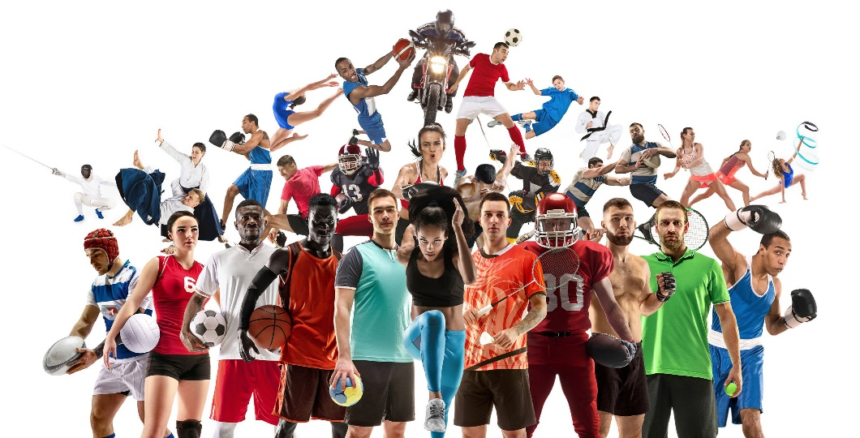

Components of fitness
INSPECTION COPY
Learn
If we recap the definition of fitness, we will remember that it is the ability to meet the demands of the sporting environment.
As most sports have different demands, there are various components of fitness. Some are health related and some are skill related.
Agility
Flexibility
Balance
Muscular endurance
Coordination
Cardiovascular fitness
COPYRIGHT
PROTECTED
Reaction time
Strength
Power
Speed
© ZigZag Education, 2023
Notes:
Click through the slide to identify the different components of fitness involved in sport.
Move on to the next slides to find out more about each component in greater detail.

Slide 3
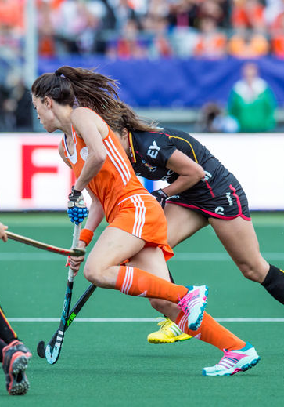

INSPECTION COPY
Agility
Learn
Definition: The ability to change direction quickly without loss of time or control.
Agility is an important component in a variety of team sports where a player must perform fast feet to feint, dodge or move to beat an opponent.
It is also beneficial for gymnasts who change direction quickly as part of their routines.
COPYRIGHT
PROTECTED
Watch this montage of players using agility to sidestep opponents in rugby union.
Agility also requires other components of fitness, such as speed, core strength, flexibility and balance.
© ZigZag Education, 2023
Notes:
Click through the slide to see what is meant by agility and how it is important in specific sports or physical activities.
Click on the play button to watch a YouTube video of agility in action in rugby union.

Slide 4
INSPECTION COPY
Measuring agility
Learn
The Illinois agility run test is used to measure agility.
Procedure:
5 m
1
The participant performs a 10-minute warm-up while the test conductor marks out a 10 m × 5 m course.
2
On the command ‘go’, they should aim to complete the course in the direction shown, as quickly as possible.
10 m
3
The test conductor times how long it takes and this time it is compared against normative data.
Test organisation:
The test can be carried out both indoors and outdoors, on a preferably non-slip surface.
It requires cones and a tape measure to set out the course.
Someone must be allocated the role of conductor in order to operate the stopwatch to time the test in seconds.
The quicker the time, the better the agility of the performer!
COPYRIGHT
PROTECTED
Click on the test diagram to see the route the participant should take.
© ZigZag Education, 2023
Notes:
Click through the slide to see the procedure and test organisation for the Illinois agility run test.
Click on the diagram for an illustration of the Illinois agility course.

Slide 5
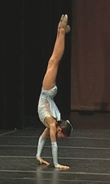
INSPECTION COPY
Balance
Learn
Definition: The ability to maintain the centre of gravity over the base of support.
Balance is an essential component of fitness in gymnastics activities, where performers are scored on their ability to hold steady (such as the rings and balance beam) or land a movement without the need to regain balance (e.g. with dismounts).
Balance can be…
Static (i.e. maintaining body position while still), or
Dynamic (maintaining control of the body while on the move).
COPYRIGHT
PROTECTED
Balance is also important for games players, so they don’t fall over.
Find out more about how this component can be measured.
(not required for Edexcel GCSE PE)
© ZigZag Education, 2023
Notes:
Click through the slide to see what is meant by balance and how it is important in sport, e.g. different gymnastic activities.
Identify any additional activities or actions in sport and physical activity that require balance.

Slide 6
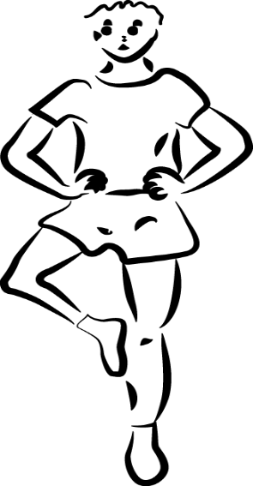
INSPECTION COPY
Measuring balance
Learn
The standing stork test can be used to measure balance. The performer adopts a one-legged stance similar to the position on the right, placing the other foot just above the knee of the standing leg. Hands should be kept on hips at all times.
Procedure:
1
The participant should be given the opportunity to practise the stance.
2
Once the participant is familiarised with the correct stance, they should adopt the stance ready for testing.
3
Once the participant is in position, the test conductor starts the stopwatch.
Test organisation:
The test should be carried out on a flat surface, ideally where there is no wind.
All it requires is for someone to take the role of conductor to look for loss of balance and to operate the stopwatch to time the test in minutes and/or seconds.
The longer the time, the better the balance of the performer!
4
The participant should try to maintain their balance for as long as possible.
COPYRIGHT
PROTECTED
5
If the participant loses balance at any point, the test conductor should stop the test and record the time.
6
This is used as their score and is compared against normative data.
Give this a go! Find a space, a partner and a stopwatch and test your balance.
© ZigZag Education, 2023

Slide 7
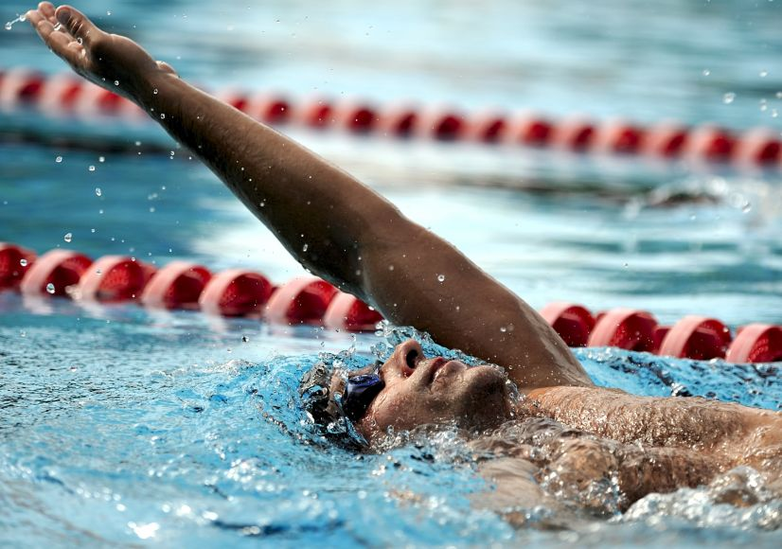
INSPECTION COPY
Cardiovascular fitness
Learn
Definition: The ability of the body to exercise for prolonged periods of time without tiring.
Cardiovascular fitness is essential for performing long-duration aerobic activities such as running, cycling and swimming races.
It is also known as aerobic endurance due to its demand on the aerobic energy system to supply the oxygen needed by the muscle to contract.
COPYRIGHT
PROTECTED
© ZigZag Education, 2023
Notes:
Click through the slide to see what is meant by cardiovascular fitness and how it is important in specific sports or physical activities.
Understand that cardiovascular fitness is beneficial in aerobic activities and, therefore, is also termed aerobic endurance.

Slide 8
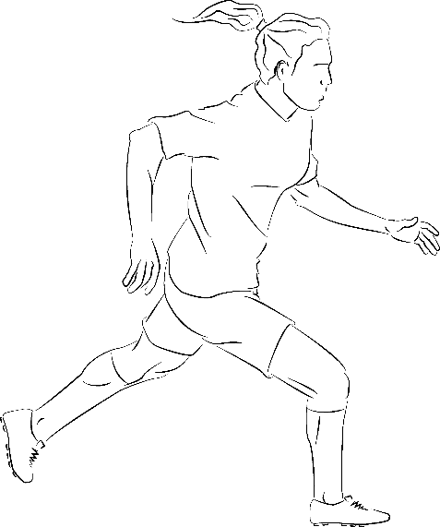
INSPECTION COPY
Measuring cardiovascular fitness
Learn
The 12-minute Cooper test is used to measure cardiovascular fitness (aerobic endurance). There are two common variations of this test to suit different activities – the run and the swim tests.
Procedure:
1
After warming up, a performer runs around a 400 m track or swims the length of the pool, depending on the test variation they are using.
2
An assistant times 12 minutes on a stopwatch.
3
Once the 12 minutes are up, the performer must stop where they are.
4
The distance they have travelled within the 12 minutes is calculated, e.g. 4 laps of a track would be 4 × 400 m = 1600 m.
COPYRIGHT
PROTECTED
Test organisation:
The test should be carried out on a 400 m athletics track for easy and accurate measuring.
The equipment required includes appropriate footwear for the track and a stopwatch to track time.
The distance travelled is used as the test score.
The further the distance travelled, the better the cardiovascular endurance of the performer!
© ZigZag Education, 2023
Notes:
Click through the slide to see the procedure and test organisation for the 12-minute Cooper run/swim tests.

Slide 9
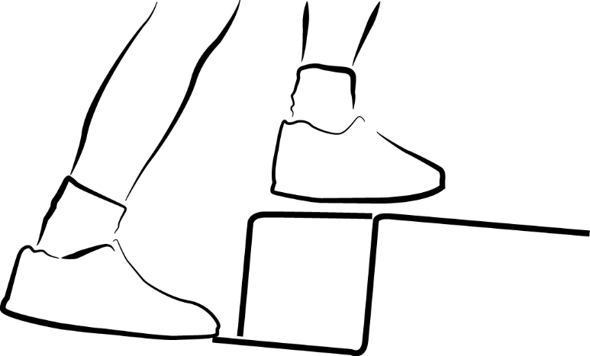
INSPECTION COPY
Measuring cardiovascular fitness
Learn
The Harvard step test is also used to measure cardiovascular fitness (aerobic endurance). Unlike the 12-minute Cooper test which involves maximal exercise, the Harvard step test involves sub-maximal exercise.
Procedure:
1
The participant begins the test by facing the stepping bench.
2
The test conductor should start a metronome via an audio player at 30 beats per minute.
3
On each beat, the participant should step up onto a bench and back down again, alternating the leading leg each time.
Test organisation:
4
They should continue doing this for 5 minutes, at which point the assistant should notify them to stop.
The test should be carried out on a bench (around 45 cm high)
Other equipment includes a stopwatch and an audio player
The test score can be calculated by the equation: 30,000 / (pulse after 1 min + after 2 mins + after 3 mins)
The higher the test score, the better the cardiovascular fitness!
COPYRIGHT
PROTECTED
5
The participant should measure their pulse rate on every minute mark after ending the test, for 3 consecutive minutes.
© ZigZag Education, 2023
Notes:
Click through the slide to see the procedure and test organisation for the Harvard step test.

Slide 10
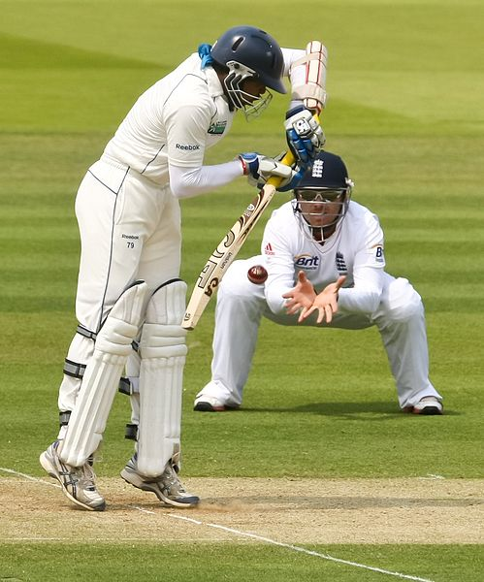
INSPECTION COPY
Coordination
Learn
Definition: The ability to efficiently use two or more body parts at the same time.
Coordination is required in a variety of sporting scenarios, some of which we may not realise!
For example, coordination is important in swimming when bringing the head out of the water to breathe while continuing with the stroke.
COPYRIGHT
PROTECTED
It is also important in team sports such as cricket where a fielder must form a long barrier with their legs while focusing on stopping the ball with their hands.
Check out some of the coordination drills here. How do you think some of these better suit some sports than others?
© ZigZag Education, 2023
Notes:
Click through the slide to see what is meant by coordination and how it is important in specific sports or physical activities.
Check out the drills to discuss how they suit some sports better than others. This will allow you to critically evaluate the fitness test for coordination.

Slide 11
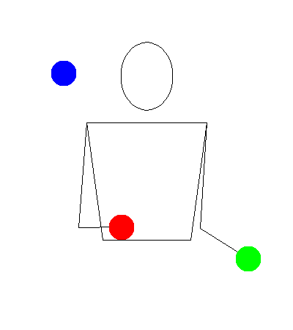
INSPECTION COPY
Can you juggle? Hand–eye coordination is required to juggle and keep an eye on three balls. Take three small balls (or pieces of scrap paper scrunched into balls) and give it a go.
How hard did you find it? Which sports do you think hand–eye coordination is required in?
Activity
COPYRIGHT
PROTECTED
Notes:
Click through the slide to see what is meant by coordination and how it is important in specific sports or physical activities.
Check out the drills to discuss how they suit some sports better than others. This will allow you to critically evaluate the fitness test for coordination.

Slide 12
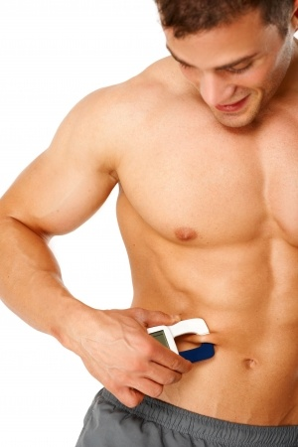
INSPECTION COPY
Body composition
Learn
Definition: The ratio of fat mass to fat-free mass.
Some sports benefit from a high fat mass and muscle mass, such as rugby, where prop forwards have a large overall body mass and are difficult to stop.
Most sports, however, will benefit from a low body fat as it can add weight, making it difficult to move freely.
For example:
100 m sprinters and gymnasts perform explosive movements, which are helped by large muscle mass and low body fat
Endurance runners require low body fat and lean muscle mass to carry their body across long distances
COPYRIGHT
PROTECTED
© ZigZag Education, 2023
Notes:
Click through the slide to see what is meant by body composition and how it is important in specific sports or physical activities.

Slide 13
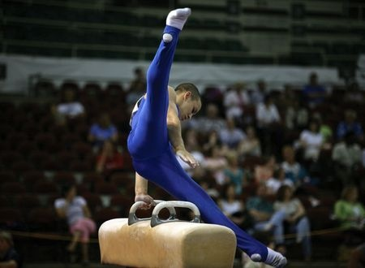
INSPECTION COPY
Flexibility
Learn
Definition: The range of movement available at a joint.
Having a lot of flexibility is highly advantageous in sport. For one, it lowers the risk of injury through overstretching the muscle.
Secondly, it can improve sporting performance. For example, flexibility is essential for gymnasts to perform movements such as the split jump and to use apparatus such as the pommel horse.
COPYRIGHT
PROTECTED
How flexible are you? Stand up and see whether you can reach your toes (keeping a straight back and legs).
© ZigZag Education, 2023
Notes:
Click through the slide to see what is meant by flexibility and how it is important in sports such as gymnastics.
Identify additional sports where flexibility is an important component of fitness.
See how flexible your students are.

Slide 14
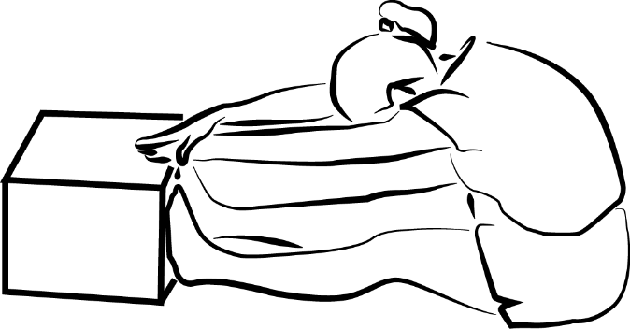
INSPECTION COPY
Measuring flexibility
Learn
The sit and reach test is used to measure flexibility.
Procedure:
1
Perform a thorough warm-up to help reduce the risk of injury during the test.
2
Sit with your feet pressed up against the sit and reach box with legs flat against the floor.
3
Stretching your legs (hamstrings) and lower back, touch the furthest distance possible on the sit and reach box.
4
Have a test conductor record your result and repeat three times, taking the average distance.
COPYRIGHT
PROTECTED
Test organisation:
The test can be carried out in any environment, preferably using a mat.
It requires a bespoke sit and reach box to be used for the measurement, as well as a test conductor to take each measurement (in centimetres or inches).
The greater the distance reached, the better the flexibility of the performer!
© ZigZag Education, 2023
Notes:
Click through the slide to see the procedure and test organisation for the sit and reach test.

Slide 15
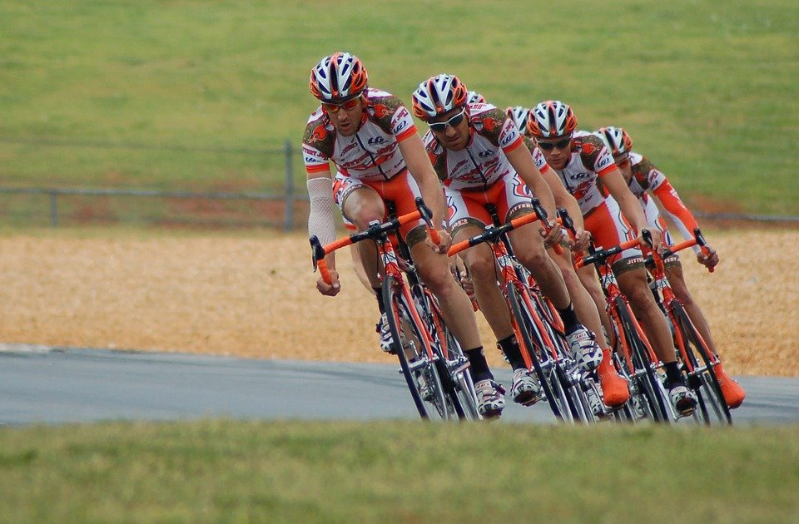
INSPECTION COPY
Muscular endurance
Learn
Definition: The ability of the muscles to repeatedly contract for an extended period of time without fatigue.
Muscular endurance is important to extended duration activities where muscles are required to sustain repeated contractions for an extended period of time.
This could be both longer duration, high-intensity exercises, such as the 400 m, or lower intensity exercises such as a road cycling race.
It is particularly important where the same muscle group is used over and over, such as the quadriceps when cycling or the gastrocnemius when running.
COPYRIGHT
PROTECTED
Can you think of exercises that could be performed in the gym to work on muscular endurance? Go around the room and state one exercise, until you run out. We will start you off with push-ups…
© ZigZag Education, 2023
Notes:
Click through the slide to see what is meant by muscular endurance and how it is important in specific sports or physical activities.
Understand that muscular endurance is important in both aerobic and anaerobic activities.

Slide 16
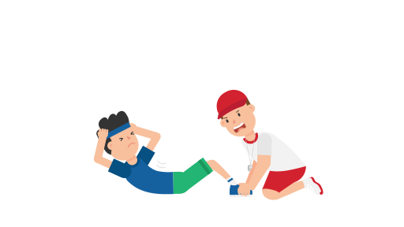
INSPECTION COPY
Measuring muscular endurance
Learn
The one-minute sit-up test is used to measure muscular endurance.
Procedure:
1
The participant lies down on an exercise mat in preparation for the test.
2
The participant performs a sit-up by bringing their chest to the knees, then lowering the body back down to the ground.
3
They perform as many sit-ups as they can within
one minute.
Test organisation:
The test should be carried out using an exercise mat.
It requires an assistant to ensure the participant performs sit-ups correctly.
The test is measured by the number of sit-ups
The greater this value, the better the muscular endurance of the performer!
4
The number of sit-ups they are able to fully perform is used as the test score.
COPYRIGHT
PROTECTED
The one-minute press-up test may also be used to measure muscular endurance. This test uses the same protocol but instead of performing sit-ups, the subject performs press-ups.
© ZigZag Education, 2023
Notes:
Click through the slide to see the procedure and test organisation for the one-minute sit-up test.
Students should be aware that the one-minute sit-up test may be used as an alternative measure of muscular endurance.

Slide 17
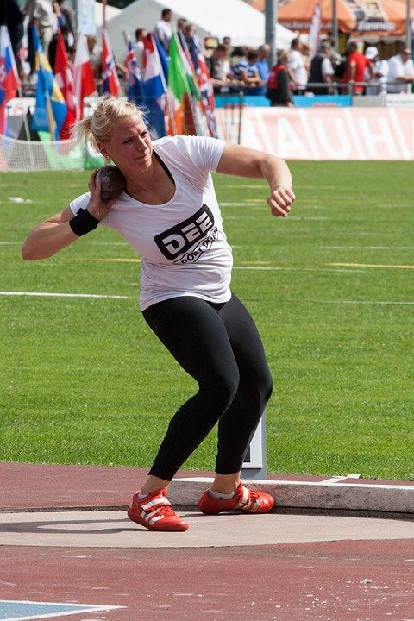
INSPECTION COPY
Power
Learn
Definition: The ability to apply a large force quickly (the product of strength and speed.
POWER = STRENGTH × SPEED
Power combines both strength and speed into each movement.
Power is important in all short-duration movements performed at a high intensity, and thus is suited for anaerobic activities.
COPYRIGHT
PROTECTED
Sporting actions that rely on power include the sprint start, jumping, and maximal-distance throwing events such as the shot-put and javelin.
© ZigZag Education, 2023
Notes:
Click through the slide to see what is meant by power and how it is important in specific sports or physical activities.
Understand the relationship between strength, speed and power.
Understand that power is important in anaerobic activities.

Slide 18
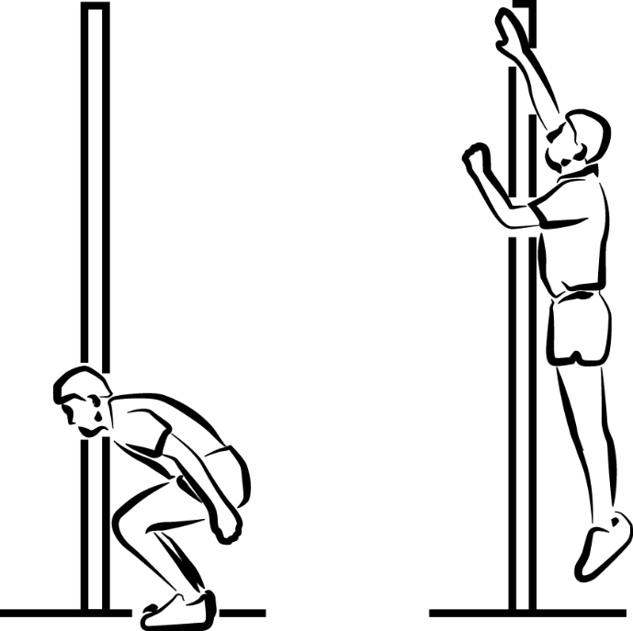
INSPECTION COPY
Measuring power
Learn
The vertical jump test is used to measure power.
Procedure:
1
The athlete marks their fingers with a piece of chalk (or holds a piece of chalk).
2
The athlete stands side-on to the wall and places both feet firmly on the ground.
3
The athlete marks the wall with their hand as they stand, reaching as high as they can.
Test organisation:
4
The athlete jumps as high as they can, marking the wall with their chalked hand.
The test should be carried out with space to jump next to a vertical wall.
It requires a piece of chalk for markings and a ruler to measure the difference in distance.
The test is measured in centimetres.
The greater this value, the greater the power of the performer!
COPYRIGHT
PROTECTED
5
The assistant records the distance between the first mark (standing) and the second mark (jump).
Take a look at this test in action.
© ZigZag Education, 2023
Notes:
Click through the slide to see the procedure and test organisation for the vertical jump test.
Click on the video button for a visual guide on how to carry out the test.

Slide 19
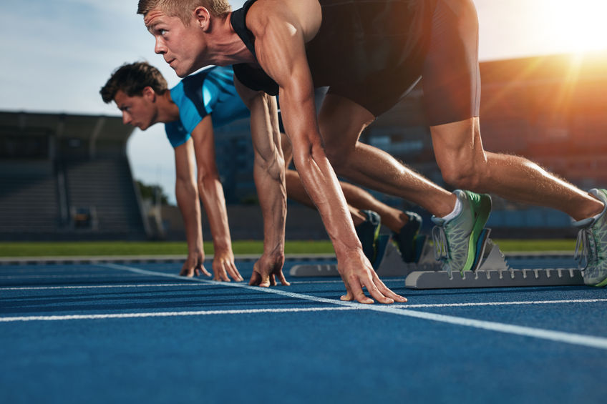
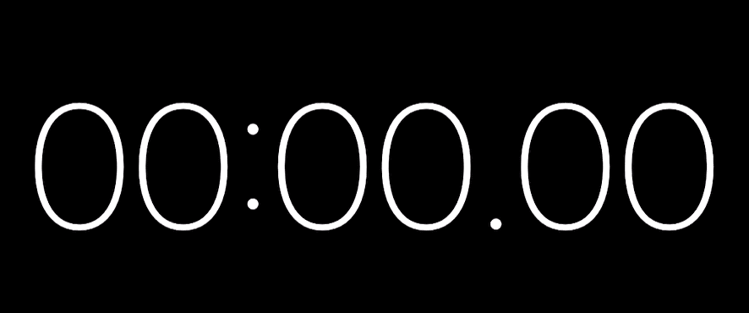
INSPECTION COPY
Reaction time
Learn
Definition: The time taken to initiate a response to a stimulus.
Reaction time is important in sports where quick responses to actions or cues are required.
For example, it is needed in sprinting events where results are often decided within a tenth of a second, and thus the reaction to the starting gun could be the difference between winning and losing.
It is also important in team sports, such as a goalkeeper responding to a close range shot or a rugby player responding to the bounce of the ball.
COPYRIGHT
PROTECTED
Left-click to start the timer and press the ‘Esc’ key to stop. Left click again to restart.
Let’s test your reaction time. Try to stop the timer on 10 seconds exactly.
Find out more about how this component can be measured.
(not required for Edexcel GCSE PE)
© ZigZag Education, 2023
Notes:
Click through the slide to see what is meant by reaction time and how it is important in specific sports or physical activities.
See whether students can complete the small challenge to stop the timer on exactly 10 seconds.

Slide 20
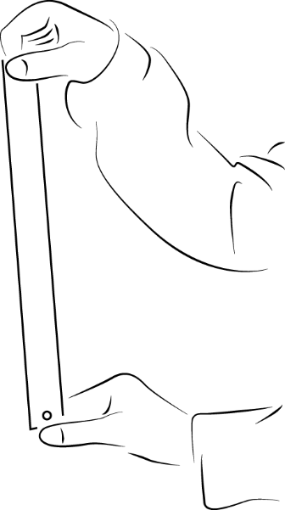
INSPECTION COPY
Measuring reaction time
Learn
The ruler drop test can be used to measure reaction time.
Procedure:
1
The performer sits at a table with their forearm resting on the surface and an open hand hanging over the end.
2
The test conductor holds a ruler with the 0 cm mark perpendicular to the open hand.
3
In the test conductor’s own time, they should drop the ruler without giving any advance indication of when.
4
The performer must respond as quickly as possible by catching the ruler.
COPYRIGHT
PROTECTED
Test organisation:
5
The point of the caught ruler at the top of the hand is used as the measure of reaction time.
The test should be carried out indoors using a desk or table.
It requires a table and a ruler.
The test score is measured in centimetres.
The smaller this value, the greater the reaction time of the performer!
Give this a go! Get a ruler and test your reaction time.
© ZigZag Education, 2023
Notes:
Click through the slide to see the procedure and test organisation for the ruler drop test.
Students should attempt the test themselves in pairs, where one person is the test conductor and one person is the subject. They should then swap roles so each has their own attempt.

Slide 21
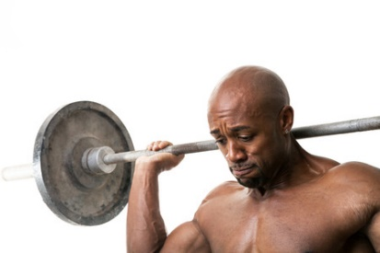
INSPECTION COPY
Strength
Learn
Definition: The ability of the muscle to apply force to overcome a resistance.
There are a number of different types of strength:
Maximal strength – the greatest possible force that a performer is able to exert against a resistance
Static strength – the maximum force applied to an immovable object/body
Dynamic strength – the force applied by a performer while moving
Explosive strength – the ability to apply a large force as quickly as possible (i.e. power – a combination
of strength and speed)
Watch the video of the ultimate feats of strength (World’s Strongest Man). Can you identify the different types of strength on display?
COPYRIGHT
PROTECTED
© ZigZag Education, 2023
Notes:
Click through the slide to see what is meant by the different types of strength.
Identify how each is important in different specific sporting actions or physical activities.
Watch the video (or some of the video) and identify the different types of strength on display in different events.

Slide 22
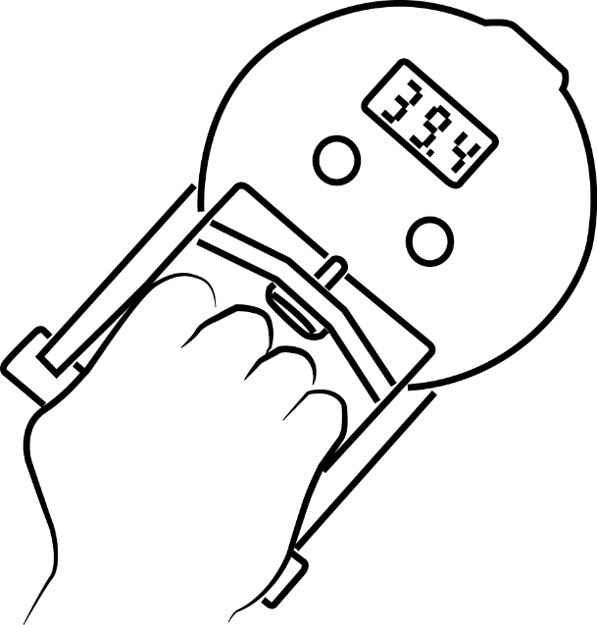
INSPECTION COPY
Measuring strength
Learn
The grip dynamometer is used to measure strength.
Procedure:
1
The performer adjusts the handgrip in order to squeeze using the heel of the palm and the middle of the fingers.
2
Once in position, the performer stands upright with the arm straight down by their side but away from the body.
3
When ready, they squeeze as hard as possible for up to five seconds, keeping their arm in position.
4
The test score is revealed on the screen and used as the general measure of strength.
COPYRIGHT
PROTECTED
Test organisation:
The test can be carried out in any environment.
All it requires is the handgrip dynamometer device.
The test is usually measured in newtons or automatically converted to kilograms.
The greater this value, the greater the handgrip strength of the performer, which may translate to whole-body strength.
© ZigZag Education, 2023
Notes:
Click through the slide to see the procedure and test organisation for the grip dynamometer test.

Slide 23
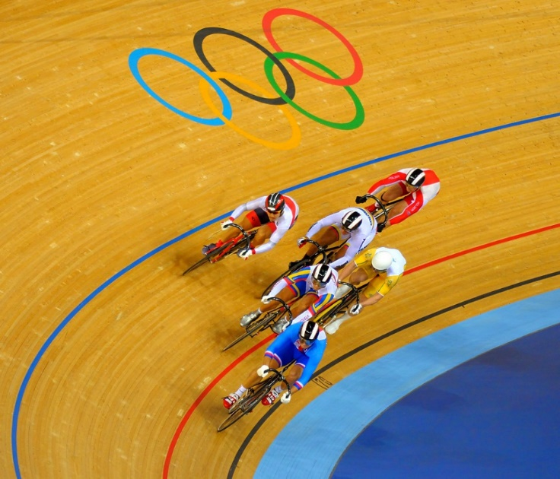
INSPECTION COPY
Speed
Learn
Definition: The ability to move a body part or cover a pre-determined distance as fast as possible.
SPEED = DISTANCE / TIME
Speed is key in sporting events or situations where the ability to cover a distance quickly is required.
For example, it determines the success of performers in events such as the sprint in track cycling.
However, it is also important in different sporting scenarios, such as chasing after the opposition in team sports such as football, hockey and rugby.
COPYRIGHT
PROTECTED
© ZigZag Education, 2023
Notes:
Click through the slide to see what is meant by speed and how it is important in specific sports or physical activities.

Slide 24
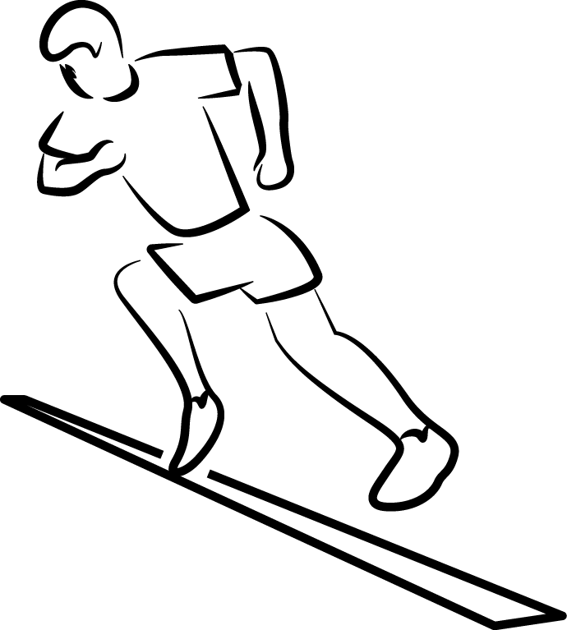
Measuring speed
Learn
The 30 m sprint test is used to measure speed.
Procedure:
1
The performer warms up in order to prepare their muscles for maximal exertion.
2
The performer stands behind the starting line of a linear track measuring 30 m in length.
3
On the command ‘go’, the performer sprints as quickly as possible over the distance, right through to the end line.
4
The test conductor times the sprint from the onset of movement to the passing of the 30 m line.
Test organisation:
The test should ideally be carried out on a running track, either indoors or outdoors when there is minimal wind.
If no track is available, it can be carried out on any other flat, non-slip surface, given there is plenty of space to run 30 m plus additional distance for slowing down.
It requires appropriate footwear, a tape measure, cones to mark the distance, and a stopwatch for timing.
The test is measured in seconds.
The faster the time, the greater the speed of the performer!
© ZigZag Education, 2023
Notes:
Click through the slide to see the procedure and test organisation for the 30 m sprint test.

Slide 25
INSPECTION COPY
Let’s test your knowledge on the definitions of each component of fitness.
Click each of the blank boxes to reveal.
Activity
Component of fitness | Definition
Agility | The ability to change direction quickly without loss of time or control.
Balance | The ability to maintain the centre of mass over the base of support.
Cardiovascular fitness (aerobic endurance) | The ability of the body to exercise for prolonged periods of time without tiring.
Coordination | The ability to use two or more body parts at the same time.
Flexibility | The range of movement available at a joint.
Muscular endurance | The ability of the muscles to repeatedly contract for an extended period of time without fatigue.
Power | The product of strength and speed.
Reaction time | The time taken to initiate a response to a stimulus.
Speed | The ability to move a body part or cover a pre-determined distance as fast as possible.
Strength | The ability of the muscle to apply force to overcome a resistance.
COPYRIGHT
PROTECTED
© ZigZag Education, 2023
Notes:
Students to define each component of fitness then reveal answers so they can self-assess.

Slide 26
INSPECTION COPY
Collecting and evaluating data
Learn
Fitness tests require different data to be collected, whether it is seconds, scores, levels, centimetres or other numbers. This data is mostly all quantitative data.
Quantitative data – the use of numbers and figures
Qualitative data – the use of description and narrative feedback
The fitness test scores for most of the fitness tests mentioned are compared against normative data (averages for that population) and given a rating ranging from excellent to poor.
Check out this website for many normative data scores:
COPYRIGHT
PROTECTED
© ZigZag Education, 2023
Notes:
Click on the website link for examples of normative data scores from a range of fitness tests.

Slide 27
INSPECTION COPY
It is important to be able to evaluate whether or not each of the fitness tests covered is relevant to performers in different sporting activities.
For each of the fitness tests below, assess whether it is suitable or not suitable for each performer given. Justify your answers and discuss with your peers.
Activity
Fitness test | Component of fitness | Sport performer | Suitable / not suitable
Illinois agility run test | Agility | 400 m sprinter | Not suitable
Standing stork test | Balance | Gymnast | Suitable
12-minute Cooper run | Cardiovascular endurance | Sprint cyclist | Not suitable
Wall toss test | Coordination | Tennis player | Suitable
Sit-and-reach test | Flexibility | Swimmer | Suitable
One-minute sit-up test | Muscular endurance | Shot-putter | Not suitable
Vertical jump test | Power | Cricketer | Suitable
Ruler drop test | Reaction time | High jumper | Not suitable
30 m sprint test | Speed | Golfer | Not suitable
Grip dynamometer | Strength | Weightlifter | Suitable
COPYRIGHT
PROTECTED
© ZigZag Education, 2023
Notes:
Students to decide whether it is suitable or not and provide justifications for each.

Slide 28

INSPECTION COPY
Values of fitness testing
Learn
There are many important reasons why fitness tests are used in sport, which benefit both performer and coach. Let’s take a look at these below.
Helps to identify strengths and weaknesses of someone’s performance
Used before, during and after a training programme to determine the success
Mid-programme testing helps monitor progress and inform the coach if any changes are needed
Establishes a performer’s result in comparison to normative data (national averages for the same population)
Helps to motivate the performer towards improvement
Can be used to set SMART goals
Adds variety to a training programme by breaking up fitness and skills training sessions
COPYRIGHT
PROTECTED
© ZigZag Education, 2023
Notes:
Identify the values of fitness testing.
Click through the slide and discuss each value.

Slide 29
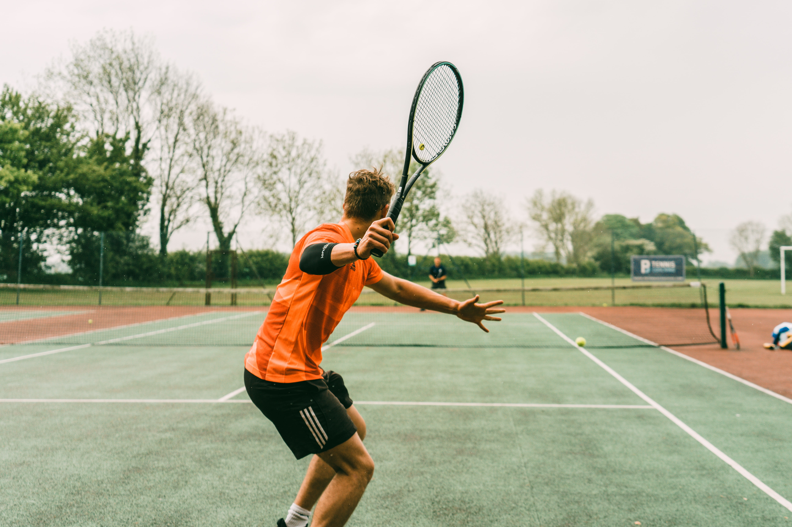
Discuss
What are meant by the terms reliability and validity in terms of fitness testing?
Which components of fitness are most important in gymnastics, and why?
Which fitness activities or training methods would help improve each component of fitness?
© ZigZag Education, 2023
Notes:
Take this opportunity to reflect on what has been learnt and how the components of fitness impact sport in a wider context.
Students can discuss these questions with their peers or respond individually by writing down their answers.

Slide 30

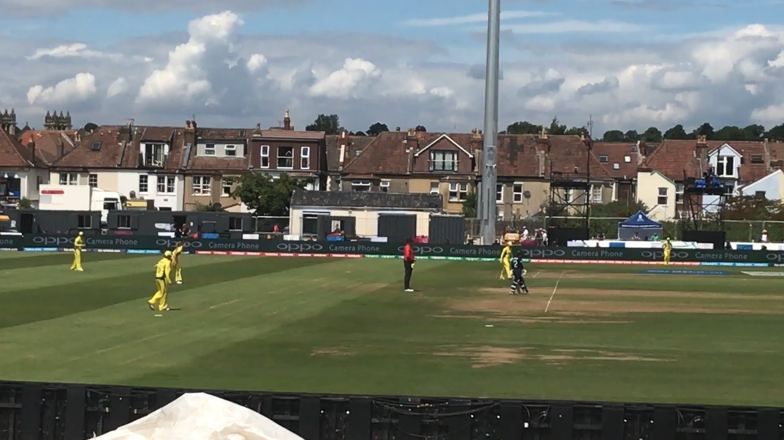
Identify the different components of fitness that are important to the batter in the cricket video below.
Use examples to explain why each component is important to the batter.
INSPECTION COPY
Activity
Click on the video to play.
Click on the coloured boxes for the
components of fitness important to cricket.
Click again to reveal explanations of why each is important.
Balance
Important for a batter to maintain their body position behind the crease when playing a shot.
Reaction time
Power / Explosive strength
Batters must make a decision to play the ball within a split second.
The batter must generate power to achieve distance in the shot.
COPYRIGHT
PROTECTED
Batters are required to use their arms and legs to get into a stance to play a shot.
Important for the batter to get from one end of the pitch to the other.
Speed
Coordination
© ZigZag Education, 2023
Notes:
Click on the video to watch a snippet of the cricket game.
Make a list of any components of fitness that are important to that batter.
Explain why each component of fitness may be important to the batter in cricket.
Click on the different-coloured boxes to reveal exemplar answers.
Discuss the components of fitness that may be important to the other roles and positions in cricket.

Slide 31
INSPECTION COPY
Exam-style questions
Answer the following exam-style question and check your answers.
1. i) Define coordination.
(1 mark)
1 × AO1 mark:
The ability to efficiently use two or more body parts at the same time.
☞ Click to reveal answer!
1. ii) Using a sporting example, explain how coordination is important in that physical activity or sport.
(2 marks)
COPYRIGHT
PROTECTED
☞ Click to reveal answer!
2 × AO2 marks for:
Example – e.g. tucking the legs and rotating the body while performing a somersault
Explanation – required to be aware of the body’s position in flight and when to coordinate the arm and leg movements to successfully land (1)
© ZigZag Education, 2023
Notes:
Students to answer each exam-style question under exam conditions (approx. 1 minute per mark).
Click to reveal answers. Students to peer-mark or self-mark answers.

