Slide 1
The Skeletal System
Structure and Function
Paper 1
Applied Anatomy and Physiology
1.1.1-
1.1.3
Photocopiable/digital resources may only be copied by the purchasing institution on a single site and for their own use.

Slide 2


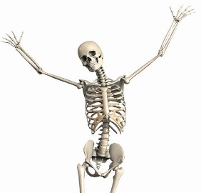
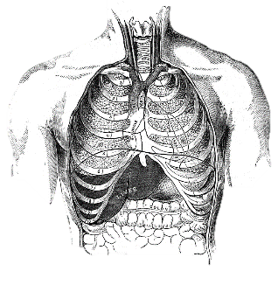
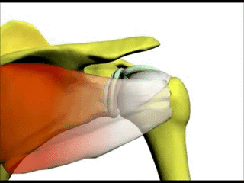
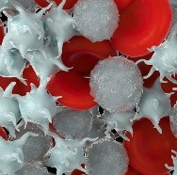
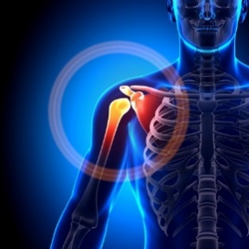

INSPECTION COPY
Skeletal functions
The skeleton has several key functions. Click on each image to reveal that function.
Learn
Storage of essential minerals such as calcium and phosphorus, which are essential for formation of healthy bones and can help protect against fractures.
Skeletal muscle functions
Flat bones protect vital organs from impacts to the body. For example, the ribs protect the heart and the lungs whereas the cranium protects the brain.
Site of muscle attachment to provide structural shape to the body. Muscles can then pull on bones when they contract to cause movement.
COPYRIGHT
PROTECTED
Production of...
Red blood cells, which transport oxygen in the blood to the working muscles.
White blood cells, which help to fight infection and ward off illness.
Platelets, which help with blood clotting when vessels burst or the skin is cut.
Formation of joints to act as the site of movement. Different joints allow for different ranges of movement. For example, the humerus at the ball-and-socket joint in the shoulder can move in many different planes.
© ZigZag Education, 2023
Notes:
Click each picture to reveal the function. Discuss each as you reveal.
Students to provide examples of bones that provide each of these functions, e.g. long bones such as the femur help to produce blood cells.

Slide 3
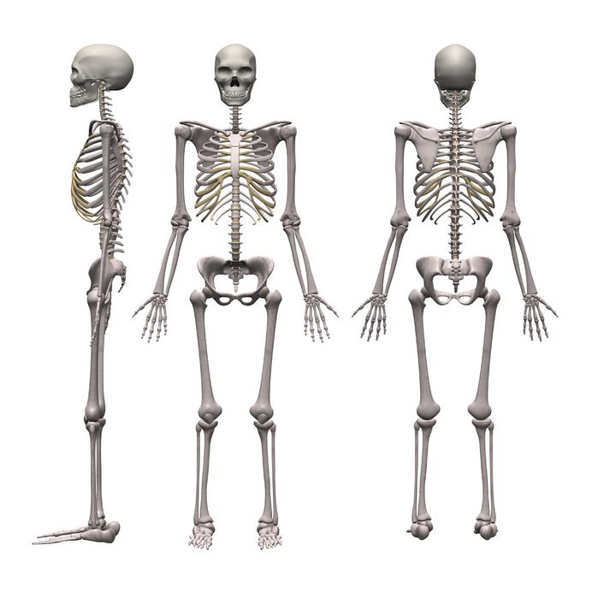
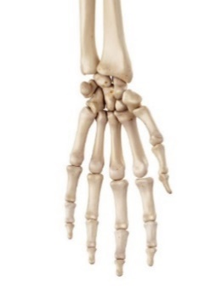
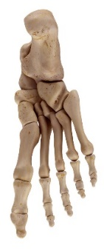
Bones
INSPECTION COPY
Click on the boxes to reveal the bone then click again
to reveal its classification.
Learn
There are 206 bones in the average adult human skeleton. Let’s take a look at the main ones you need to know for your exam.
Colour key for bone classifications:
Long Bone
Flat Bone
Flat Bone
Cranium
Short Bone
Sesamoid Bone*
* you are not required to know about sesamoid bones, but it is useful to know which are classified as this in the body.
Long Bone
Clavicle
Scapula
Flat Bone
Flat Bone
Sternum
Humerus
Long Bone
Flat Bone
Ribs
Pelvis
Ulna
Long Bone
Flat Bone
Radius
Long Bone
Long Bone
Femur
COPYRIGHT
PROTECTED
Carpals
Short Bone
Sesamoid Bone*
Patella
Metacarpals
Long Bone
Short Bone
Tarsals
Phalanges
Long Bone
Long Bone
Metatarsals
Tibia
Long Bone
Long Bone
Phalanges
Fibula
Long Bone
© ZigZag Education, 2019
© ZigZag Education, 2023
Notes:
Identify the major bones of the skeletal system.
Click on each connecting arrow to reveal the bone (testing knowledge).
Click on the name of each bone to reveal the bone classification (preparation for application to specific function).

Slide 4
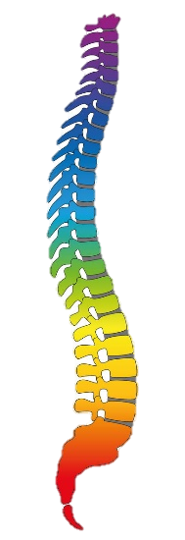

Major Bones
The Vertebral Column
INSPECTION COPY
Learn
The vertebral column is made up of a series of irregular bones called the vertebrae, which extend from the neck to the tail bone (in the lower back). It is split into five different regions.
Click on each region to reveal more
Cervical (7 vertebrae)
The first two bones are known as the atlas and axis and form a pivot joint, allowing movement at the neck
Thoracic (12 vertebrae)
Each thoracic vertebrae connects to a rib to form a joint. Their function is to hold the ribcage in place in order to protect the heart and lungs.
Lumbar (5 vertebrae)
The lumbar vertebrae of the lower back play a vital role in supporting the weight of the upper body and offer a point of attachment for muscles
COPYRIGHT
PROTECTED
Sacrum (5 fused vertebrae)
These form the pelvic girdle, connecting the upper and lower body
Coccyx (4 fused vertebrae)
These form the evolutionary remains of the tail bone, but has no function
4
© ZigZag Education, 2023
© ZigZag Education, 2019
© ZigZag Education, 2023
Notes:
Highlight the regions of the vertebral column.
Click on each region (square) (test your students’ knowledge of their names, number of vertebrae and functions).

Slide 5
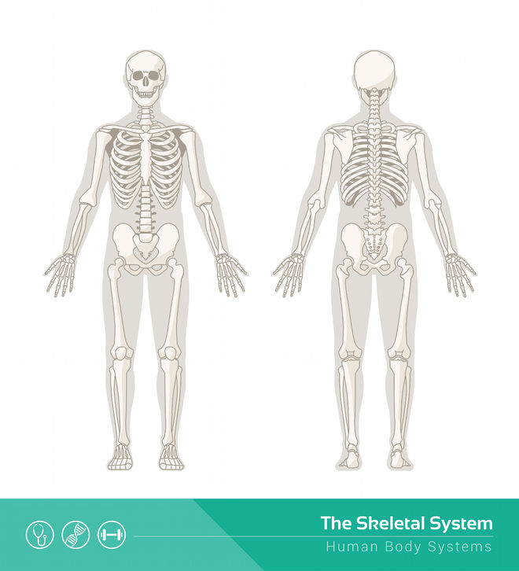
INSPECTION COPY
Categorise each bone into the different locations of the body.
Note that some bones may span more than one area of the body.
Activity
Femur
Clavicle
Fibula
Femur
Humerus
Scapula
Humerus
Radius
Ulna
Tibia
Tibia
Cranium
Pelvis
Sternum
Ribs
Patella
Head/ Neck
Shoulder
Chest
Elbow
Hip
Knee
Ankle
COPYRIGHT
PROTECTED
Click on each table heading to identify
the correct location of each bone.
© ZigZag Education, 2023
Notes:
Students could pair up and label each other with sticky notes to take part in this activity. They should then note their answers on the worksheet.
Each table heading can then be clicked on to reveal the bones at each location, so students can check their answers. Bones that feature in more than one location will feature twice.

Slide 6
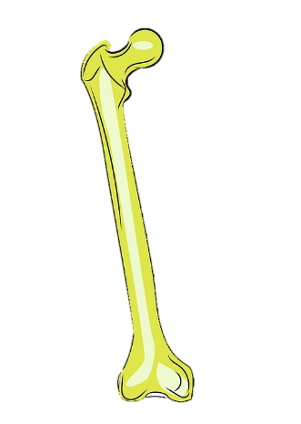

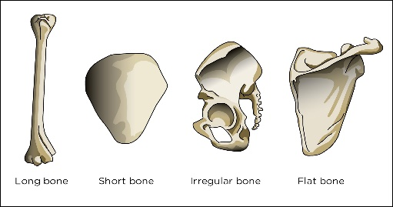

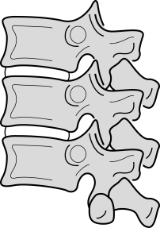
INSPECTION COPY
Classifications of bones
Learn
The different classifications of bones have unique functions regarding performance in sport and physical activity.
Click on each of the bones to reveal the classification and its function.
Long bones (e.g. humerus, femur, tibia) provide leverage at a joint to allow for gross movements of limbs. For example: to throw, kick and jump in a variety of sports and physical activities.
Short bones (e.g. tarsals in the foot and carpals in the hand) provide weight-bearing in high-impact activities such as running and jumping. This helps reduce the forces going through the body.
Irregular bones (e.g. the vertebrae) provide protection of the spinal cord which, along with the brain, forms the central nervous system. They also provide a site of muscle attachment for many muscles in the back which help maintain posture during sport, e.g. in a rugby scrum.
Flat bones play a key role in the protection of vital organs. For example, the sternum and the ribs protect the heart and lungs if a boxer receives a body shot. Their large surface area also provides a site for muscle attachment.
COPYRIGHT
PROTECTED
© ZigZag Education, 2023
Notes:
Discuss the roles of the different bone classifications.
Reassess ability to categorise bone types from slide 1. See how many long bones, short bones and flat bones students can name.
Students to provide other sporting examples of each.
Be sure to click on each bone to reveal the function(s) of each classification.

Slide 7
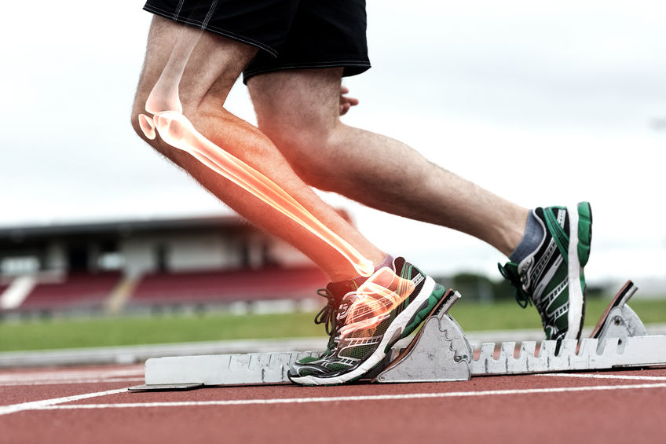
INSPECTION COPY
Discuss
How do the different functions of the skeleton help with performance in physical activity?
How might the shape of different bones forming at a joint relate to the classification of that joint?
Which muscles in the body attach at flat bones such as the scapula and the pelvis?
For what type of injuries might production of platelets by the skeletal system be important?
COPYRIGHT
PROTECTED
© ZigZag Education, 2023
Notes:
Take this opportunity to reflect on what has been learnt about the functions of the skeletal system and how it impacts performance in physical activity.
Students can discuss these questions with their peers or respond individually by writing down their answers.

Slide 8
INSPECTION COPY
Match up the different functions of the skeleton with the examples of how they are applied in sport and physical activity.
Activity
Click on each function to reveal
the correct match.
The cranium helps minimise damage to the brain when heading in football
Protection of vital organs
The biceps is joined to the scapula (origin) and the radius in the forearm (insertion) to allow a biceps curl to be completed
Movement
This assists with the roles such as the transport of oxygen during aerobic activity, and blood clotting if someone scrapes their knee.
Muscle attachment
Mineral storage
Calcium and phosphorus are deposited in the bone to add strength and protect against fracture from impact in contact sports
COPYRIGHT
PROTECTED
Blood cell and platelet production
The knee joint flexes and extends in order to allow a track athlete to run
© ZigZag Education, 2023
Notes:
Students should attempt the match-up before clicking each function to reveal the correct answer.
Students to come up with additional examples where each function is applied to performance in sport.

Slide 9
INSPECTION COPY
Exam-style questions
Answer the following exam-style question and check your answer.
1. One function of the skeleton is to store minerals such as calcium and phosphorus.
Identify one other function of the skeleton.
(1 mark)
☞ Click to reveal answer!
1. 1 × AO1 mark for any of the following:
Protection of vital organs
Formation of joints for sporting movement
Points of attachment
Platelet and blood cell production
COPYRIGHT
PROTECTED
© ZigZag Education, 2023
Notes:
Students to answer each exam-style question under exam conditions (approx. 1 minute per mark).
Click to reveal answers. Students to peer-mark or self-mark answers.

Slide 10
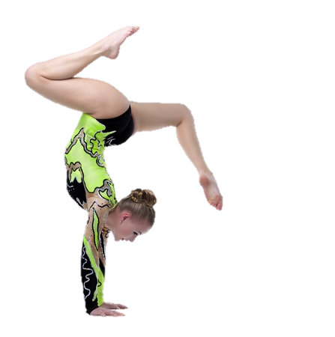
INSPECTION COPY
Exam-style questions
Answer the following exam-style question and check your answer.
2. The image below shows a gymnast performing a handstand.
Explain why short bones are important in sports such as gymnastics.
(2 marks)
☞ Click to reveal answer!
2. 1 × AO1 mark for the role of short bones:
  Help in weight-bearing of the body
  1 × AO2 mark for the importance of short bones for the gymnast:
  So the performer can support their body weight and hold the handstand position using their hands and wrists
  Accept any other appropriate answers.
COPYRIGHT
PROTECTED
© ZigZag Education, 2023
Notes:
Students to answer each exam-style question under exam conditions (approx. 1 minute per mark).
Click to reveal answers. Students to peer-mark or self-mark answers.

