Slide 1
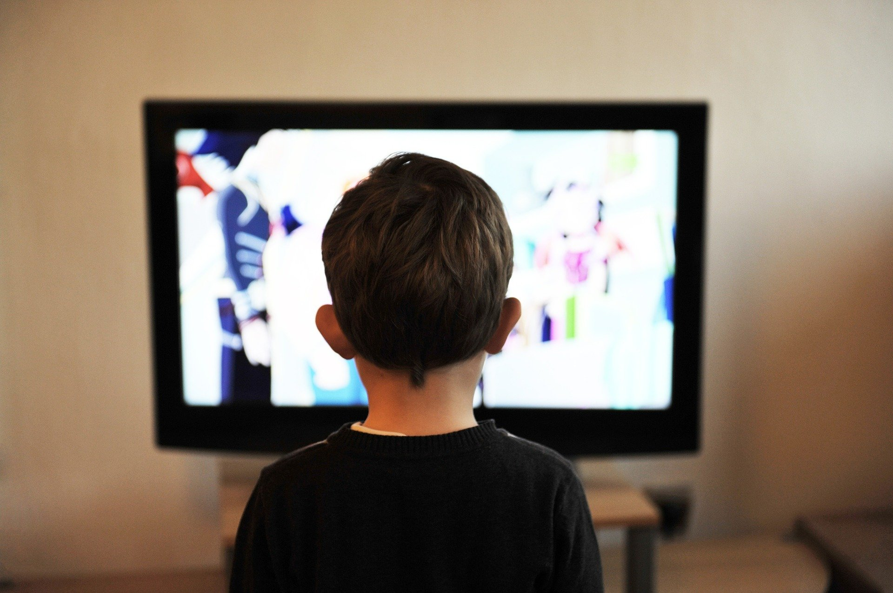
Photocopiable/digital resources may only be copied by the purchasing institution on a single site and for their own use
Consequences of a Sedentary Lifestyle
Paper 2
Health, Fitness and Well-being
2.3
Notes:
This PowerPoint should be used in conjunction with PowerPoint 8 to cover Health, Fitness and Well-being.

Slide 2

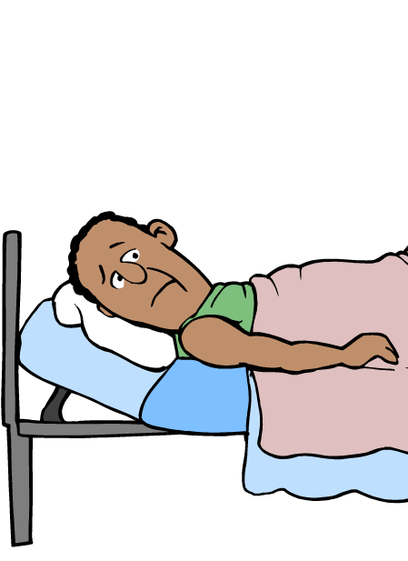
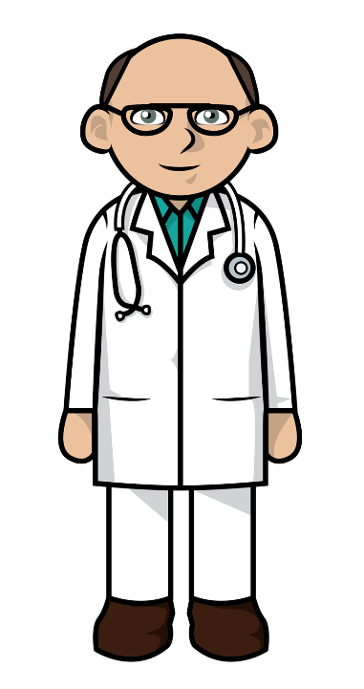

Sedentary lifestyle
INSPECTION COPY
Learn
Lifestyle is the way in which an individual lives their life.
‘What is a sedentary lifestyle?’
‘A sedentary lifestyle is one that consists of little or no exercise and prolonged sitting or lying down.’
COPYRIGHT
PROTECTED
Watch this video which looks at the hidden health risks of prolonged sitting, before moving on to look at the different consequences in more detail:
© ZigZag Education, 2023
Notes:
Identify the definition of a sedentary lifestyle, then click through the slide to learn the definition.
Click on the play button to watch the video on the health risks of prolonged sitting.

Slide 3
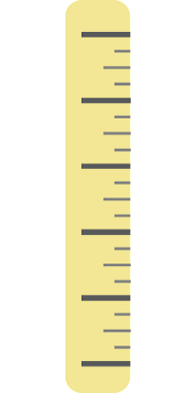
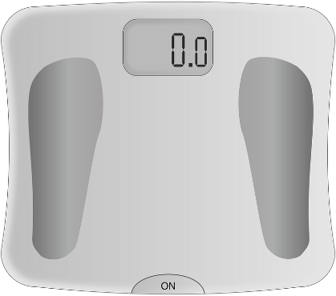
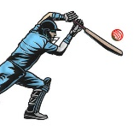



Consequences of a sedentary lifestyle
on physical health
Learn
Obesity is one of the main physical consequences of a sedentary lifestyle.
Body mass index (BMI) is the universal scale used to classify body weight.
Obesity is clinically defined as a BMI of 30 kg/m² and over.
You can also use a BMI calculator
This can be calculated very simply using an individual’s body weight and height.
For example…
1.7 m
90.0 KG
This is classified as obese!
Weight
÷
Height²
(1.7 m × 1.7 m)
=
BMI of 31.1 kg/m²
But what's the issue with BMI?
The importance of avoiding obesity is because it is highly associated with a range of adverse health effects. It also impairs a range of fitness components in sports.
Exercise performance
Physical health
Social health
Emotional health
© ZigZag Education, 2023
Notes:
Identify what is meant by obesity and click through the slide to see how it is defined.
Calculate the BMI of the individual displayed – what does this show?
(Optional) Use a BMI calculator to calculate some other examples (or students’ own BMIs, if appropriate).
Watch the video and discuss the issues with BMI.
Introduce the importance of avoiding obesity with a sedentary lifestyle – covered in the next slides.

Slide 4
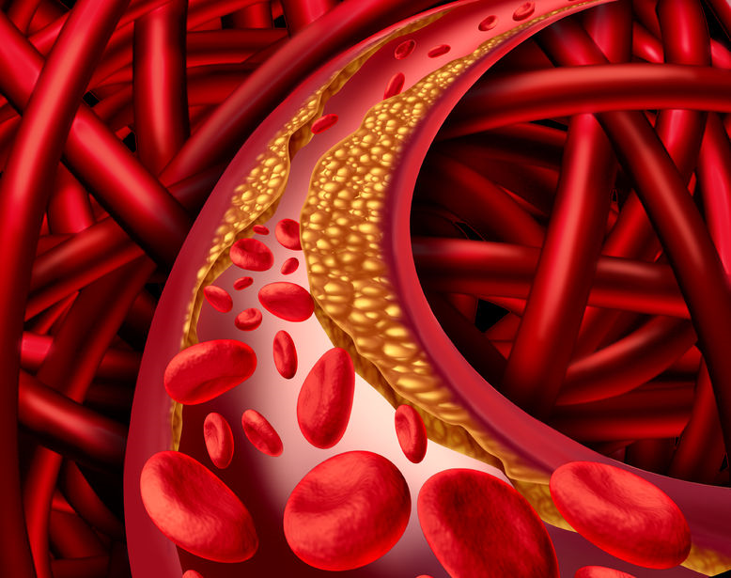
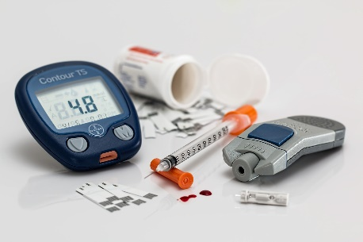
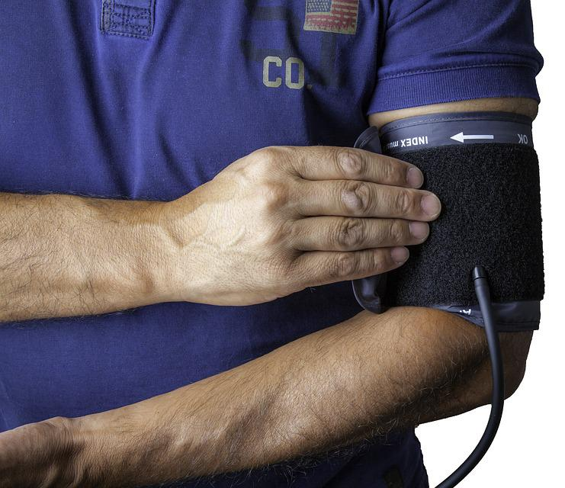
INSPECTION COPY
Consequences of a sedentary lifestyle
on physical health
Learn
Obesity is associated with a range of other physical health consequences that are brought on by leading a sedentary lifestyle…
CORONARY HEART DISEASE
Blood flow through the coronary arteries supplying the heart is obstructed by fatty deposits, starving the heart of oxygen.
TYPE 2 DIABETES
A lack of exercise and a diet high in sugar reduces the sensitivity of the body’s cells to insulin. Insulin is needed to clear glucose from the blood. High levels of blood glucose (hyperglycaemia) can damage blood vessels.
COPYRIGHT
PROTECTED
BLOOD PRESSURE
An accumulation of fatty deposits restricts blood flow and increases the pressure on the artery walls, increasing the risk of them bursting.
© ZigZag Education, 2023
Notes:
Identify the different effects that obesity and a sedentary lifestyle can have on physical health.
Click on the obesity banner to reveal more information about the different effects that it can have.

Slide 5
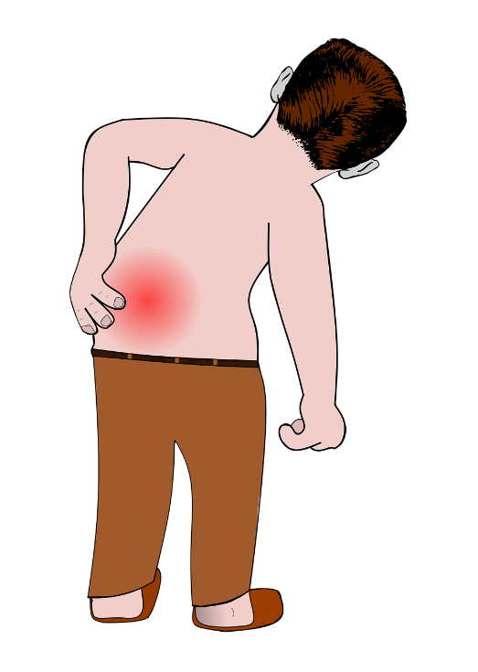
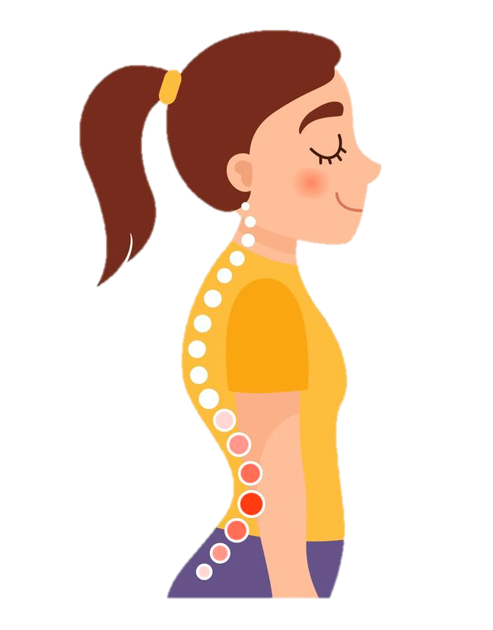
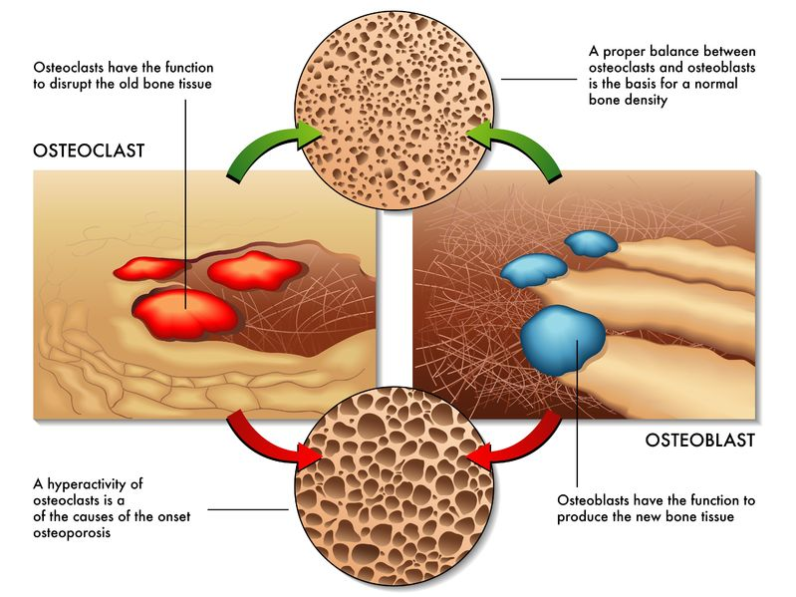

INSPECTION COPY
Consequences of a sedentary lifestyle on long-term health
Learn
Other physical health consequences of leading a sedentary lifestyle include…
Poor posture
Greater risk of injury
Reduced bone density
COPYRIGHT
PROTECTED
A lack of activity leads to atrophy and weakening of muscles, increasing the risk of strains when moving. It also means that joints lack flexibility so are at a greater risk of going beyond their safe range of motion.
Physical activity is important for stimulating the uptake of bone minerals such as calcium and phosphorus and building new bone tissue. Sedentary activity leads to weakened bones which are more prone to fracture.
Sedentary activity involves a lot of slouching. A poor sitting position, such as slouching, can make the individual develop postural conditions such as kyphosis, characterised by a rounding of the lower spine.
© ZigZag Education, 2023
Notes:
Click through the slide to reveal more information about the different consequences of a sedentary lifestyle.
See whether you can recall how a sedentary lifestyle leads to each consequence.

Slide 6
Consequences of a sedentary lifestyle
on fitness
INSPECTION COPY
Learn
A sedentary lifestyle can affect a number of different fitness components important for success in sport and physical activity.
Cardiovascular endurance / stamina
A sedentary lifestyle reduces aerobic capacity, meaning the cardiorespiratory system has to work harder to deliver oxygen to the muscles.
Carrying excess weight from leading a sedentary lifestyle also provides an added resistance for muscles to overcome in order to move the body.
Flexibility
Lack of physical activity leads to tight muscles and a limited range of motion at the joints. Excess weight from a sedentary lifestyle also creates an obstruction, preventing the body from being able to reach the range of motion afforded by the joints.
Agility requires the ability of the performer to change direction quickly. Excess body weight from a sedentary lifestyle makes the performer more sluggish, hindering their ability to change direction without loss of time.
Agility
COPYRIGHT
PROTECTED
It is important that performers requiring speed and power have a high proportion of muscle to fat. Sedentary individuals tend to have the opposite, limiting the speed and power they are able to generate.
Speed and power
© ZigZag Education, 2023
Notes:
Identify different components of fitness that may be affected by a sedentary lifestyle, and why.
Click through the slide to reveal some of these components and the reasons they are affected.
Identify other aspects of fitness that may be affected by a sedentary lifestyle.

Slide 7
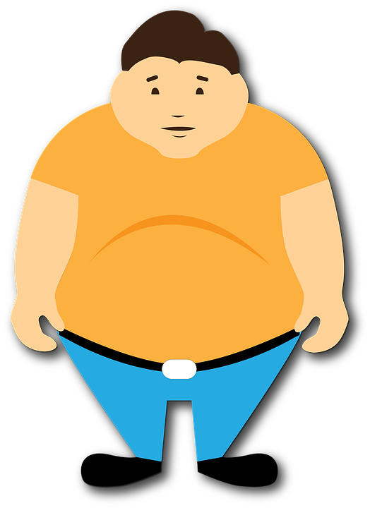
Consequences of a sedentary lifestyle
on emotional health
Learn
It is clear that a sedentary lifestyle impairs physical health, but it may be less known that it is also associated with emotional health issues.
A sedentary person may feel shameful of their image as someone who doesn’t participate in any physical activity.
They may also feel dissatisfied with their body appearance, especially if they compare themselves to others or to a former self.
Check out this short blog post on the complex relationship between obesity and emotional health:
A sedentary lifestyle can lead to a loss of confidence, both in general life and in sports participation. Body shaming is an issue inherent in society which can impact self-esteem.
It is important it is addressed in order to help sedentary individuals regain confidence in themselves.
© ZigZag Education, 2023
Notes:
Identify the different effects that leading a sedentary lifestyle can have on emotional health.
Click through the slide to reveal more information about the different effects that obesity can have.
Click on the info button to reveal a short blog post on the relationship between obesity and emotional health.

Slide 8
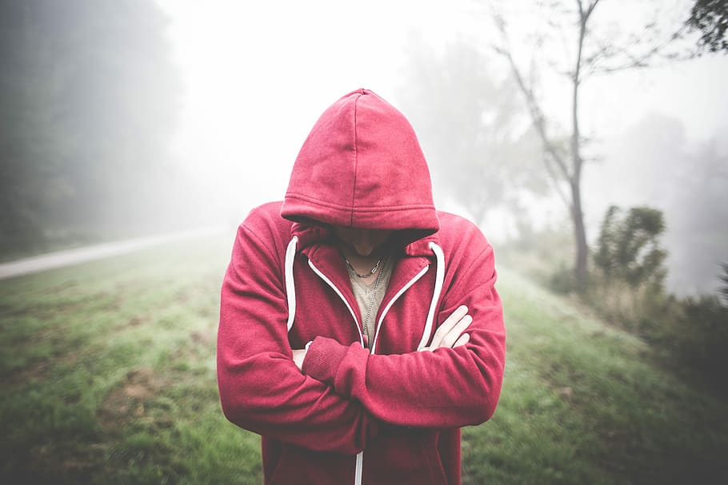
INSPECTION COPY
Effects of obesity on social health
Learn
The effect of obesity on mental health is closely related to its effect on social health.
Sedentary individuals tend not to leave home and, therefore, may become a social hermit. This impacts their opportunity to integrate with the rest of society, leaving them feeling lonely.
Obesity can affect someone’s ability to socialise and make friends, making them feel removed from any sense of belonging.
Communicating with others requires confidence, which can be severely affected by obesity.
COPYRIGHT
PROTECTED
© ZigZag Education, 2023
Notes:
Identify the different effects that a sedentary lifestyle can have on social health.
Click through the slide to reveal more information about the different effects that obesity can have.

Slide 9
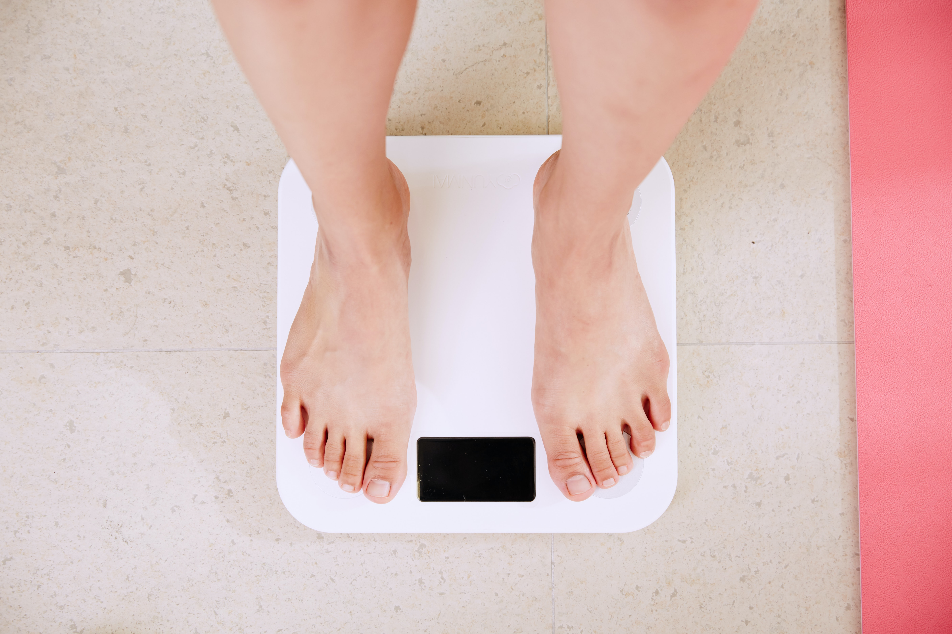
Discuss
What are the wider implications of obesity on society and the economy?
What reasons might individuals have for leading a sedentary lifestyle?
How are calorie intake and expenditure likely to be influenced by a sedentary lifestyle?
© ZigZag Education, 2023
Notes:
Take this opportunity to reflect on what has been learnt about obesity and somatotypes and how they impact sport in a wider context.
Students can discuss these questions with their peers or respond individually by writing down their answers.

Slide 10
INSPECTION COPY
Exam-style questions
Answer the following exam-style questions and check your answers.
1. Which one of the following is a way in which leading a sedentary lifestyle can affect emotional health?
a) Increases risk of injury
b) Makes it harder to socialise
c) Limits flexibility
d) Can result in a loss of confidence (1 mark)
☞ Click to reveal answer!
1 × AO1 mark:
d) Can result in a loss of confidence
2. Give three possible consequences of a sedentary lifestyle on physical health.
(3 marks)
COPYRIGHT
PROTECTED
Click to reveal answer!
Obesity (1)
Type 2 diabetes (1)
Reduced fitness (1)
Poor posture (1)
3 × AO1 marks from:
Injury
Coronary heart disease (CHD) (1)
Increased blood pressure (hypertension) (1)
Reduced bone density (1)
© ZigZag Education, 2023
Notes:
Students to answer each exam-style question under exam conditions (approx. 1 minute per mark).
Click to reveal answers. Students to peer-mark or self-mark answers.

