Slide 1
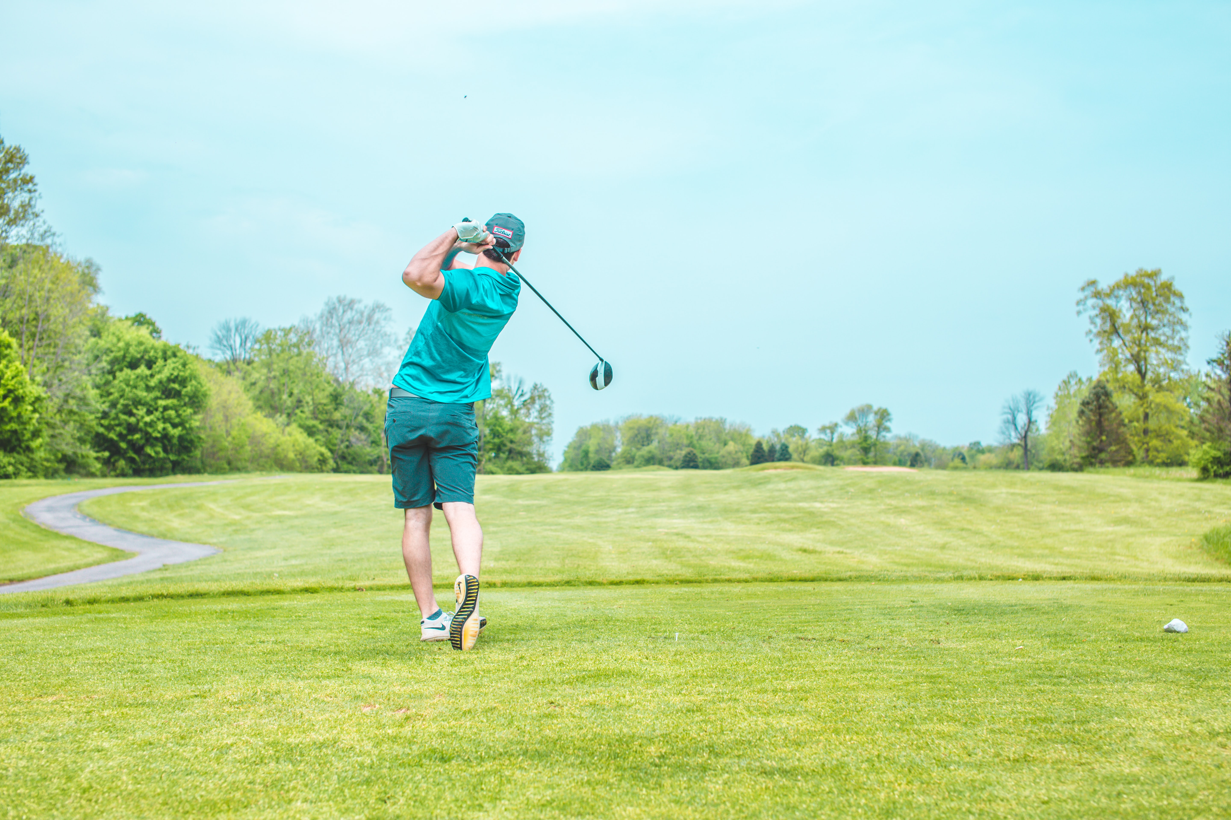
Classification of Skills
Photocopiable/digital resources may only be copied by the purchasing institution on a single site and for their own use
Paper 2
Sports Psychology
2.2

Slide 2
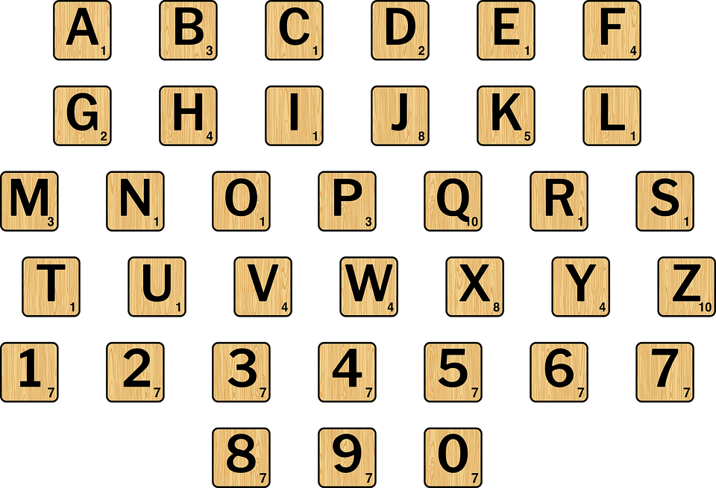

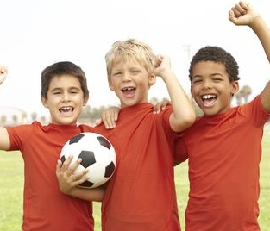
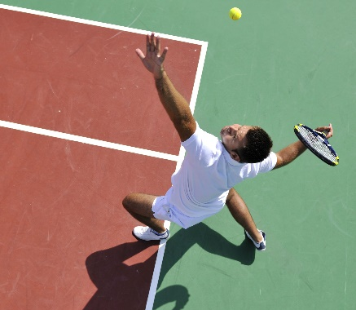
Motor skills
Learn
Skills in sport are developed from the motor skills learnt from a very young age.
A learned movement response of the arms, legs or other part of the body to complete a task or an action.
Early motor skills involve reaching and grasping for objects and putting together patterns about how they are used…
As children grow, they begin to apply these developmental motor skills to different sports…
Once motor skills are perfected, they are then refined to optimise performance…
© ZigZag Education, 2023
Notes:
Click through the slide to learn the definition of motor skill and how motor skills are used in sport.

Slide 3



INSPECTION COPY
Characteristics of skills
Learn
Skills in sport can be very different from each other. For example, throwing in netball is very different from pole-vaulting in athletics.
Click on each box to reveal the definition.
Click on each box to reveal a practical example.
Nevertheless, all skills are made up of similar characteristics.
Definition
Practical example
Characteristic
Performing a skill in the most effective way without loss of time or energy.
A marathon runner is efficient with their running technique so that they are able to reserve some energy.
Efficient
Knowing what skill needs to be performed, and how, before it happens.
A fly half in rugby who knows what move they are going to make before they receive the ball, e.g. pass, carry or kick.
Predetermined
Linking together different movements that go into a skill.
A basketball player who is able to link up different actions such as dribbling, jumping then shooting.
Coordinated
COPYRIGHT
PROTECTED
Moving from one movement of a skill to the next with natural flow.
A tennis player who is able to throw the ball up in the air, draw the arm back and hit the ball to serve in one fluent motion.
Fluent
Aesthetic
A skill that looks pleasing to the eye when executed.
A gymnast who is able to successfully land a difficult tumble without losing their balance.
© ZigZag Education, 2023
Notes:
Click on the coloured boxes to learn the definition of each characteristic of skill, then click on the coloured boxes to see a practical example of how each is applied.

Slide 4
Classifications of skill
Learn
Not all skills are the same. Some are easier to perform than others, and some are easier to predict than others.
Let’s take a look at some of these classifications below and what they mean!
Simple
Easy to perform
Complex
Difficult to perform
Open
Unpredictable environment
Closed
Fixed environment
Skills can have multiple classifications, such as being simple and closed.
However, they can’t be from the same category, such as being simple and complex!
© ZigZag Education, 2023
Notes:
Click through the slide to learn about the different terms used to classify skills.
Begin to think about the types of skills in sport and how they may be classified using these terms.

Slide 5
Now that you have been introduced to the different skill classifications, let’s see whether you can match-up the examples with the correct classifications.
Activity
Click on the classifications to reveal the answers.
Simple and open
Performing a somersault
Simple and closed
Passing in hockey
Complex and open
Performing a long jump
Complex and closed
Playing a ramp shot in cricket
© ZigZag Education, 2023
Notes:
Match up the different skill classifications with their examples.
Click on each skill classification to reveal the correct match-up.

Slide 6
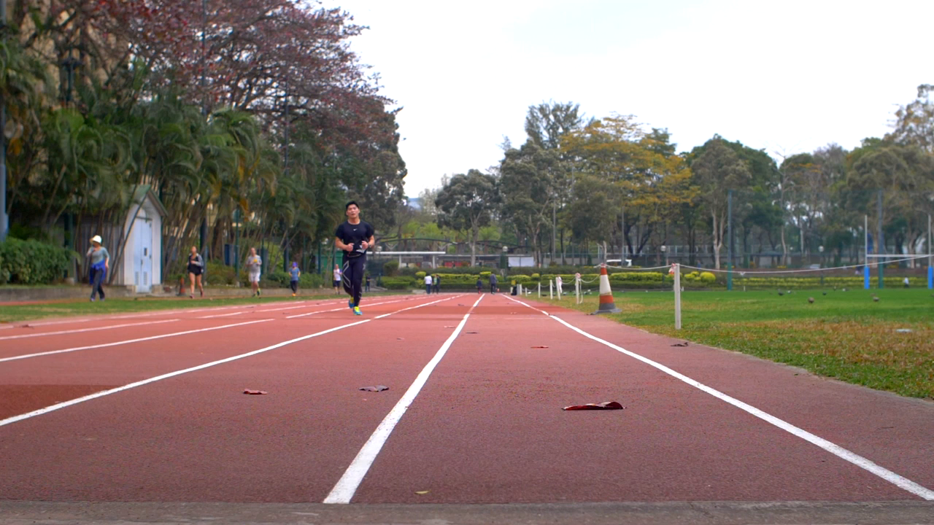
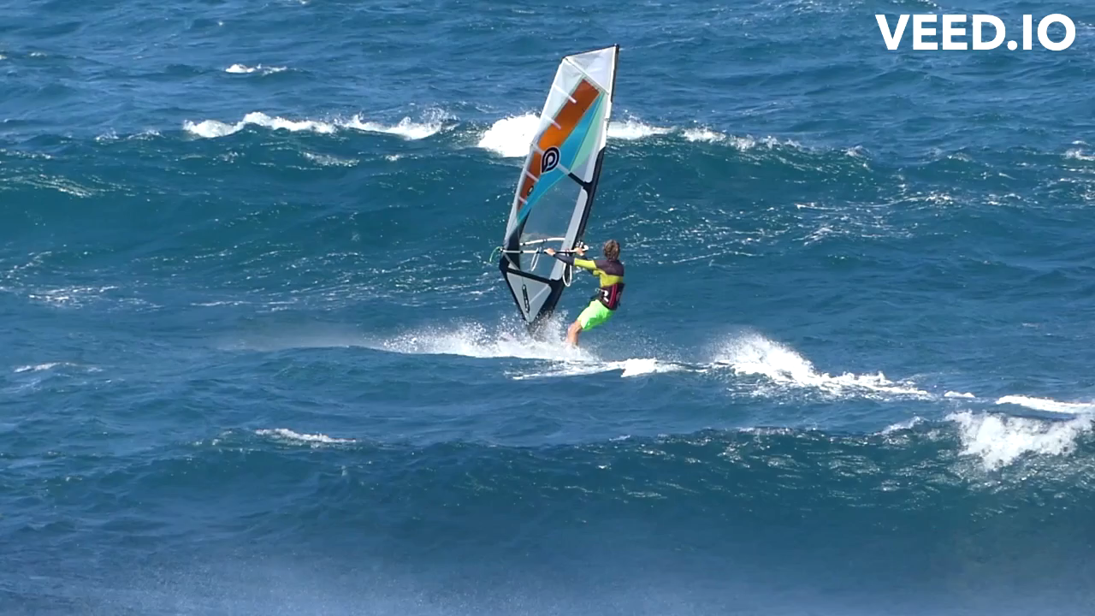
INSPECTION COPY
Simple–complex skills
Learn
Skills can be classified from simple to complex, depending how difficult they are to perform.
Running
Wind surfing
Simple skills:
Example
Click on the example buttons to see each in action and then press play on each of the videos.
Example
Complex skills:
COPYRIGHT
PROTECTED
Requires decision-making
Coordination important
Subroutines need to be linked together
Likely to have higher physical demand
Increased risk of danger
More difficult to learn
Decision-making limited
Transferable
Few subroutines
Little risk of danger
Simple to learn
Less physical demand
Best for novice performers
© ZigZag Education, 2023
Notes:
Identify the characteristics of simple and complex skills.
Reveal the characteristics.
Watch the videos of examples of simple and complex skills in sport.
Identify any other skills which could be classified on each end of the continuum.

Slide 7
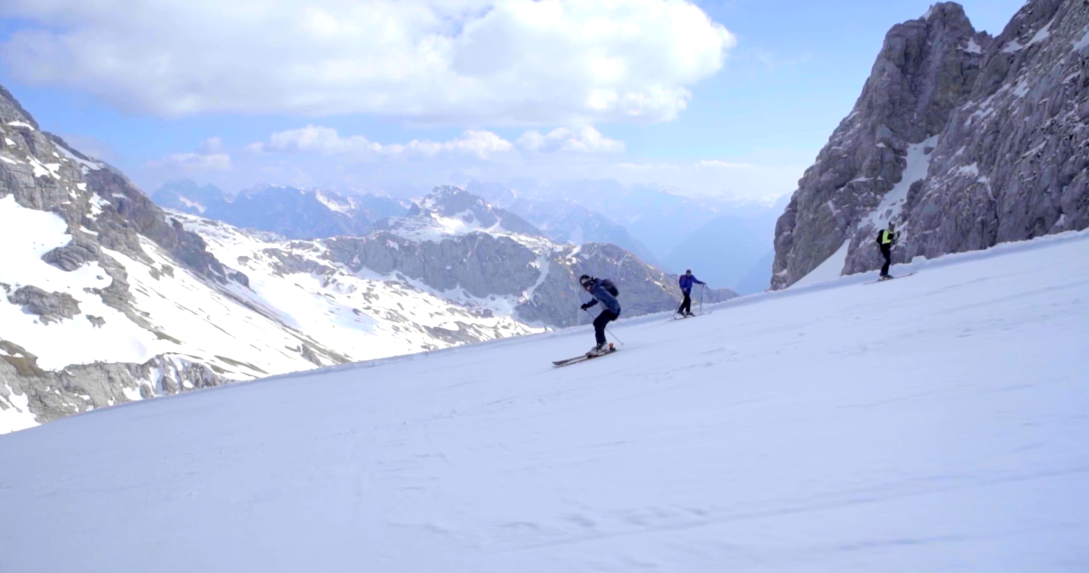
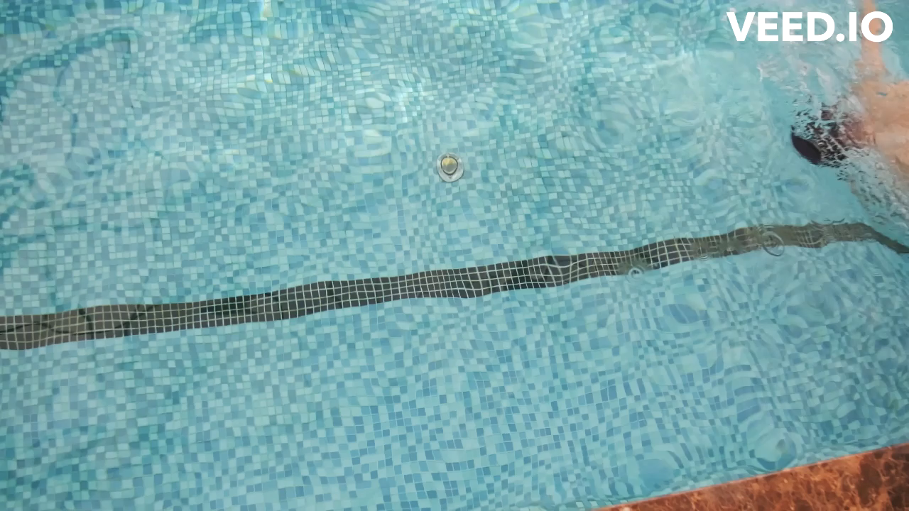
Open–closed skills
Learn
Skills can be classified from open to closed, based on how much they are affected by the environment (e.g. other participants, terrain, weather or situations).
Skiing
Swimming
Open skills:
Example
Click on the example buttons to see each in action and then press play on each of the videos.
Example
Closed skills:
Environment is constantly changing
Movements need to be adapted to external cues
Usually externally paced
Decision-making is key
Environment is stable
Technique does not need to be adapted
Usually self-paced
Fewer decisions needed
© ZigZag Education, 2023
Notes:
Identify the characteristics of open and closed skills.
Reveal the characteristics.
Watch the videos of examples of open and closed skills in sport.
Identify any other skills which could be classified on each end of the continuum.

Slide 8
INSPECTION COPY
Choosing appropriate classifications
Learn
One skill can be classified on all the continuums. It is also important to remember that it is a continuum, so the skill won’t always be placed to the ends of the continuum, and different parts
of the same skill can be placed along the continuum. You should, therefore, justify your placements.
Let’s take a look at some skills... first a rugby tackle!
Running into position to make a rugby tackle is a basic skill...
… but effective technique of the rugby tackle is a more complex skill requiring coordination, timing and subroutines.
Simple skills
Complex skills
Making a rugby tackle requires perception of the opposition’s movements (environment) to get into the correct position to make the tackle, so is an open skill.
COPYRIGHT
PROTECTED
Open skills
Closed skills
© ZigZag Education, 2023
Notes:
Click through the slide to see how a rugby tackle can be classified on each continuum.

Slide 9
Choosing appropriate classifications
Learn
Now let’s take a look at a somersault in gymnastics…
A somersault is a complex movement that is difficult to learn, requires a lot of co-ordination, and can be dangerous if performed incorrectly.
Simple skills
Complex skills
Open skills
The gymnast is in control of the timing of their somersault, so it is a closed skill.
Closed skills
© ZigZag Education, 2023
Notes:
Click through the slide to see how a somersault can be classified on each continuum.

Slide 10
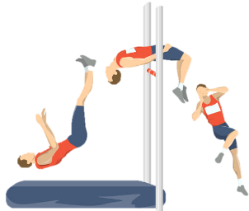
INSPECTION COPY
Your turn!
Click on each classification that performing the high jump would fall under.
Activity
Watch the slow-motion video of the performer executing the high jump and choose the different skill classifications it would fall under.
Simple
The high jumper must arch their back over the bar by performing the Fosbury flop – a complex skill.
Complex
COPYRIGHT
PROTECTED
Open
The environment for the high jump is the same every time.
Closed
© ZigZag Education, 2023
Notes:
Click on the play button to watch the slow-motion video of the high jumper.
Identify the different classifications of the high jump as a skill and justify choices.

Slide 11
Classify the sports skills below onto each of the continuums.
Can you provide a justification for each?
Click on each skill twice to see the placement and compare your answers.
Activity
Serving in tennis
Serving in tennis
Passing in hockey
Passing in hockey
Putting in golf
Putting in golf
Simple skills
Complex skills
Open skills
Closed skills
© ZigZag Education, 2023
Notes:
Classify the skills given.
Click each skill twice to reveal placement.
Answers may vary depending on justifications given.

Slide 12
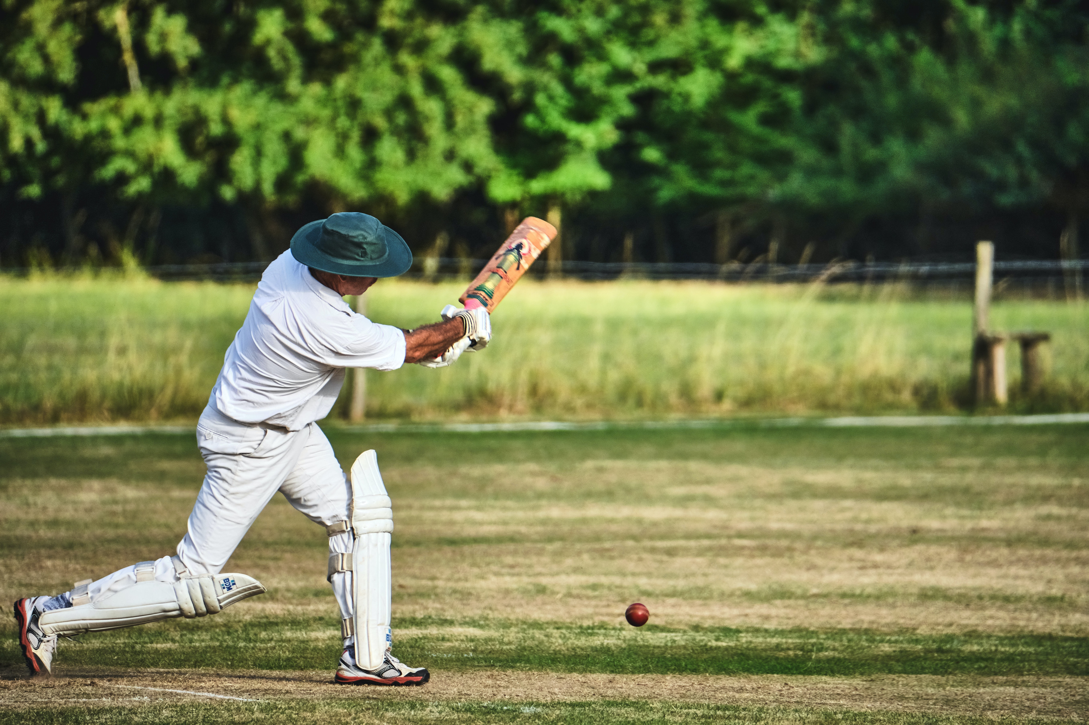
Discuss
How could an open skill be made into a closed skill?
Using a sport of your choice, classify five different skills in that sport.
What different skills might be both complex and closed?
For a sports skill of your choice, discuss how it meets each of the five characteristics.
© ZigZag Education, 2022
Notes:
Take this opportunity to reflect on what has been learnt about classifications of skill and how it impacts sport in a wider context.
Students can discuss these questions with their peers or respond individually by writing down their answers.
Potential responses
Examples of fine skills include: potting in snooker, flicking the wrist when spin bowling in cricket, throwing a dart, using the bow in archery, releasing the stone in curling.
Skills that are both complex and self-paced include: the high jump, the vault in gymnastics, bowling in cricket.

Slide 13
INSPECTION COPY
Exam-style questions
Answer the following exam-style questions and check your answers.
1. Give an example of ‘aesthetic' as a characteristic of a skilful performer. (1 mark)
1 × AO2 mark for any skill that looks visually pleasing:
e.g. a successfully landed somersault in gymnastics
e.g. curling the ball in to the top corner in football
e.g. successfully side-stepping an opponent in rugby
e.g. a perfect entry into the pool in Olympic diving
Accept other suitable examples.
☞ Click to reveal answer!
2. Give one practical example of a sports skill that is classified as a simple skill on the difficulty continuum. (1 mark)
☞ Click to reveal answer!
COPYRIGHT
PROTECTED
1 × AO2 mark for:
Any basic running/passing/jumping/throwing action, such as the long jump
© ZigZag Education, 2023
Notes:
Students to answer each exam-style question under exam conditions (approx. 1 minute per mark).
Click to reveal answers. Students to peer-mark or self-mark answers.

