Slide 1
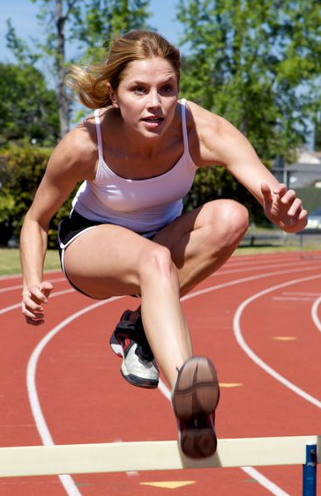
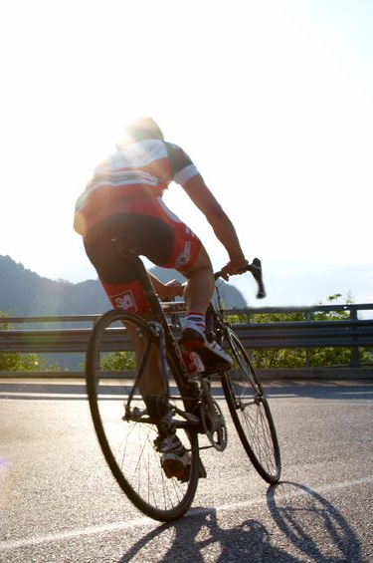
The
Paper 1
Applied Anatomy and Physiology
1.1.d
Anaerobic
Aerobic
and
Energy Systems
Photocopiable/digital resources may only be copied by the purchasing institution on a single site and for their own use.

Slide 2

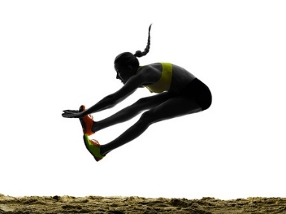
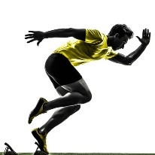
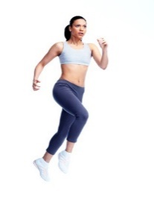
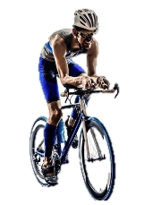

Aerobic and anaerobic exercise
INSPECTION COPY
Exercise can be categorised as aerobic and anaerobic, based on the needs of the body to supply energy to fuel the activity.
Let’s take a close look at these terms below!
Learn
Anaerobic
Without using oxygen
Aerobic
With oxygen
This type of exercise involves actions of a short duration and high intensity.
This type of exercise involves activities of a long duration and low intensity.
COPYRIGHT
PROTECTED
During anaerobic exercise, the body is able to exercise for a short amount of time without oxygen.
During aerobic exercise, the body is able to meet the oxygen demands of the activity, prolonging exercise.
© ZigZag Education, 2023
Notes:
Introduce types of aerobic and anaerobic exercise.
Students to think of other examples.

Slide 3
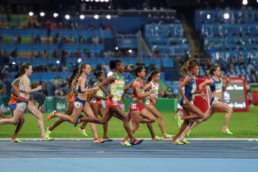

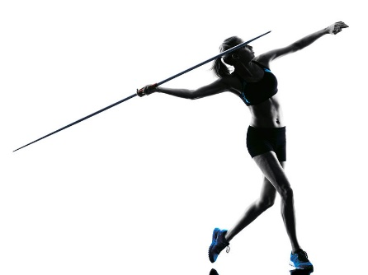
Anaerobic exercise
Learn
Although anaerobic exercise allows high-intensity exercise for a short duration, it results in the build-up of lactic acid. This is a substance associated with fatigue and pain when performing vigorous exercise.
The following equation is used to express anaerobic exercise:
Glucose
Energy
Lactic acid
Let’s see some examples of anaerobic exercise based on the duration and intensity of activities:
400 m sprint
Weightlifting
Javelin throw
All activities last a few seconds, up to 1 min and require a high intensity!
© ZigZag Education, 2023
Notes:
Describe the different types of anaerobic activities in terms of duration and intensity.

Slide 4
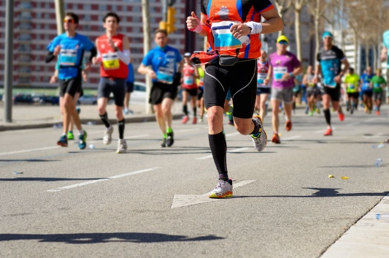
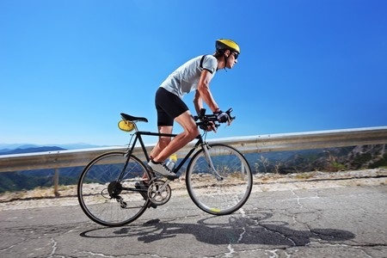
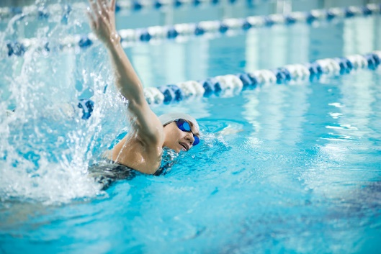
Aerobic exercise
INSPECTION COPY
Learn
Aerobic exercise also results in by-products. However, unlike lactic acid with anaerobic exercise, aerobic exercise produces carbon dioxide and water, which can be easily removed from the body.
The following equation is used to express aerobic exercise:
Glucose
Oxygen
Energy
Carbon dioxide
Water
Let’s see some examples of aerobic exercise based on the duration and intensity of activities:
COPYRIGHT
PROTECTED
Marathon running
Cross-country cycling
Long-distance swimming
All activities last for a longer duration and can be completed at a low intensity!
© ZigZag Education, 2023
Notes:
Describe the different types of aerobic activities in terms of duration and intensity.

Slide 5

Categorise the following sports/skills into aerobic exercise, anaerobic exercise or both.
Football
10 km open-water swim
5 km run
Plyometrics
Activity
Click on each sport/skill to reveal.
110 m hurdles
Long jump
Triathlon
Hockey
Both
Aerobic exercise
Anaerobic exercise
© ZigZag Education, 2023
Notes:
Students to categorise the sports into aerobic exercise, anaerobic exercise or both.
Students to discuss and form justifications for their answers.

Slide 6

INSPECTION COPY
Discuss
How can we optimise training to focus on either the aerobic or anaerobic energy system?
Which athletics track events will be predominantly aerobic or anaerobic?
Discuss why some sports require both the aerobic and anaerobic energy systems. Can you give examples?
COPYRIGHT
PROTECTED
© ZigZag Education, 2023
Notes:
Take this opportunity to reflect on what has been learnt and how it impacts sport in a wider context.
Students can discuss these questions with their peers or respond individually by writing down their answers.

Slide 7
INSPECTION COPY
Exam-style questions
Answer the following exam-style questions and check your answer.
1. Give two practical examples of aerobic exercise.
(2 marks)
2 × AO2 marks:
e.g. walking (1) / running a marathon (1) / triathlon (1) / cross-country skiing (1)
Accept any activities completed at a low intensity / long duration.
☞ Click to reveal answer!
2. Explain why the high jump is classed as an anaerobic activity.
(2 marks)
☞ Click to reveal answer!
COPYRIGHT
PROTECTED
2 × AO2 marks:
Carried out at a high intensity, over a short duration
Does not rely on oxygen delivery to the muscle in order to complete the activity
© ZigZag Education, 2023
Notes:
Students to answer each exam-style question under exam conditions (approx. 1 minute per mark).
Click to reveal answers. Students to peer-mark or self-mark answers.

