Slide 1
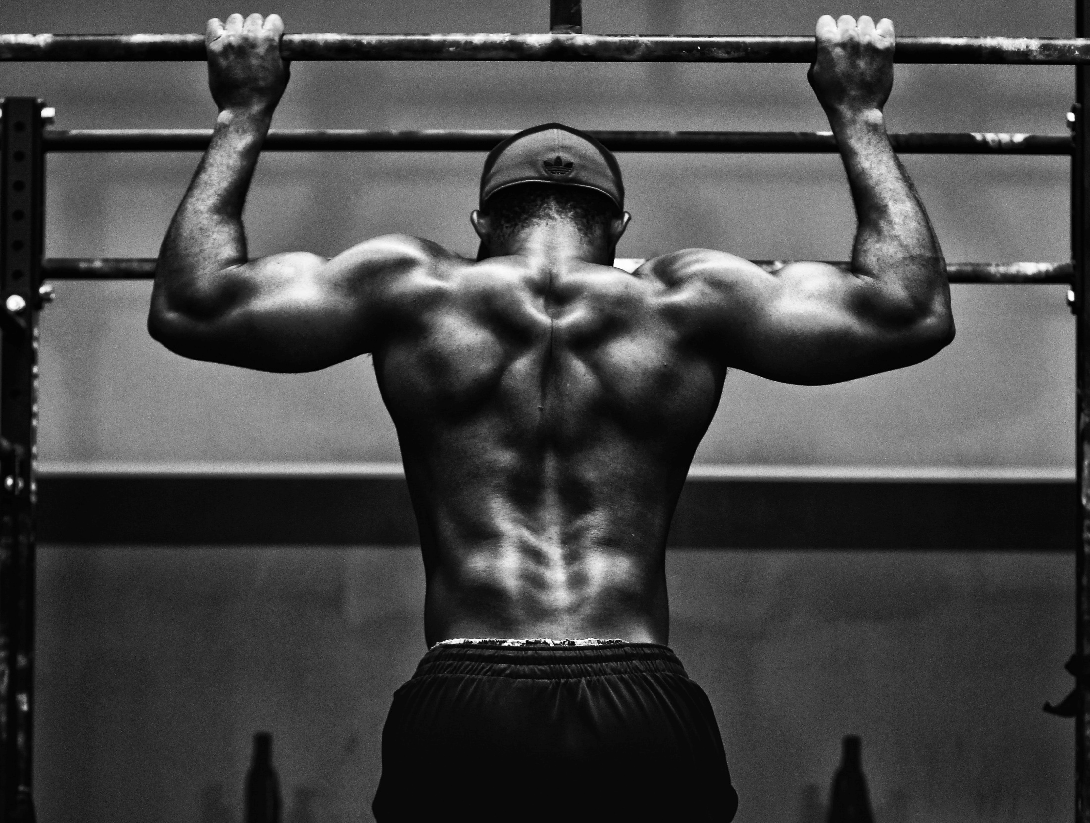
The Muscular System
Location, Structure and Function
Paper 1
Applied Anatomy and Physiology
1.1.b
Photocopiable/digital resources may only be copied by the purchasing institution on a single site and for their own use.

Slide 2

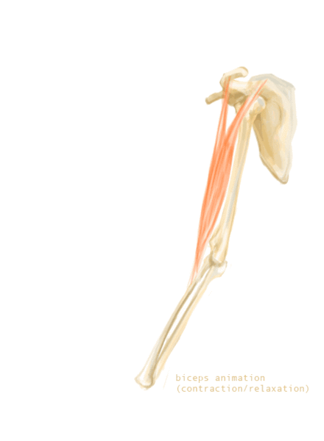

The muscular system
INSPECTION COPY
Learn
The muscular system works alongside the skeletal system to allow movement.
Tendons connect muscle to bone, and when the muscle contracts, the tendon pulls on the bone to cause movement.
In the example given, the tendons connect the biceps muscle at the scapula. This helps fix the muscle to a joint to act as an anchor.
The biceps then also connects to the radius bone in the forearm. When the muscle contracts concentrically, it pulls the bone upwards in a movement called flexion.
COPYRIGHT
PROTECTED
2
© ZigZag Education, 2023
Notes:
Recap the role of the skeletal system in allowing movement.
Re-cover the role of tendons.

Slide 3

Before we learn about the muscles, we should recap the movements at a joint.
Match the movements to their definitions.
Click on the movements to reveal the answers.
Activity
Shoulder, elbow, hip and knee joints
Flexion
Straightening movement to increase the angle at the joint
Shoulder, elbow, hip and knee joints
Extension
Movement of a limb away from the midline of the body
Shoulder and hip joints
Movement around an axis
Abduction
Shoulder and hip joints
Adduction
Bending movement to decrease the angle at the joint
Shoulder and hip joints
Rotation
Conical/circular motion around a joint to combine movements in more than one plane
Shoulder and hip joints
Circumduction
Movement of a limb towards the midline of the body
Write the joint locations where each movement can take place.
© ZigZag Education, 2023
Notes:
Students to match up the movements to their definitions.

Slide 4
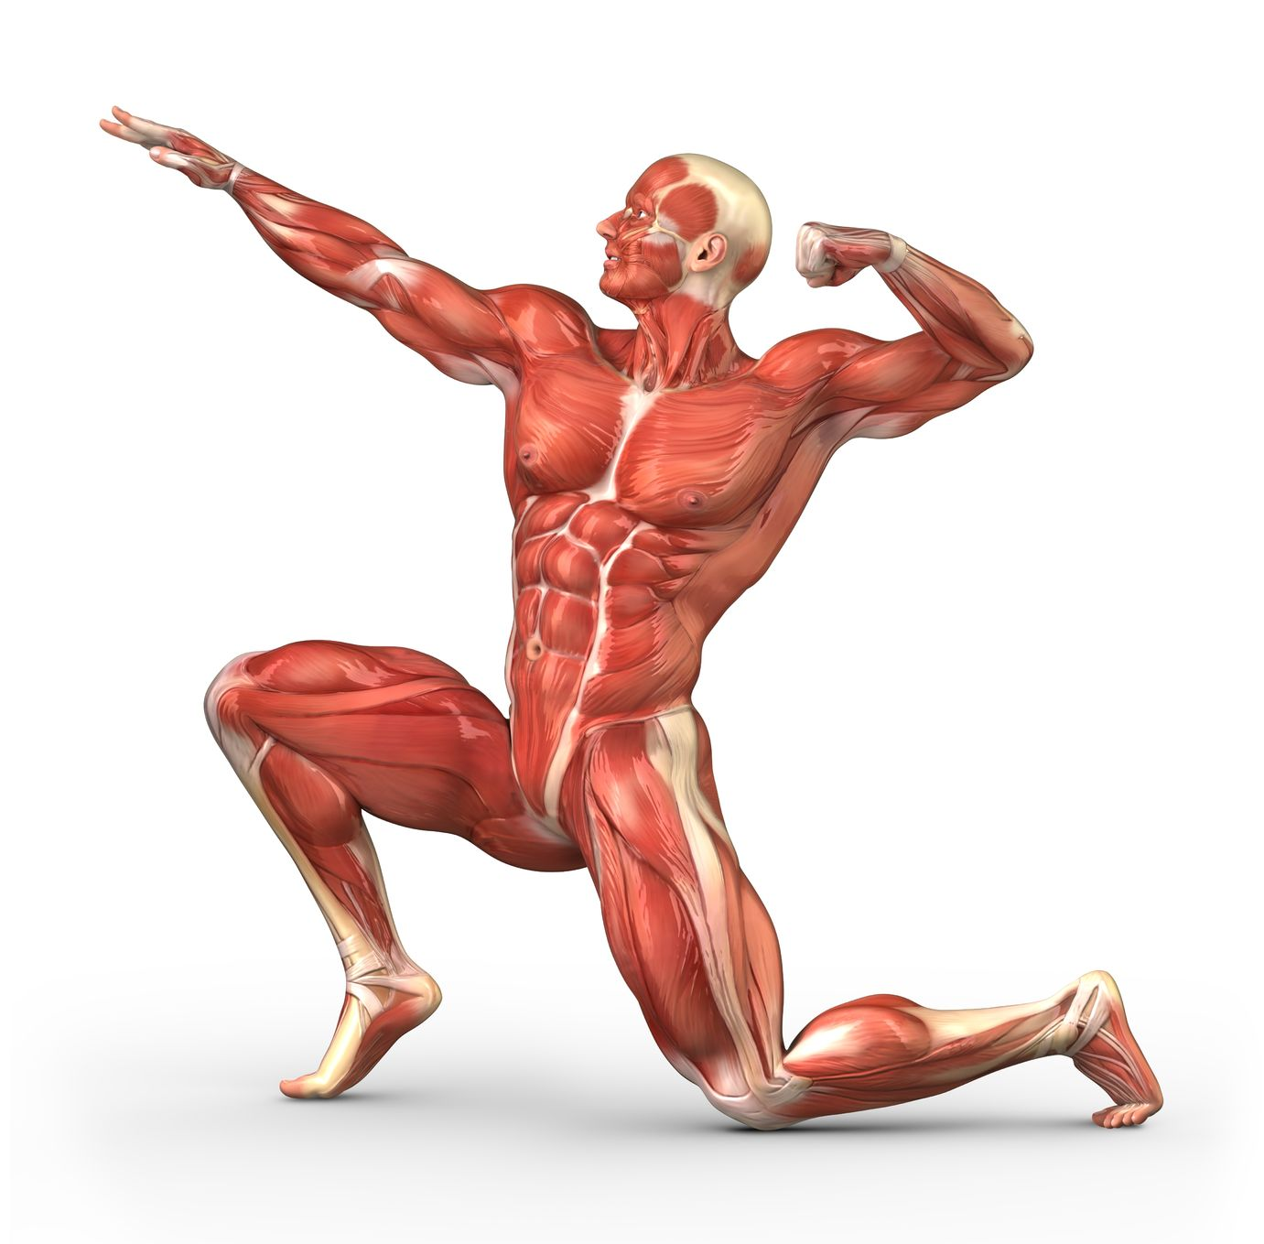
The muscular system
Learn
There are approximately 600 muscles in the body. You will need to be aware of the location of the following muscles for your exams:
Latissimus dorsi
Deltoid
Trapezius
Pectorals
Biceps
Triceps
Abdominals
Gluteals
Hamstring group
Quadriceps group
Gastrocnemius
Lets take a look at these muscles in action at the different locations where they
are found and the movements they help to perform.
Let’s start with an easy one! Can you identify this muscle?
The abdominals allow flexion at the trunk and also help keep the body stable. They also help protect vital organs.
4
© ZigZag Education, 2023
Notes:
Introduce the major muscles of the body. See how many students can identify before revealing the list.

Slide 5
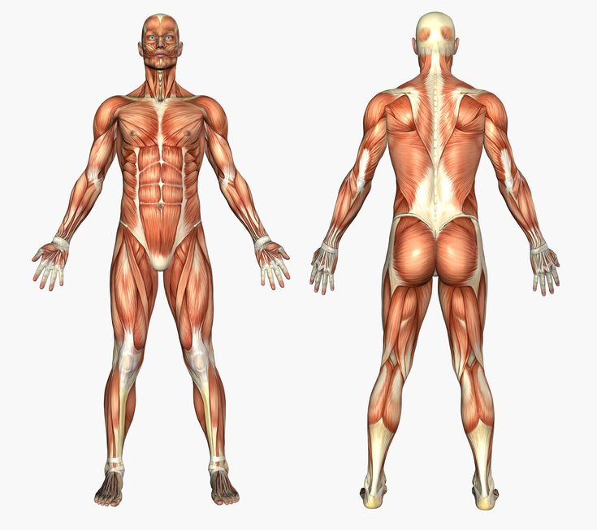
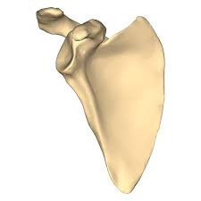
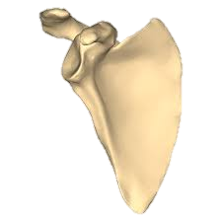
The shoulder joint
INSPECTION COPY
Learn
The shoulder joint allows the largest range of movement and requires four main muscles to enable these movements to occur.
Click on the boxes to reveal the muscles, and click again to reveal examples of their movements.
Trapezius
– Extension (at the neck)
– Elevation and retraction of the scapula* (shown below)
Deltoid
– Flexion
– Abduction
Pectorals
Elevation, e.g. a shrug
Retraction, e.g. a row
– Flexion
– Adduction
COPYRIGHT
PROTECTED
Latissimus dorsi
– Extension
– Adduction
* The trapezius doesn’t act at the shoulder joint, but instead causes elevation and retraction of the scapula at the shoulder girdle. As such, these movements are not a requirement of the specification, but it is still important to understand the role of the trapezius in sporting movements.
5
© ZigZag Education, 2023
Notes:
Students to identify the muscles. Click on each box to reveal the muscle, and then click again to reveal its movements. (Note: students do not need to know the movements elevation and retraction.)
Students to identify some sporting examples for each of the given movements.

Slide 6
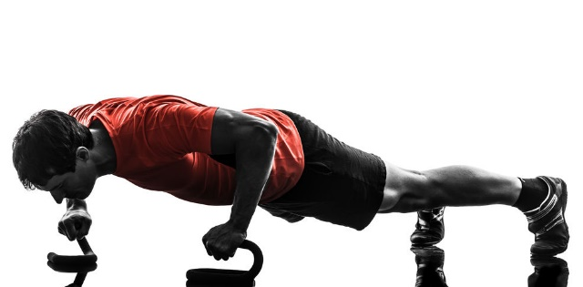
The shoulder joint
Click on the examples to reveal the movements, then click on the movements to reveal the muscles.
Learn
Let’s take a look at some examples of movements at the shoulder joint.
Mime or try the movements to feel the muscles working.
Muscles in action:
Latissimus dorsi
Movement: Extension
Example: Pulling back on an oar when rowing.
Muscles in action:
Pectorals and (anterior/front) deltoids
Movement: Flexion
Example: Upwards phase of a press-up.
Muscles in action:
Deltoid
Movement: Abduction
Example: Lifting the arm away from the midline of the body when swinging a golf club.
Muscles in action:
Latissimus dorsi
Movement: Adduction
Example: Pulling the arm towards the midline of the body when performing a pull-up.
6
© ZigZag Education, 2023
Notes:
Introduce some examples of movements caused by the muscles in the shoulder.
Students to mime these actions and feel the muscle contracting to allow the movement to occur.
Students to provide other examples of movements.

Slide 7
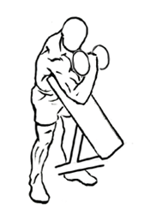
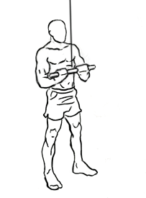
The elbow joint
INSPECTION COPY
Learn
The elbow is a hinge joint. It is limited in its movement and relies on only two muscles to be able to move.
Click on the boxes to reveal the muscles, and click
again to reveal examples of their movements.
Biceps
Triceps
- Flexion
- Extension
COPYRIGHT
PROTECTED
Biceps contracts to cause flexion to lift the weight during a biceps curl
Triceps contracts to cause extension and pull the weight down during a triceps extension
7
© ZigZag Education, 2023
Notes:
Students to identify the muscles. Click on each box to reveal the muscle, then click again to reveal its movements.
Students to identify other examples of these movements in sport.

Slide 8
The hip joint
Learn
The hip joint, like the shoulder, is a ball-and-socket joint and has a wide range of movements that are initiated with the help of certain muscle groups.
Click on the boxes to reveal the muscles, and click again to reveal examples of their movements.
Hip flexors*
Gluteals
– Flexion
– Extension
– Abduction
– Adduction
– Rotation
* You do not need to know the hip flexor muscle groups for your exam, but it is useful to be aware that the hip flexors cause flexion at the hip.
© ZigZag Education, 2023
Notes:
Students to identify the muscles. Click on each box to reveal the muscle, then click again to reveal its movements.
Students to identify some sporting examples for each of the given movements.

Slide 9
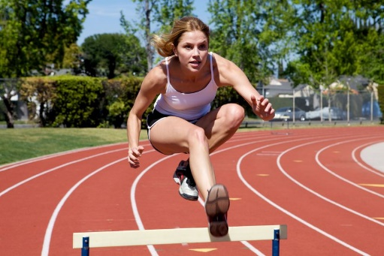
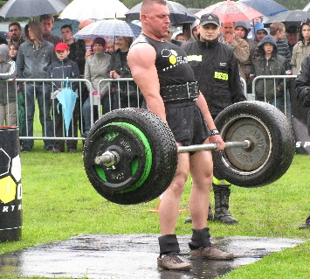
The hip joint
Click on the examples to reveal the movements, then click on the movements to reveal the muscles.
Learn
Let’s take a look at some examples of movements at the hip joint.
Mime or try the movements to feel the muscles working.
Example: Lifting the leg in front of you to jump over a hurdle.
Muscles in action:
Hip flexors*
Movement: Flexion
Example: Straightening at the hip when performing a deadlift or upwards phase of a squat.
Muscles in action:
Gluteals
Movement: Extension
The hip joint also performs the following movements:
Abduction – caused by gluteus medius* and gluteus minimus* (part of the gluteals)
Adduction – caused by hip adductors*
Rotation – caused mostly by the gluteals
Circumduction – caused by a combination of all muscles in the hip
* You do not need to know these muscles!
9
© ZigZag Education, 2023
Notes:
Introduce some examples of movements caused by the muscles in the hip.
Students to mime these actions and feel the muscle contracting to allow the movement to occur.
Students to provide other examples of movements.

Slide 10
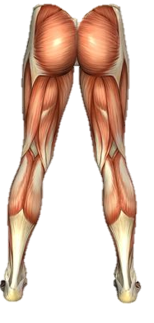
The knee joint
Learn
The knee is another hinge joint that allows only two movements.
Click on the boxes to reveal the muscles, and click
again to reveal examples of their movement.
Quadriceps
Hamstrings
– Extension
– Flexion
Gastrocnemius
The gastrocnemius is found in the posterior of the lower leg.
It doesn’t cause movement at the knee, but it does cause plantar flexion at the ankle joint.*
* You are not required to know about this movement.
© ZigZag Education, 2023
Notes:
Students to identify the muscles of the knee. Click on each box to reveal the muscle.
Students to identify a sporting example for each of the given movements.
Students be made aware of the location of the Gastrocnemius muscle that causes movement at the ankle.

Slide 11
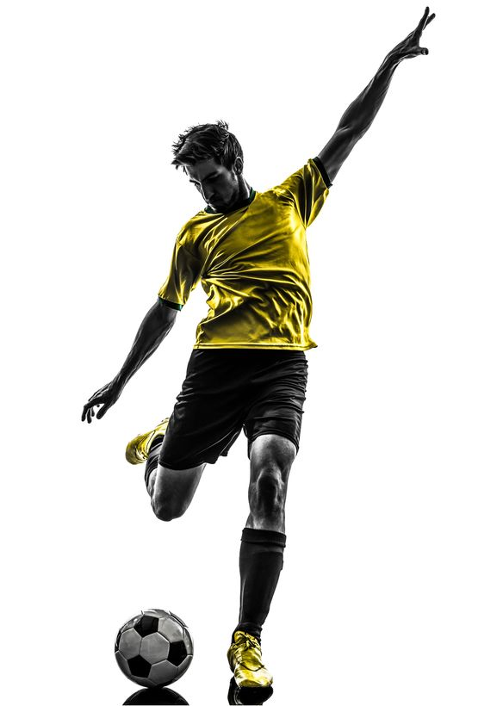
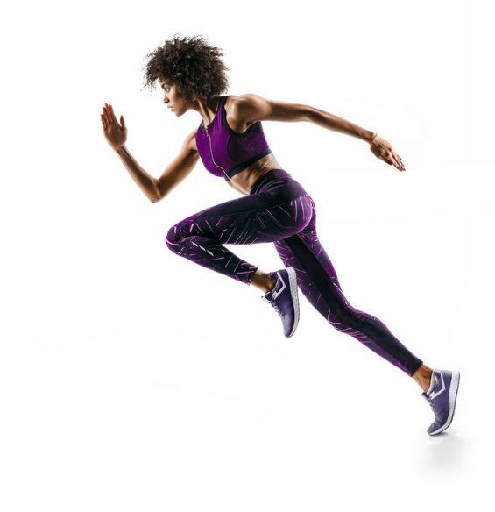
The knee joint
Learn
Let’s take a look at some examples of movements at the knee joint.
Mime or try the movements to feel the muscles working.
Click on the red circles to reveal movements, then click on the movements (boxes) to reveal muscles.
Muscles in action:
Quadriceps
Movement: Extension
Muscles in action:
Hamstrings
Movement: Flexion
Muscles in action:
Quadriceps
Movement: Extension
11
© ZigZag Education, 2023
Notes:
Introduce some examples of movements caused by the muscles in the knee.
Students to mime these actions and feel the muscle contracting to allow the movement to occur.
Students to provide other examples of movements.

Slide 12
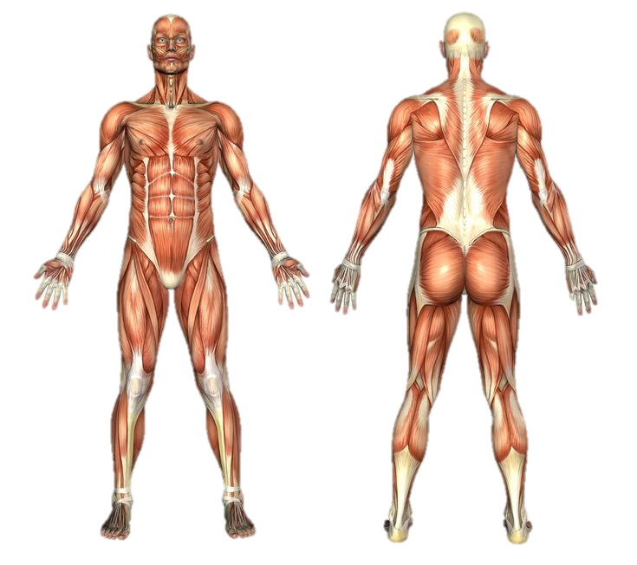
Let’s recap.
Label the diagram to identify each of the muscles.
Click on the labels to reveal the names.
Activity
Deltoid
Pectorals
Trapezius
Biceps
Triceps
Abdominals
Latissimus dorsi
Gluteals
Quadriceps
Hamstrings
Gastrocnemius
© ZigZag Education, 2023
Notes:
Students to identify each of the major muscles.
Click each label to reveal answer.

Slide 13
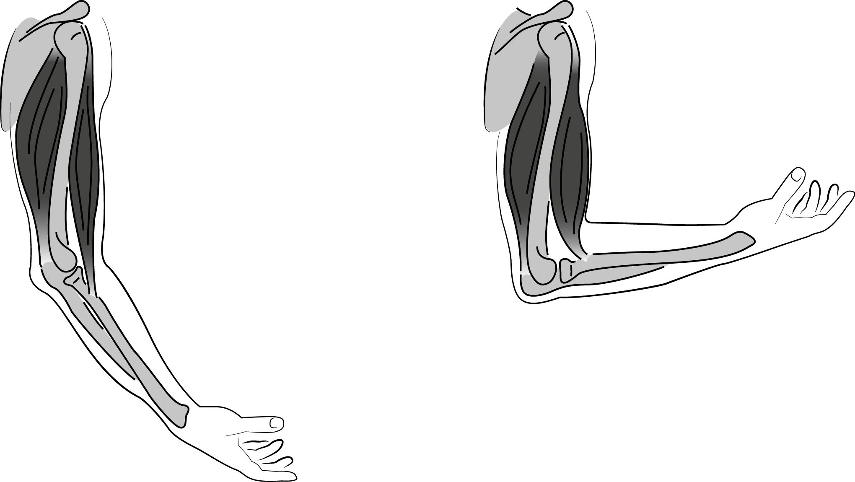
INSPECTION COPY
Roles of muscles
Learn
To cause movement, muscles need to either contract or relax!
Muscles have to work in pairs – called antagonistic pairs – to allow movement to occur.
During flexion of the elbow, the biceps contracts and shortens.
This is known as the agonist muscle.
To maintain stability of the movement, the deltoids in the shoulder works as a fixator muscle.
However, the agonist and antagonist muscles change when extending the arm, e.g. to pull a weight down during a triceps extension.
Antagonist muscle: Biceps
Agonist muscle: Triceps
To recap:
The agonist causes the movement by contracting
The antagonist allows the movement to occur by relaxing
The fixator stabilises joint movements
While the triceps relaxes and lengthens.
This is known as the antagonist muscle.
COPYRIGHT
PROTECTED
© ZigZag Education, 2023
Notes:
Click through the slide to explain the roles of agonists, antagonists and fixators that work in antagonistic muscle pairs.
Students to identify other examples of antagonistic muscle pairs and the agonists, antagonists and fixators involved.

Slide 14
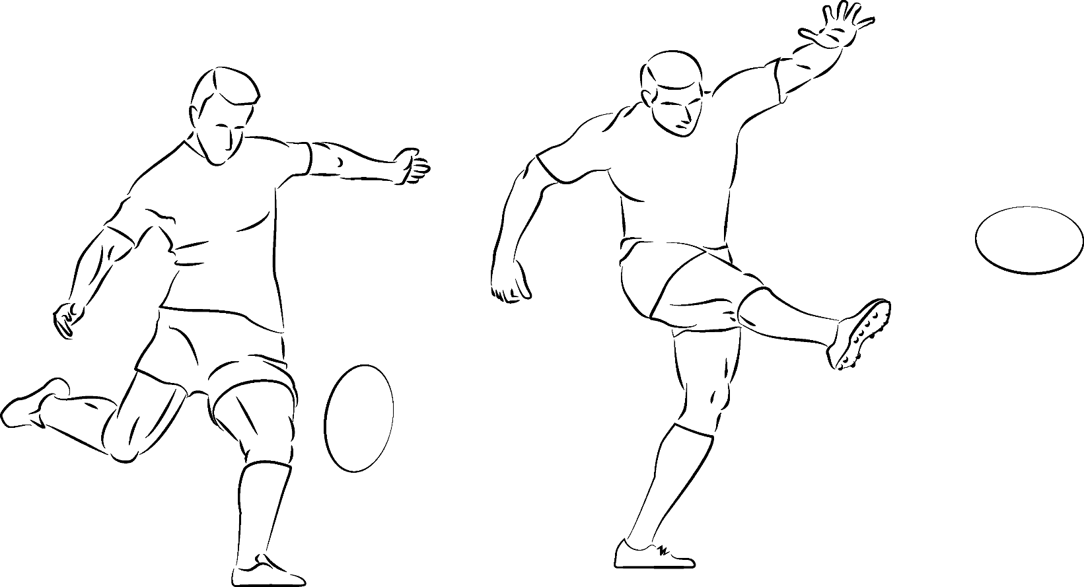
Roles of muscles
Learn
Here we see the quadriceps and the hamstrings working together as an antagonistic muscle pair at the knee to enable the performer to kick the ball.
The hamstrings contract during flexion of the knee, so is the agonist during the preparation phase.
The quadriceps relax
to allow the movement,
so act as the antagonist.
As the performer performs extension at the knee the roles are reversed and the quadriceps contract (agonist) and the hamstrings relax (antagonist).
The abdominals act as the fixator throughout both actions by stabilising movement at the hip.
© ZigZag Education, 2023
Notes:
Discuss the antagonistic pairs involved in causing movement at the knee.
Students to identify antagonistic pairs working at the ankle.

Slide 15
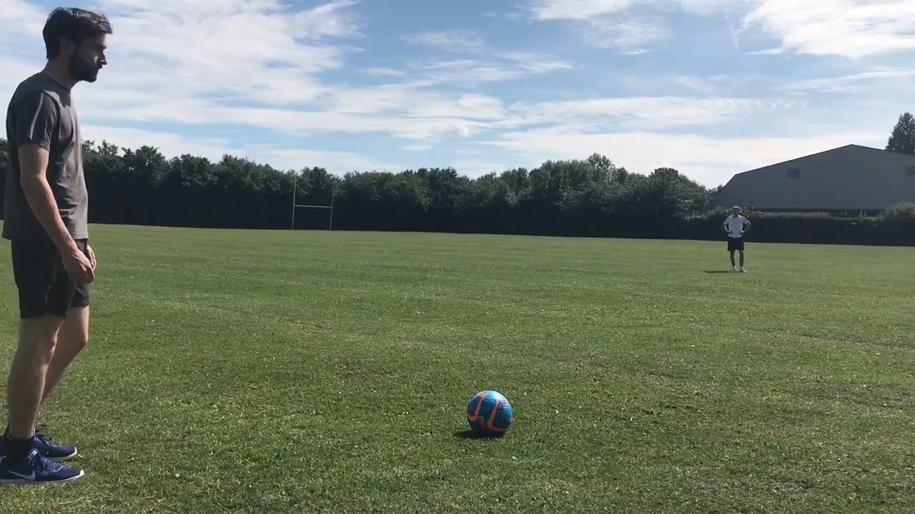
INSPECTION COPY
Identify the movements and the antagonist muscle pairs involved at the following joints in the right kicking leg when executing a long pass in football.
Activity
Hover over the video and click to play on loop.
COPYRIGHT
PROTECTED
Hip
Knee
Flexion
Extension
Movement:
Movement:
Agonist | Antagonist
Agonist | Antagonist
Hip flexors
Gluteals
Quadriceps
Hamstrings
Click on each table to reveal the answers.
© ZigZag Education, 2023
Notes:
Students to identify the agonist and antagonist at the hip and knee by analysing the sporting action in the video.
Each table can then be clicked to reveal the answers – agonist and antagonist are revealed together.

Slide 16
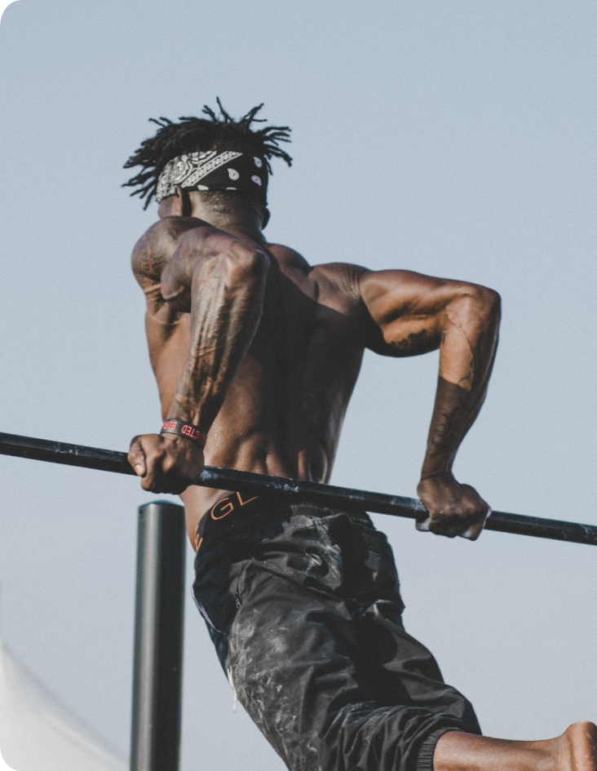
Discuss
Identify the muscles that work together in the lower body to allow an athlete to run.
What are the long-term training effects on the muscular system?
Muscles can contract hundreds of times when performing; what short-term impact may this have on performance?
© ZigZag Education, 2023
Notes:
Take this opportunity to reflect on what has been learnt and how it impacts sport in a wider context.
Students can discuss these questions with their peers or respond individually by writing down their answers.

Slide 17
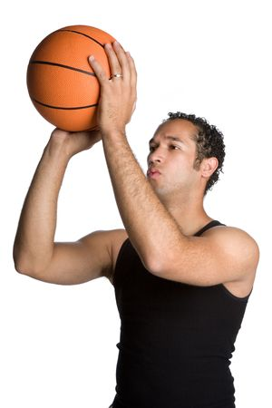
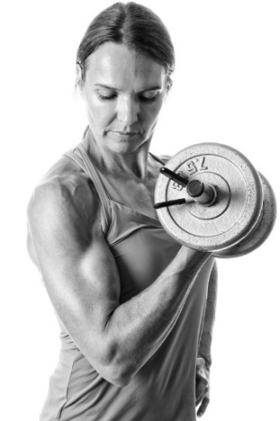
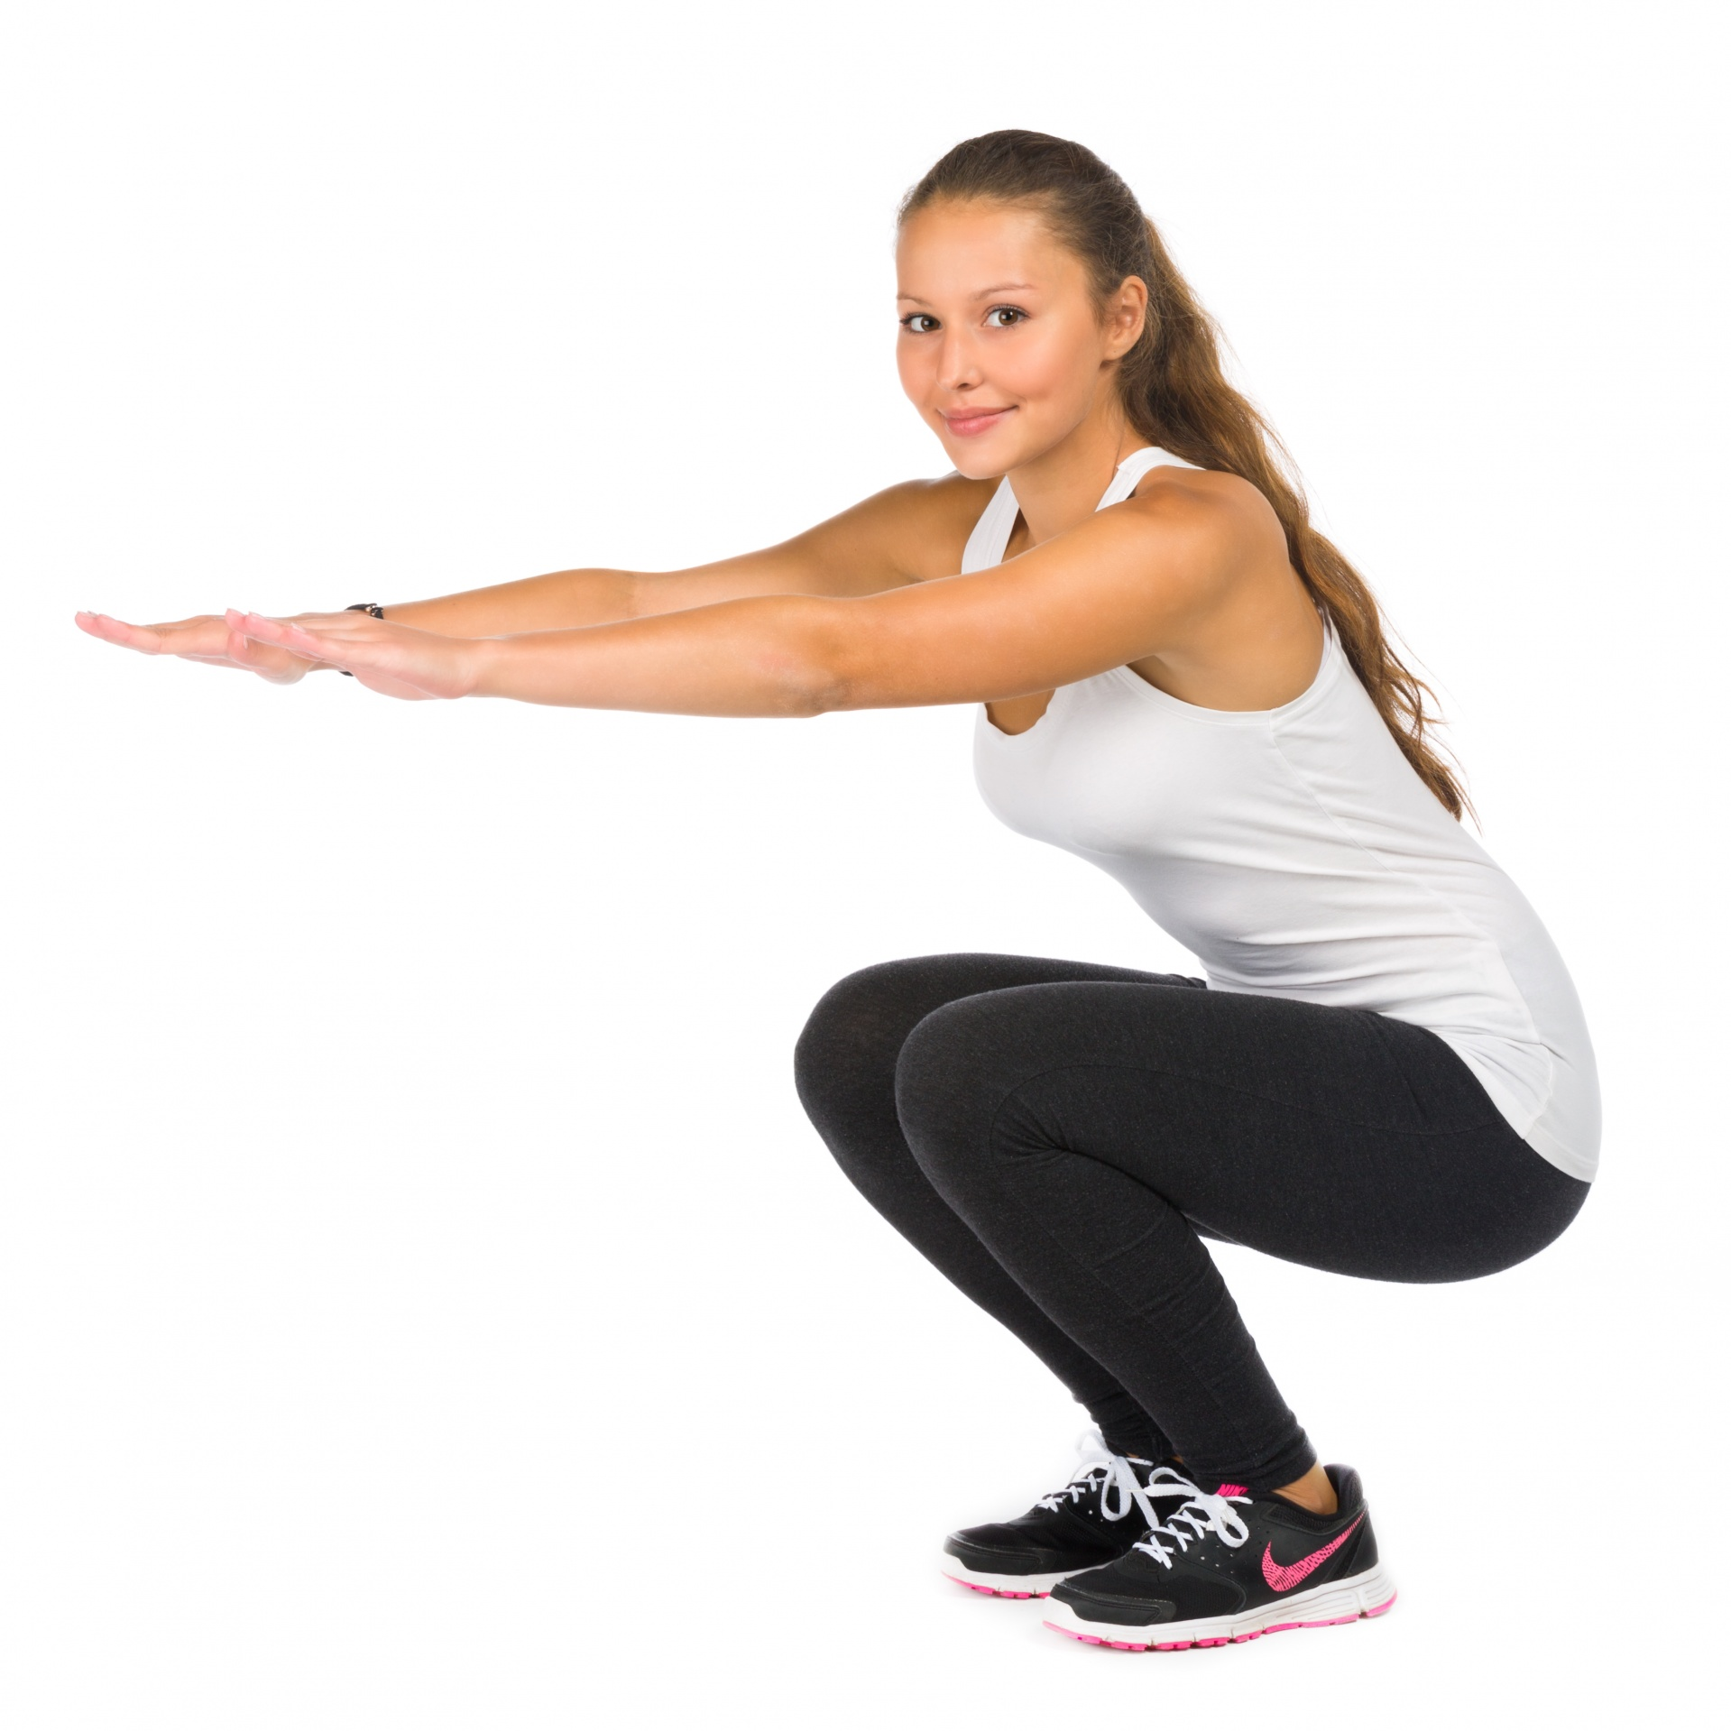
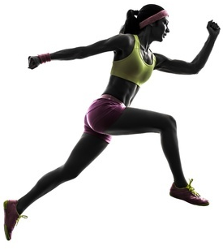
INSPECTION COPY
Identify the following in each of the sporting movements below:
Agonist muscle
The movement at the joint
Click on the images to reveal the answers.
Activity
Swinging the shoulder forward when running
The elbow when shooting
The elbow when lowering a weight
The hip in the upward phase of a squat
COPYRIGHT
PROTECTED
Agonist muscle
Joint movement
Deltoid
Triceps
Biceps
Gluteals
Flexion
Extension
Extension
Extension
© ZigZag Education, 2023
Notes:
Students to identify the agonist and joint movement in each image.
Click on each image to reveal the answer.
Discuss why the biceps muscle is the agonist during extension when lowering a weight.

Slide 18
INSPECTION COPY
Exam-style questions
Answer the following exam-style questions and check your answers.
Which one of the following muscles contracts to cause movement at the hip?
a) Trapezius
b) Abdominals
c) Gluteals
d) Gastrocnemius
(1 mark)
Click to reveal answer!
1 × AO1 mark:
Gluteals
Define the term ‘agonist’ and give an example of a movement in sport or physical activity where the quadriceps group acts as the agonist.
(2 marks)
COPYRIGHT
PROTECTED
☞ Click to reveal answer!
1 × AO1 mark for definition:
The prime mover at a joint / the muscle or muscle group that contracts to cause movement
1 × AO2 mark for any example of knee extension:
e.g. quadriceps when extending at the knee to kick a football
© ZigZag Education, 2023
Notes:
Students to answer each exam-style question under exam conditions (approx. 1 minute per mark).
Click to reveal answers. Students to peer-mark or self-mark answers.

Slide 19
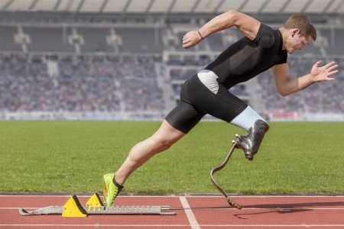
Exam-style questions
Answer the following exam-style question and check your answers.
Complete the table to identify the agonist, antagonist and type of movement at the knee joint as the performer pushes off their left leg from the starting blocks.
(3 marks)
Agonist
Antagonist
Type of movement
☞ Click to reveal answer!
3 × AO3 marks:
Agonist | Quadriceps (1)
Antagonist | Hamstrings (1)
Type of movement | Extension (1)
© ZigZag Education, 2023
Notes:
Students to answer the exam-style question under exam conditions (approx. 1 minute per mark).
Click to reveal answers. Students to peer-mark or self-mark answers.

