Slide 1

Paper 1
Physical Training
1.2.b
The Principles of Training
and Their Application to Personal Exercise and Training Programmes
Photocopiable/digital resources may only be copied by the purchasing institution on a single site and for their own use.

Slide 2



INSPECTION COPY
Introduction
Learn
It is essential that training programmes and sessions are well thought out, so that they have purpose and allow for progression.
This can be applied through the principles of training, remembered by the acronyms ‘SPOR’ and ‘FITT’:
Specificity
Progression
Overload
Reversibility
Frequency, Intensity, Time, Type
COPYRIGHT
PROTECTED
Let’s take a look at what each of these principles means and how they can be applied in sport to bring about improvements in fitness.
© ZigZag Education, 2023
Notes:
Introduction to the acronyms for the principles of training that can be applied in sport.
Learn the two acronyms for identifying the different principles of training involved in planning effective sessions/programmes.
Move to the next slides to find out more about each principle in greater detail.

Slide 3

INSPECTION COPY
Specificity
Learn
Training which is relevant to the sport or activity, the role within that sport or activity, and components of fitness required to perform successfully.
It is important to be specific as to what training and improvements need to be made, in order to ensure:
focus
purpose
a well-planned programme
weaknesses are identified
weaknesses are addressed
The right skills are involved
Improved reaction time out of the blocks is a specific skill that only occurs at the beginning of 100 m, 200 m and 400 m races.
COPYRIGHT
PROTECTED
Application: If a 100 m sprinter wanted to specifically work on their reaction time, it would be advantageous to work on their start time out of the blocks, rather than trying to increase running speed, as that is quite general.
© ZigZag Education, 2023
Notes:
Define ‘specificity’.
Discuss the importance of applying the principle of specificity.
Read the example application given – can students think of more?

Slide 4

Progression
Learn
This refers to ensuring that training progresses gradually over time so that improvements can be made without the risk of fatigue or injury.
Training that progresses too quickly will increase the risk of injury as the body is not physically prepared.
Application: A swimmer who is looking to progress their training from one session per week should do so gradually. Therefore, instead of jumping straight up to the goal of three sessions per week, they should become familiar with performing two sessions per week until their body is physically ready to handle the demands that come with training three times per week.
Training should be improved gradually over time instead of spiking increases from one week to the next.
© ZigZag Education, 2023
Notes:
Define ‘progressive overload’.
Discuss the importance of applying the principle of progressive overload.
Read the example application given – can students think of more?

Slide 5

INSPECTION COPY
Overload
Learn
This refers to the increase in the frequency, intensity, time or type of training over time. Doing so ensures that:
the demand of the environment increases
improvements in fitness are continually made
skill improves rather than plateauing
Application: If an athlete were preparing for a marathon (26.2 miles) and they wanted to improve their previous time, they should add more miles each week (increasing intensity and duration) so that 26 miles can be run efficiently, e.g. they should work at being able to run up to 30 miles before the next marathon so that 26 miles is achievable.
Training can be improved by increasing the frequency of sessions, the intensity of sessions or the time and type of sessions.
COPYRIGHT
PROTECTED
© ZigZag Education, 2023
Notes:
Define ‘progressive overload’.
Discuss the importance of applying the principle of progressive overload.
Read the example application given – can students think of more?

Slide 6
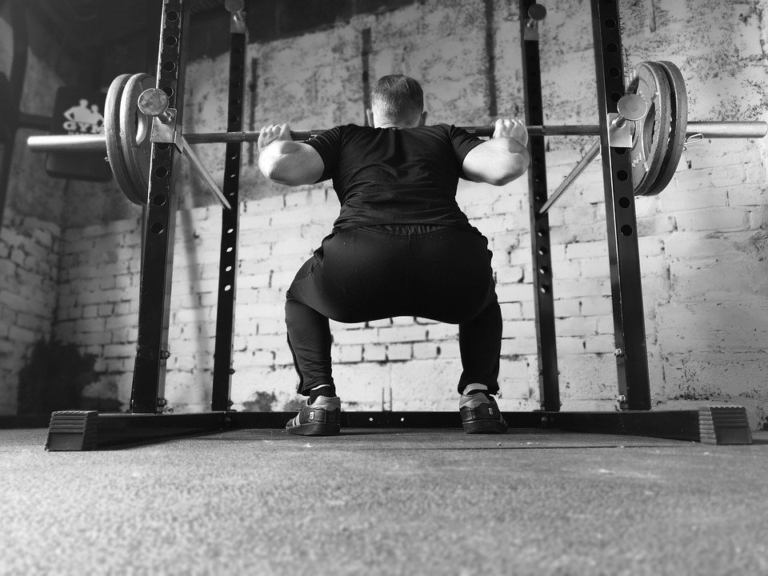
INSPECTION COPY
Reversibility
Learn
The decline in fitness levels as a result of prolonged absence from training.
While it is important that adequate rest and recovery is planned to prevent injury and to allow full recovery, it is important that reversibility does not occur, otherwise:
improvements made will be lost
the demand of the environment decreases
components of fitness decrease in response
skills deteriorate
While it is important to have holidays and rest time, it is also important to limit the number of days off, as this is when reversibility takes place (as there is no longer a demand).
Application: A weightlifter has been squatting 60 kg; she goes on holiday for two weeks on an all-inclusive holiday and does no exercise. When she comes back, she misses a few training sessions in the first week. She finds that she can comfortably squat only 55 kg, despite her good progress before.
COPYRIGHT
PROTECTED
© ZigZag Education, 2023
Notes:
Define ‘reversibility’.
Discuss the importance of ensuring that reversibility does not occur.
Read the practical example given – can students think of more?

Slide 7

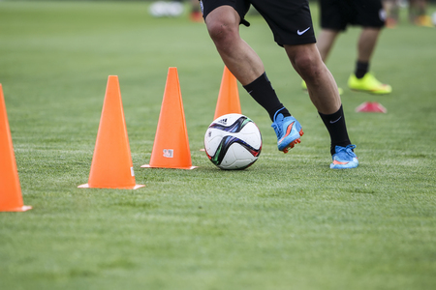
INSPECTION COPY
FITT principles
Learn
The principles of FITT can be applied to training in order to apply the principle of progressive overload. If applied successfully, they are very effective in improving performance!
F | Frequency – refers to the number of times an individual undergoes the training regime. This is normally measured in days per week.
I | Intensity – refers to how hard the performer is working, which in turn can determine whether they are exercising aerobically or anaerobically. Intensity can be measured in a range of different ways, from % of maximum heart rate to rating of perceived exertion (RPE).
T | Type – refers to what exercise is being completed. The more varied and relevant to the sport, the more effective the training programme.
T | Time – refers to the duration of the training programme or session.
COPYRIGHT
PROTECTED
Check out how to apply the FITT principles of overload to different training methods:
Application: A netball player may apply the FITT principles of training by either performing an additional session per week (frequency), increasing work rate to a greater % of max heart rate (intensity), performing interval training alongside skills training (type), or extending the duration of each session (time).
© ZigZag Education, 2023
Notes:
Understand that FITT principles are applied as part of the progressive overload of training.
Identify the different principles of FITT.
Describe what is meant by each principle.
Discuss how these principles can be applied to different sporting examples.
Click on the ‘info’ button to read through a web page on the application of different FITT principles.

Slide 8

INSPECTION COPY
Discuss
How will the specificity of training be applied differently to a games player compared to a swimmer?
Identify the potential effects that reversibility would have on a weight training programme.
Create a short example training programme and apply the principles of progression and overload in one week through to the next.
COPYRIGHT
PROTECTED
© ZigZag Education, 2023
Notes:
Take this opportunity to reflect on what has been learnt about the principles of training and their impacts on sport in a wider context.
Students can discuss these questions with their peers or respond individually by writing down their answers.

Slide 9

Match up each of the FITT principles to its application(s) in sport and physical activity.
Click on each example to see which principle(s) it links to.
Activity
Increasing the heart rate training zone from 60% of max HR to 75%, during continuous training
Frequency
Changing between continuous training and interval training when preparing to compete in a triathlon
Intensity
Increasing the number of sessions from three a week to four a week
Increasing a weight training session from 40 minutes to 60 minutes
Type
Increasing the number of repetitions completed in order to increase muscular endurance
Time
Using dumb-bells, resistance machines and body weight exercises in your session
© ZigZag Education, 2023
Notes:
Ask students to match up answers on paper or work in pairs / as a whole class.
Click on each principle from top to bottom to reveal the correct match-up.

Slide 10
INSPECTION COPY
Exam-style questions
Answer the following exam-style question and check your answers.
1. i) Define the term ‘intensity’ as a FITT principle.
(1 mark)
1 × AO1 mark for:
How hard training is performed.
☞ Click to reveal answer!
1. ii) Using a practical example from sport, explain how intensity can be used to apply overload to training.
(2 marks)
1 × AO1 mark for description of progressive overload using the FITT principles:
Overload is the increase in either frequency, intensity, time or type of training which allows the body to continuously progress/adapt.
1 × AO2 mark for any suitable sporting example of application using intensity:
e.g. increasing the % of maximum heart rate in an aerobic training session from 60% to 65%
☞ Click to reveal answer!
COPYRIGHT
PROTECTED
© ZigZag Education, 2023
Notes:
Students to answer the exam-style question under exam conditions (approx. 1 minute per mark).
Click to reveal answers. Students to peer-mark or self-mark answers.

