Slide 1
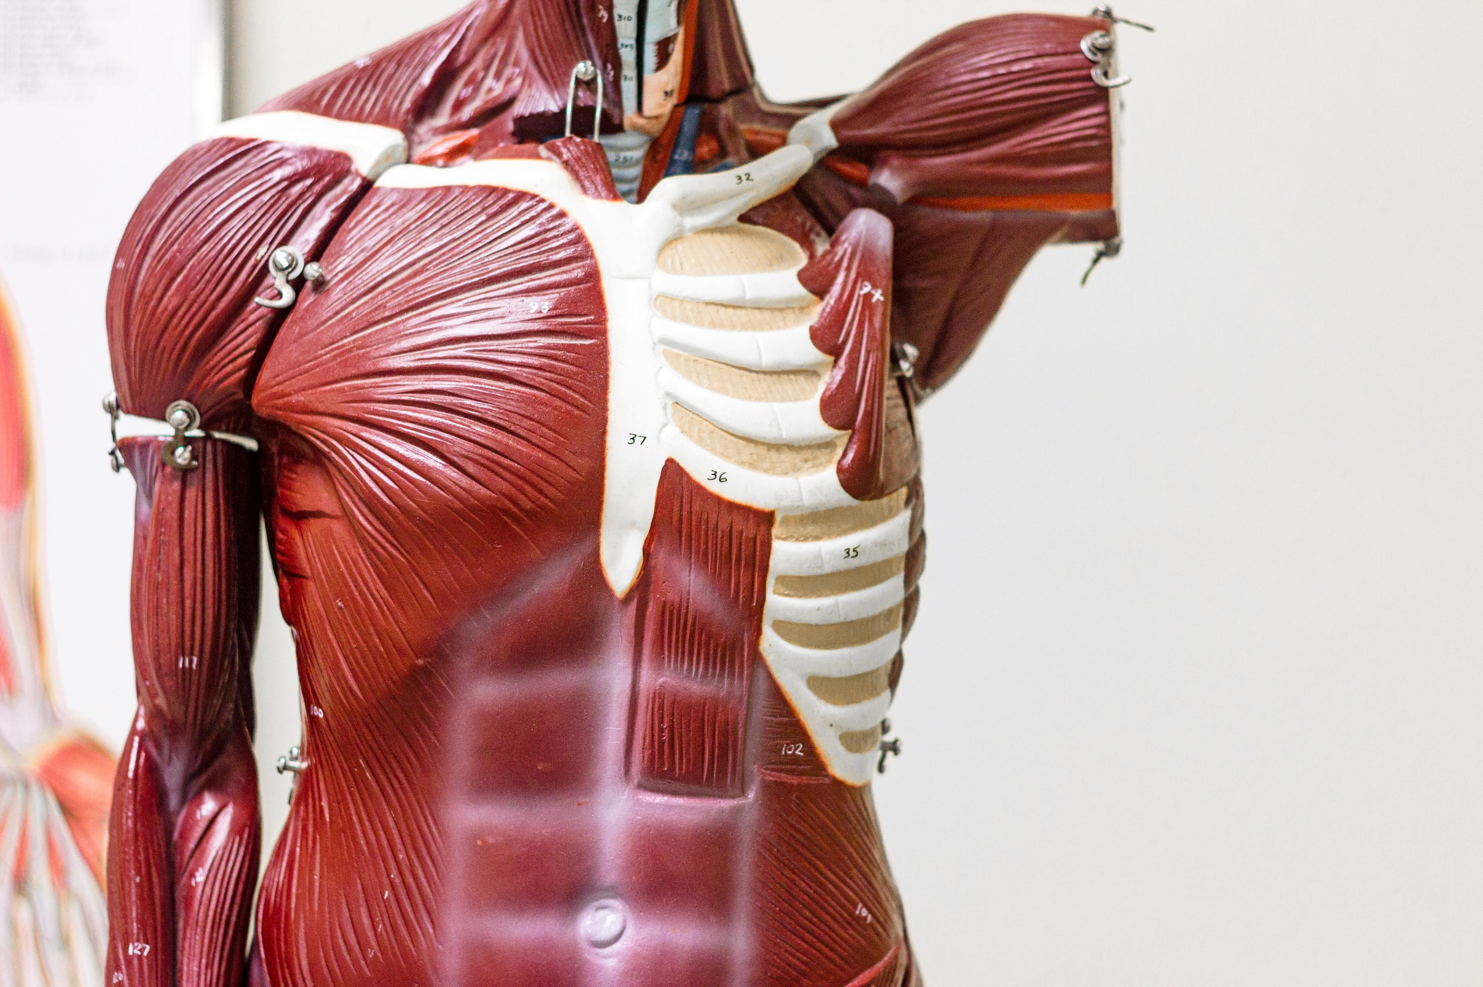
B: The effects of exercise and sports performance on…
The
Muscular
System
B1 Characteristics and functions of different types of muscle
B2 Major skeletal muscles
© ZigZag Education, 2022

Slide 2

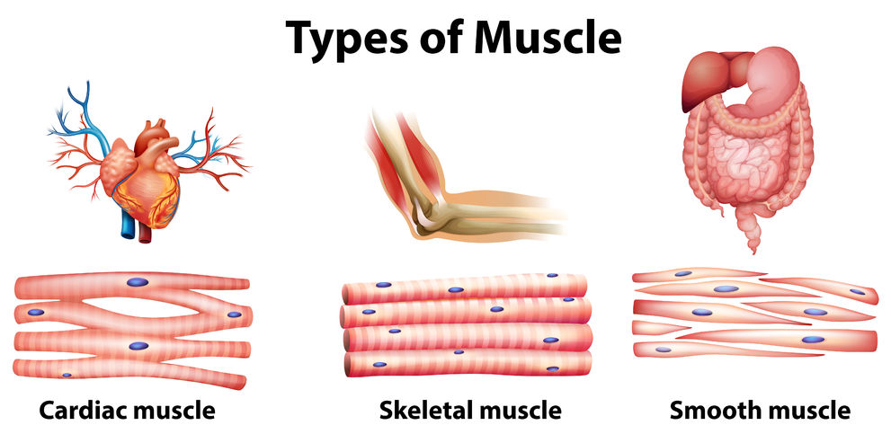
Learn
Types of Muscle
Types of Muscle
Click on the boxes to reveal the different types of muscle, then click on the images to reveal the characteristics of each.
When we think of muscles, our first thought immediately goes to those that cause movement. However, there are three different types of muscle you should know…
In the heart
All over the body, attached to the skeleton.
Lines the walls of blood vessels and organs such as the liver.
Contracts involuntarily and is non-fatiguing.
Contractions are voluntary and the muscle can be fatiguing.
Functions involuntarily and contracts slowly.
© ZigZag Education, 2022
Notes:
Students to identify the different types of muscles in the body from the examples of their locations
Click on the grey boxes to reveal each type
Students to identify the characteristics of each type of muscle
Click on the images of each muscle type to reveal their characteristics

Slide 3

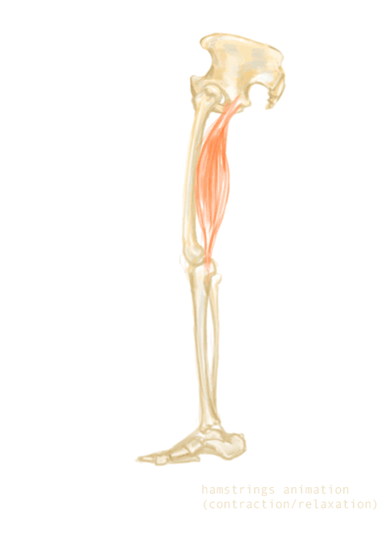
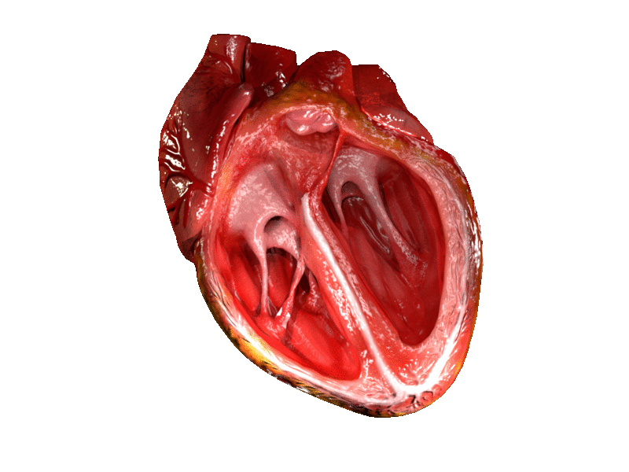

Learn
Types of Muscle
INSPECTION COPY
Types of Muscle
Involuntary means we do not have conscious control,
while voluntary muscle action involves us having conscious control.
We cannot consciously make our heart (cardiac muscle) beat faster!
But we can consciously move our limbs (e.g. legs) by telling our skeletal muscle (e.g. hamstrings) to contract.
COPYRIGHT
PROTECTED
Also, the heart beats continuously on average 60–100 beats per minute, but never tires (it’s non-fatiguing).
If you tried contracting your hamstring 60–100 times in a minute there is a good chance you will tire / become fatigued.
Watch out for cramp!
© ZigZag Education, 2022
Notes:
Students to recap the terms involuntary/voluntary and fatiguing/non-fatiguing

Slide 4

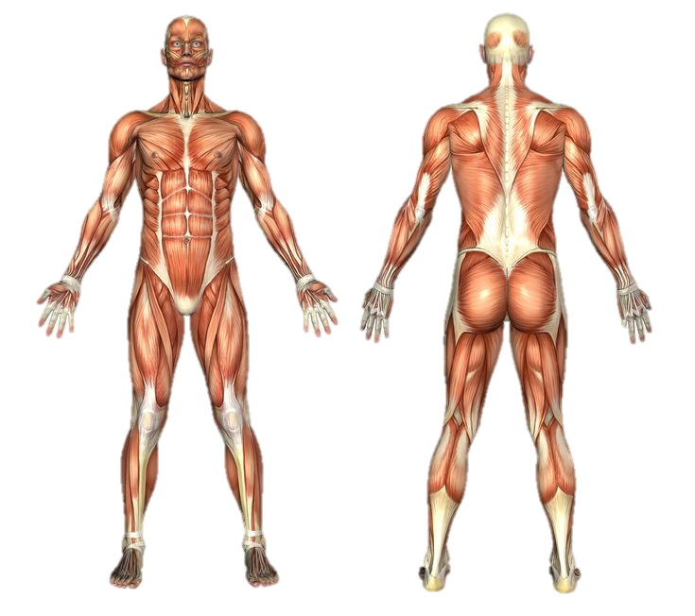
Learn
Major Skeletal Muscles
Major Skeletal Muscles
Click on the labels to reveal the name.
You will need to know the location of the major skeletal muscles in the body for your exams…
Pectorals
Deltoids
Biceps
Wrist extensors
Trapezius
Triceps
Obliques
Latissimus dorsi
Abdominals
Erector spinae
Gluteals
Hip flexors
Wrist flexors
Hamstrings
Quadriceps
Gastrocnemius
Soleus
Tibialis anterior
You will also need to know the supinators and pronators in the wrist; click here to find out more!
© ZigZag Education, 2019
© ZigZag Education, 2022
Notes:
Students to see whether they can name any of the major skeletal muscles labelled on the diagram before revealing the list
Introduce each muscle by clicking on the boxes

Slide 5
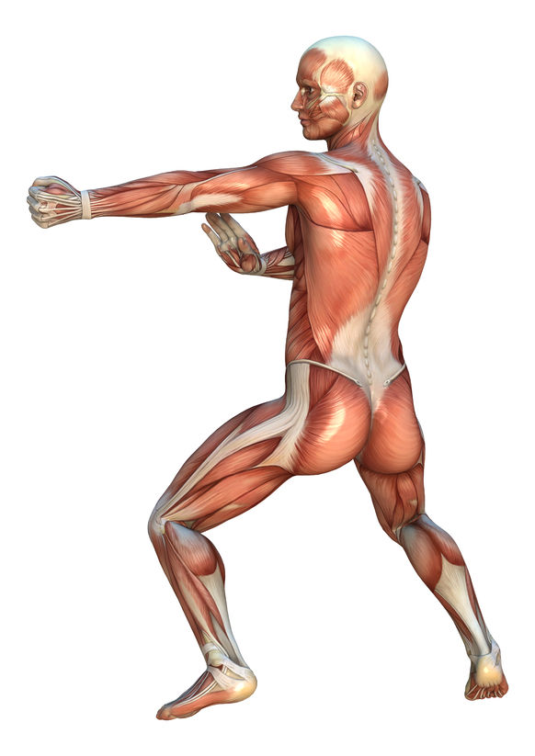
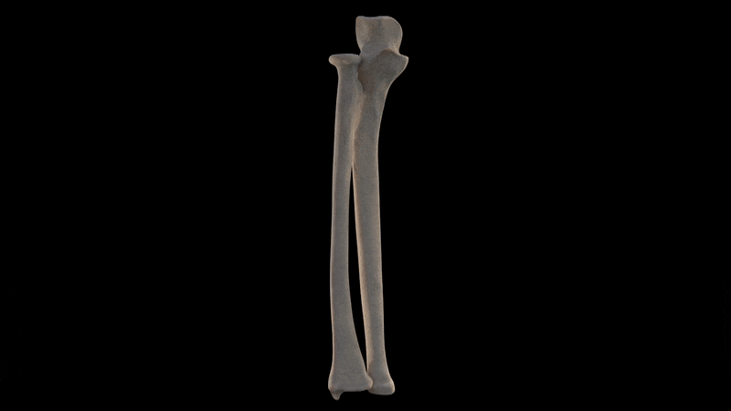
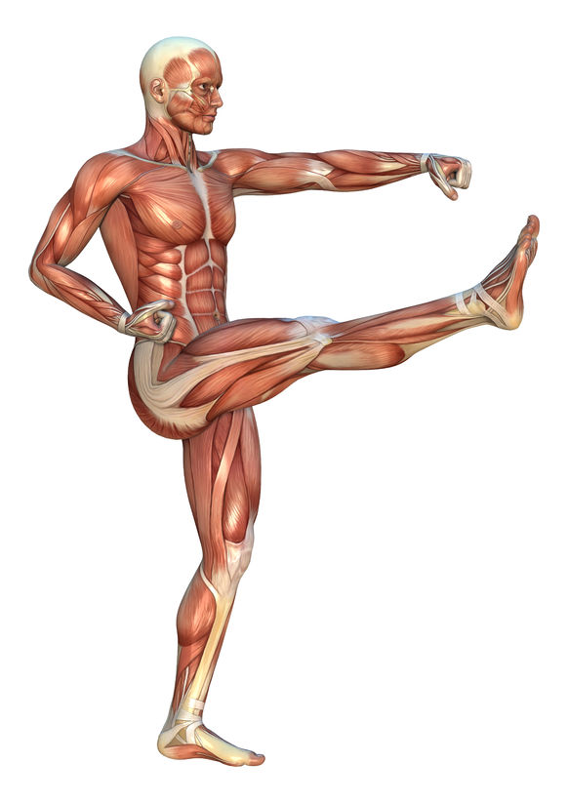
Learn
Major Skeletal Muscles
INSPECTION COPY
Major Skeletal Muscles in the Forearm
You will need to know the major superficial muscles in the forearm that operate the movements at the wrist joints.
Pronators (pronator teres*)
allow inward rotation (pronation)
Supinators
allow outward rotation (supination)
Supination and pronation in action
Wrist extensors
cause extension at the wrist (movement of the hand backwards to posterior side of forearm).
Wrist flexors
cause flexion at the wrist (movement of the hand forwards to the anterior side of forearm).
COPYRIGHT
PROTECTED
Click here to test your knowledge on muscles
* Muscle not required by specification
© ZigZag Education, 2019
© ZigZag Education, 2022
Notes:
Students to identify the superficial muscles of the forearm that operate the movements at the wrist. You may need to describe locations.
Pronator teres is on the anterior aspect of the forearm
Supinator is on the posterior part of the forearm

Slide 6
Major Skeletal Muscles
Now it’s time to test yourself! Label the following muscles and click on each to reveal the name.
Click on the labels to reveal the names.
Activity
Pectorals
Deltoids
Wrist extensors
Trapezius
Biceps
Triceps
Obliques
Latissimus dorsi
Abdominals
Erector spinae
Gluteals
Hip flexors
Wrist flexors
Hamstrings
Quadriceps
Gastrocnemius
Soleus
Tibialis anterior
© ZigZag Education, 2019
© ZigZag Education, 2022
Notes:
Students to identify each muscle then check their answers by clicking on the empty boxes

Slide 7
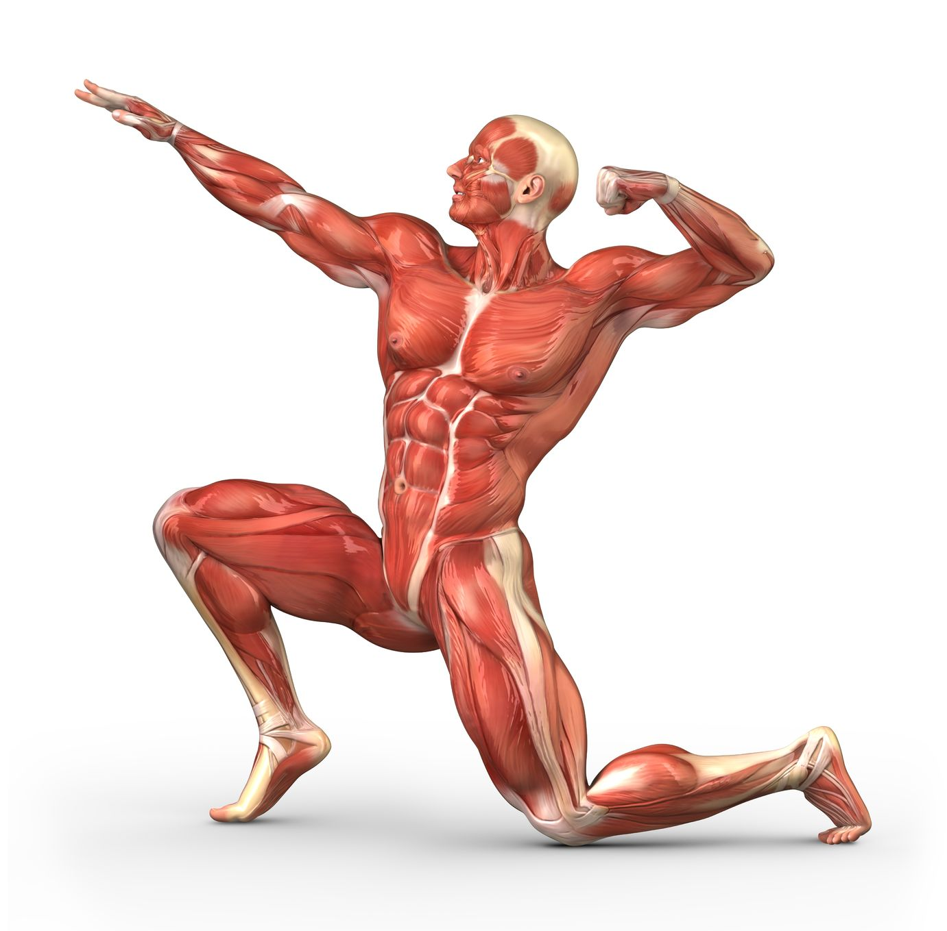
Learn
Major Skeletal Muscles
INSPECTION COPY
Major Skeletal Muscles
You will need to be aware of the movements that the different skeletal muscles in the body help perform, as well as the sporting actions for each.
Let’s start with an easy one! Can you identify this muscle?
The abdominals allow flexion at the trunk and also help keep the body stable. They also help protect vital organs.
COPYRIGHT
PROTECTED
Let’s take a look at the major joints in the body and the muscles that cause movement at each.
© ZigZag Education, 2019
© ZigZag Education, 2022
Notes:
Introduce the role of muscles in causing the different joint movements covered in the PowerPoint presentation on joints
Click through the slide to reveal the example
Students to see whether they can identify any other examples before taking a look at each joint in detail

Slide 8
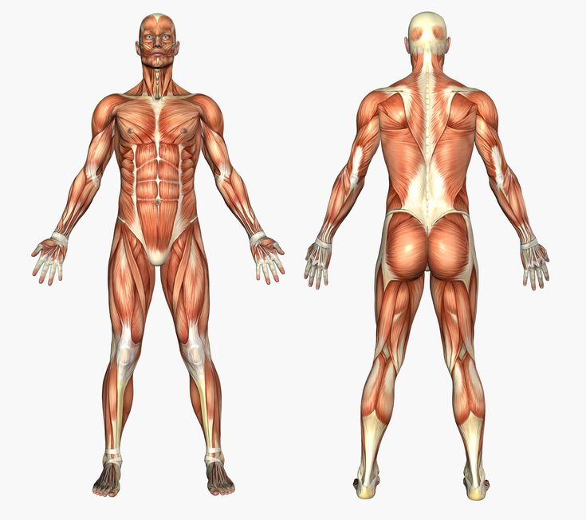
Learn
Major Skeletal Muscles
The Shoulder Joint
Click on the boxes to reveal the muscles, then click again to reveal the joint movements they can cause.
The shoulder joint allows the largest range of movement and requires four main muscles to enable these movements to occur.
Deltoids
– Flexion
– Abduction
– Hyperextension
Latissimus dorsi
– Extension
– Adduction
– Hyperextension
– Horizontal abduction
– Horizontal adduction
Pectorals
– Flexion
– Adduction
– Horizontal abduction
– Horizontal adduction
© ZigZag Education, 2022
Notes:
Students to identify the muscles labelled
Click on each box to reveal the muscle
Click on the box again to reveal the movements it can cause when it contracts
Students can mime these actions and feel the muscle contracting
Students to identify a sporting example for each of the given movements

Slide 9
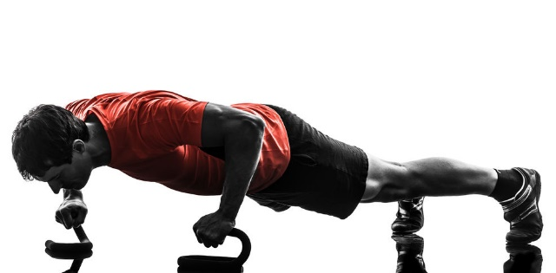
Learn
Major Skeletal Muscles
INSPECTION COPY
Shoulder Joint
Click on the examples to reveal the joint movements and then click the movements to reveal the muscles causing the movement.
Let’s take a look at some examples of movements at the shoulder joint.
Mime or try the movements to feel the muscles working.
Muscles in action:
Latissimus dorsi
Movement: Extension
Example: pulling back on an oar when rowing
Muscles in action:
Pectorals and (anterior / front) deltoids
Movement: Flexion
Example: upwards phase of a press-up
Muscles in action:
Deltoids
Movement: Abduction
Example: lifting the arm away from the midline of the body when swinging a golf club
COPYRIGHT
PROTECTED
Muscles in action:
Latissimus dorsi
Movement: Adduction
Example: pulling the arm towards the midline of the body when performing a pull-up
All muscles in the shoulder support with rotation and circumduction movements.
© ZigZag Education, 2019
© ZigZag Education, 2022
Notes:
Introduce some examples of movements caused by the muscles at the shoulder
Students to mime these actions and identify the joint movement occurring
Click on each example to reveal the joint movements
Students to then identify what muscle(s) might be contracting to cause the movement
Click the movements to reveal the muscles causing the movement

Slide 10
Major Skeletal Muscles
Now let’s test your knowledge on the different sporting examples. Work out what movement is occurring at the shoulder in each example and identify the muscle that causes it.
Activity
Muscles in action:
Latissimus dorsi
Movement: Extension
Example: pulling through underwater in the front crawl
Muscles in action:
Deltoids
Movement: Abduction
Example: performing a lateral raise by lifting a weight to the side of the body
Muscles in action:
Pectorals and (anterior / front) deltoids
Example: raising the left arm in front of the body to play a drive shot in cricket
Movement: Flexion
2. Click on the movements to reveal the muscles in action.
1. Click on the examples to reveal the joint movements.
© ZigZag Education, 2019
© ZigZag Education, 2022
Notes:
Students to guess the joint movements for each example and muscles causing each movement
Click on each example to reveal the joint movements
Click the movements to reveal the muscles causing the movement

Slide 11
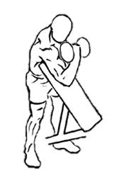
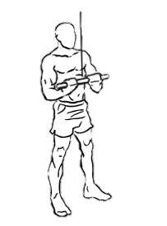
Learn
Major Skeletal Muscles
Elbow Joint
Click on the boxes to reveal the muscles, then click again to reveal the joint movements they can cause.
The elbow is a hinge joint. It is limited in its movement and relies on only two muscles to be able to move.
Biceps
Triceps
- Flexion
- Extension
Biceps contracts to cause flexion to lift the weight during a biceps curl
Triceps contracts to cause extension and pull the weight down during a triceps extension
© ZigZag Education, 2022
Notes:
Students to identify the muscles labelled
Click on each box to reveal the muscle
Click on the box again to reveal the movements it can cause when it contracts
Students can mime these actions and feel the muscle contracting
Students to identify a sporting example for each of the given movements
Click through the slide to reveal a sporting example for each

Slide 12
Learn
Major Skeletal Muscles
INSPECTION COPY
Hip Joint
Click on the boxes to reveal the muscles, then click again to reveal the joint movements they can cause.
The hip joint, like the shoulder, is a ball-and-socket joint and has a wide range of movements that are initiated with the help of certain muscles.
Hip flexors
Gluteals
– Flexion
– Extension
(also support abduction, adduction and rotation alongside other muscles at the hip)
COPYRIGHT
PROTECTED
© ZigZag Education, 2022
Notes:
Students to identify the muscles labelled
Click on each box to reveal the muscle
Click on the box again to reveal the movements it can cause when it contracts
Students can mime these actions and feel the muscle contracting
Students to identify a sporting example for each of the given movements

Slide 13
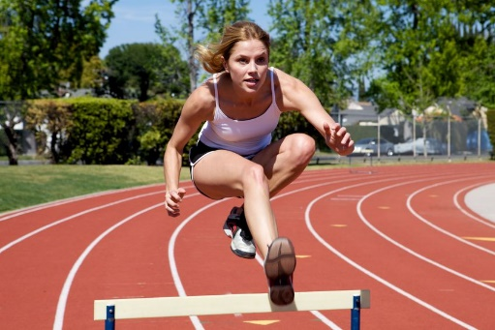
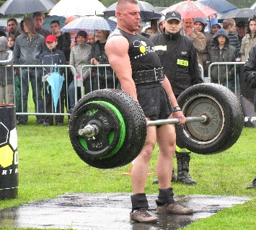
Learn
Major Skeletal Muscles
INSPECTION COPY
Hip Joint
Click on the examples to reveal the joint movements and then click the movements to reveal the muscles causing the movement.
Let’s take a look at some examples of movements at the hip joint.
Mime or try the movements to feel the muscles working.
Example: lifting the leg in front of you to jump over a hurdle
Muscles in action:
Hip flexors
Movement: Flexion
Example: straightening at the hip when performing a deadlift or upwards phase of a squat
Muscles in action:
Gluteals
Movement: Extension
COPYRIGHT
PROTECTED
The hip joint also performs the following movements:
Abduction – caused by gluteus medius* and gluteus minimus* (part of the gluteals)
Adduction – caused by hip adductors*
Rotation – caused mostly by the gluteals
Circumduction – caused by a combination of all muscles in the hip
* You do not need to know these muscles!
© ZigZag Education, 2022
Notes:
Introduce some examples of movements caused by the muscles at the hip
Students to mime these actions and identify the joint movement occurring
Click on each example to reveal the joint movements
Students to then identify what muscle(s) might be contracting to cause the movement
Click the movements to reveal the muscle(s) causing the movement.

Slide 14
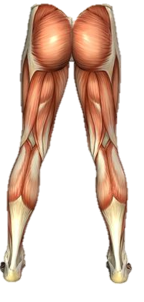
Learn
Major Skeletal Muscles
Knee and Ankle Joints
Click on the boxes to reveal the muscles, then click again to reveal the joint movements they can cause.
The knee and ankle are, again, both hinge joints and allow only two movements.
Quadriceps
Hamstrings
– Extension at the knee
– Flexion at the knee
Tibialis anterior
Gastrocnemius
– Dorsiflexion
– Plantar flexion
Soleus
– Plantar flexion
© ZigZag Education, 2022
Notes:
Students to identify the muscles labelled
Click on each box to reveal the muscle
Click on the box again to reveal the movements it can cause when it contracts
Students can mime these actions and feel the muscle contracting
Students to identify a sporting example for each of the given movements

Slide 15
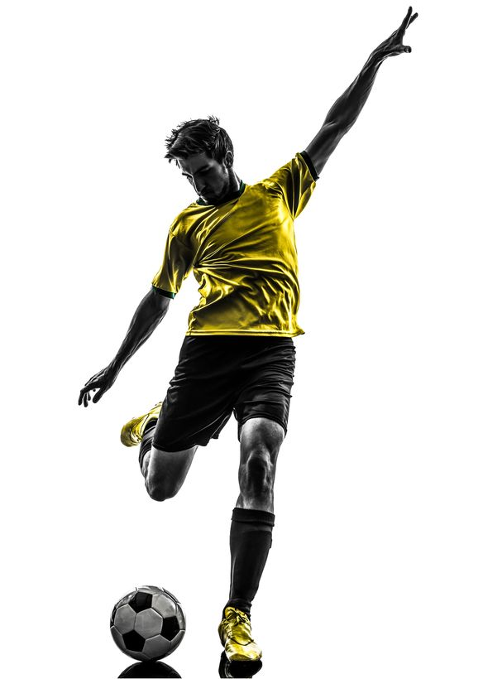
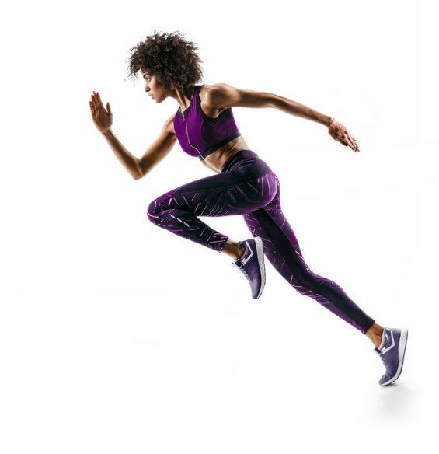
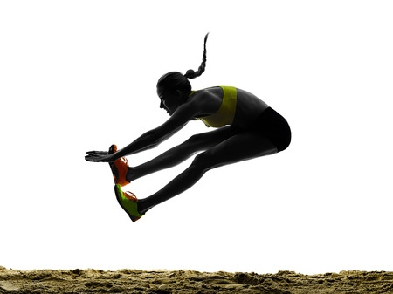
Learn
Major Skeletal Muscles
Knee and Ankle Joints
Click on the red circles to reveal movements and then click on the movement (boxes) to reveal the muscles.
Let’s take a look at some examples of movements at the knee and ankle joints.
Mime or try the movements to feel the muscles working.
Muscles in action:
Quadriceps
Movement: Extension
Muscles in action:
Hamstrings
Movement: Flexion
Muscles in action:
Gastrocnemius and soleus
Movement: Plantar flexion
Muscles in action:
Tibialis anterior
Movement: Dorsiflexion
© ZigZag Education, 2022
Notes:
Introduce some examples of movements caused by the muscles at the knee and ankle
Students to mime these actions and identify the joint movement occurring
Click on each example to reveal the joint movements
Students to then identify what muscle(s) might be contracting to cause the movement
Click the movements to reveal the muscle(s) causing the movement

Slide 16
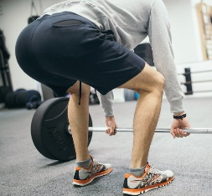
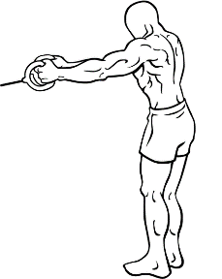
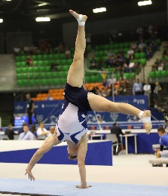
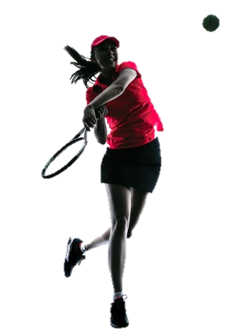
Learn
Major Skeletal Muscles
Additional Movements
Click on the examples to reveal the joint movements and then click the movements to reveal the muscles causing the movement.
There are many additional muscles in action in different areas of the body.
Muscle:
Erector spinae
Movement: extension of the lumbar vertebrae (when straightening the back)
Example: keeping the back straight when performing a deadlift
Muscle:
Trapezius
Joint movement: elevation and retraction of the scapula*
Example: pulling cables away from the midline of the body
* You don’t need to know these movements for your exam
Muscle:
Obliques
Movement: lateral (sideways) flexion of the trunk
Example: a gymnast performing a cartwheel
Muscle:
Supinators
Movement: of the forearm from palm facing downwards to palm facing upwards
Example: applying backspin to a tennis ball
Muscle:
Pronators
Movement: of the forearm from palm facing upwards to palm facing downwards
Example: applying topspin to a tennis ball
© ZigZag Education, 2022
Notes:
Go through the additional examples of movements
Students to mime these actions and identify the joint movement occurring
Click on each example to reveal the joint movements
Students to then identify what muscle(s) might be contracting to cause the movement
Click the movements to reveal the muscle(s) causing the movement

Slide 17
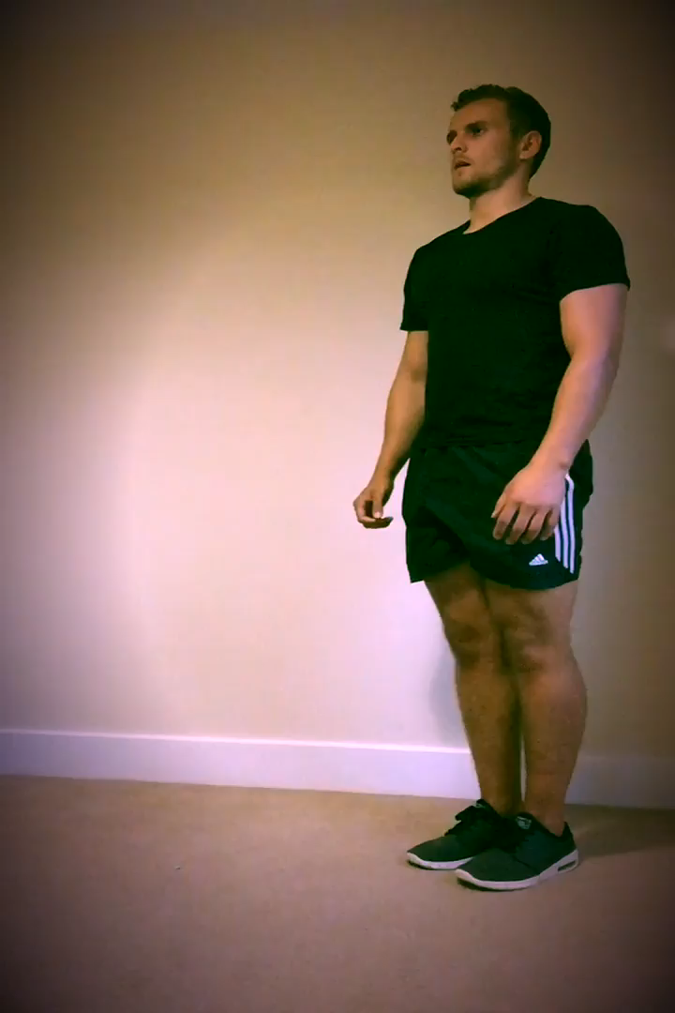
Major Skeletal Muscles
INSPECTION COPY
Identify the movements, and the main (agonist) muscle that causes each movement, at the right hip, knee and ankle and the plane of movement when performing a lunge.
1. Hover over the video and click to play on loop.
Activity
2. Click anywhere to reveal answers.
Forwards phase…
Backwards phase…
Movement:
Flexion of the right hip
Flexion of the right knee
Dorsiflexion of the right ankle
Movement:
Extension of the right hip
Extension of the right knee
Plantar flexion of the right ankle
Agonist muscles:
Hip: Hip flexors
Knee: Quadriceps
Ankle: Tibialis anterior
Agonist muscles:
Hip: Gluteals
Knee: Hamstrings
Ankle: Gastrocnemius and soleus
COPYRIGHT
PROTECTED
© ZigZag Education, 2022
Notes:
Click on the video to play
Students to identify the muscles than cause the different joint movements in both phases of the lunge
Click through the slide to reveal the answers

Slide 18
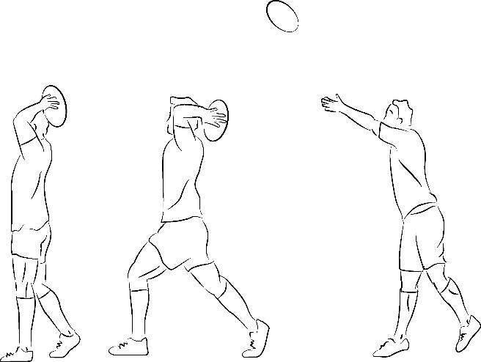
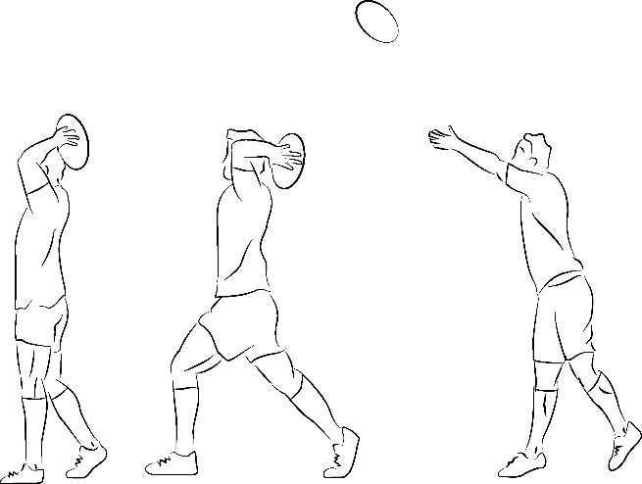
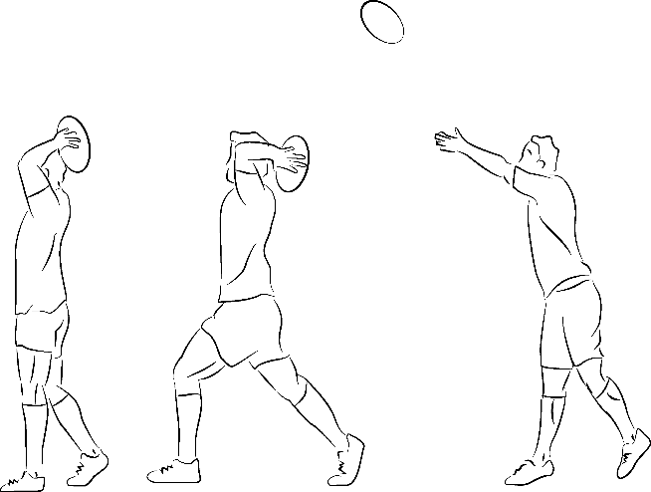
The Muscular System
INSPECTION COPY
Answer the following exam-style question and check your answers.
Exam-style Question
Identify the main agonist muscle working at the elbow as the rugby player throws the ball.
(1 mark)
Click to reveal answer!
1 x AO1 mark:
Triceps
State two characteristics of smooth muscle. (2 marks)
Click to reveal answer!
COPYRIGHT
PROTECTED
2 x AO1 marks from:
  Slow contraction
  Involuntary contraction
  Found lining the walls of organs or blood vessels
© ZigZag Education, 2022
Notes:
Students to write answers to questions and check their answers
Click to reveal answers. Students to peer-mark or self-mark answers.

