Slide 1

D: The effects of exercise and sports performance on…
The
cardiovascular
System
D4 Responses to a single sport or exercise session
D5 Adaptations to exercise
D6 Additional factors
© ZigZag Education, 2022

Slide 2

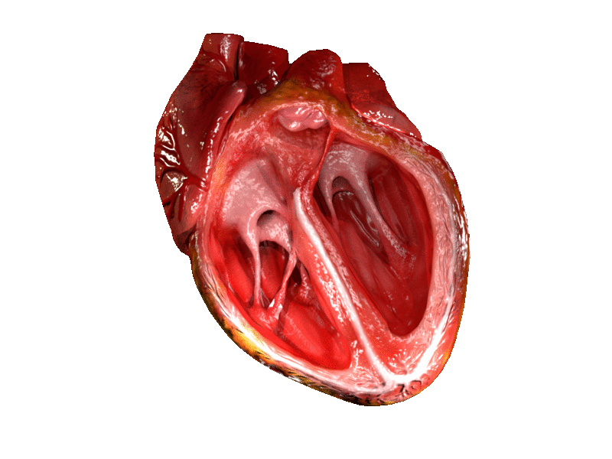

Learn
Responses and Adaptations
INSPECTION COPY
Heart Rate, Stroke Volume and Cardiac Output
There are three main values associated with the heart, each of which responds to a single exercise/sports session and adapts with long-term training. Let’s take a look at what each value means and its response/adaptation.
Heart rate
The number of times the heart beats in a minute
(bpm)
Stroke volume
The volume of blood ejected from the heart per beat
(mL)
Cardiac output
The volume of blood ejected from the heart per minute
(L/min)
×
=
Response to a single exercise/sports session
Increase
Increase
Increase
COPYRIGHT
PROTECTED
These all increase as the demand of the muscles for oxygen increases and, therefore, there is a greater need for transport of oxygen in the blood.
Decrease at rest and during sub-maximal exercise
Increase at rest and during exercise
Increase during maximal exercise
Adaptation to long-term training
The heart is able to eject more blood per beat, allowing it to become efficient and maintain the same cardiac output at a lower heart rate.
© ZigZag Education, 2022
Notes:
Introduce each heart value and the equation that links them
Students to suggest how each heart value responds to a single exercise/sports session
Click through the slide to reveal the correct response
Students to suggest how each heart value adapts to long-term training
Click through the slide to reveal the correct adaptation

Slide 3
Learn
Responses and Adaptations
INSPECTION COPY
Heart Rate and Recovery
Let’s take a look at the immediate changes in heart rate before, during and after exercise.
An anticipatory rise in heart rate occurs before exercise as the body prepares to be physically active.
This is caused by an increase in adrenaline.
It ensures that oxygen is available for the working muscles when exercise begins.
During steady-state exercise, the heart rate reaches a plateau.
This is where the heart rate is meeting the demand for oxygen at the working muscles.
After exercise has finished, the heart rate remains elevated for a period of time.
This ensures waste products (e.g. lactic acid) are removed and the oxygen debt from the beginning of exercise is repaid.
Following long-term training, an adaptation to the cardiovascular system is a decrease in heart rate recovery time.
This is important in intermittent sports such as football, as it enables the performer to recover at a quicker rate between periods of high-intensity activity.
COPYRIGHT
PROTECTED
Pre-exercise
Exercise session
Recovery
© ZigZag Education, 2022
Notes:
Discuss the response of heart rate before, during and after exercise using the graph and the annotations to aid the discussion
Students to identify the change in heart rate recovery as an adaptation to long-term training
Discuss the importance of a greater heart rate recovery to performance in sport and exercise

Slide 4

Responses and Adaptations
Draw two graphs to represent the change in stroke volume and cardiac output as exercise intensity increases.
Activity
REVEAL ANSWERS
Stroke volume (mL/beat)
Cardiac output (L/min)
Exercise intensity (% max)
Exercise intensity (% max)
© ZigZag Education, 2022
Notes:
Students to complete the graphs using the axes provided
Click the reveal answers box for students to check their answers

Slide 5
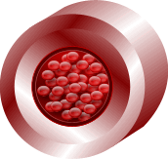
Learn
Responses
INSPECTION COPY
Redirection of Blood Flow
The body also responds to exercise by altering the distribution of blood flow around the body in a process called the vascular shunt mechanism.
The arteries can be vasodilated (widened) in order to increase the supply of blood to the working muscles.
Or… they can be vasoconstricted (narrowed) in order to decrease the supply to non-essential tissues, such as certain organs.
COPYRIGHT
PROTECTED
The process of vascular shunting is controlled by the vasomotor centre in the medulla oblongata which alters the diameter of the arteries via the sympathetic nervous system.
© ZigZag Education, 2022
Notes:
Introduce the redirection of blood flow as a response to exercise
Click through the slide to identify when arteries vasodilate and vasoconstrict and discuss the impact of each

Slide 6
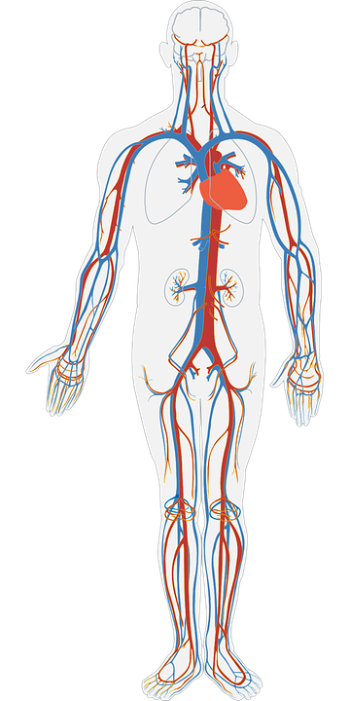
Learn
Responses
INSPECTION COPY
Redirection of Blood Flow
Let’s see this in action.
Brain: 750 mL/min
Click to reveal how blood is distributed at rest
Brain: 750 mL/min
Internal organs: 1,100 mL/min
Internal organs:
600 mL/min
Click again to reveal how blood is redistributed during exercise
COPYRIGHT
PROTECTED
Muscles:1,200 mL/min
Muscles: 12,500 mL/min
As the performer begins to exercise, we notice that the blood is redistributed from the internal organs to the skeletal muscle, but the brain sees no change in blood supply!
© ZigZag Education, 2022
Notes:
Click on the slide to illustrate how blood supply to the brain, kidneys and working muscles changes between rest and exercise
It is important to mention that the blood supply to the brain never changes as restricting blood flow to the brain could be fatal

Slide 7
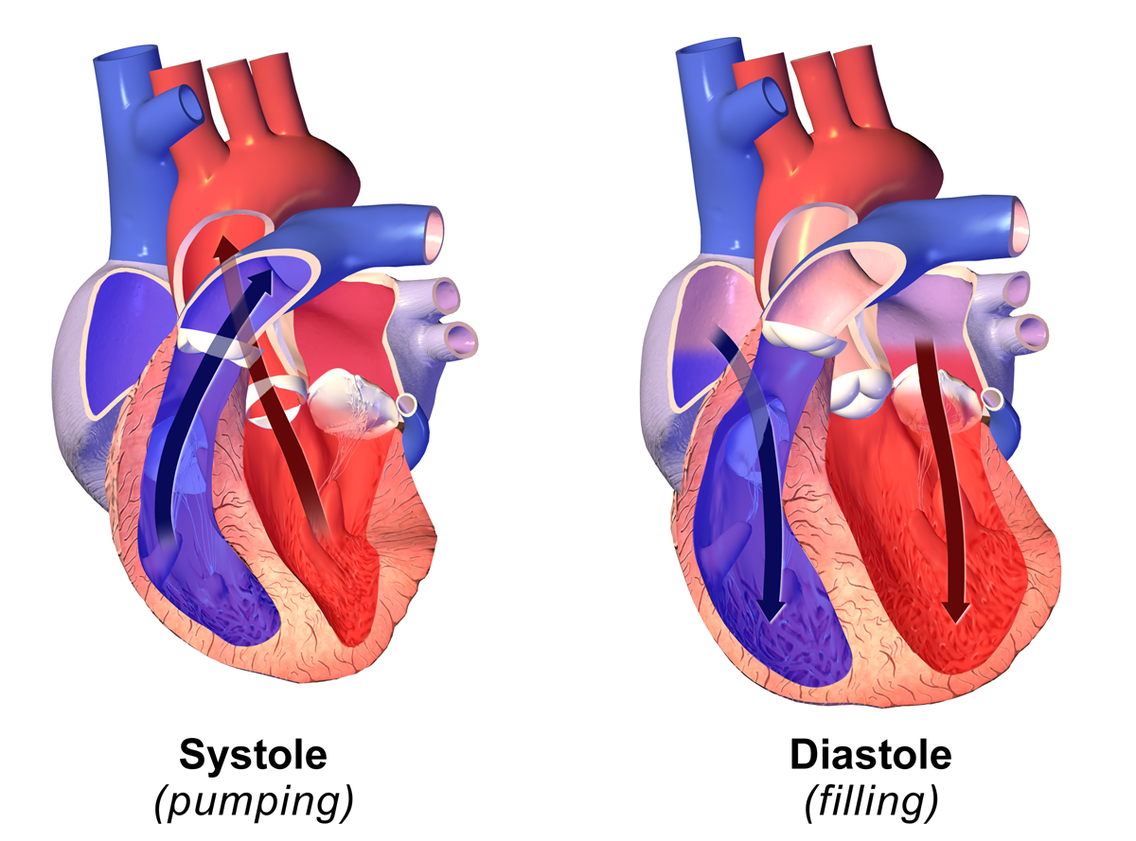
Learn
Responses and Adaptations
INSPECTION COPY
Blood Pressure
Blood pressure is another aspect of the cardiovascular system that both responds and adapts to exercise. Let’s take a look at how below…
Blood pressure readings are given as systolic pressure / diastolic pressure.
During exercise, blood pressure increases as more blood is forced out of the heart. This increase is in systolic pressure, whereas diastolic pressure slightly decreases.
COPYRIGHT
PROTECTED
Following long-term training, blood pressure decreases. This is due to the increased elasticity of arteries, which are able to stretch during systole and reduce the strain on arterial walls.
Systole is the period when the ventricles contract, allowing blood to flow out of the heart.
Diastole is the period when the heart relaxes, allowing the ventricles to fill with blood.
© ZigZag Education, 2022
Notes:
Introduce what blood pressure is and the terms systole and diastole
Students to understand that blood pressure changes as an immediate response to exercise and as a long-term adaptation of the cardiovascular system
Students to suggest how blood pressure changes as a response and as an adaptation
Click through the slide to reveal the answers

Slide 8

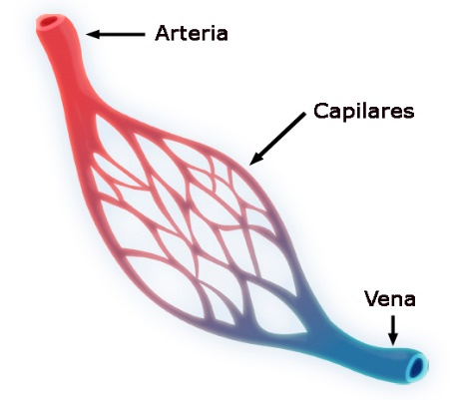
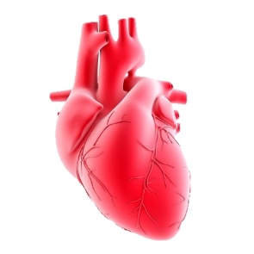
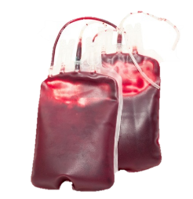
Learn
Adaptations
Additional Adaptations
Click on the images of each adaptation to reveal the impact it has on the body.
The body also adapts in the following ways as a result of long-term training…
Cardiac hypertrophy
The increase in the size of the heart – in particular, the left ventricle.
Adaptations
of the cardiovascular system
Capillarisation
The increase in capillary density, which occurs at the alveoli and the muscle.
Increases the number of sites for gaseous exchange, allowing for a greater diffusion of oxygen in the blood and extraction at the muscle.
Also increases the removal of carbon dioxide and waste products from the muscle.
Increase in blood volume
The expansion of blood plasma.
Allows for a more forceful contraction and ejection of oxygenated blood to the working muscles.
Increasing stroke volume for more oxygen delivery to the muscle.
Also improves thermoregulation through a greater blood flow to the skin, helping to cool the body and prevent it from overheating.
© ZigZag Education, 2022
Notes:
Students to identify additional adaptations of the cardiovascular system to exercise
Click through the slide to reveal the three additional adaptations
Discuss how each adaptation impacts exercise performance
Click on the image for each adaptation to reveal its impact on exercise performance

Slide 9

Responses and Adaptations
INSPECTION COPY
Summarise the responses and adaptations of the cardiovascular system to exercise by categorising the changes below into the respective columns.
Activity
Increase in blood volume
Redirection of blood flow
Reduction in blood pressure
Anticipatory increase in heart rate
Capillarisation of alveoli and skeletal muscle
Increased cardiac output
Increase in exercising stroke volume
Increase in heart rate
Cardiac hypertrophy
Increased blood pressure
Increase in resting stroke volume
Quicker heart rate recovery
Responses | Adaptations
COPYRIGHT
PROTECTED
Click each answer to reveal its corresponding category.
© ZigZag Education, 2022
Notes:
Students to categorise the options into responses and adaptations of the cardiovascular system
Click the slide to reveal the answers

Slide 10
Learn
Additional Factors
Sudden Arrhythmic Death Syndrome
Sudden arrhythmic death syndrome (SADS) is a heart condition that causes a sudden, unexplained death.
It is common among seemingly young and fit people so is not associated with cardiac deaths related to leading unhealthy or sedentary lifestyles, such as heart attacks.
Instead, SADS is genetic and can be passed down if a parent has had an unexplained cardiac event.
As well as a family history of SADS, there are a number of warning signs and symptoms that people should be aware of when exercising:
Fainting
Dizziness
Seizures
Chest pains
Unusual breathlessness
Anyone displaying these symptoms can and should contact their GP or see a specialist to have their heart screened.
Charities such as Cardiac Risk in the Young (CRY) also offer free screenings to all young people aged 18–35.
Visit the SADS Foundation website to learn more…
© ZigZag Education, 2022
Notes:
Introduce SADS and click through the slide to learn more about how it impacts exercise participation
Click on the info link to visit the SADS Foundation website

Slide 11
Learn
Additional Factors
INSPECTION COPY
Blood Pressure
A normal, healthy blood pressure is between 90/60 mmHg and 120/90 mmHg.
Values below 90/60 mmHg are classed as low blood pressure (hypotension).
Values above 140/90 mmHg are classed as high blood pressure (hypertension).
190
180
People with high blood pressure are at a greater risk of cardiovascular events such as stroke and heart attacks during high-intensity activities, such as weightlifting.
170
High blood pressure
160
150
140
Systolic blood pressure
Pre-high blood pressure
130
120
110
Target blood pressure
COPYRIGHT
PROTECTED
100
People with low blood pressure are at risk of fainting during activities involving quick postural changes or where the head is below heart level, such as rugby.
90
Low blood pressure
80
70
40
50
60
70
80
90
100
Diastolic blood pressure
© ZigZag Education, 2022
Notes:
Introduce low and high blood pressures
Discuss the effects that low and high blood pressure might have on exercise participation

Slide 12
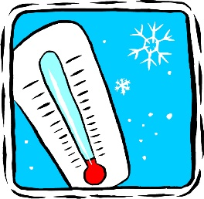
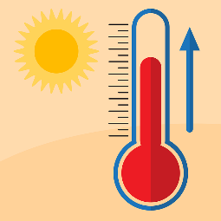
Learn
Additional Factors
INSPECTION COPY
Hypothermia/Hyperthermia
The natural internal environment of the body is 37 °C.
When we exercise, our bodies produce heat, so an increase in body temperature is normal with exercise.
However, the environmental conditions can lead to an excessive drop or rise in body temperature:
In cold conditions, the body responds by shivering and redirecting blood flow to the central circulation.
In hot and humid conditions, the body responds by sweating and redirecting blood flow to the surface of the skin to help dissipate heat.
COPYRIGHT
PROTECTED
Some environmental conditions can be so severe that they cause hypothermia (a drop in body temperature below 35 °C).
Exercising in extreme heat can run the risk of an excessive rise in body temperature above 39/40 °C (hyperthermia).
Symptoms of hypothermia include:
Blue skin and lips
Slurred speech
Slow, shallow breathing
Drowsiness
Symptoms of hyperthermia include:
Rapid heart rate
Dizziness and light-headedness
Exhaustion
Fainting
© ZigZag Education, 2022
Notes:
Introduce the terms hypothermia and hyperthermia
Discuss the effects that exercise can have on hypothermia and hyperthermia
Students to identify the symptoms of hypothermia and hyperthermia

Slide 13

The Cardiovascular System
INSPECTION COPY
What will happen to each adaptation of the cardiovascular system if training were
to stop?
Discuss
What effects to the cardiovascular system could be observed by competing in extreme conditions, e.g. cold/hot weather?
What are the benefits of having a low resting heart rate?
COPYRIGHT
PROTECTED
© ZigZag Education, 2022
Notes:
Take this opportunity to reflect on what has been learnt and how it impacts on sport in a wider context

Slide 14
The Cardiovascular System
INSPECTION COPY
Describe the redirection of blood flow as a performer starts to exercise. (3 marks)
Exam-style Question
3 x AO2 for:
The vascular shunt mechanism redistributes blood
Arteries supplying less important areas of the body during exercise are vasoconstricted to reduce blood flow
Arteries supplying the working muscles are vasodilated to increase blood flow
Click to reveal answer!
Explain the impact of high blood pressure on performance in sport
and exercise. (3 marks)
Click to reveal answer!
3 x AO2 from:
High blood pressure increases the risk of cardiovascular events, such as stroke or an aneurysm
People with high blood pressure are at an even greater risk during intense exercise (e.g. interval training)
This is because blood pressure increases to a greater level during intense exercise, placing an added stress on the heart and blood vessels
People with high blood pressure must reduce the intensity of their exercise to manage their condition
COPYRIGHT
PROTECTED
© ZigZag Education, 2022
Notes:
Students to write answers to the questions and check their answers
Click to reveal answer. Students to peer-mark or self-mark answers.

