Slide 1
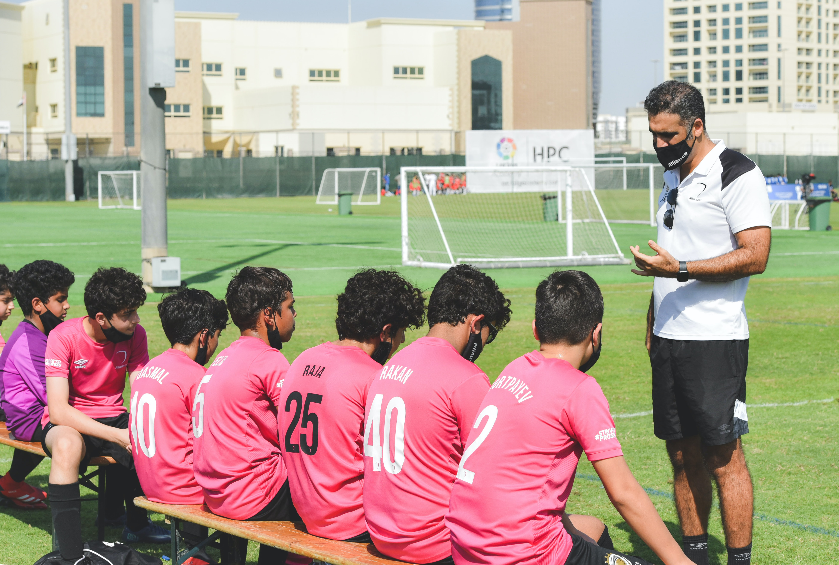
Photocopiable/digital resources may only be copied by the purchasing institution on a single site and for their own use
Guidance and Feedback
on Performance
Paper 2
Sports Psychology
3.2.1.4

Slide 2

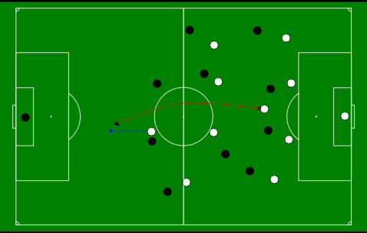
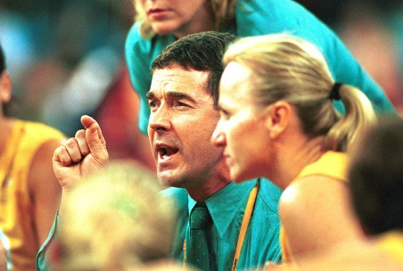
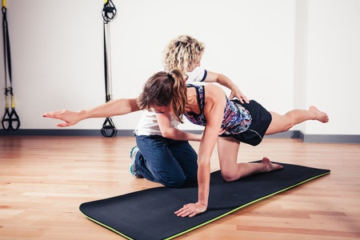
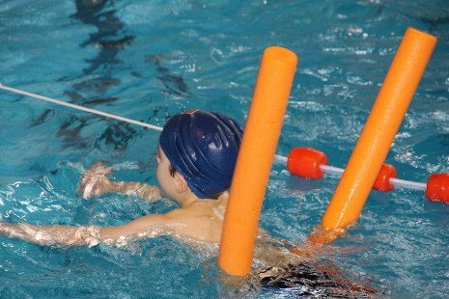


INSPECTION COPY
Introduction to guidance
Learn
Guidance is the way in which information is conveyed to a performer to help them learn a new skill.
There are four types of guidance:
Visual
Verbal
Manual
Mechanical
COPYRIGHT
PROTECTED
The effectiveness and appropriateness of the type of guidance used is dependent on the ability level of the performer.
Click on each button (below each image) to explore more on each type of guidance.
© ZigZag Education, 2022
Notes:
Introduce the concept of guidance.
Click through the slide to reveal the four different types of guidance.
Identify which type of guidance is being displayed in each picture.
Click on the pictures to go to each type of guidance and learn more about its evaluation and examples.

Slide 3
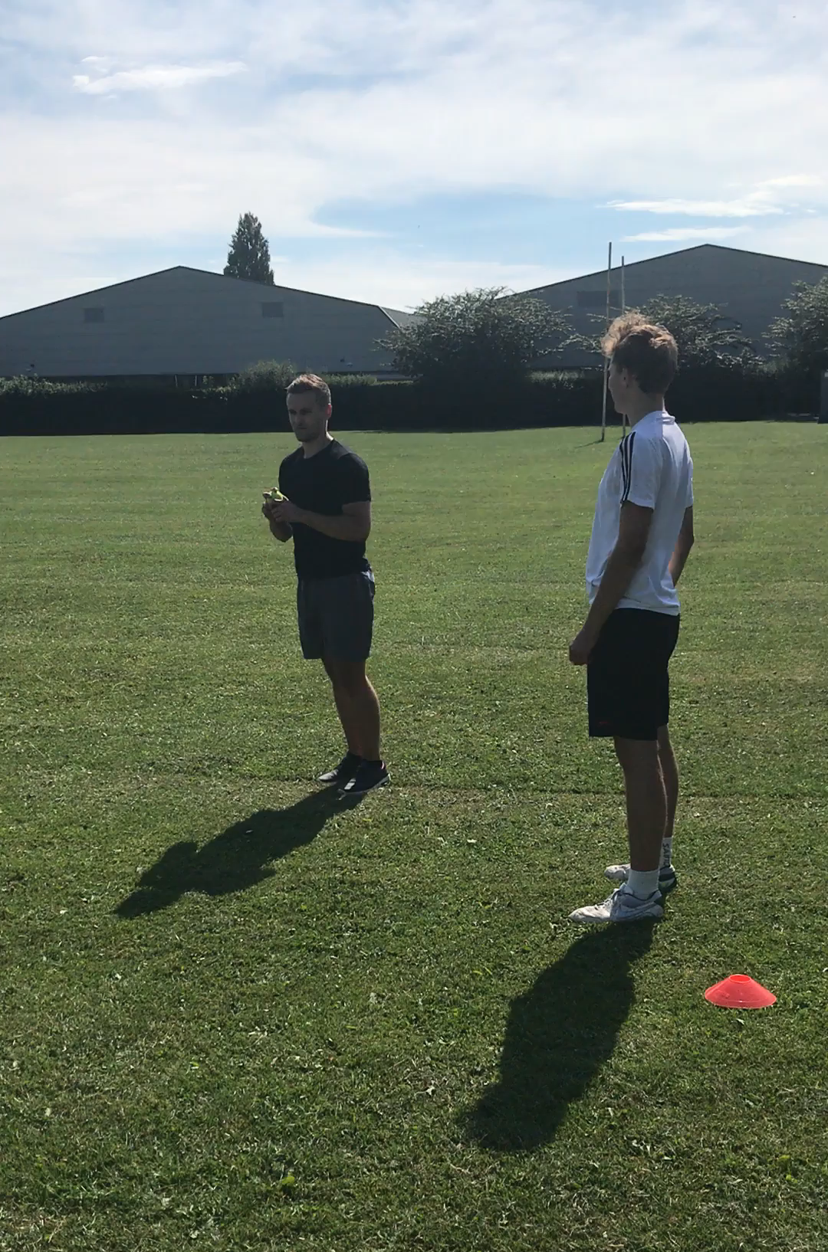

INSPECTION COPY
Visual guidance
Learn
Visual guidance involves the coach providing a demonstration of how to perform a skill, or use of a visual aid to outline performance.
Click on the video to show how a visual demonstration can be used by a coach.
Examples:
A gymnastics coach showing their performer how to safely dismount from the high bar.
A football coach displaying the team’s formation on a whiteboard so it is clear in which positions everyone will play.
Most suited to beginners
COPYRIGHT
PROTECTED
Evaluation
Beginner performers… | Expert performers…
… benefit from seeing a skill demonstrated by a coach or performer as they can create a mental image of how it is meant to be performed. | … already know how a skill should look so seeing it performed by another person would have limited added value.
Back to intro page
© ZigZag Education, 2022
Notes:
Click on the video to see a demonstration of visual guidance used by a coach.
Click through the slide to see an evaluation of visual guidance in sport and why it is most suited to beginners.
Identify different examples of visual guidance, then click to reveal examples within the slide.
Return to the intro page by clicking the back button.

Slide 4
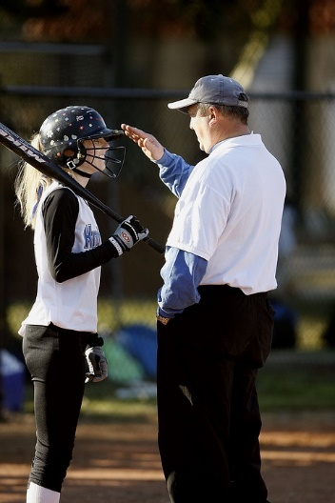

INSPECTION COPY
Verbal guidance
Learn
Verbal guidance involves the use of words to talk the learner through a skill.
Examples:
A track cycling coach informing their athletes how far the opposition team is behind them in the team pursuit.
A boxing coach guiding their performer through different combinations by calling out commands such as ‘jab, jab, cross’.
Most suited to expert performers
Evaluation
Beginner performers… | Expert performers
… don’t have a clear understanding of how movements should look or feel so may struggle to understand the use of verbal guidance on its own. | The style of verbal guidance can be adapted to suit expert performers, e.g. through use of complex terminology.
COPYRIGHT
PROTECTED
Back to intro page
4
© ZigZag Education, 2022
Notes:
Click through the slide to see an evaluation of verbal guidance in sport and why it is most suited to expert performers.
Identify different examples of verbal guidance, then click to reveal examples within the slide.
Return to the intro page by clicking the back button.

Slide 5
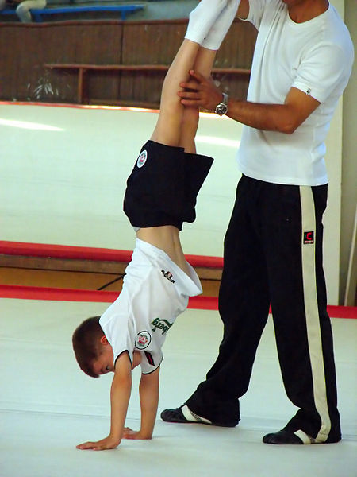
Guidance and Feedback
INSPECTION COPY
Manual guidance
Learn
Manual guidance involves a ‘hands-on’ approach to providing assistance to the performer when performing a skill.
Examples:
A fitness trainer helping their client to perform a pull-up.
A swimming coach holding their performer’s body at the top of the water to show how they should keep their body from sinking.
Most suited to beginners
Evaluation
Beginner performers… | Expert performers…
… are unaware of how a movement should feel, so having a coach manually guide them through the movement will give them a good understanding of how they should perform the skill on their own. | … already have experience of how the skill should feel, and so will obtain no further benefit from manual guidance.
COPYRIGHT
PROTECTED
Back to intro page
© ZigZag Education, 2022
Notes:
Click through the slide to see an evaluation of manual guidance in sport and why it is most suited to beginners.
Identify different examples of manual guidance, then click to reveal examples within the slide.
Return to the intro page by clicking the back button.

Slide 6
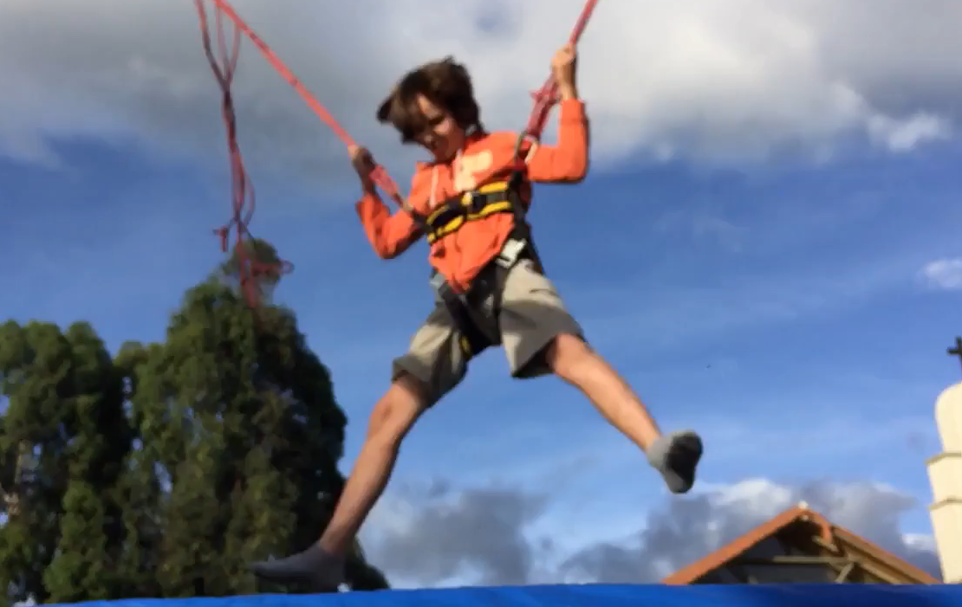
Guidance and Feedback
INSPECTION COPY
Mechanical guidance
Learn
Mechanical guidance involves the use of equipment to provide support to the learner as they perform a skill.
Examples:
Using a hoist/harness to practise somersaulting on the trampoline.
Using armbands to allow a beginner swimmer to stay afloat and practise their technique.
Most suited to
beginners
Evaluation
Beginner performers | Expert performers…
Mechanical guidance can be beneficial for beginners by allowing them to build up their confidence in performing a movement in a safe manner. | … should already be able to safely perform most skills, so mechanical guidance will be of limited use.
COPYRIGHT
PROTECTED
Click on the video to show how equipment can be used to guide a learner.
Back to intro page
© ZigZag Education, 2022
Notes:
Click on the video to see a demonstration of mechanical guidance used by a coach.
Click through the slide to see an evaluation of mechanical guidance in sport and why it is most suited to beginners.
Identify different examples of mechanical guidance, then click to reveal examples within the slide.
Return to the intro page by clicking the back button.

Slide 7
Categorise each of the different examples into the correct type of guidance.
The use of demonstrations to show how a skill should be performed.
Providing a float to focus on kicking technique in swimming.
Holding a performer in a handstand position.
Activity
Reminding a performer to wrap their arms when tackling in rugby.
Watching a video of a perfect model executing a skill.
Using stabilisers on a bike in order to practise how to ride.
Can you list any further examples?
Click on the different examples to see how they are categorised.
Visual
Verbal
Manual
Mechanical
© ZigZag Education, 2022
Notes:
Categorise the examples given.
Students to write down any further examples they can think of.

Slide 8
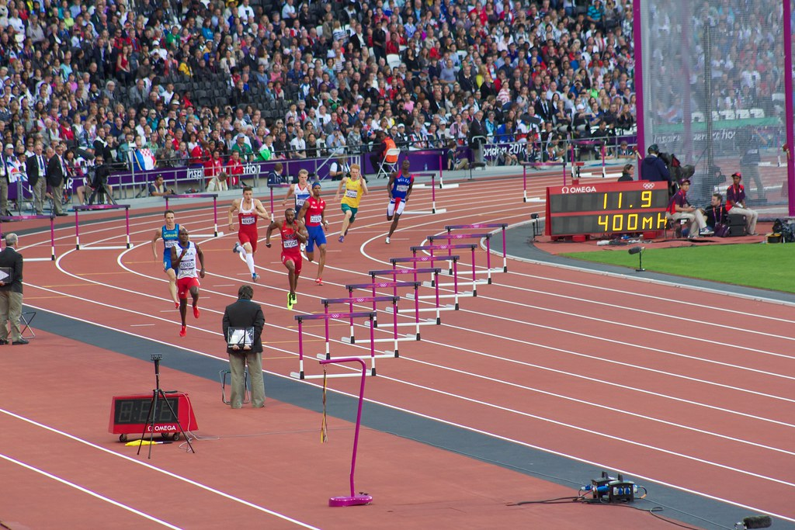
INSPECTION COPY
Introduction to feedback
Learn
Athletes can gain different types of feedback from various sources in order to improve their performance.
Click on each type of feedback to find out more about it.
Knowledge of performance
Knowledge of results
Intrinsic
Extrinsic
COPYRIGHT
PROTECTED
Negative
Positive
© ZigZag Education, 2022
Notes:
Introduce the concept of feedback.
Identify different examples of feedback in the image.
Click through the slide to show the different types of feedback, then click on each to reveal more information about it.
Once you have viewed each type of feedback, move on to the next slide.

Slide 9
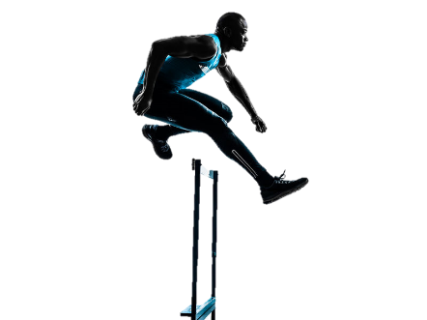
Guidance and Feedback
INSPECTION COPY
Positive feedback ✓
Learn
Positive feedback lets the athlete know that they are performing well.
In the example of the 400 m hurdles, the performer may use a thumbs up from the coach to provide them with positive feedback during exercise.
Additional example: a long jumper who sees the white flag shown to them to indicate a valid jump.
Evaluation
Positive feedback should be used with beginners to build confidence and ensure that they stick with the sport or activity. This is particularly beneficial if it comes from someone they see as a role model in sport.
Expert performers will also benefit from positive feedback in sport to help them maintain performance levels in the activity; however, it is not essential.
COPYRIGHT
PROTECTED
Most suited to beginners
Back to intro page
© ZigZag Education, 2022
Notes:
Click through the slide to see an evaluation of positive feedback in sport and why it is most suited to beginners.
Identify different examples of positive feedback, then click to reveal an example within the slide.
Return to the 400 m hurdles page to move on to the next type of feedback.

Slide 10
Guidance and Feedback
INSPECTION COPY
Negative feedback ✗
Learn
Negative feedback lets the athlete know that they have not performed very well.
In the example of the 400 m hurdles, this could come from being shown the red card for making a false start.
Additional example: a cycling coach who informs their athlete that they need to adopt a lower body position if they want to go faster.
Evaluation
Negative feedback should be avoided at all costs for beginners as it is likely to knock their confidence and could force them to drop out of the sport early.
Negative feedback should be reserved for expert performers to highlight areas they need to improve, but it should not be overused so as to avoid fall-outs.
COPYRIGHT
PROTECTED
Back to intro page
Most suited to expert performers
© ZigZag Education, 2022
Notes:
Click through the slide to see an evaluation of negative feedback in sport and why it is most suited to expert performers.
Identify different examples of negative feedback, then click to reveal an example within the slide.
Return to the 400 m hurdles page to move on to the next type of feedback.

Slide 11
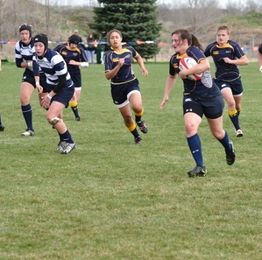
Guidance and Feedback
INSPECTION COPY
Knowledge of results
Learn
Knowledge of results informs an athlete of the outcome of their performance.
In the example of the 400 m hurdles, the performer receives knowledge of results through the time and position among the other runners.
Additional example: a taekwondo athlete will
understand how clear the margin was between
winning and losing by seeing the points score.
Evaluation
Knowledge of results is useful for beginners as it gives them an understanding of successful and unsuccessful outcomes in sport. However, it is important that it is not overused if the outcome is negative.
Expert performers will understand the difference between success and failure, so benefit more from understanding why that difference is.
COPYRIGHT
PROTECTED
Most suited to beginners
Back to intro page
© ZigZag Education, 2022
Notes:
Click through the slide to see an evaluation of knowledge of results in sport and why it is most suited to beginner performers.
Identify different examples of knowledge of performance, then click to reveal an example within the slide.
Return to the 400 m hurdles page to make sure you have looked at each type of feedback.

Slide 12
Guidance and Feedback
INSPECTION COPY
Knowledge of performance
Learn
Knowledge of performance provides information about how well a skill is being performed.
In the example of the 400 m hurdles, the performer is able to judge their performance by the number of hurdles they knock over.
Additional example: a rugby coach who understands that the reason they lost the game was because of gaps in the defence.
Evaluation
Beginners can benefit from knowledge of performance as they will be able to identify what they need to improve; however, it is important that the information provided is straightforward and uses simple language.
Knowledge of performance is preferred for expert performers as they need to understand why they have performed in the way that they have.
COPYRIGHT
PROTECTED
Most suited to expert performers
Back to intro page
© ZigZag Education, 2022
Notes:
Click through the slide to see an evaluation of knowledge of performance in sport and why it is most suited to expert performers.
Identify different examples of knowledge of performance, then click to reveal an example within the slide.
Return to the 400 m hurdles page to move on to the next type of feedback.

Slide 13
Guidance and Feedback
INSPECTION COPY
Extrinsic feedback
Learn
Extrinsic feedback is received from a source external to the athlete.
Additional example: a cricket coach who informs their young athlete that they have scored six runs by playing the ball over the boundary without it touching the floor.
In the example of the 400 m hurdles, the performer can use the noise from the crowd to spur them on in the race.
Evaluation
Beginners rely on extrinsic feedback to inform them whether they have been successful or not, as they are unlikely to know what success feels like themselves.
Expert performers will also benefit from extrinsic feedback in sport to help them maintain performance levels, but they are also able to draw from intrinsic feedback to derive feedback for themselves.
COPYRIGHT
PROTECTED
Most suited to beginners
Back to intro page
© ZigZag Education, 2022
Notes:
Click through the slide to see an evaluation of extrinsic feedback in sport and why it is most suited to beginners.
Identify different examples of extrinsic feedback, then click to reveal an example within the slide.
Return to the 400 m hurdles page to move on to the next type of feedback.

Slide 14
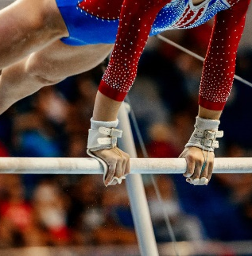
Guidance and Feedback
INSPECTION COPY
Intrinsic feedback
Learn
Intrinsic feedback is received from within the athlete themselves and is based on the feel of movement.
In the example of the 400 m hurdles, the performer is
able to judge how much energy they have left to give by judging how their body is feeling.
Additional example: a gymnast who is able to
judge their orientation in the air in order to
land safely on their feet.
Evaluation
Beginner performers don’t have the level of ability to judge how their body is or should be feeling during exercise; therefore, they will struggle to use intrinsic feedback.
Expert performers are experienced in perceiving their body during exercise and using it to inform on and improve performance; therefore, they are able to use intrinsic feedback effectively.
COPYRIGHT
PROTECTED
Back to intro page
Most suited to expert performers
© ZigZag Education, 2022
Notes:
Click through the slide to see an evaluation of intrinsic feedback in sport and why it is most suited to expert performers.
Identify different examples of intrinsic feedback, then click to reveal an example within the slide.
Return to the 400 m hurdles page to move on to the next type of feedback.

Slide 15

Watch the video on Australian swim coach Dean Boxall and note down the types of feedback and guidance he gives to his swimmers. Give specific examples from the video of where he uses each.
Click to play.
Activity
Example: negative feedback (0:30)
Telling the swimmer to watch that they don’t turn their head drastically.
Example:
(2:00)
‘A little bit more underwater (knowledge of performance / negative feedback)… it’s probably taken a 0.15 [seconds] off you (knowledge of results).’
Example: visual guidance (0:40)
Demonstration of the stroke – not hooking straight away.
Example: negative feedback (1:13)
‘You gotta wake it up’
Example: positive feedback and knowledge of results
(2:26)
‘1:28:07, great job’
Example: positive feedback (1:33)
‘I’m amazed at how you picked that up so easily’
Example: positive feedback and knowledge of results
(1:02)
‘Great job, 2:58, great decision, much better, very good’
Example: positive feedback (2:55)
‘Great job, easily your best’
© ZigZag Education, 2022
Notes:
Click on the play button to watch the video.
Write down different examples of feedback provided by the coach during the video. (You may pause and rewind where needed.)
Click through the slide to reveal examples of feedback picked up during the video to compare with your answers.

Slide 16
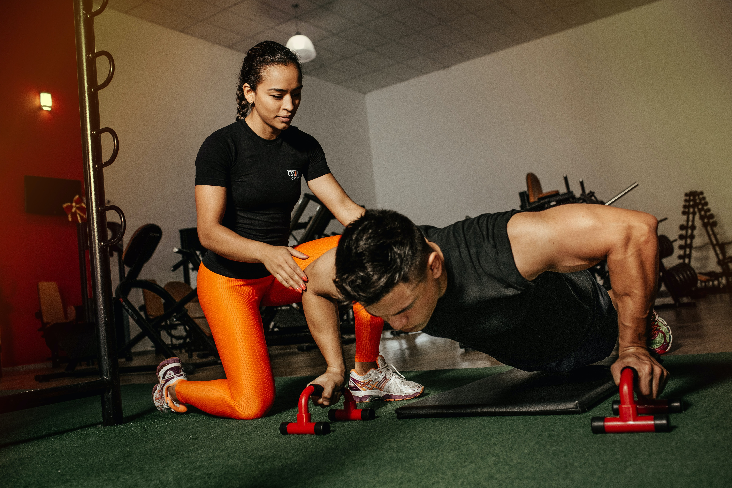
INSPECTION COPY
Discuss
Which types of guidance would you use for a beginner in gymnastics, and why?
Identify different types of mechanical aids that can be used to guide performers in sport.
What examples of knowledge of results and performance could you give to a performer in the same sport?
COPYRIGHT
PROTECTED
© ZigZag Education, 2022
Notes:
Take this opportunity to reflect on what has been learnt about guidance and feedback and how it impacts sport in a wider context.
Students can discuss these questions with their peers or respond individually by writing down their answers.

Slide 17
INSPECTION COPY
Exam-style questions
Answer the following exam-style questions and check your answers.
1. Which one of the following is an example of knowledge of performance?
a) Your time was 15.4 seconds
b) You conceded three goals
c) Your tumble turn was very efficient
d) You were 5 kg off your personal best (1 mark)
1 × AO2 mark:
c) Your tumble turn was very efficient
Click to reveal answer!
2. Michelle is an elite triple jumper.
Explain why Michelle’s triple jump coach should use verbal guidance to
improve her performance. (2 marks)
COPYRIGHT
PROTECTED
2 × AO2 marks for:
The coach can use specialist terminology that Michelle understands (1), which helps get the message across as to what is needed to perform a successful jump (1).
Accept any other suitable explanation.
☞ Click to reveal answer!
© ZigZag Education, 2022
Notes:
Students to answer each exam-style question under exam conditions (approx. 1 minute per mark).
Click to reveal answers. Students to peer-mark or self-mark answers.

Slide 18
INSPECTION COPY
Exam-style questions
Answer the following exam-style question and check your answer.
3. Rachael is a gymnastics coach who has just taken on a group of new gymnasts in her recreational group for 10–12-year-olds.
Discuss the suitability of mechanical guidance when teaching. (4 marks)
4 × AO3 marks for:
Suitable (sub-max. 3 marks):
10–12-year-olds may be new to the sport, so mechanical guidance could be useful for assisting with movements
Mechanical guidance can be used to make skills less dangerous for young performers who may be novices
Can be effective alongside visual guidance so that the performer can build up an understanding of what movements should look like
Mechanical guidance could be used to introduce a particular movement before the performer attempts it without assistance
Not suitable (sub-max. 3 marks):
Some gymnasts start the sport from a very early age so may already be proficient at performing movements without the assistance of mechanical guidance
For novice 10–12-year-olds, manual guidance may be better so that the coach has more control over their gymnast’s performance
Overreliance on mechanical guidance can take away the ‘feel’ for movements
Accept any other suitable answers.
☞ Click to reveal answer!
COPYRIGHT
PROTECTED
© ZigZag Education, 2022
Notes:
Students to answer each exam-style question under exam conditions (approx. 1 minute per mark).
Click to reveal answers. Students to peer-mark or self-mark answers.

