Slide 1

Ethical and Sociocultural issues in Physical Activity and Sport
Conduct of Performers and Prohibited Substances and Methods
Sportsmanship!
Paper 2
Sociocultural influences
3.2.2.3
Photocopiable/digital resources may only be copied by the purchasing institution on a single site and for their own use

Slide 2

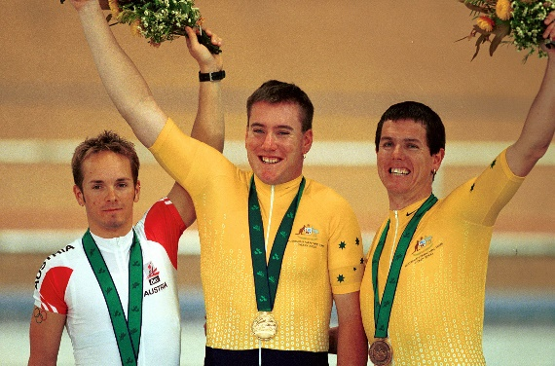

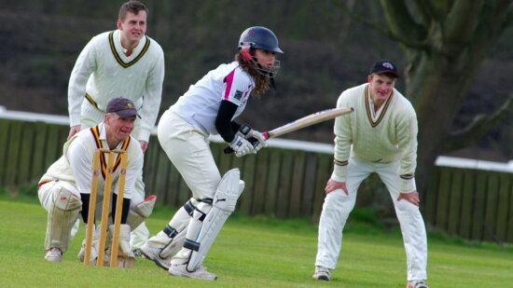

INSPECTION COPY
Conduct of performers
Learn
Performers in sport conduct themselves in various ways. Some consistently show signs of respect and fair play, despite the end result, while others will bend or even break the rules to improve their chances of winning.
There are key terms used to describe the ways in which performers conduct themselves:
Etiquette
An unwritten show of respect and politeness towards everyone involved in sport.
Sportsmanship
Playing within the rules of sport and showing etiquette to those involved.
Gamesmanship
Bending the rules of sport to gain a competitive advantage over the opponent.
COPYRIGHT
PROTECTED
Everyone who participates in sport is expected to fulfil a contract to compete – an unwritten agreement to follow the written and unwritten rules of the sport.
© ZigZag Education, 2022
Notes:
Click through the slide to learn the meaning of the different terms used to describe the conduct of performers in sport.

Slide 3

Now that you know what each of the terms means, make a list of some examples of each in sport.
Click the headings to reveal some examples.
Activity
Etiquette / Sportsmanship
Gamesmanship
Helping an opponent up off the ground if they have fallen over
Shaking hands with an opponent before and after a game
Applauding an opponent for performing well
Respecting the referee’s decision and not arguing it
Remaining quiet during a rugby player’s kick at goal
Calling if you notice the ball is out in tennis, if it hasn’t been identified by the umpire
Did you list any others?
Sledging (insulting) an opponent in cricket to distract them when batting
Wasting time by taking the ball into the corner in football
Purposely false starting during a 100 m race to put off the fast starters
Faking an injury to run down the clock or win a penalty/free-kick
Wishing a footballer bad luck as they step up to take a penalty
Did you list any others?
Check out eight of the greatest displays of sportsmanship in sport:
Join the debate: Does gamesmanship belong in rugby?
© ZigZag Education, 2022
Notes:
Identify different sporting examples of sportsmanship and gamesmanship in sport.
Click to reveal answers.
(Optional) click on the info and video links to expand your knowledge further.

Slide 4

Learn
Drugs in sport
Prohibited substances
Learn
Although acts of gamesmanship in sport are only bending and not actually breaking the rules, taking prohibited substances is strictly against the rules.
Click on each cell to find out more information.
These are taken by athletes for their positive effects on performance, but they also come with a lot of serious negative side effects, which makes them dangerous to take.
Common examples of prohibited substances used by different sportspersons are shown below.
Illegal drug | Description | Who?
Peptide hormones, e.g. EPO | A hormone naturally created by the kidneys which increases red blood cell count in the body and, therefore, oxygen-carrying capacity, enhancing aerobic performance. | Endurance athletes (e.g. triathletes)
Anabolic agents | Artificial hormones designed to increase muscle mass, improving strength and power production. | Power athletes (e.g. weightlifters)
Narcotic analgesics | Medicines designed to act as pain relievers so that athletes can continue to perform despite injury or overtraining. | Athletes who may be suffering from injury or compete more than once in a short space of time
Diuretics | Medications that rid the body of water so that performers can flush their systems and reduce their weight. | Weight-category athletes (e.g. boxers)
Stimulants | Drugs that increase the activity of the central nervous system to increase awareness and improve high-intensity performance. | A range of sports, e.g. rugby, cycling, sprinting
For the latest list of banned substances in sport, check out what is prohibited on the World Anti-Doping Agency (WADA) website:
© ZigZag Education, 2022
Notes:
Know that some supplements in sport are considered illegal and cannot be used by athletes in order to improve performance.
Click on each row in the illegal drugs column to learn more about each type of drug and which athletes are likely to take it.
Click on the info button to look through the list of banned substances on the WADA website.

Slide 5
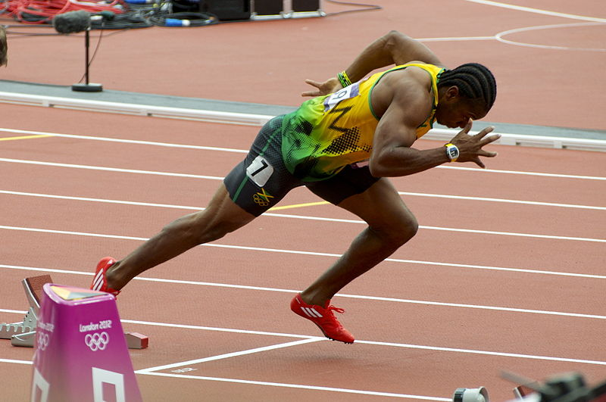
Drugs in sport
Effects of stimulants
INSPECTION COPY
Learn
There are many different types of stimulants that have been used in sport. Their common goal is to increase alertness in the athlete, important for sports where reaction time is key, such as for a sprinter to get out of the starting blocks.
Increased alertness
Rapid heart rate
Quicker reaction time
Overexertion
Increased aggression
Impaired sleep
COPYRIGHT
PROTECTED
Increased motivation
Risk of addiction
Reduced fatigue
Headache and nausea
© ZigZag Education, 2022
Notes:
Identify the reasons why stimulants are used by athletes and the side effects involved.
Which athletes would particularly benefit from this drug?

Slide 6
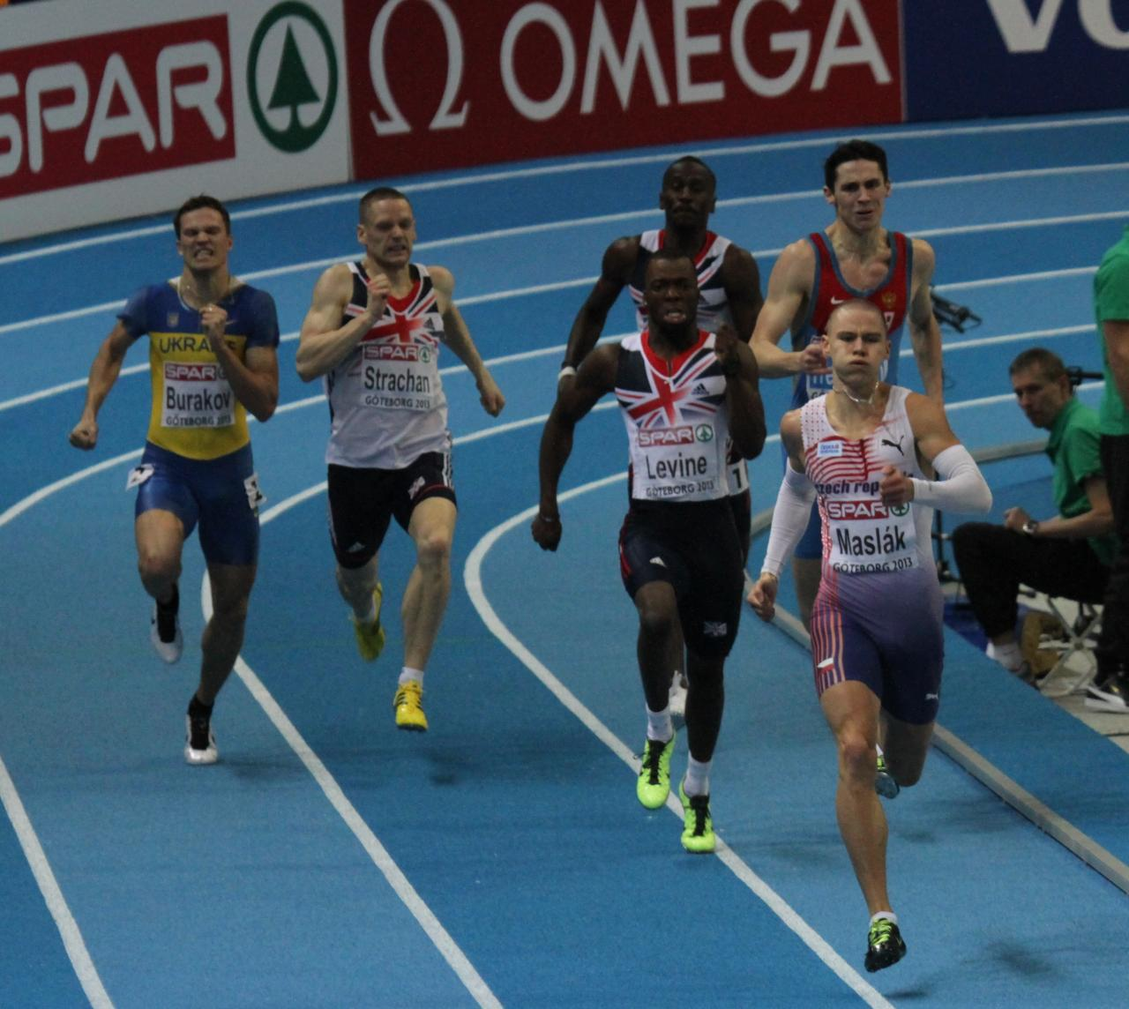
Drugs in sport
Effects of narcotic analgesics
INSPECTION COPY
Learn
Narcotic analgesics help mask the pain felt during strenuous exercise, such as the build-up of lactic acid towards the end of a 400 m race. They are also used to deal with the side effects of overtraining. But there are reasons why they are a prohibited substance.
Can worsen the severity of an injury
Can result in overexertion
Highly addictive
COPYRIGHT
PROTECTED
Results in withdrawal symptoms
Masks pain
Impairs concentration
Reduces sensations of fatigue
© ZigZag Education, 2022
Notes:
Identify the reasons why narcotic analgesics are used by athletes and the side effects involved.
Which athletes would particularly benefit from this drug?

Slide 7
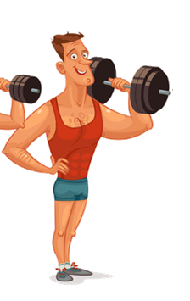
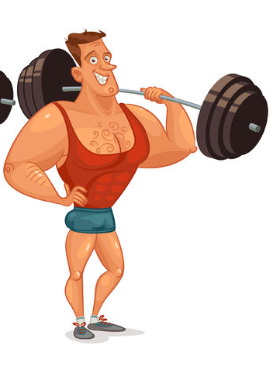
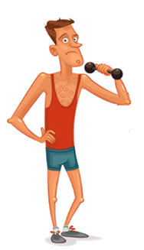
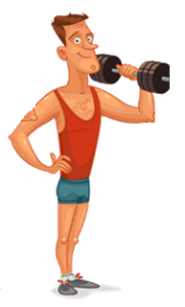


Drugs in sport
Effects of anabolic agents
INSPECTION COPY
Learn
Anabolic agents are synthetically made and are based on the body's natural testosterone. Let’s take a look at why athletes take them in sport and why we are advised to avoid them.
Increased muscle protein synthesis leads to…
… an increase in muscle mass, which can improve…
strength
power
body composition
Increased risk of stroke
Acne
Liver damage
COPYRIGHT
PROTECTED
Mood swings
Increased risk of heart attack and heart conditions
What are the negative side effects?
© ZigZag Education, 2022
Notes:
Identify the reasons why anabolic agents are used by athletes and the side effects involved.
Which athletes would particularly benefit from this drug?

Slide 8
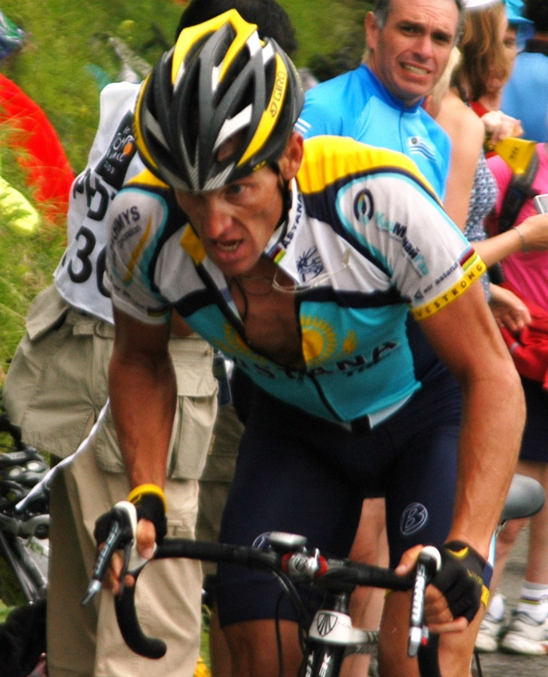
Drugs in sport
Effects of peptide hormones (EPO)
Learn
EPO is a naturally occurring hormone. However, levels can be boosted by injecting a synthetic version of it into the blood. Here are some of the positive impacts on performance and negative side effects to health:
Increases red blood cell count
Increased viscosity/
thickness of the blood
Greater oxygen delivery to working muscle
Increased risk of heart disease and conditions
Greater resistance to fatigue
Increased risk of stroke
Sustained maintenance of exercise intensity
Possible infection
Greater endurance performance
Can result in abnormal growth
© ZigZag Education, 2022
Notes:
Identify the reasons why EPO is used by athletes and the side effects involved.
Which athletes would particularly benefit from this drug?

Slide 9
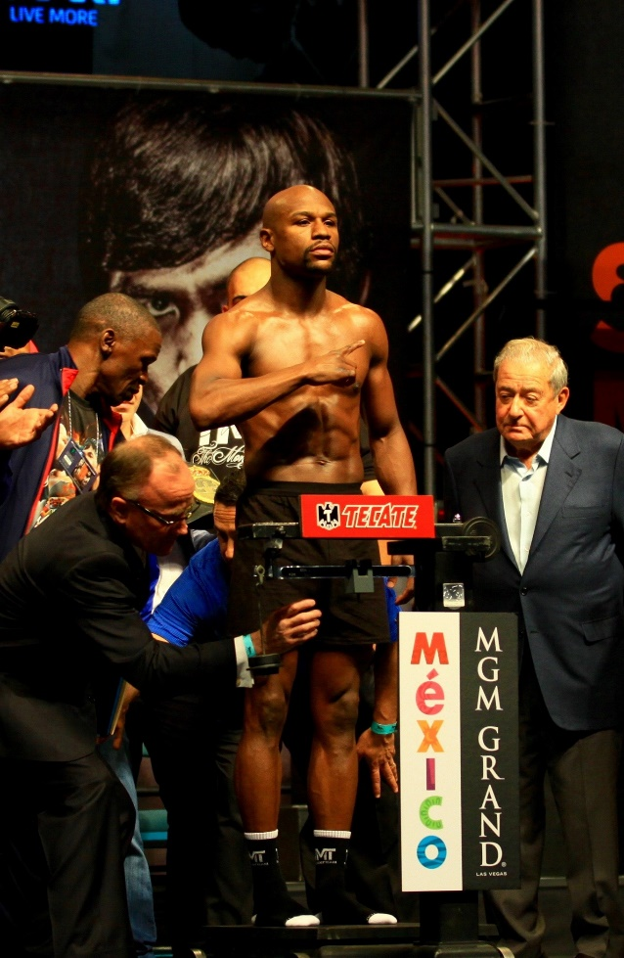
Drugs in sport
Effects of diuretics
INSPECTION COPY
Learn
Banned diuretics in sport are usually taken in tablet form and are termed ‘water pills’ as they help rid the body of water so that the performer can lose weight, e.g. when making a weight category in boxing. However, this can have very serious side effects.
Can cause severe dehydration and cramping
Increased weight loss to meet a weight category
Increased urge to urinate
Ability to mask other drugs in the system
Can bring about headaches and confusion
COPYRIGHT
PROTECTED
© ZigZag Education, 2022
Notes:
Identify the reasons why diuretics are used by athletes and the side effects involved.
Which athletes would particularly benefit from this drug?

Slide 10

Drugs in sport
Blood doping
INSPECTION COPY
Learn
Blood doping is a prohibited method which involves a series of steps to increase the number of red blood cells in the body.
Blood is withdrawn from the performer in the weeks prior to competition.
The red blood cells in the blood are separated and frozen.
Blood doping is dangerous as it comes with a range of potential side effects, including:
Increased blood viscosity (thickening)
Risk of injection due to use of needles
Potential for heart attack or an embolism (blockage of an artery) due to increased blood viscosity
The red blood cells are injected into the performer in the days before competition.
COPYRIGHT
PROTECTED
The performer benefits from an increased red blood cell count. This increases the oxygen-carrying capacity of the blood, leading to increases in aerobic performance.
Lance Armstrong's use of blood doping brought blood doping under the spotlight:
© ZigZag Education, 2022
Notes:
Describe the process of blood doping.
Identify the types of sports which are likely to benefit from an increase in red blood cells.
Identify the risks to health of blood doping.

Slide 11

Beta blockers
INSPECTION COPY
Learn
Beta blockers are prescription-only medicines that are used for a number of different medical reasons. However, they are banned in certain sports, such as darts, archery and golf, due to their physiological benefits in fine motor control.
Improves accuracy
There are also negative side effects of beta blockers…
Tiredness
Reduces anxiety
Low blood pressure
Decreases heart rate
Reduced aerobic capacity
COPYRIGHT
PROTECTED
Decreases hand trembles
Weakness
Improves precision
Upset stomach
Decreases muscle spasms
© ZigZag Education, 2022
Notes:
Identify the reasons why beta blockers are used by athletes and the side effects involved.
Which athletes would particularly benefit from this drug?

Slide 12
For each performer’s goal below, identify the PED they are most likely to use.
“
”
Activity
In my upcoming 10 km race, I want to be able to maintain a quicker speed throughout so I can complete it in under 45 minutes.
EPO or blood doping
“
”
Click on each quote to reveal the performance-enhancing drug.
I want to be able to work through the pain in my next gym session in order to keep on top of my training.
Narcotic analgesics
“
”
In the next hockey match I know that our goal is going to come under a lot of pressure so I need to find a way to ensure that I’m alert.
Stimulants
“
”
I have my boxing weigh-in in two days’ time and I am still 3 kg off my target weight. Cutting out food is not going to be enough.
Diuretics
“
”
The nerves of competition are starting to get the better of me. I need to steady them so that my fine motor control is optimal.
Beta blockers
© ZigZag Education, 2022
Notes:
Identify the PED that each performer is most likely to use.
Click on each quote to reveal the answers.

Slide 13
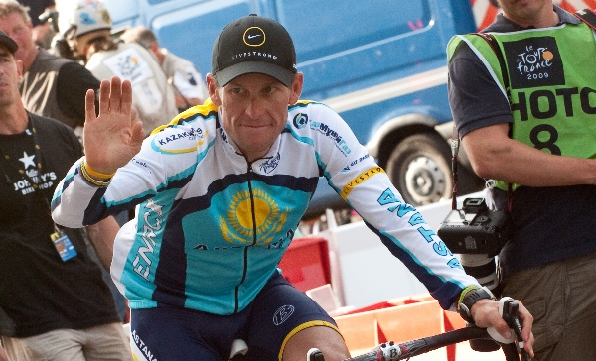
INSPECTION COPY
Advantages of taking PEDs
Learn
Taking performance-enhancing drugs in sport comes with a number of different advantages to the performer, which come from the specific positive effects with each PED already covered.
Improved chance of successful performance
The positive effects of PEDs result in improvements to performance, allowing the performer to progress with their career.
Increased winning brings fame to the athlete
Winning attracts interest from the media, which in turn attracts sponsors and additional commercial opportunities.
Increased winning brings wealth through prize money
Prize money is awarded for winning an event / a competition, or making progress through the various rounds.
Lance Armstrong was found guilty of (and later admitted to) using a range of PEDs throughout his cycling career, including EPO and diuretics, and even blood doping. He was stripped of his seven consecutive Tour de France titles from 1999 to 2005.
COPYRIGHT
PROTECTED
Levels the playing field against others using PEDs
Many athletes are unable to physically match their fellow counterparts who are using PEDs, so must take PEDs themselves.
© ZigZag Education, 2022
Notes:
Identify the advantages of using PEDs in sport for the performer.
Click through the slide to reveal example advantages.

Slide 14

INSPECTION COPY
Disadvantages of taking PEDs
Learn
There are many disadvantages to taking PEDs for the performer.
Cheating, and is against the ethics of sport
Risks a range of negative health effects
Results in fines if caught
Athlete can be banned from competing
Damages the reputation of the athlete
These also have a knock-on effect on the sport the athlete competes in:
Damages the credibility of the sport – spectators are less likely to trust that the result is down to the performer’s ability, believing instead that it is down to a PED that has gone undetected.
COPYRIGHT
PROTECTED
Damages the reputation of the sport – excessive use of PEDs in the sport gives it a bad association. Over time, this forms people’s views which stereotype the sport as one where PED use is widespread. This makes the sport less appealing to young performers and sponsors looking to invest.
© ZigZag Education, 2022
Notes:
Identify the disadvantages of using PEDs in sport for the performer and for the sport itself.
Click through the slide to reveal example disadvantages.

Slide 15

INSPECTION COPY
Discuss
Is the reward of winning greater than the risk of getting caught?
What measures are in place to reduce the use of PEDs in sport?
What other PEDs have been used by athletes in sport? Can you identify famous cases?
COPYRIGHT
PROTECTED
© ZigZag Education, 2022
Notes:
Take this opportunity to reflect on what has been learnt about the conduct of performers and how it impacts sport in a wider context.
Students can discuss these questions with their peers or respond individually by writing down their answers.

Slide 16
INSPECTION COPY
Exam-style questions
Answer the following exam-style questions and check your answers.
1. Explain the difference between sporting etiquette and sportsmanship.
(2 marks)
2 × AO1 marks:
Sporting etiquette is the unwritten acts of fair play and respect in sport (1)
Sportsmanship is the acting out of sporting etiquette and abiding by the rules of sport (1)
☞ Click to reveal answer!
2. Suggest the negative impacts that Lance Armstrong admitting to using PEDs may have had on other performers in cycling. (4 marks)
☞ Click to reveal answer!
4 × AO3 marks from:
Loss of positive role models to inspire participation in cycling (1)
Performers may see that there were no negative health impacts on Lance Armstrong and may, therefore, use PEDs themselves (1)
Performers may see the ‘reality’ of Lance Armstrong’s reason to use PEDs (because everyone else was doing it), and may follow in his footsteps (1)
Damaged reputation of cycling may result in loss of funding and thus support for performers (1)
Accept other appropriate answers.
COPYRIGHT
PROTECTED
© ZigZag Education, 2022
Notes:
Students to answer each exam-style question under exam conditions (approx. 1 minute per mark).
Click to reveal answers. Students to peer-mark or self-mark answers.

