Slide 1
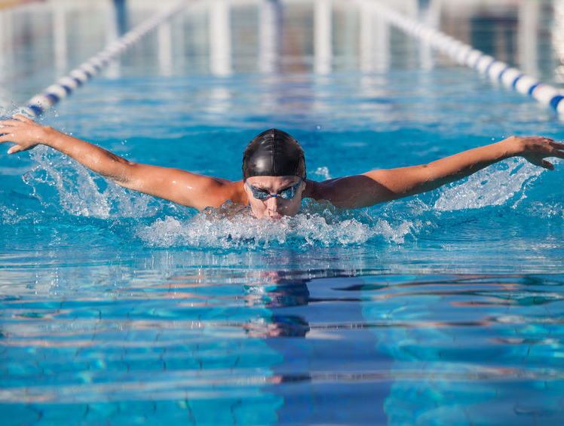
The Respiratory System
Structure and Function
Paper 1
Applied Anatomy and Physiology
3.1.1.2
Photocopiable/digital resources may only be copied by the purchasing institution on a single site and for their own use.

Slide 2

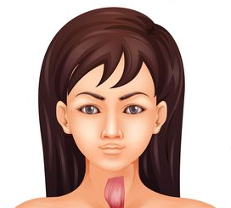

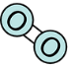
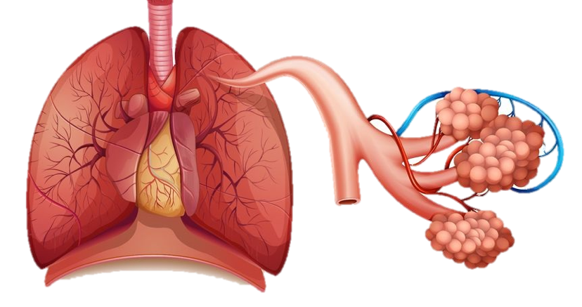

INSPECTION COPY
Pathway of air
Learn
Air flows through several structures on its way through the respiratory system…
Click to go through each stage in the flow of air.
2
Air enters the trachea, also known as the windpipe.
1
These terminate at tiny air sacs known as alveoli, which act as the site of gaseous exchange.
Oxygen in the air moves from the atmosphere into the body through the mouth and nose.
5
COPYRIGHT
PROTECTED
3
Air enters each lung via the bronchi. These are two tubes that carry air from the trachea into each lung.
4
These extend into many smaller branches known as bronchioles.
© ZigZag Education, 2022
Notes:
Introduction to the respiratory system by identifying the structures involved in the pathway of air.

Slide 3

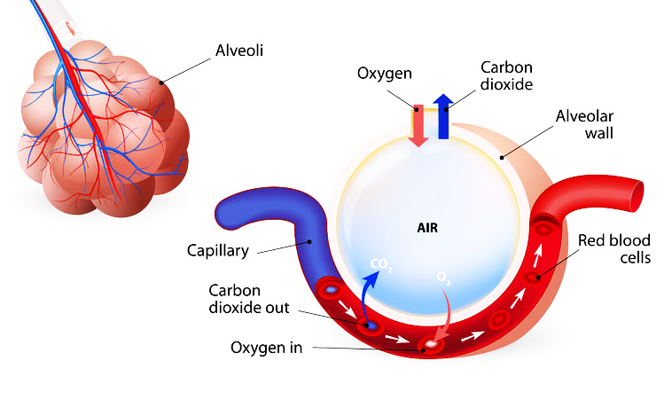
INSPECTION COPY
Gaseous exchange at the alveoli
Learn
Diffusion of gases from a high concentration to a low concentration:
O₂ moves from the alveoli (high concentration of O₂) to capillary blood (low concentration of O₂) for delivery to working tissues
At the same time, CO₂ moves from the capillaries (high concentration of CO₂) to the alveoli (low concentration of CO₂) for exhalation to the atmosphere
There are numerous factors that assist with gaseous exchange:
Large surface area of alveoli, allowing a large space for gaseous exchange to take place
High density of surrounding capillaries, providing a large blood supply for oxygen to diffuse into
Short distance for diffusion, meaning the diffusion process is quick
Moist walls of alveoli, helping gases dissolve. These walls are very thin (one cell thick), providing a short diffusion distance.
COPYRIGHT
PROTECTED
© ZigZag Education, 2022
Notes:
Describe the process of gaseous exchange at the lungs.
Explain the different factors that assist the process of gaseous exchange.

Slide 4
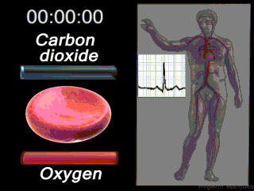
INSPECTION COPY
Oxygen transport
Learn
Oxygen is bound to a molecule in red blood cells known as haemoglobin. Once bound, the molecule becomes oxyhaemoglobin.
Once blood arrives at the muscle, haemoglobin offloads oxygen and picks up carbon dioxide to become carboxyhaemoglobin.
Therefore, as well as transporting oxygen in the blood, haemoglobin has an additional role of carrying carbon dioxide away from the muscle for exhalation into the atmosphere.
COPYRIGHT
PROTECTED
© ZigZag Education, 2022
Notes:
Introduce the molecule haemoglobin.
Explain its role in transporting both oxygen and carbon dioxide towards and away from the muscle.

Slide 5
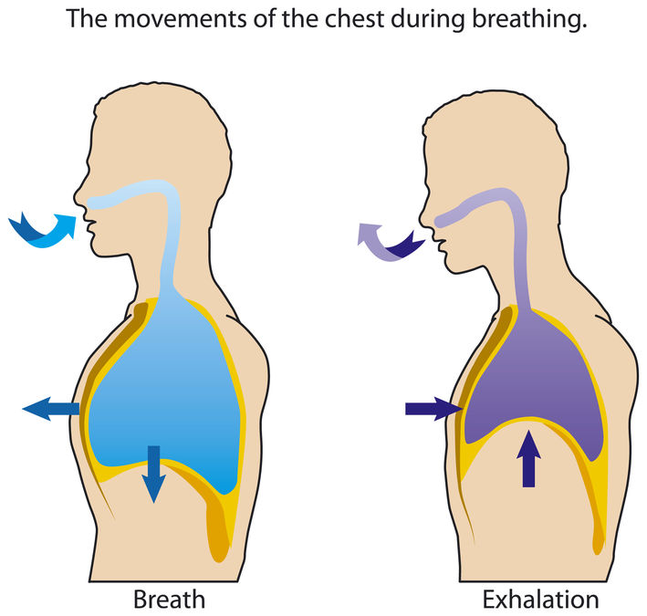
INSPECTION COPY
Mechanics of breathing
Learn
The processes of inspiration and expiration at rest are controlled by the movement of two key respiratory muscles.
Inhaling (breathing in)
Exhaling (breathing out)
The diaphragm…
flattens by contracting, which increases the volume of the thoracic cavity
The diaphragm…
returns to a dome shape by relaxing, which decreases the volume of the thoracic cavity
The external intercostals…
pull the ribs up and out by contracting, which increases the volume of the thoracic cavity
The external intercostals…
relax and move the ribs down and in, which decreases the volume of the thoracic cavity
COPYRIGHT
PROTECTED
These changes reduce the air pressure in the thoracic cavity, causing air to rush in from the atmosphere.
These changes increase the air pressure in the thoracic cavity, causing air to be forced out of the lungs.
© ZigZag Education, 2022
Notes:
Introduce the movement of the diaphragm and external intercostals.
Explain how these movements affect the volume of the thoracic cavity.
Explain the movement of air caused by changes in air pressure.

Slide 6
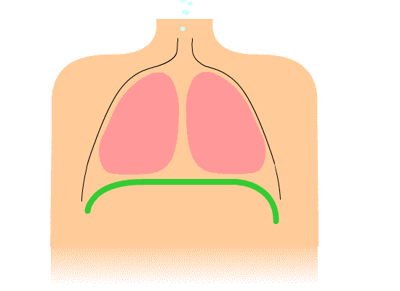
INSPECTION COPY
Let’s test your knowledge. Using the GIF below as a prompt, describe the mechanics of breathing.
Activity
COPYRIGHT
PROTECTED
Note that the GIF doesn’t change the diaphragm; however, the diaphragm should change as we inhale and exhale, but which way?
Click here to check answers.
© ZigZag Education, 2022
Notes:
Students to describe the mechanics of breathing.
Click once on the slide to reveal the exemplar answer.

Slide 7
INSPECTION COPY
Mechanics of breathing
Learn
The processes of inspiration and expiration at rest are controlled by the movement of two key respiratory muscles.
Inhaling (breathing in)
Exhaling (breathing out)
The diaphragm…
flattens by contracting, which increases the volume of the thoracic cavity
The diaphragm…
returns to a dome shape by relaxing, which decreases the volume of the thoracic cavity
The external intercostals…
pull the ribs up and out by contracting, which increases the volume of the thoracic cavity
The external intercostals…
relax and move the ribs down and in, which decreases the volume of the thoracic cavity
COPYRIGHT
PROTECTED
These changes reduce the air pressure in the thoracic cavity, causing air to rush in from the atmosphere.
These changes increase the air pressure in the thoracic cavity, causing air to be forced out of the lungs.
© ZigZag Education, 2022
Notes:
Students to use this slide to check their answers from the activity.

Slide 8
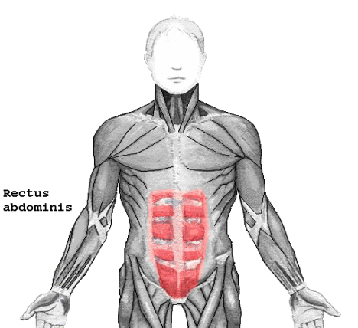
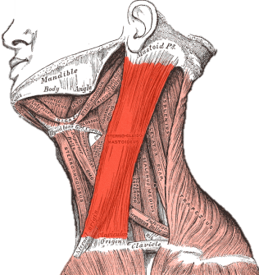
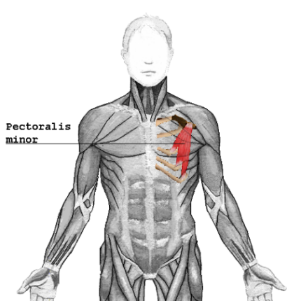
Mechanics of breathing
Learn
During exercise, additional muscles are involved in getting more air into and out of the lungs to meet the higher demands for oxygen delivery and carbon dioxide removal.
Click on the muscles to reveal their role in breathing during exercise.
Increase inspiration
Increase expiration
Sternocleidomastoid
Further increases the volume of the thoracic cavity by lifting the sternum and ribcage
Pectorals
Further increases the volume of the thoracic cavity by lifting the sternum and ribcage
Abdominals
Aids expiration by contracting and increasing the intra-abdominal pressure and forcing the diaphragm into a dome shape
© ZigZag Education, 2022
Notes:
Introduce the additional muscles involved in inspiration and expiration during exercise.
Explain how their actions affect the volume of the thoracic cavity, compared to rest.

Slide 9


Click on each of the squares on the spirometer trace to identify the different lung volumes.
Click on each of the volumes to the right of the page to reveal the change during exercise.
Lung volumes
Learn
A spirometer trace demonstrates the different lung volumes. Let’s explore these below!
Residual volume
The volume of air remaining in the lungs after maximum expiration.
Inspiratory reserve volume
No change
Expiratory reserve volume
The volume of air expired by force after a regular breath.
Volume (L)
Tidal volume
Decreases
Expiratory reserve volume
Inspiratory reserve volume
The volume of air inspired by force after a regular breath.
Decreases
Residual volume
Tidal volume
The volume of air inspired or expired per breath.
Time (s)
9
Increases
© ZigZag Education, 2022
Notes:
Introduce each lung volume, discussing the impact that exercise can have on each value.
Click on each text box to reveal how that value changes during exercise.

Slide 10
INSPECTION COPY
Use your knowledge of lung volumes to continue the spirometer trace below to show the change you would expect to see with tidal volume at the onset of exercise.
Activity
Click to reveal the model answer.
Volume (L)
COPYRIGHT
PROTECTED
Time (s)
© ZigZag Education, 2022
Notes:
Students to sketch out the graph on a blank piece of paper and continue the trace to indicate the onset of exercise.
Click once on the slide to reveal the exemplar answer.

Slide 11

INSPECTION COPY
Discuss
How do the different features of the alveoli assist gaseous exchange?
Describe the entire pathway of air through the respiratory system and to the muscle.
What are the immediate effects of exercise that you expect to see with the respiratory system?
COPYRIGHT
PROTECTED
© ZigZag Education, 2022
Notes:
Take this opportunity to reflect on what has been learnt and how it impacts sport in a wider context.
Students can discuss these questions with their peers or respond individually by writing down their answers.

Slide 12
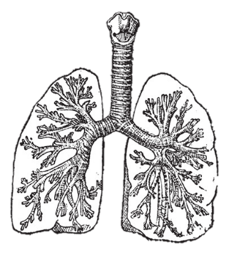
INSPECTION COPY
Exam-style questions
Answer the following exam-style question and check your answer.
1. Identify the structures of the respiratory system labelled A and B. (2 marks)
2 × AO1 marks:
A – Bronchus (or bronchi)
B – Trachea
☞ Click to reveal answer!
B
A
COPYRIGHT
PROTECTED
© ZigZag Education, 2022
Notes:
Students to answer each exam-style question under exam conditions (approx. 1 minute per mark).
Click to reveal answers. Students to peer-mark or self-mark answers.

Slide 13
INSPECTION COPY
Exam-style questions
Answer the following exam-style question and check your answer.
2. Explain the process of exhalation at rest.
(4 marks)
☞ Click to reveal answer!
4 × AO1 marks – any from:
The (external) intercostals relax (1)
The diaphragm assumes a dome shape (1)
The volume inside the thoracic cavity is reduced (1)
Air pressure in the lungs increases / is higher than that of the atmosphere (1)
Air is forced out / exhaled into the atmosphere (1)
COPYRIGHT
PROTECTED
© ZigZag Education, 2022
Notes:
Students to answer each exam-style question under exam conditions (approx. 1 minute per mark).
Click to reveal answers. Students to peer-mark or self-mark answers.

