Slide 1

Paper 1
Physical Training
3.1.3.3
Types of Training
Photocopiable/digital resources may only be copied by the purchasing institution on a single site and for their own use.

Slide 2

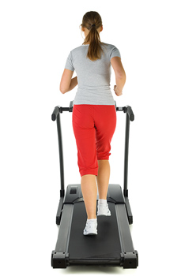

INSPECTION COPY
What are training methods?
Learn
Training methods are specific forms of training which aim to improve a certain component of fitness in order to improve skill and fitness for a particular sport or physical activity.
There are several training methods that athletes can use, which focus on improving different fitness components.
Through the next several slides we are going to explore the following training methods:
Circuit training
Continuous training
Fartlek training
Interval training / High-intensity interval training (HIIT)
Static stretching
Weight training
Plyometric training
COPYRIGHT
PROTECTED
© ZigZag Education, 2022
Notes:
Introduce what training methods are, i.e. they are specific forms of training that are used to improve particular components of fitness.
Different athletes will use different training methods depending on their sport and the components of fitness they are aiming to improve.

Slide 3
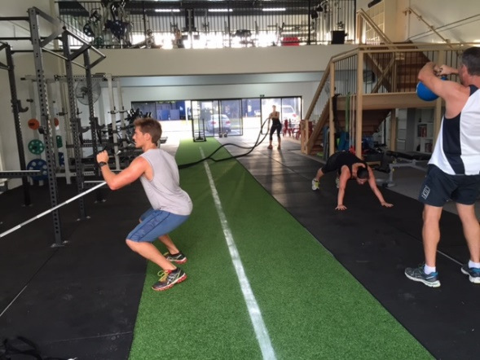
INSPECTION COPY
Circuit training
Learn
Circuit training is a type of training that can be adapted in order to improve a range of fitness components.
Circuit training can be adapted via the following ways:
Number of circuits
Number of exercise stations
Type of exercise/equipment at each station
Intensity of work
Work-to-rest ratio
Advantages:
Can be easily adapted to improve different fitness components
Can utilise a range of different equipment
Can incorporate a range of different exercises to use equipment
Example: For a resistance circuit training session, a performer may spend 30 s working and 1 min resting at each station, incorporating exercises such as press-ups, body squats, sit-ups and pull-ups. They may also choose to perform these exercises with resistance machine variations.
COPYRIGHT
PROTECTED
Disadvantages:
Requires a large space to make room for each station
Certain sessions are dependent on the availability of equipment
© ZigZag Education, 2022
Notes:
Explain that circuit training is where different stations are set up, with each station aiming to target different muscle groups.
Identify the different ways in which circuit training can be manipulated and discuss how these can be used to suit different fitness aims.
Evaluate the use of circuit training by discussing the advantages and disadvantages.

Slide 4
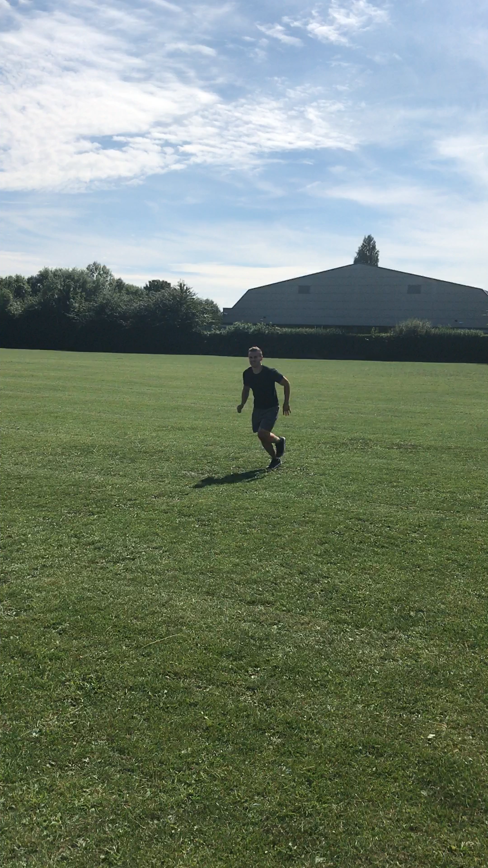

INSPECTION COPY
Continuous training
Learn
Continuous training is a type of training suited to endurance activities as it is performed at a constant (steady-state) low intensity for a sustained duration, without rest.
Continuous training should be performed at an intensity of 60–80% of maximum heart rate for a duration of at least 20 minutes.
Advantages:
Effective in improving aerobic fitness qualities
Requires minimal equipment
Can mimic different sporting activities (e.g. running, cycling, swimming, rowing)
Disadvantages:
May result in repetitive strain injuries (e.g. shin splints)
Can be very tedious
Little room for adaptation
COPYRIGHT
PROTECTED
Example: A long-distance runner may go for a 10 km run at a fixed intensity (e.g. 70% of maximum heart rate).
Hover over the video and click to play.
© ZigZag Education, 2022
Notes:
Identify that continuous training is designed solely for aerobic activities.
Identify the intensity and duration at which continuous training sessions should be performed.
Click on the video to see a quick example of a continuous running session.
Evaluate the use of continuous training by discussing the advantages and disadvantages.

Slide 5
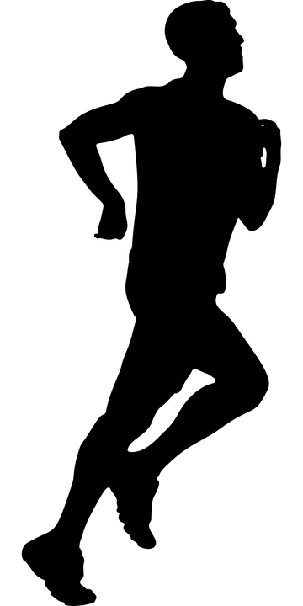
INSPECTION COPY
Fartlek training
Learn
Fartlek training involves exercise of varying speeds and/or over varying terrains.
Advantages:
Effective in improving both aerobic and anaerobic fitness components
Can adapt work-to-rest ratio to work at different intensities
Intermittent activity suited to team sports
Disadvantages:
Can be difficult to gauge a suitable work-to-rest ratio
COPYRIGHT
PROTECTED
Example: A football player may go for a run in a hilly area to vary the intensity of exercise through use of different terrains.
Jogging at a comfortable pace…
… followed by periods of high-intensity running/sprinting before returning to the comfortable jogging pace
and/or with varying terrain
© ZigZag Education, 2022
Notes:
Identify the key principles of fartlek training and that it is particularly relevant in sports involving both aerobic and anaerobic activities.
Click through the presentation to see an animation of the different ways fartlek training can be performed.
Evaluate the use of fartlek training by discussing the advantages and disadvantages.

Slide 6
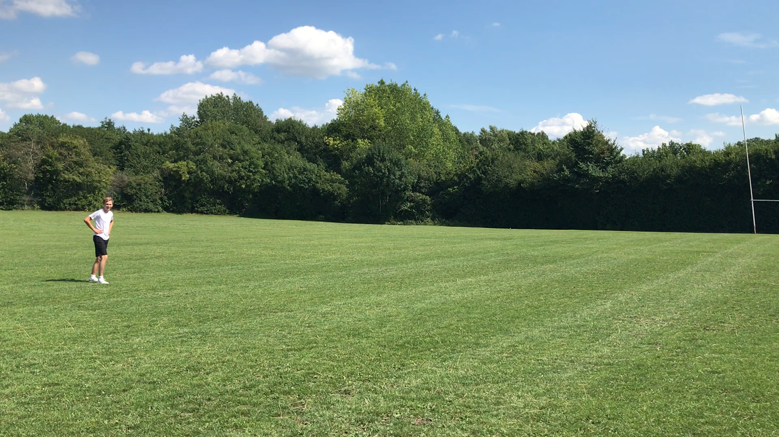
INSPECTION COPY
Interval training
Learn
Interval training comprises periods of work interspersed with periods of rest or low-intensity exercise. It is also known as high-intensity interval training (HIIT) when the intensity of work periods is hard and predominantly anaerobic.
Hover over the video and click to play.
High-intensity interval training should be performed at an intensity of 80–90% of maximum heart rate for exercise in the anaerobic training zone.
Example: A 400 m sprinter may intersperse 1-minute periods of high-intensity exercise with 4-minute periods of active recovery, for a total of 8 reps.
COPYRIGHT
PROTECTED
Advantages:
Can result in both aerobic and anaerobic fitness improvements in a short space of time
Work-to-rest ratios can be adapted to suit exercise needs
Disadvantages:
Working at a high intensity comes with an increased risk of injury
Requires a large amount of motivation to perform at a high intensity
© ZigZag Education, 2022
Notes:
Understand what is meant by interval training and that the high-intensity variation is termed HIIT.
Identify the intensity at which interval training sessions should be performed.
Click the video to see an example of the work period of an HIIT work bout.
Evaluate the use of interval training by discussing the advantages and disadvantages.

Slide 7
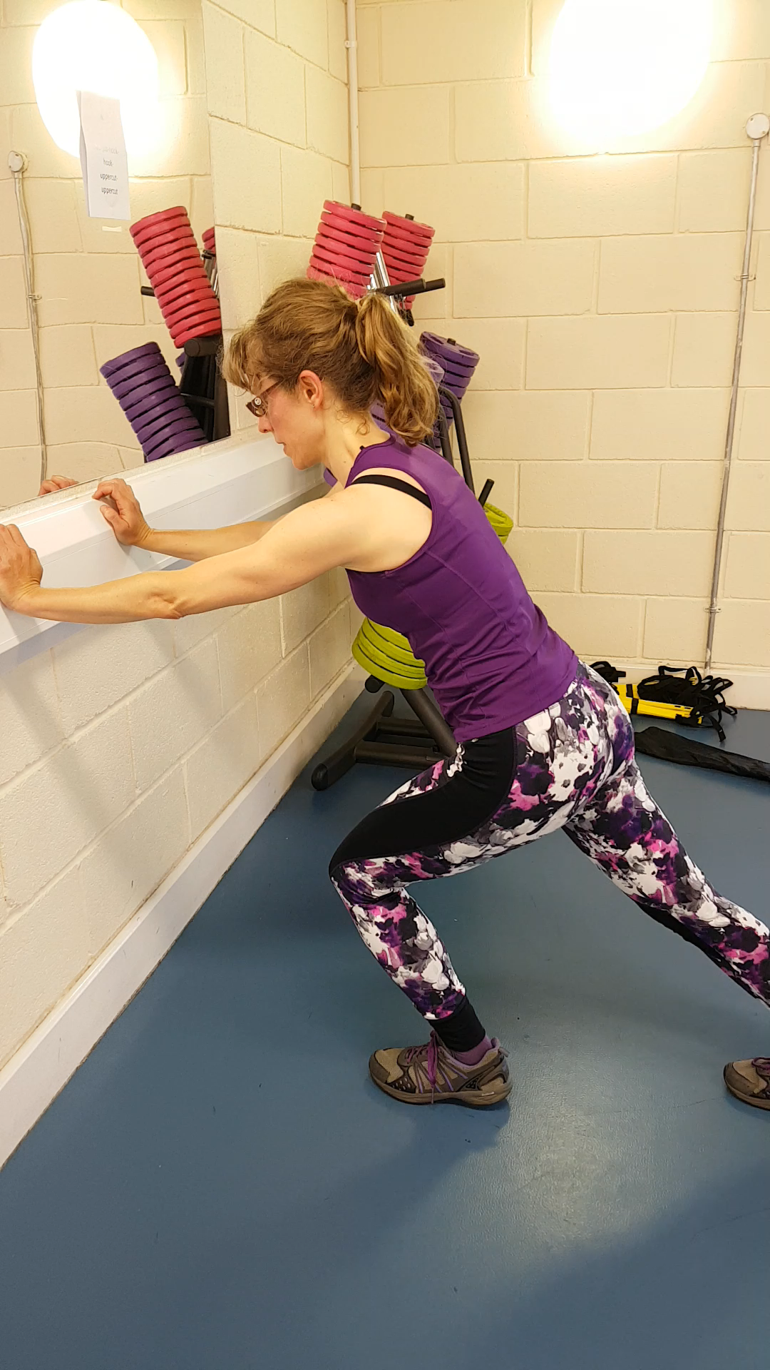
INSPECTION COPY
Static stretching
Learn
Static stretching is a training method aimed at improving flexibility.
The key components involve:
Holding a stretch for 30 seconds
Isometric contraction
Moving on to a different muscle group used in the activity
Advantages:
Requires minimal or no equipment
Effective against reducing the risk of injury
Disadvantages:
Can be very tedious
Performer may be at risk of overstretching
Requires use of the correct technique
COPYRIGHT
PROTECTED
Example: A gymnast may perform a range of stretches while seated. For example, they could sit with their legs apart and reach over on both sides of the body, holding on to the feet to allow for a deeper stretch.
Hover over the video and click to play.
© ZigZag Education, 2022
Notes:
Identify the use of static stretching for improving flexibility.
Understand what is meant by static stretching and the key components involved.
Click the video to see an example of a static stretch of the gastrocnemius muscle.
Evaluate the use of static stretching by discussing the advantages and disadvantages.

Slide 8
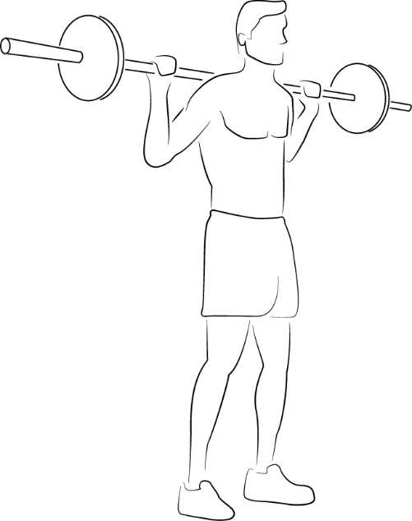
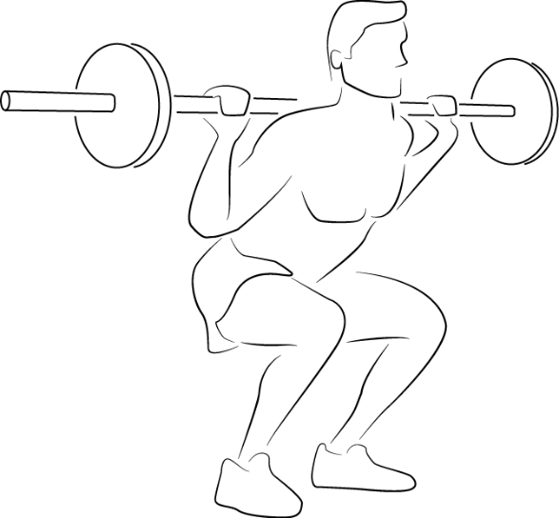
INSPECTION COPY
Weight training
Learn
Weight training can be manipulated to improve strength and power or muscular endurance.
Weight training can be manipulated via the following ways:
Repetitions – number of times a weight is lifted
Sets – number of times a series of repetitions is performed
Load – the amount of weight lifted
Advantages:
Can be adapted to improve different components of fitness
Intensity can be easily calculated from one-repetition maximum (1RM)
Disadvantages:
Requires access to specialist equipment and facilities
Lifting heavy loads relies on spotters
Correct lifting technique / safe practice required
COPYRIGHT
PROTECTED
Example: A rugby player may perform four different exercises in a weight training session (e.g. back squat, dead lift, bench press and prone pull), each with 6–8 reps over 4 sets, in order to develop strength.
© ZigZag Education, 2022
Notes:
Identify the key terms used in weight training.
Discuss how these terms can be manipulated in order to suit different fitness aims.
Evaluate the use of weight training by discussing the advantages and disadvantages.

Slide 9

INSPECTION COPY
Plyometric training
Learn
Plyometric exercise involves bounding movements that help to improve power.
Plyometric exercises consist of three stages:
Eccentric contraction
  (lengthening of the muscle)
Short amortisation phase
  (generating energy)
Forceful concentric contraction
  (shortening of the muscle)
Learn more about different examples of plyometric training here.
COPYRIGHT
PROTECTED
Example: A rugby player may perform plyometric exercises such as medicine ball throws against a wall to simulate passing.
Advantages:
Effective for improving power
Can target different muscle groups for different sports
Disadvantages:
Forceful movements come with a high risk of injury
May require equipment such as boxes
© ZigZag Education, 2022
Notes:
Know that plyometric training is a method designed to improve power / explosive strength.
Understand the key stages of a plyometric activity.
Identify different examples of plyometric exercises and the sports/activities they are tailored towards.
Evaluate the use of plyometric training by discussing the advantages and disadvantages.

Slide 10
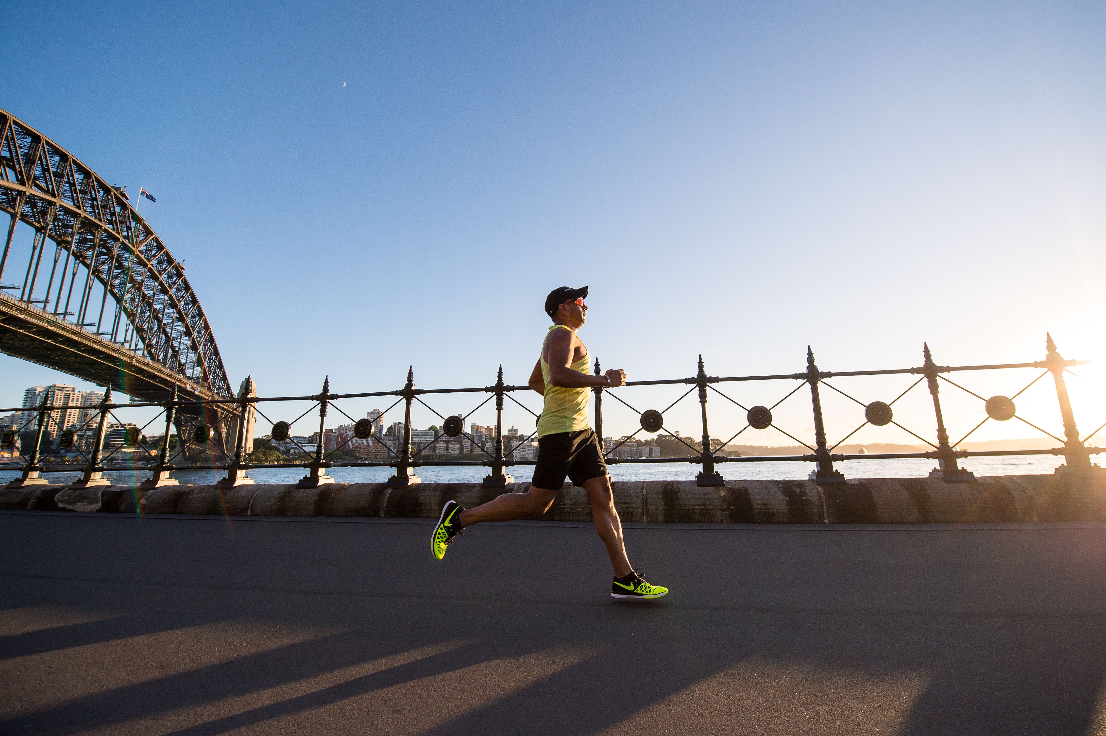
INSPECTION COPY
Which methods of training are designed to improve which components of fitness?
Discuss
How will recovery differ for each of the fitness training methods covered?
Choose an athlete in a specific sport/activity and discuss your selection of a suitable training method for that athlete.
COPYRIGHT
PROTECTED
© ZigZag Education, 2022
Notes:
Take this opportunity to reflect on what has been learnt and how it impacts sport in a wider context.
Students can discuss these questions with their peers or respond individually by writing down their answers.

Slide 11

Categorise each of the different sporting activities (below) into the given training method that is most suitable for improving performance in that activity.
Activity
A. Long-distance cyclist wanting to improve aerobic endurance
B. Gymnast who wants to improve their ability to hold a handstand for longer and improve their strength
C. Recreational runner training to improve aerobic endurance for the half marathon
D. Rugby player who wants to improve their aerobic endurance by adjusting speed and intensity
Click on each activity to reveal the correct category.
E. Footballer aiming to improve power to jump higher to head the ball
H. Trail runner wanting to improve their aerobic endurance using different terrains
F. Tennis player aiming to improve their speed and endurance
G. Triathlete looking to improve the muscular endurance in their legs
Continuous | Fartlek | HIIT | Plyometrics | Weight
© ZigZag Education, 2022
Notes:
Categorise each sporting activity into the training method that is best designed to improve performance in that activity.
Click on each activity to reveal the correct category.

Slide 12
INSPECTION COPY
Exam-style questions
Answer the following exam-style question and check your answers.
Colin competes in the long jump and uses plyometric training to improve his power.
1. i) What is plyometric training? (1 mark)
1 × AO1:
A training method used to improve power, which involves bounding movements resulting in an eccentric contraction followed by a more powerful concentric contraction.
Click to reveal answer!
1. ii) Discuss whether plyometric training is an effective training method for Colin.
(4 marks)
4 × AO3 marks:
For (sub-max. 3 marks)
Power required to generate distance in the jump (1)
Plyometric exercises can replicate the movement of the jump (1)
Plyometric training improves anaerobic power which is needed in the long jump (1)
Plyometric training can also help with acceleration in the run-up to the jump (1)
Against (sub-max. 3 marks)
Plyometric training comes with an increased risk of injury (1)
Plyometric exercises may require access to specialist equipment and facilities (1)
Plyometric training requires a large amount of motivation to perform explosive movements (1)
Accept other suitable responses.
☞ Click to reveal answer!
COPYRIGHT
PROTECTED
© ZigZag Education, 2022
Notes:
Students to answer each exam-style question under exam conditions (approx. 1 minute per mark).
Click to reveal answers. Students to peer-mark or self-mark answers.

