Slide 1
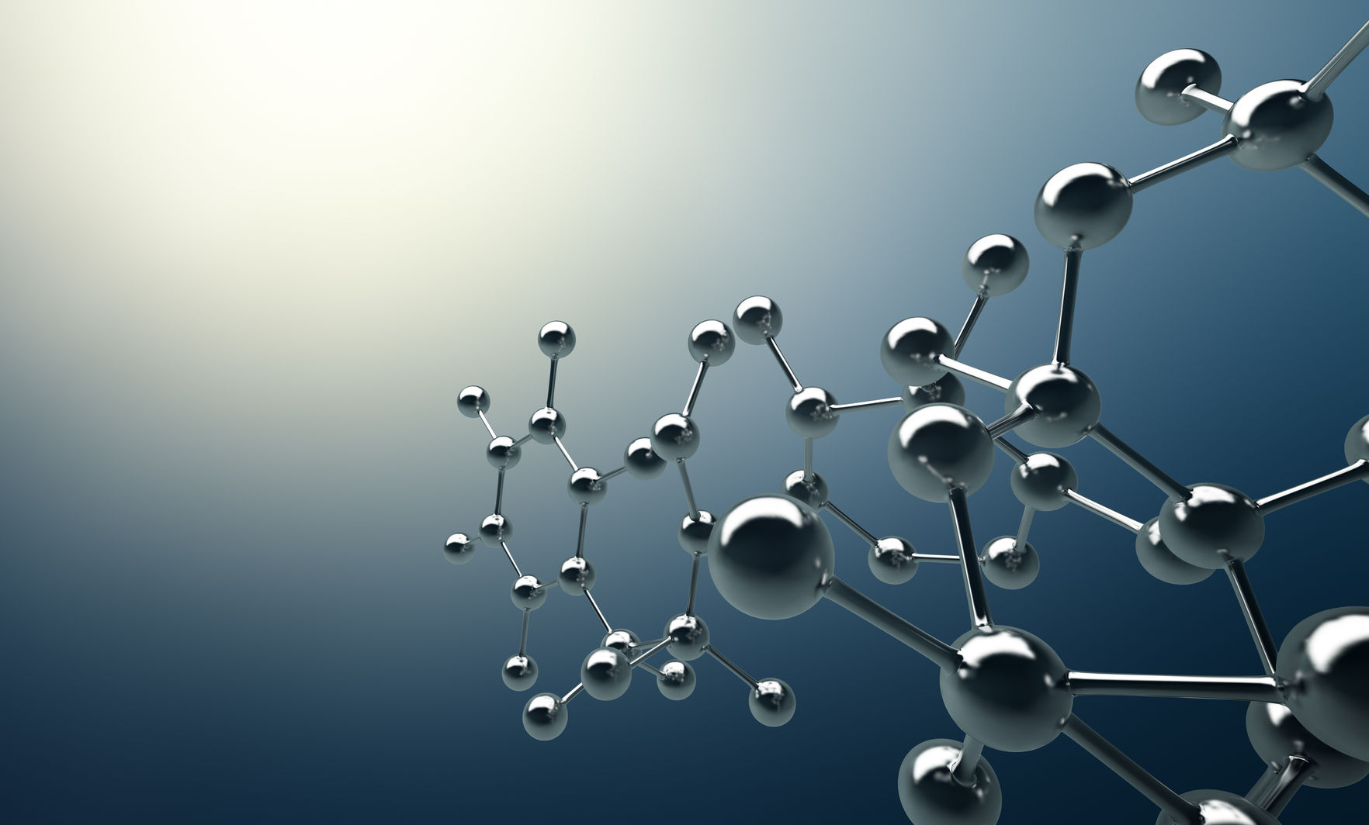
3.1.1.6 Energy Systems
Section A:
Applied Anatomy and Physiology
Energy Transfer
(An introduction to the systems)

Slide 2

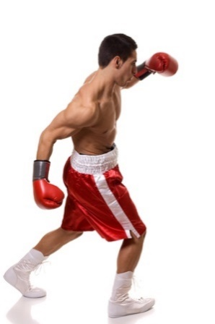

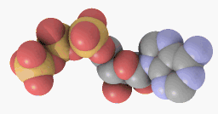
Learn
ATP and Energy Systems
INSPECTION COPY
What is Adenosine Triphosphate (ATP)?
Energy is required for performing physical and mental activities, and can come in many different forms.
Chemical Energy
Found in foods that we eat; it is released during chemical reactions.
Potential Energy
This is energy stored within an object due to its position, e.g. energy stored in the muscle tissues.
Electrical Energy
Energy that is stored and released by charged particles. The human body uses electrical energy to pass impulses through the nervous system and to cause muscular contractions.
Kinetic Energy
Any energy that causes movement of an object.
COPYRIGHT
PROTECTED
Although the food that we eat (i.e. macronutrients) provides the body with energy for movement, we must first break it down in order to release adenosine triphosphate (ATP).
ATP is the energy currency that our bodies run on.
A molecule of adenosine triphosphate
In order to perform any form of exercise, we must first break down ATP to release energy.
© ZigZag Education, 2020
Notes:
Introduce what energy is and different forms of energy (not essential for spec, but gives context).
Introduce what ATP is and the role that it plays in all energy systems, e.g. energy currency of the body.

Slide 3
Learn
ATP and Energy Systems
INSPECTION COPY
Breakdown of ATP
ATP (adenosine triphosphate) is made up of 1 adenosine molecule and 3 phosphate molecules.
Adenosine
P
P
P
In order to release the energy that is held in the bonds between the 3 phosphate molecules in ATP, one of these bonds must be broken.
This chemical reaction is catalysed by the enzyme ATPase…
COPYRIGHT
PROTECTED
Adenosine
P
P
P
Energy
ATPase
This is called an exothermic reaction
… which splits the bond between two of the phosphate molecules to produce ADP (adenosine diphosphate), 1 phosphate molecule and energy.
© ZigZag Education, 2020
Notes:
Explain how the breakdown of ATP to ADP provides energy for exercise.
Explain that this is an exothermic reaction.

Slide 4
Learn
ATP and energy systems
INSPECTION COPY
Resynthesis of ATP
ATP only lasts for approximately 2–3 seconds.
We do not have an endless supply of ATP within the body and, therefore, it needs to be resynthesised after it is broken down, in order to provide more energy in the future.
It is resynthesised by using energy to form a bond between a phosphate molecule (Pi) and ADP.
P
This is called an endothermic reaction
Adenosine
P
P
COPYRIGHT
PROTECTED
Energy
The ATP that is formed will be available to fuel the next burst of high-intensity exercise that an athlete performs, using energy systems.
© ZigZag Education, 2020
Notes:
Explain how ATP is resynthesised from ADP in order to replenish ATP stores.
Explain that this is an endothermic reaction.
Explain what is meant by a coupled reaction.

Slide 5
Learn
ATP and Energy Systems
INSPECTION COPY
Energy Systems
The body must use one of three energy systems to produce the energy which is required to resynthesise ATP from ADP + Pi:
ATP-PC (Phosphocreatine) System
Resynthesises ATP from breakdown of phosphocreatine.
Glycolytic System
Resynthesises ATP from the breakdown of glycogen.
Aerobic System
Resynthesises ATP from the breakdown of glycogen, glucose and free fatty acids (FFAs).
For each of these three systems you will need to know:
Whether the system is aerobic or anaerobic (i.e. whether it uses oxygen or not)
What chemical or food fuel is used
Site of reaction
Controlling enzyme
ATP yield
Stages within each of the three energy systems
By-products of each of the three energy systems
COPYRIGHT
PROTECTED
© ZigZag Education, 2020
Notes:
Introduce the three energy systems and the information that the students will need to know about each system.
Inform students that they must keep an eye out for these things on each slide.

Slide 6
Learn
ATP and Energy Systems
INSPECTION COPY
ATP-PC (phosphocreatine) System
The ATP-PC energy system occurs in the sarcoplasm (the cytoplasm of a muscle cell) and produces energy by breaking down phosphocreatine (PC).
The process is catalysed by the enzyme creatine kinase.
The energy and phosphate molecule released from the breakdown of PC are then used to resynthesise 1 ATP from 1 ADP.
P
Creatine kinase
Creatine
Energy
Adenosine
P
P
COPYRIGHT
PROTECTED
This energy system is used to provide energy very quickly, as PC is readily available and doesn’t require oxygen to be delivered.
It is an anaerobic energy system and provides energy for actions, such as sprinting.
However, due to the limited stores of PC in the body, it can only support up to 10 seconds of exercise.
This energy system produces no by-products.
© ZigZag Education, 2020
Notes:
Outline the steps of the ATP-PC system.
Outline the following for the ATP-PC system:
it is an anaerobic energy system
chemical or food fuel used is phosphocreatine
site of reaction is in the sarcoplasm of the muscle cell
controlling enzyme is creatine kinase
yields 1 mole of ATP
stages within the system: exothermic and endothermic
it has no by-products

Slide 7
Learn
ATP and energy systems
INSPECTION COPY
Glycolytic System
The glycolytic energy system is used to produce energy once the PC stores have been used up when performing anaerobic exercise.
As ADP + Pi levels rise, an enzyme called phosphofructokinase (PFK) is released which catalyses the breakdown of glucose in the blood.
If glucose levels are low, glycogen (stored glucose in the muscle cells) is broken down by an enzyme called glycogen phosphorylase (GPP), to retain the concentration of glucose back in the blood.
COPYRIGHT
PROTECTED
Glycogen
Glycogen phosphorylase
When no oxygen is available, glucose is used as a fuel and broken down to continue the resynthesis of ATP in the sarcoplasm, in a process called anaerobic glycolysis.
Glucose
Phosphofructokinase
© ZigZag Education, 2020
Notes:
Explain how continued anaerobic exercise continues after 10 seconds.
Explain the enzymes involved in catalysing the breakdown of glucose and glycogen (when glucose levels are low).

Slide 8
Learn
ATP and energy systems
INSPECTION COPY
Glycolytic system
This system coverts glucose into pyruvic acid.
One mole of glucose produces 2 moles of ATP and produces a by-product called NADH.
Glucose
If oxygen is available (aerobic) then the final stage of the glycotic energy system will involve pyruvic acid being converted to acetyl CoA (instead of lactic acid), which will then enter the Krebs Cycle of the aerobic energy system.
Phosphofructokinase
P
P
Adenosine
P
NADH
Energy
P
P
P
Adenosine
Pyruvic acid
Lactic acid
COPYRIGHT
PROTECTED
Lactate dehydrogenase
During high-Intensity exercise, without oxygen, energy is unable to be continually extracted from pyruvic acid, and an enzyme called lactate dehydrogenase (LDH) is released, converting pyruvic acid into lactic acid.
As lactic acid continues to accumulate, it inhibits enzyme activity from earlier processes, slowing the rate of ATP resynthesis, leading to fatigue and the onset of blood lactate accumulation (OBLA).
© ZigZag Education, 2020
Notes:
Outline the steps of the glycolytic system.
Outline the following for the glycolytic system:
anaerobic energy system
glucose as fuel source
site of reaction is the sarcoplasm
controlling enzymes: GPP, PFK and LDH
2 ATP yield from one glucose molecule
stages involve anaerobic glycolysis and the lactate pathway
by-products are lactic acid and NADH
Get students to think of examples of when this energy system may be used.

Slide 9
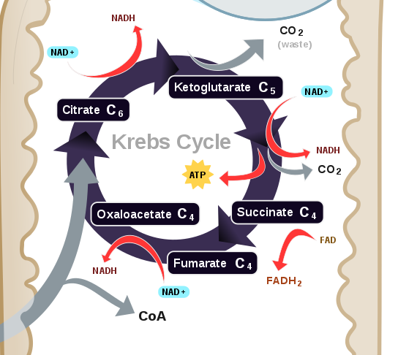
Learn
ATP and energy systems
INSPECTION COPY
Aerobic system
When exercising at an intensity which allows aerobic energy production to occur, aerobic glycolysis produces 2 moles of acetyl coenzyme A per 1 mole of glucose.
This then enters the Krebs cycle which occurs in the matrix of the mitochondria.
During this process, hydrogen is released and accepted by the hydrogen carriers NAD and FAD, and ATP is resynthesised.
The conversion of 1 mole of acetyl CoA within the Krebs cycle results in the production of:
1 FADH₂
3 NADH₂
1 ATP
CO₂
COPYRIGHT
PROTECTED
As 2 moles of acetyl CoA enter the Krebs Cycle for each mole of glucose, it produces a net of 2 moles of ATP.
Acetyl coenzyme A
© ZigZag Education, 2020
Notes:
Outline the stages of the Krebs cycle of the aerobic system.
Outline the following for the aerobic system:
aerobic energy system
site of reaction is the matrix of the mitochondria
controlling enzyme: acetyl coenzyme A
ATP yield: 2 ATP
by-products: carbon dioxide

Slide 10
Learn
ATP and energy systems
INSPECTION COPY
Aerobic system
The hydrogen atoms produced in the Krebs cycle are transported by NAD and FAD to the electron transport chain (ETC).
At the ETC, hydrogen is split into ions and electrons.
The ions are transferred over the inner membrane of the mitochondria, and the electrons pass through a series of reactions which release energy and produce H₂0.
The energy is used to resynthesise 34 moles of ATP from ADP.
COPYRIGHT
PROTECTED
Watch this music video to get an understanding of the process that occurs in the electron transport chain:
© ZigZag Education, 2020
Notes:
Outline the steps of the electron transport chain of the aerobic energy system.

Slide 11
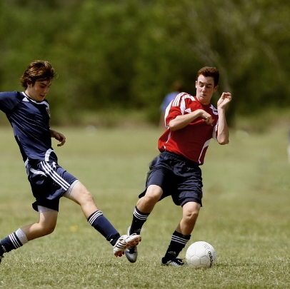
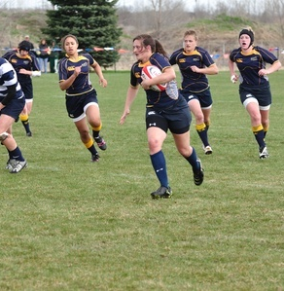
Learn
ATP and energy systems
INSPECTION COPY
Aerobic system
When all stages are combined, the aerobic system produces 38 molecules of ATP:
2 ATP from Aerobic Glycolysis
2 ATP from Krebs Cycle
34 ATP from Electron Transport Chain
Some sports, such as football and rugby, will want to save glycogen stores for high explosive movements, as glycogen can be used for aerobic exercise and anaerobic exercise.
As a result, they may use fats as a fuel for the aerobic system during lower-intensity exercise.
COPYRIGHT
PROTECTED
The enzyme lipase is released to break down fats into free fatty acids (FFAs) and glycerol, where the FFAs can be converted to acetyl-coenzyme A by a process called beta oxidation and enter the Krebs cycle.
More ATP can be produced from one molecule of fatty acids than glucose, so long-duration, low-intensity exercise, e.g. a marathon, will predominantly use fats as a source of energy.
© ZigZag Education, 2020
Notes:
Reiterate amount of ATP yielded from the three stages: aerobic glycolysis, Krebs cycle and electron transport chain.

Slide 12
ATP and energy systems
INSPECTION COPY
What are the benefits of training the three energy systems for a 1,500 m runner?
Discuss
When would the different energy systems be used during a hockey match?
How can an athlete apply principles of training in order to train the different energy systems?
How could an athlete adjust their diet in order to improve energy production?
COPYRIGHT
PROTECTED
© ZigZag Education, 2020
Notes:
Take this opportunity to reflect on what has been learnt and how it impacts on the wider context of sport.

Slide 13

ATP and energy systems
See whether you can complete the table below relating to the three energy systems.
Activity
Click on each section of the table to reveal the answers.
Things to know | ATP-PC | Glycolytic system | Aerobic system
Type of reaction | Anaerobic | Anaerobic or aerobic | Aerobic
Chemical / food fuel used | Phosphocreatine | Glucose/ glycogen | Glucose/ glycogen and fat
Site of reaction | Sarcoplasm | Sarcoplasm | Mitochondria
Controlling enzyme | Creatine kinase | PFK, GP, LDH | PFK, GPP, acetyl coenzyme A and lipase (if fats used)
ATP yield | 1 ATP | 2 ATP | 38 ATP
By-products | ADP and a single phosphate | NADH and lactic acid | Carbon dioxide and water
© ZigZag Education, 2020
Notes:
Get the students to try to fill in the table relating to the three energy systems.
Students can reveal each part of the table individually in order to reveal the correct answers.

Slide 14
ATP and energy systems
INSPECTION COPY
Exam-style question
Explain why all three energy systems are important for a football player.
(3 marks)
Click to reveal answer!
3 marks for:
The ATP-PC system provides energy for the first 10 seconds of maximal exercise, e.g. when sprinting for the ball or when performing explosive jumps.
The glycolytic system provides energy when working at high intensity for longer periods, e.g. when chasing an opponent around the pitch.
The aerobic energy system provides energy when working at a low intensity for prolonged periods, e.g. when jogging around the pitch to maintain the correct defensive positioning.
Accept other suitable answers
COPYRIGHT
PROTECTED
© ZigZag Education, 2020
Notes:
Students to write answers to questions on paper and check answers.
Click to reveal answers. Students to peer-mark or self-mark answers.

