Slide 1

Section A
Exercise physiology and biomechanics
3.2.2 Biomechanical movement
Projectile
motion

Slide 2




Learn
Projectile motion
INSPECTION COPY
Introduction
Projectile motion is used to describe the movement of any object which travels through the air.
Examples of objects undergoing Projectile motion within sport include:
Shot
Shuttlecock
Tennis ball
Long jumper
High jumper
The flight path of a shuttlecock and a shot will be different.
The flight path of the object through the air will be affected by a number of factors, and the impact on their flight path will be determined by the characteristics of the object and action.
COPYRIGHT
PROTECTED
We will look at these factors on the following slides.
© ZigZag Education, 2020
Notes:
Introduce the concept of projectile motion.
Identify examples of projectile motion in sport.
Introduce the idea that different projectiles have different flight paths – explain the terms ‘parabolic’ and ‘non-parabolic’.

Slide 3
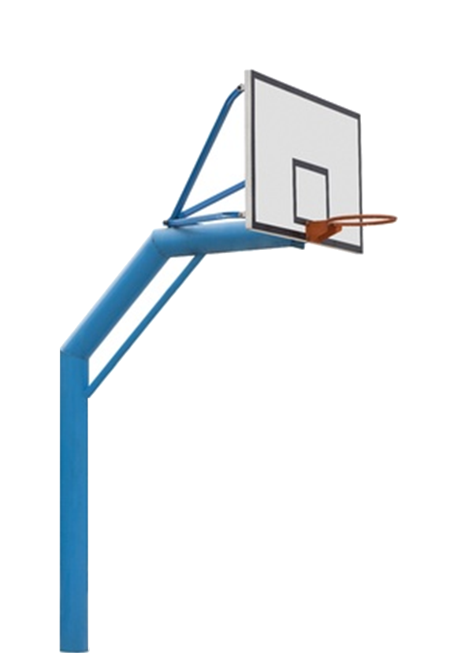


Learn
Projectile motion
Factors affecting the distance travelled by a projectile
The distance that a projectile travels is affected by three factors:
1. Height of release – a ball that is released at a higher point will more likely travel further in the air, if the correct optimal angle of release is applied.
Click on the basketballs to see who is able to make the hoop!
© ZigZag Education, 2020
Notes:
Explain how the height from which a projectile is released will impact on the distance travelled by the projectile.
Get students to visualise this concept by clicking on the basketballs being released from different heights.

Slide 4
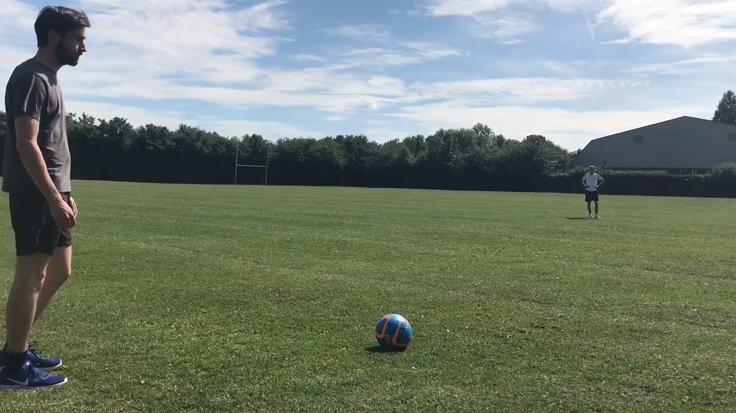
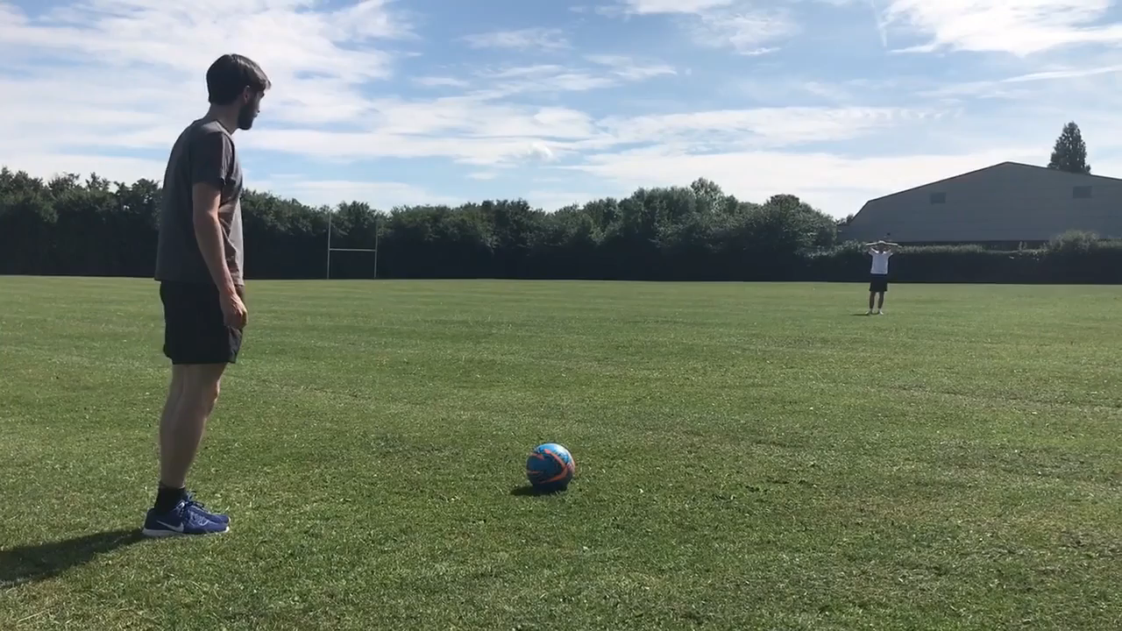
Learn
Projectile motion
INSPECTION COPY
Factors affecting the distance travelled by a projectile
2. Speed of release – the greater the force applied through a projectile, the further it will travel (Newton's second law of motion).
Play the videos to see how speed of release impacts on the distance travelled by a projectile
COPYRIGHT
PROTECTED
A less powerful kick will result in a shorter distance travelled by the projectile (a ball in this instance), due to less acceleration of the projectile through the air.
When the athlete applies more power, the projectile accelerates more quickly and goes further.
© ZigZag Education, 2020
Notes:
Explain how the speed at which a projectile is released will impact on the distance travelled by the projectile.
Get students to visualise this concept by watching the two videos of a football being kicked with different release speeds.

Slide 5
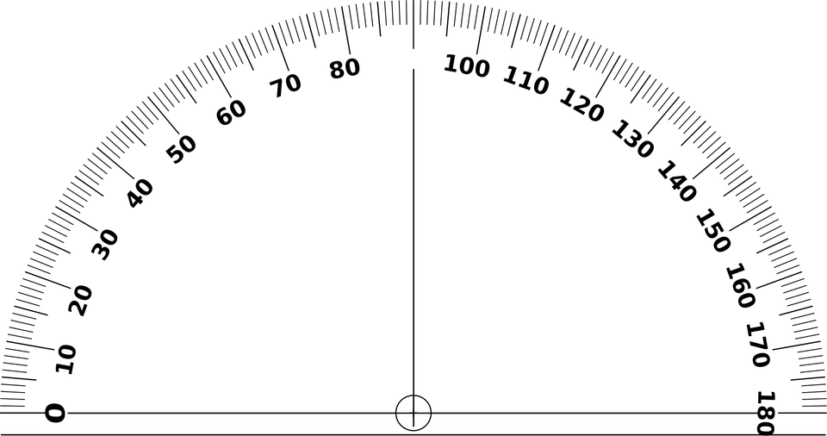
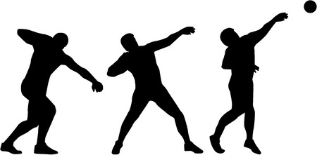
Learn
Projectile motion
Factors affecting the distance travelled by a projectile
3. Angle of release – releasing a projectile at an angle of 45 degrees is considered to be the optimal release angle, resulting in a greater distance being achieved.
60 degrees
Click on each of the different degrees to see what happens when the athlete releases the shot.
45 degrees
30 degrees
© ZigZag Education, 2020
Notes:
Explain how the angle at which a projectile is released will impact on the distance travelled by the projectile.
Get students to visualise this concept by clicking on the different angles to see the impact each one has.

Slide 6
Learn
Projectile motion
INSPECTION COPY
Free-body diagrams
Patterns of flight paths
Free-body diagrams like the one below demonstrate the impact that air resistance and weight have on a body in flight.
COPYRIGHT
PROTECTED
The arrows of the resultant forces of weight and air resistance form a parallelogram on the projectile, which indicates which forces will have the greatest impact on the flight path of the object.
© ZigZag Education, 2020
Notes:
Introduce free-body diagrams and explain what they show.

Slide 7
Learn
Projectile motion
Free-body diagrams
Here we will take a look at a free-body diagram of a shot in flight, to see how the forces affect its flight path.
The flight path of a shot is described as parabolic.
To see what this looks like, click on the shot below.
We can use parallelograms of force to visualise the impact of force on the flight path.
Flight direction
In this example, the weight of the shot provides more resistance to movement than the air resistance, and, therefore, the flight path is parabolic.
Air resistance
Resultant force
Weight
© ZigZag Education, 2020
Notes:
Get the students to click on the shot to see its parabolic flight path.
Explain how the parallelogram of force can be used to explain why the shot-put travels along this path.

Slide 8


Learn
Projectile motion
INSPECTION COPY
Free-body diagrams
Here we will take a look at a free-body diagram of a shuttlecock in flight, to see how the forces affect its flight path.
To see what this looks like, click on the shuttlecock below.
The flight path of a shuttlecock is described as non-parabolic.
Flight direction
Air resistance
Resultant force
Weight
COPYRIGHT
PROTECTED
In this example, the force of air resistance is the greatest force acting on the projectile. This is due to the relatively low mass of the object and the high initial velocity.
This results in a non-parabolic flight path.
© ZigZag Education, 2020
Notes:
Get the students to click on the shuttlecock to see its parabolic flight path.
Explain how the parallelogram of force can be used to explain why the shuttlecock travels along this path.

Slide 9
Learn
Projectile motion
INSPECTION COPY
Vector components of parabolic flight
Lets take a close look at the vector components of a parabolic flight, such as that of a shot-put.
The projectile travels horizontally and vertically during this flight path, and each stage and the amount of horizontal and vertical motion can be drawn on a vector diagram.
As gravity influences the flight path, the vertical arrow reduces in magnitude (size).
As gravity influences the flight path and is greater than mass, the vertical arrow points downwards.
No vertical arrow at top, as gravity is equal to mass.
COPYRIGHT
PROTECTED
Large vertical component, generated from muscular force of the athlete.
Now gravity is much greater than mass and continues to increase size of vertical arrow.
Air resistance is minimal, so remains constant throughout the whole flight. So the horizontal arrow remains the same.
By joining up the horizontal and vertical arrows you get the true flight path.
© ZigZag Education, 2020
Notes:
Get the students to click on the shuttlecock to see its parabolic flight path.
Explain how the parallelogram of force can be used to explain why the shuttlecock travels along this path.

Slide 10

Projectile motion
INSPECTION COPY
Identify some sports where being taller would be an advantage due to the impact that it has on projectile motion.
Discuss
Why do shot-putters have to make a trade-off between the optimal height, speed and angle of release?
How do designers ensure that track bikes produce high amounts of downwards lift?
COPYRIGHT
PROTECTED
© ZigZag Education, 2020
Notes:
Take this opportunity to reflect on what has been learnt and how it impacts on the wider context of sport.

Slide 11

Projectile motion
Draw and label the parallelogram of forces acting on the two projectiles, including:
Air resistance
Weight
Resultant force
Flight direction
Activity
Click on the images to reveal answers
Shot-put (Parabolic flight path)
Shuttlecock (non-parabolic flight path)
Air resistance
Flight direction
Air resistance
Flight direction
Weight
Resultant force
Weight
Resultant force
© ZigZag Education, 2020

Slide 12
Projectile motion
INSPECTION COPY
Exam-style question
Explain how releasing a shot-put at height will affect the distance travelled.
(3 marks)
Click to reveal answer!
AO1:
A greater release height leads to a greater horizontal displacement of a projectile.
AO3:
Gravity is constantly acting on the projectile, so when released at height it extends the length of time before the projectile falls to the ground
This results in a longer flight, if the optimal angle of release is used.
COPYRIGHT
PROTECTED
© ZigZag Education, 2020
Notes:
Students to write answers to questions on paper and check answers.
Click to reveal answers. Students to peer-mark or self-mark answers.

