Slide 1
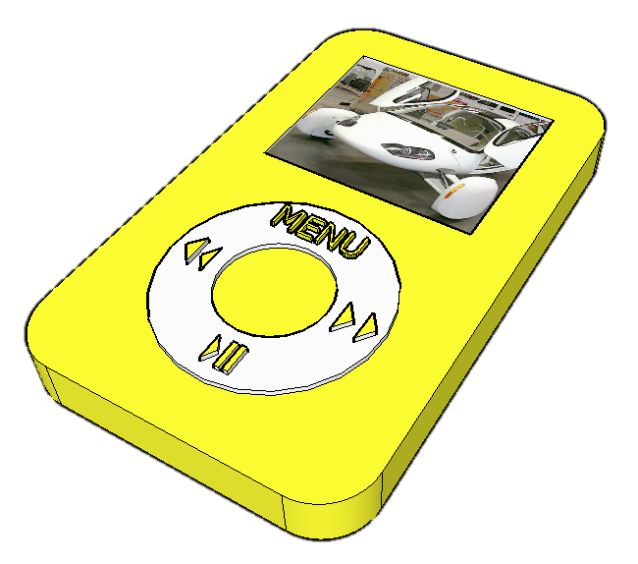
SketchUp
The iPod Classic
Level of Difficulty
Time
Approximately 20–25 minutes
Photocopiable/digital resources may only be copied by the purchasing institution on a single site and for their own use © ZigZag Education, 2013

Slide 2
By the end of this tutorial you will be able to…
Draw an iPod using real-life sizes
Use guidelines (construction lines)
Add and use other tool sets
Add 3D letters
Add your own photographs
Colour/render your design

Slide 3
Skills to be used in this project…
Basic Skills | New and Higher Skills
Zoom tool | Tape Measure tool for guidelines
Orbit tool | Arc tool
Pan tool | Move tool
Line tool | Use Views toolbar
Rectangle tool | Import photographs
Circle tool | Paint Bucket tool
Eraser tool | 3D Text tool
Push/Pull tool
Basic skills are those required to do very basic drawings and are detailed as part of this presentation.
New and higher skills may be new to the novice and are the focus for learning in this presentation.

Slide 4
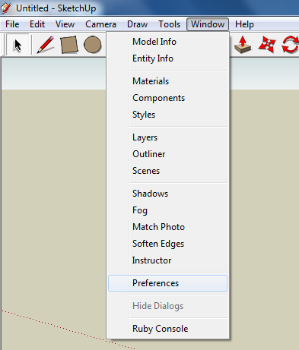
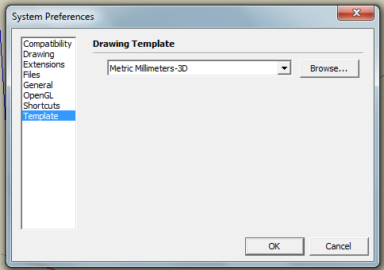
1. Once you have opened SketchUp, go to Window and select Preferences.
2. Select Template and choose Metric Millimeters-3D. We are using this template because we are doing a product design.
Therefore, on some versions of SketchUp you will need to select Product Design & Woodwork, Millimetres.
Note: It is often necessary to start a new file to use the new template.
Go to File then New.

Slide 5
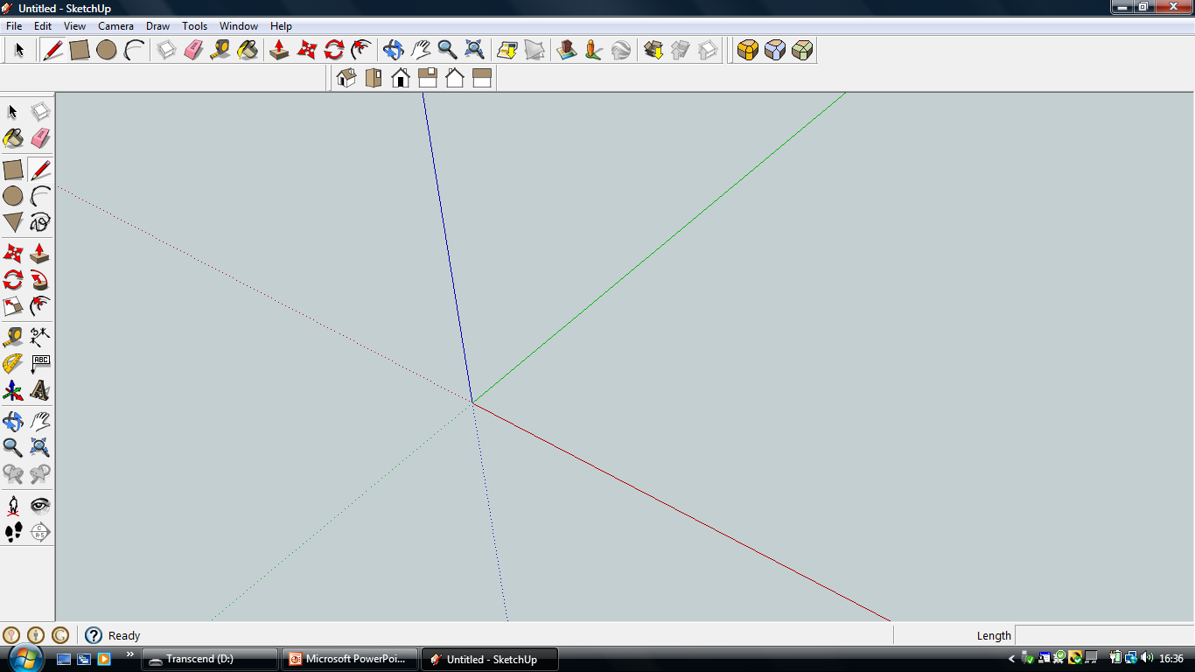
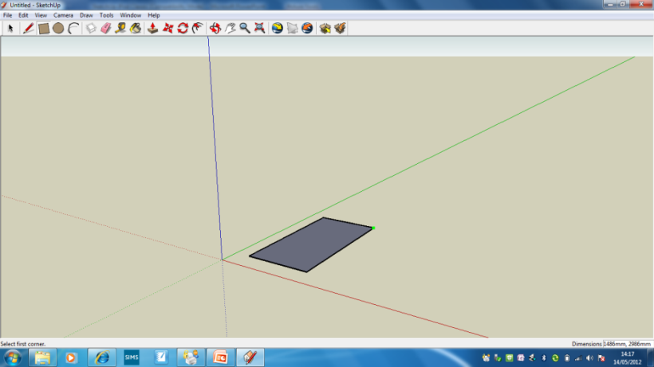
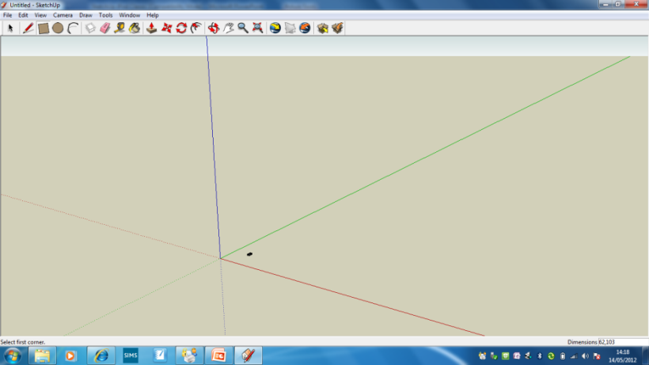
3. Now select the Rectangle tool and draw a rectangle on the base by clicking and dragging the cursor diagonally.
4. Once you have drawn the rectangle, DO NOT press enter. Firstly, enter ‘62,103’ and then press Enter. This gives the real-life size dimensions of the iPod.
5. Your resized rectangle may look very small. Just place your mouse cursor over it and use the middle wheel to roll and zoom in on it.
Alternatively, use the Zoom tool on the toolbar.

Slide 6
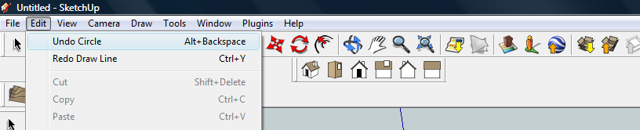
Some useful tips…
Note: If you make a mistake at any time during this tutorial you can just go to Edit and choose Undo from the drop-down menu, or press the Alt and Backspace keys.
You can use the Orbit tool to change the angle that you are viewing your design from. You can do the same by pressing the middle wheel of your mouse.
You can also use the Pan tool to grab and move your object around the screen.
Alternatively, you can pan by pressing the Shift key and holding down the mouse's middle wheel.

Slide 7
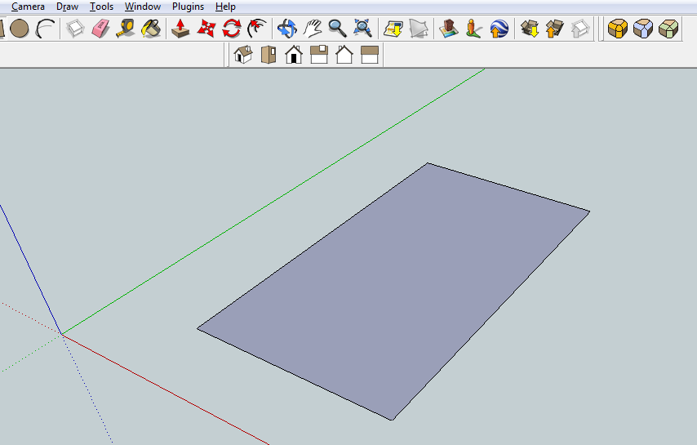
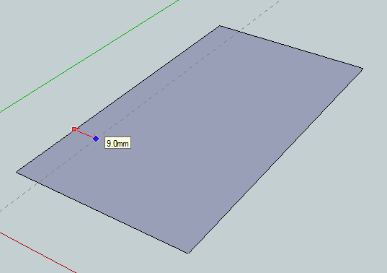
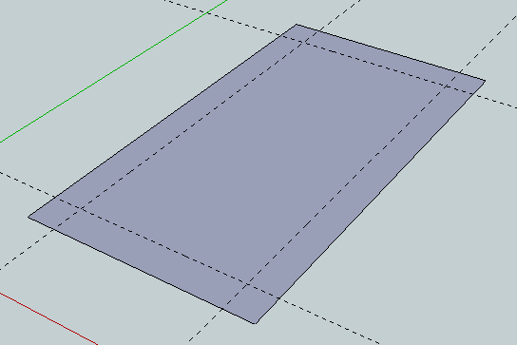
6. Having zoomed in, your view should look more like this one.
1
7. Select the Tape Measure tool from the toolbar. Click on the edge shown as 1 (look for the red dot). Move the cursor in from the edge and a guideline will appear. Type ‘8’ and this will set the guideline 8 mm from the edge.
8. Do this on the other three edges to make a margin all the way around the rectangle.

Slide 8
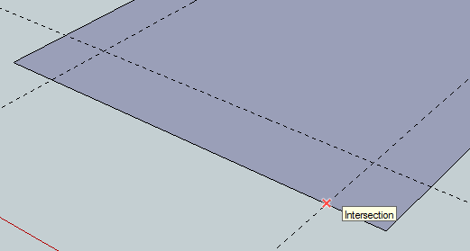

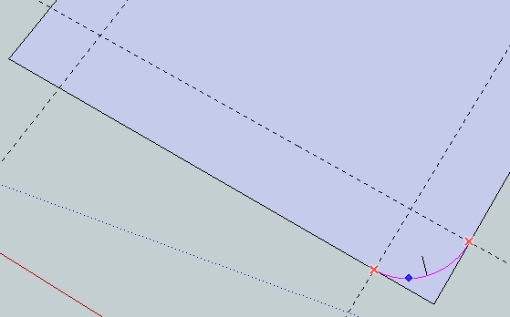
9. Now select the Arc tool so that you can round the corners off.
10. Click on the end of a guideline where it meets the edge (1). Look for the red cross and the prompt Intersection to appear.
1
11. Now draw a line diagonally across the corner, to join with the other guideline’s end (2). Again, look for the red cross and Intersection to appear before clicking on it.
2
12. Now move the cursor towards the centre of the line you have just drawn and bend it outwards a little. Then type ‘8’ and press Enter to give a radius of 8 mm.
Tip: I find it useful to orbit so that I can see the rectangle directly from above.

Slide 9
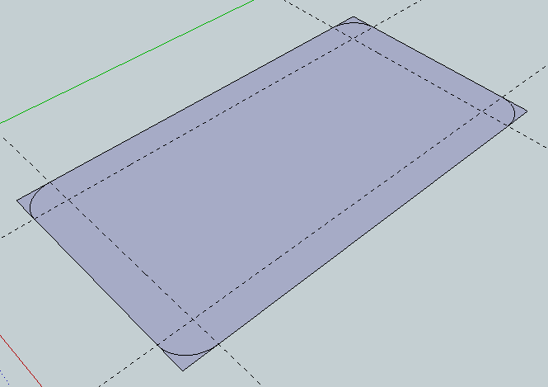
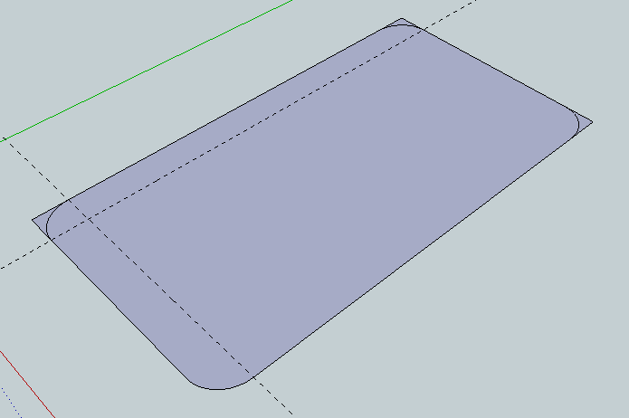
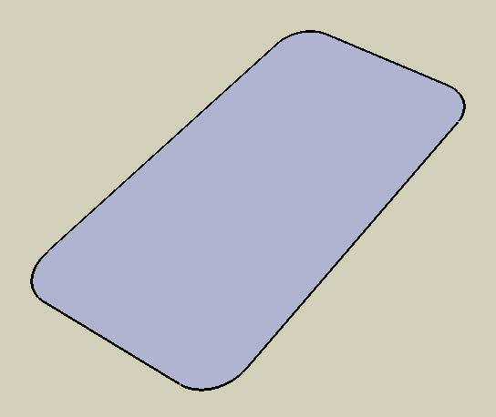
13. Do the same at each corner of the rectangle, to form an arc at each corner.
It helps to orbit and pan the each corner as you do so.
14. Use the Eraser tool to remove the unwanted corner lines and guidelines.
15. This will leave you with a shape like this.

Slide 10
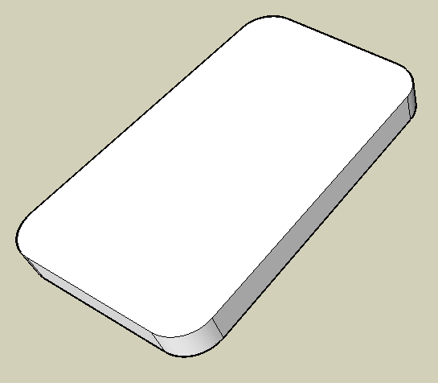
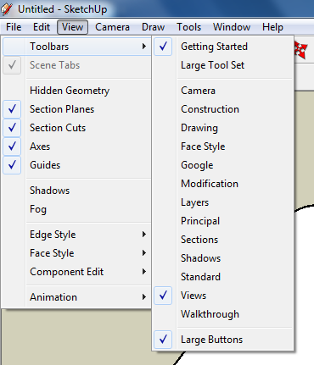
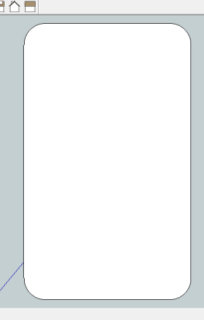
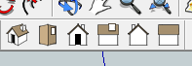
16. Select the Push/Pull tool and click on the shape. It should now be highlighted blue.
Pull up the shape to make it 3D, but do not click to stop it yet.
Instead, enter ’10’ and then click and this will make it 10 millimetres thick. The real size!
17. Now you want to be able to view your object straight on. To do this you are going to use the View toolbar.
Go to View, select Toolbars and then click on Views; this new set of tools will be next to your toolbar.
18. Click on this icon and you should see this.

Slide 11
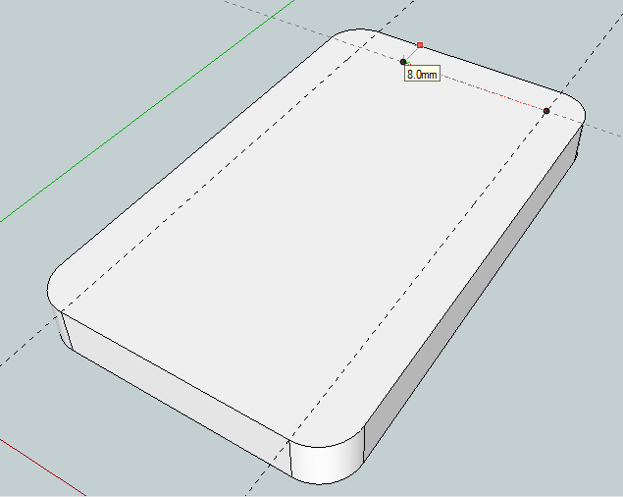
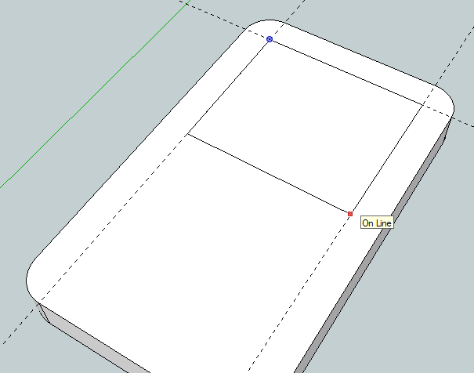
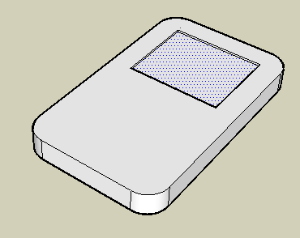
19. Use the new Views toolbar to
switch back to a perspective view
OR just Orbit again.
20. Now you are going to create the screen.
Use the Tape Measure tool to add some guidelines along the top and two sides of the block (as you did before).
1
21. Use the Rectangle tool to draw a rectangle starting from the corner of the guideline (look for the blue dot and the prompt Centre, shown at 1). Click somewhere on the other guideline (2) to form your screen. Use your own judgement to choose the size.
2
22. Delete the guidelines.
23. Select the Push/Pull tool.
Push the square down and type ‘1’.
This will recess the screen by 1 millimetre.

Slide 12
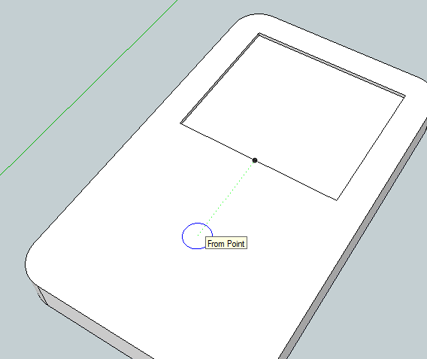
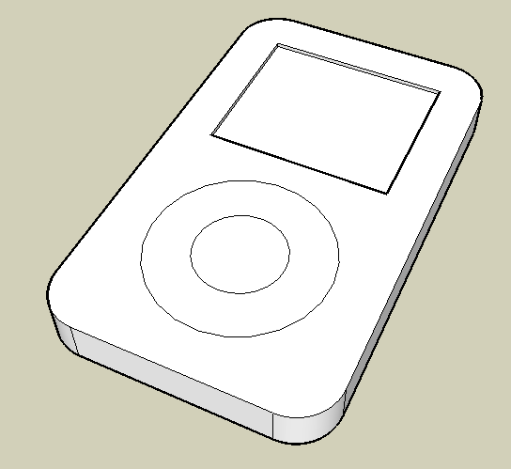
24. Select the Circle tool.
25. To form the click wheel, first find the centre of the bottom edge of the screen by hovering the cursor over it. (look for the blue dot and Midpoint prompt).
Gently move the mouse away and a green dotted line will appear, showing you that you are still in line with the centre.
26. Use your judgement to place the circle’s centre and click.
Then drag out to form a circle and enter ’20’.
This will make the outside of the circle have a 20 millimetres radius.
27. Then, making sure you start from the circle’s centre (look for the blue dot and prompt), draw the inner circle.
Use the Push/Pull tool to pull the ring up by 1 mm.

Slide 13
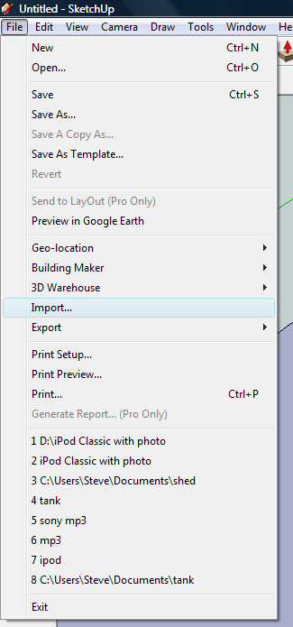
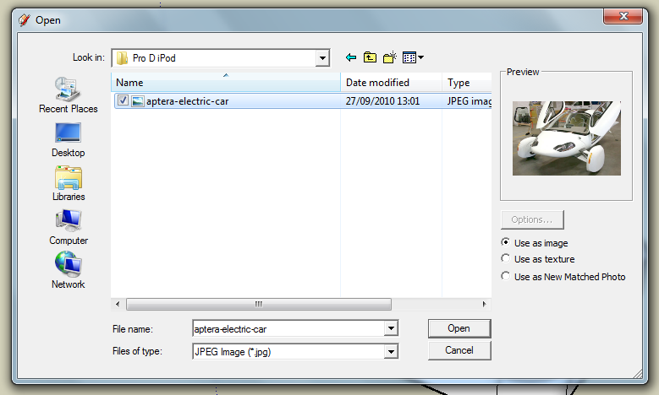
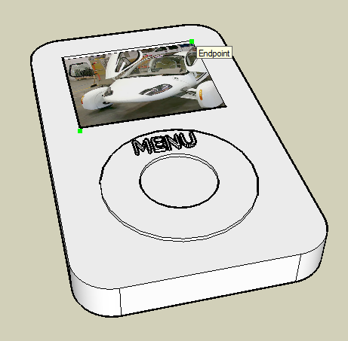
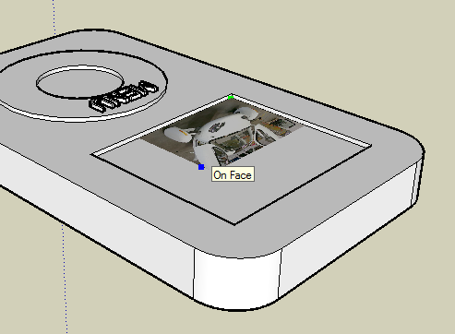
28. Now you are going to put your own picture on the screen.
To do this go to File, then Import and from your own files find a picture that you like.
29. You need to select this button, ‘Use as image’ and then click Open.
The type of image will need to be a JPEG so make sure this is selected in the box.
30. Then you need to rotate (using the mouse’s middle wheel) the iPod to get the image to start in this corner. Look for the bright green spot.
31. With the image still selected, use the mouse’s middle wheel to rotate so that you can select this opposite corner.

Slide 14

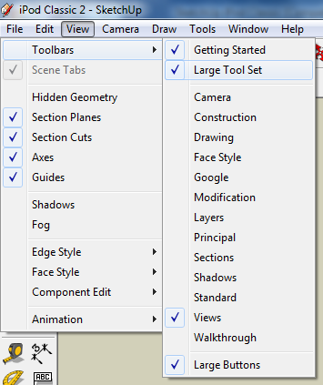
32. Now, again, you are going to add to your toolbars by selecting View then Toolbars, then Large Tool Set.
It will give you a toolbar like this one on the left-hand side of your screen.
33. Next you are going to select the text tool. The one that is a capital ‘A’.

Slide 15
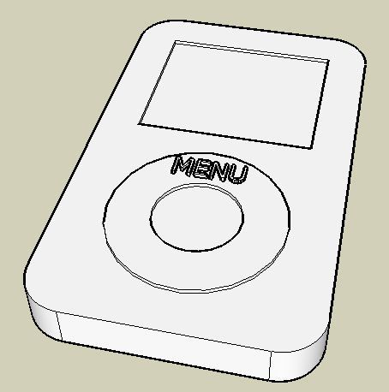
34. When the 3D text prompt box comes up, type ‘MENU’ and enter a value of 3 mm for its height and 1 mm to extrude (this means its thickness).
35. Place the 3D lettering on the click wheel.
36. If you are not happy with its position, use the Pick tool to select it by drawing a box around it. This will highlight it again in blue. Then use the Move tool to place it where you want. You can move lots of things in this way.

Slide 16
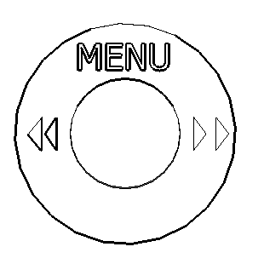
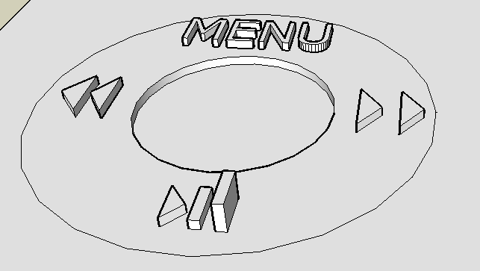
37. Some of you may be able to create these details for the click wheel by using the Line tool carefully.
38. Don’t forget to add a play button here!
39. Then, use the Push/Pull tool to raise the details by 1 millimetre.
I’m halfway through this one!

Slide 17
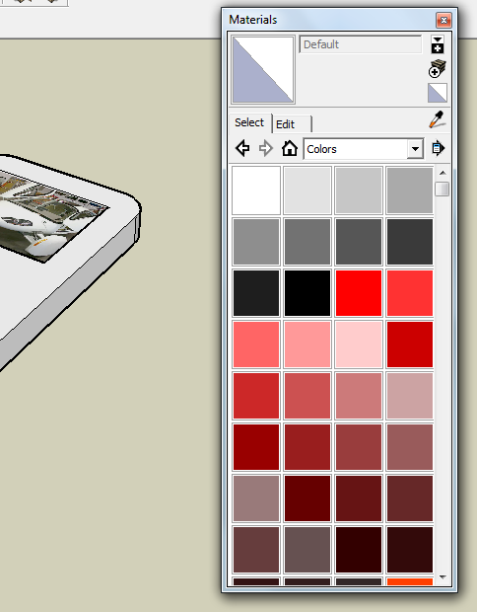
Select the Paint Bucket tool and a colours menu will come up.
41. Select your colour and then click on the bucket over the area that you want to colour.

Slide 18
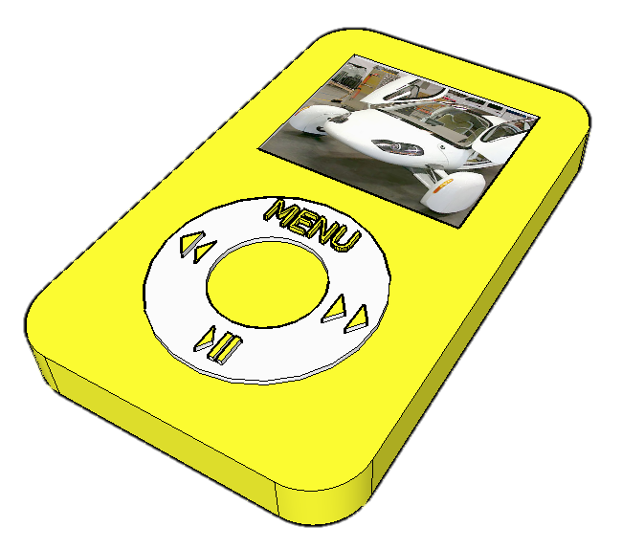
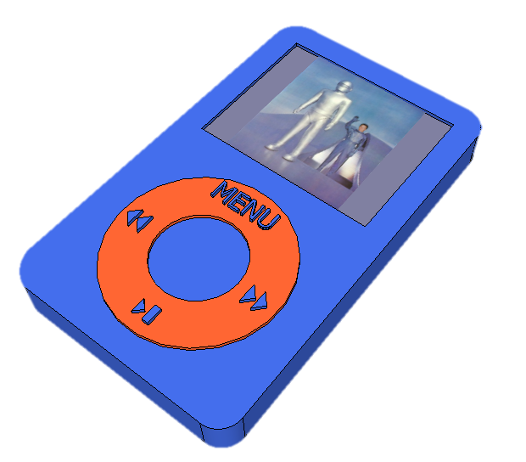
The finished result!
Extensions:
Put other details on the iPod such as a charging socket, earphones, camera, new buttons and features, etc.
Experiment with colours and materials for rendering.
Design a completely different iPod for the future.
Design and draw a tablet computer.

