Slide 1
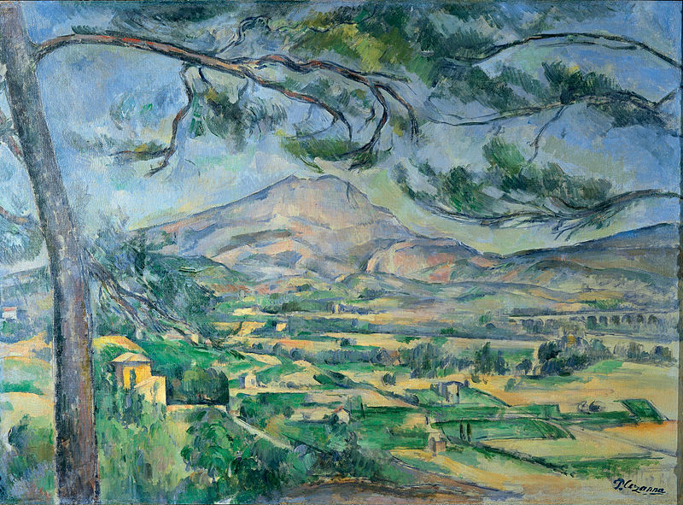
Exploring... Cote d’Azur (Year 8) Lesson 8 – Food Provençal Specialities

Slide 2
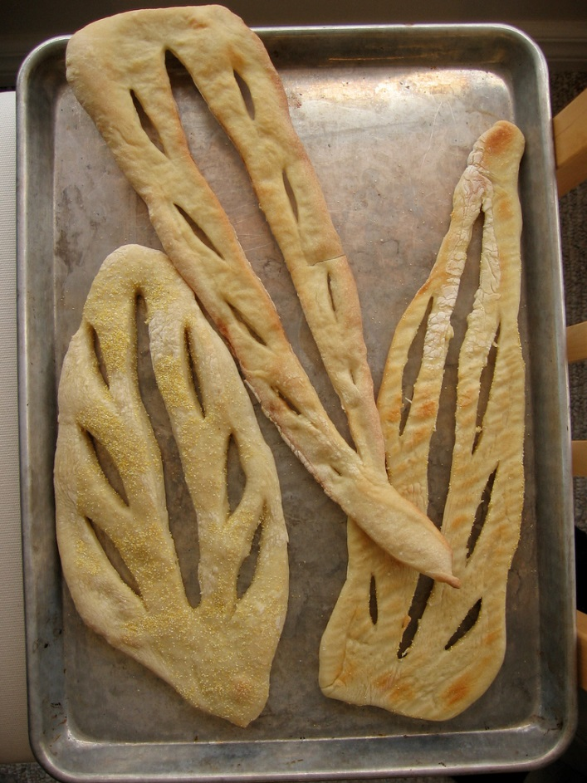
2.
Picture A
Photocopiable/digital resources may only be copied by the purchasing institution on a single site and for their own use

Slide 3
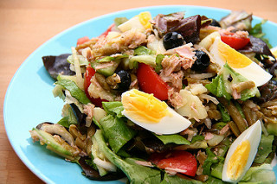
Picture B

Slide 4
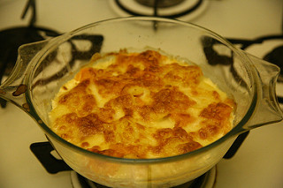
Picture C

Slide 5
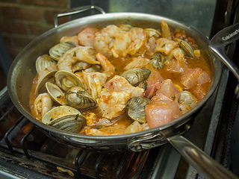
Picture D

Slide 6
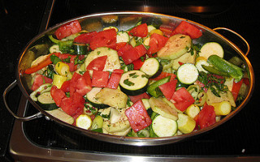
Picture E

