Slide 1
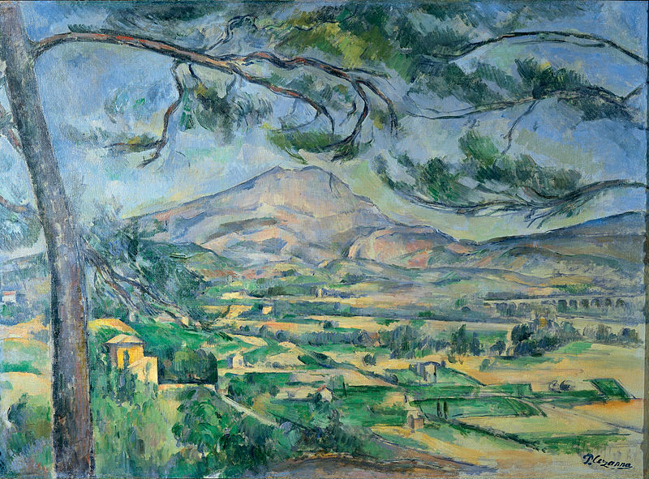
Exploring... Cote d’Azur (Year 8) Lesson 6 – Cinema Cannes Film Festival

Slide 2
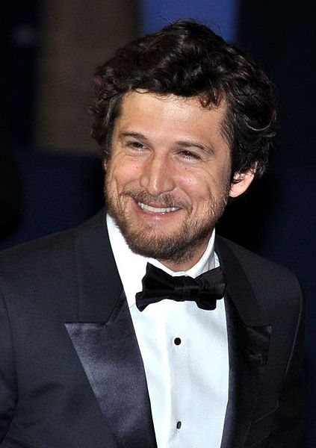
3. Actors
Guillaume Canet
Photocopiable/digital resources may only be copied by the purchasing institution on a single site and for their own use

Slide 3
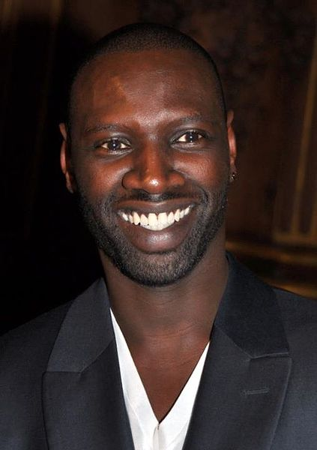
Omar Sy

Slide 4
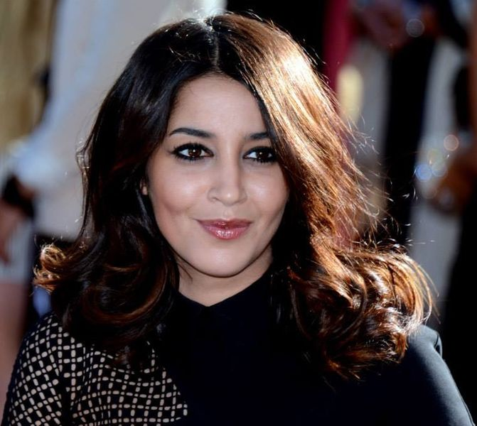
Leila Bekhti

Slide 5
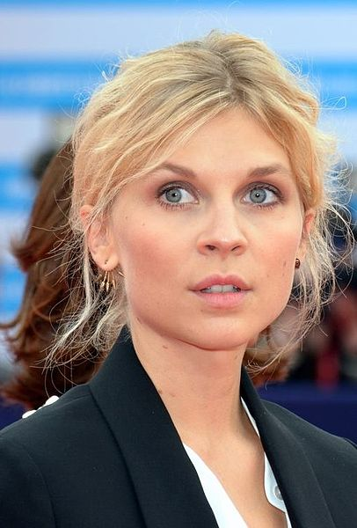
Clémence Poésy

