Slide 1
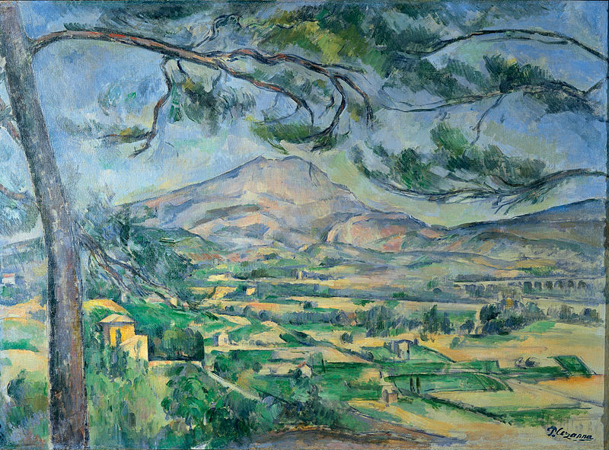
Exploring... Cote d’Azur (Year 8) Lesson 3 – Art Paul Cézanne, the Provençal painter

Slide 2
Starter
Painting 1: Mont Sainte-Victoire
Photocopiable/digital resources may only be copied by the purchasing institution on a single site and for their own use

Slide 3
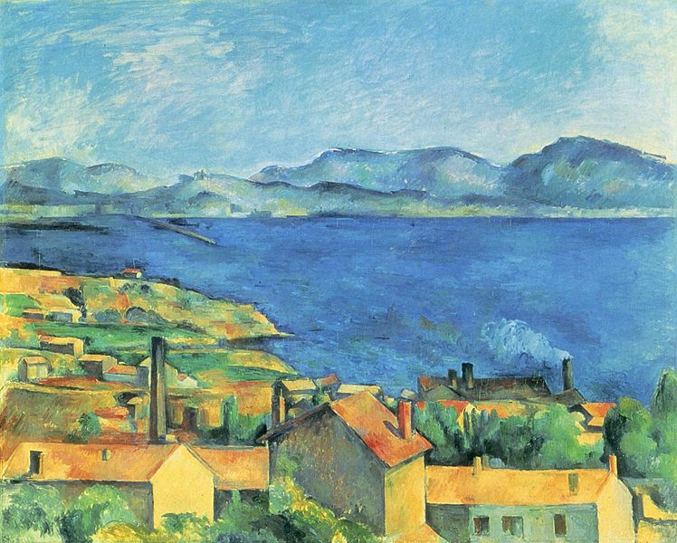
Painting 2: Baie de Marseille

Slide 4
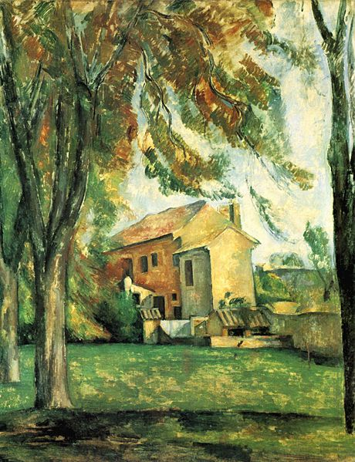
Painting 3: Le Jas de Bouffan

Slide 5
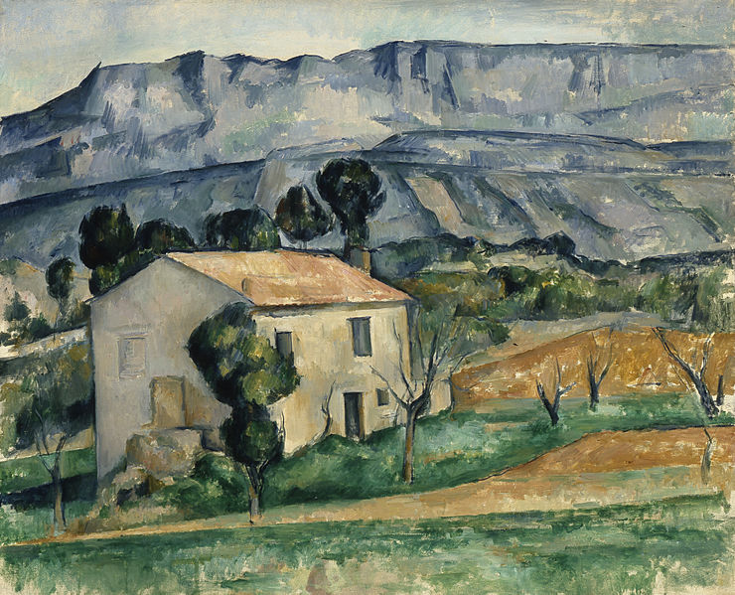
Painting 4: Maison en Provence

