Slide 1
Exploring... Cote d’Azur (Year 8) Lesson 1 – Geography Provence-Alpes-Côte d’Azur

Slide 2
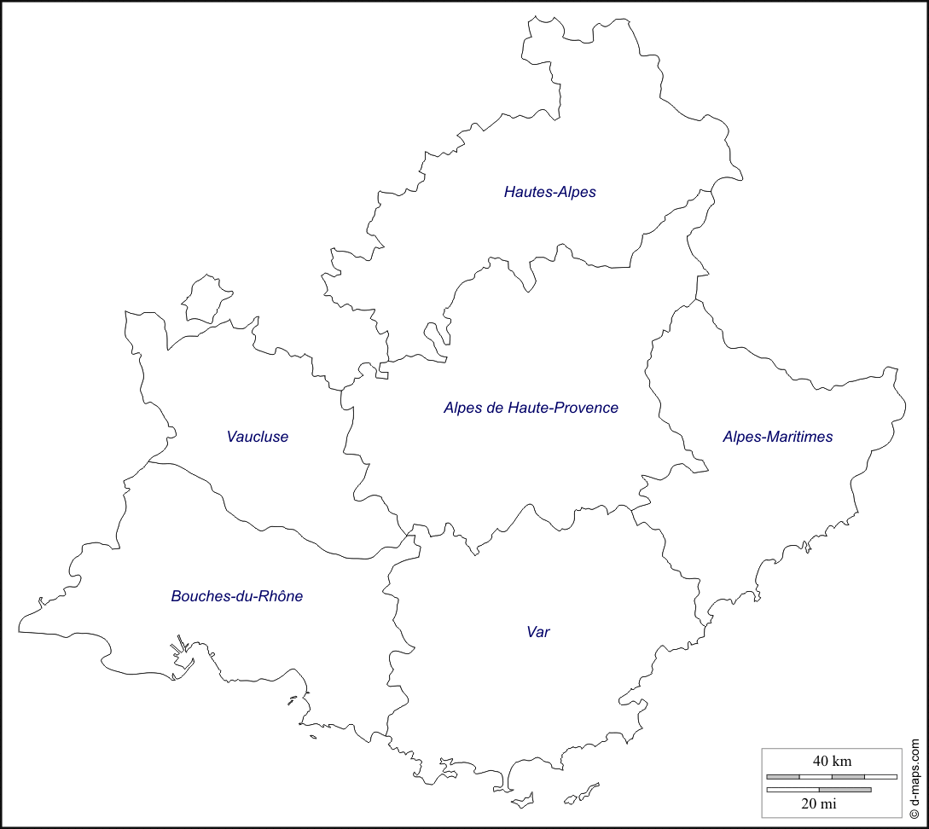
A. Complete Maps
Photocopiable/digital resources may only be copied by the purchasing institution on a single site and for their own use

Slide 3
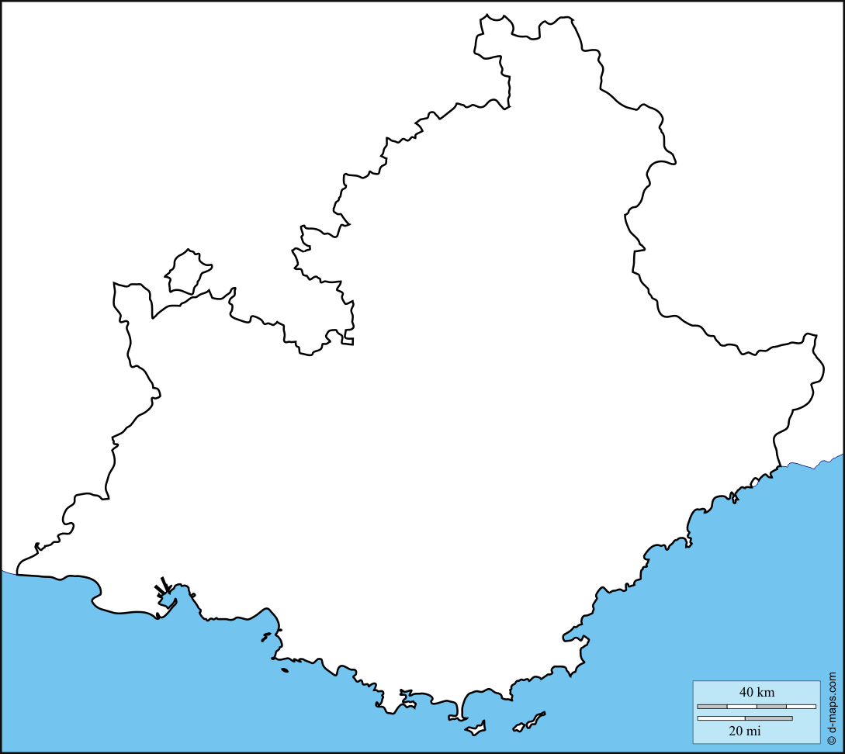
Gap
Digne-les-Bains
Avignon
Nice
Marseille
Toulon

Slide 4
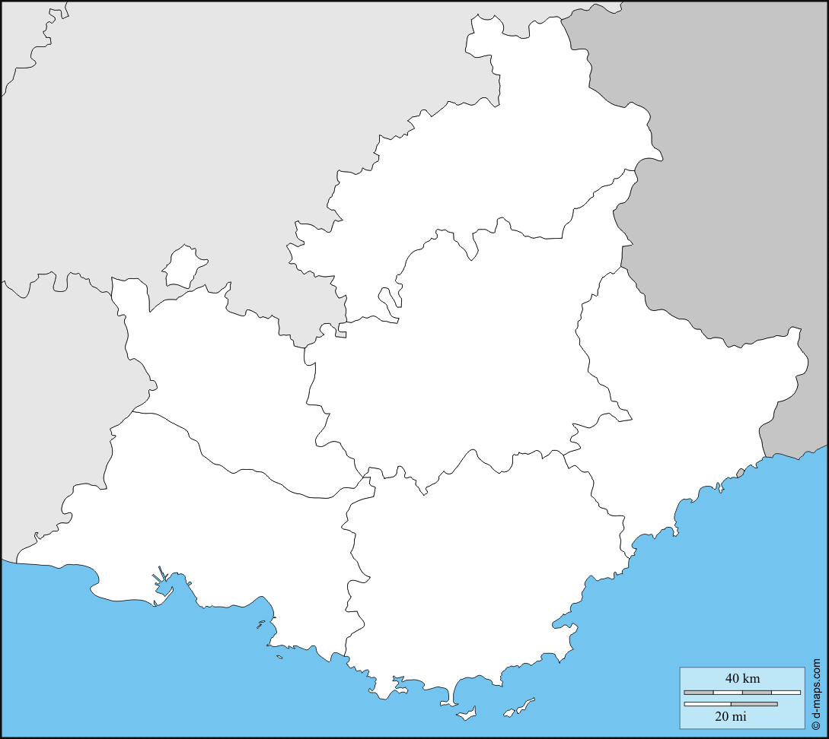
Departments to put on the map:
Vaucluse
Hautes-Alpes
Alpes-Maritimes
Bouches-du-Rhône
Var
Alpes-de-Haute-Provence
B. Map 1

Slide 5
Cities to put on the map:
Gap
Avignon
Nice
Digne-les-Bains
Marseille
Toulon
C. Map 2

