Slide 1
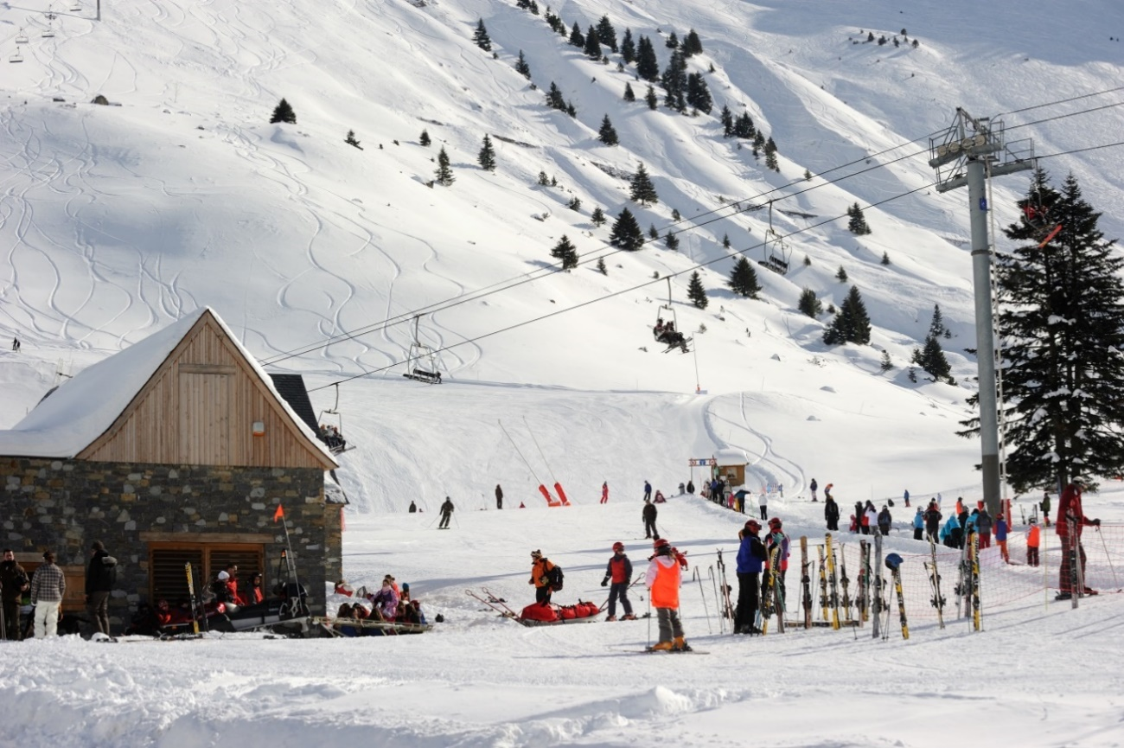
Exploring... Midi-Pyrenees (Year 9) Lesson 5 - Images

Slide 2
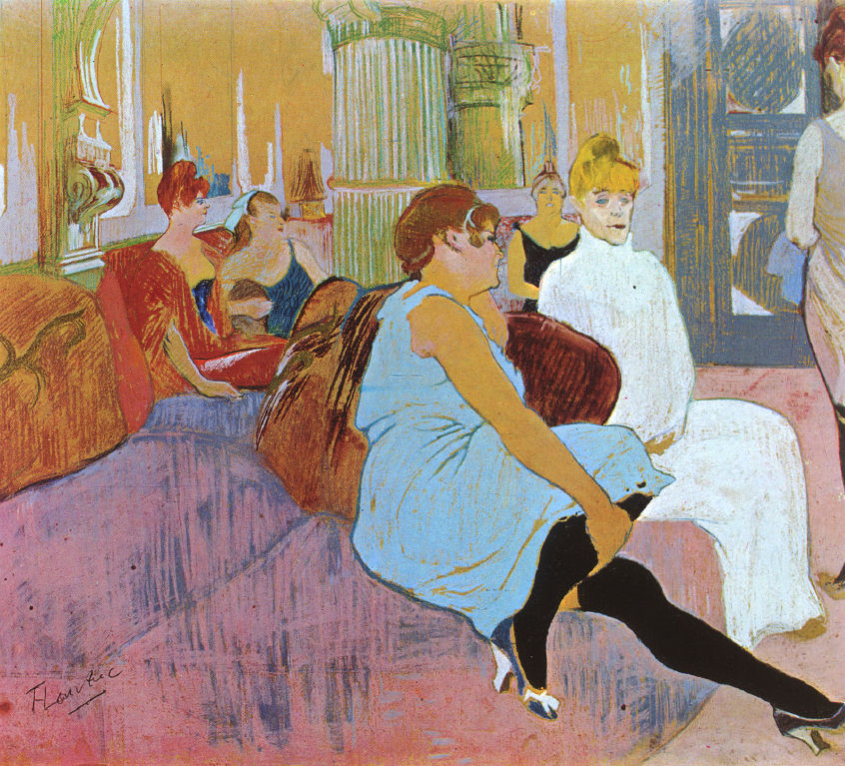
Au salon de la rue des Moulins (1894)
Photocopiable/digital resources may only be copied by the purchasing institution on a single site and for their own use

Slide 3
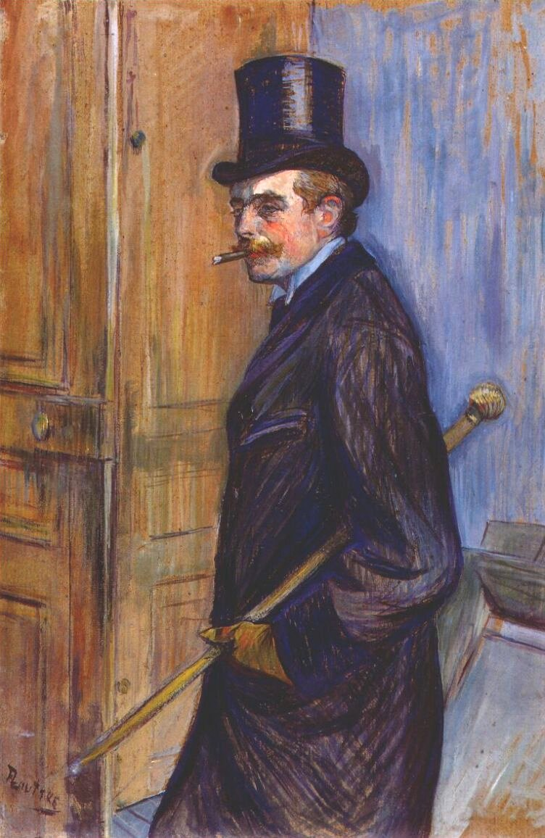
Monsieur Louis Pascal (1891)

Slide 4
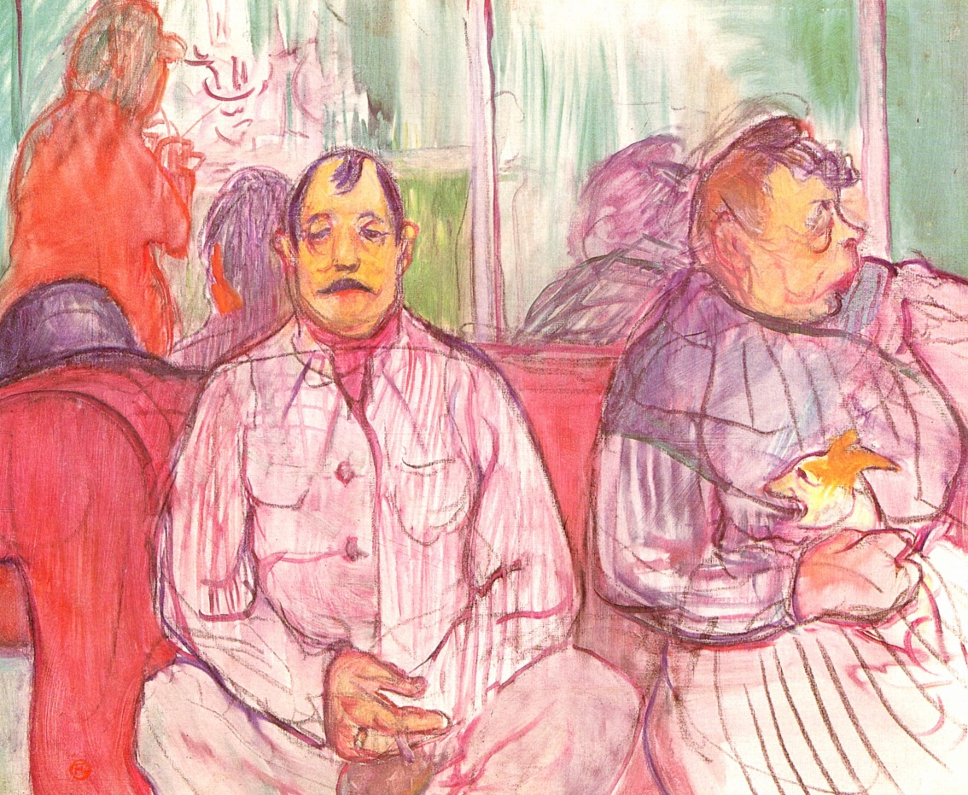
Monsieur, Madame et le chien (1894)

Slide 5
Reine de Joie (1892)

