Slide 1
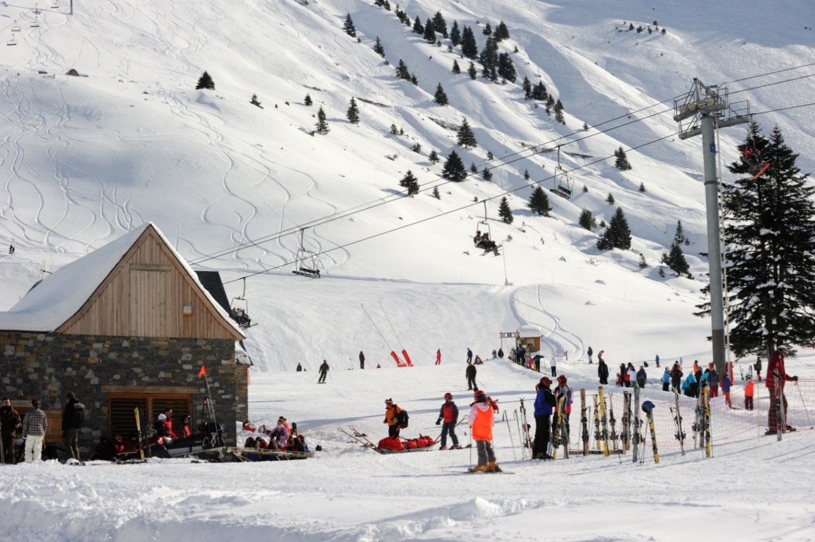
Exploring... Midi-Pyrenees (Year 9) Lesson 4 - Images

Slide 2
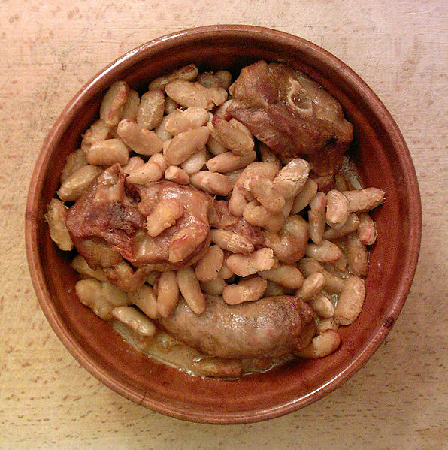
Le cassoulet
Photocopiable/digital resources may only be copied by the purchasing institution on a single site and for their own use

Slide 3
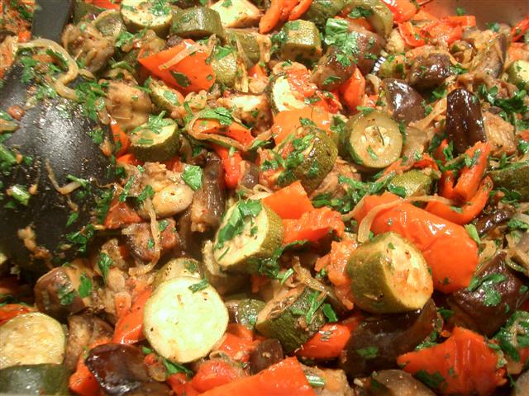
La ratatouille

Slide 4
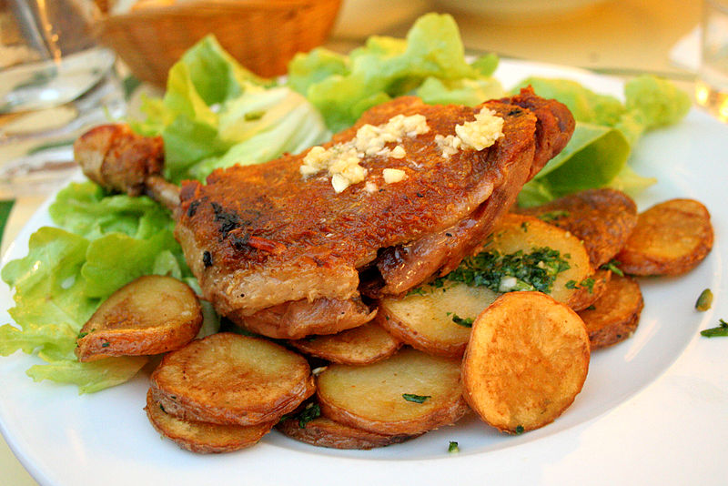
Le confit de canard

Slide 5
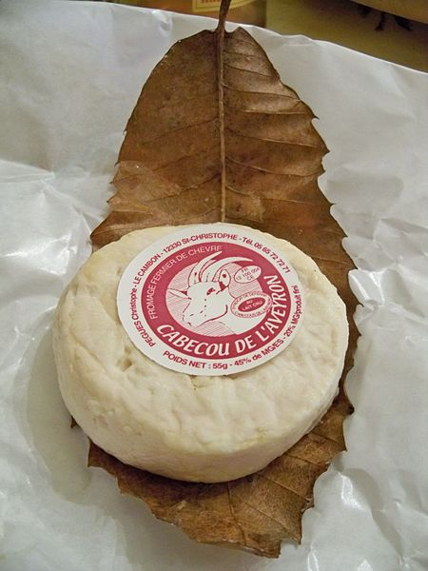
Le fromage de chèvre (Cabécou)

Slide 6
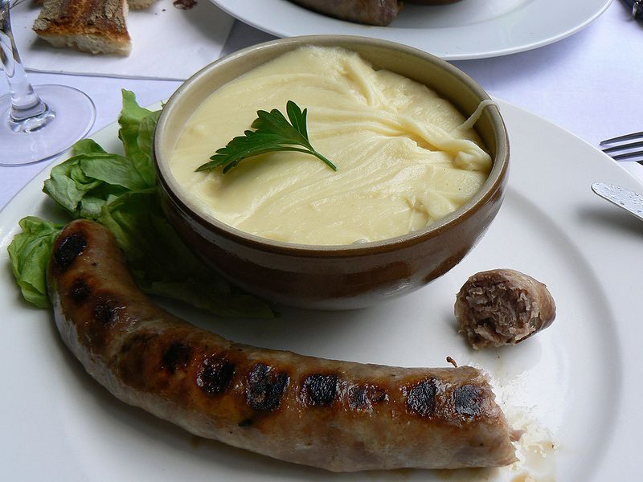
L’aligot

