Slide 1

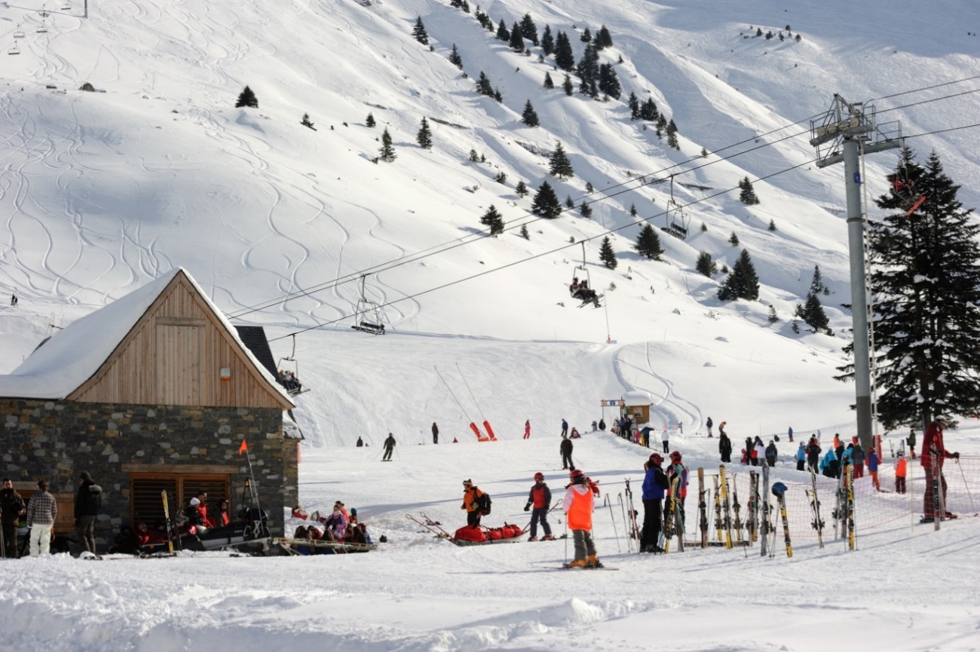

Exploring... Midi-Pyrenees (Year 9)
Lesson 1 - Images

Slide 2
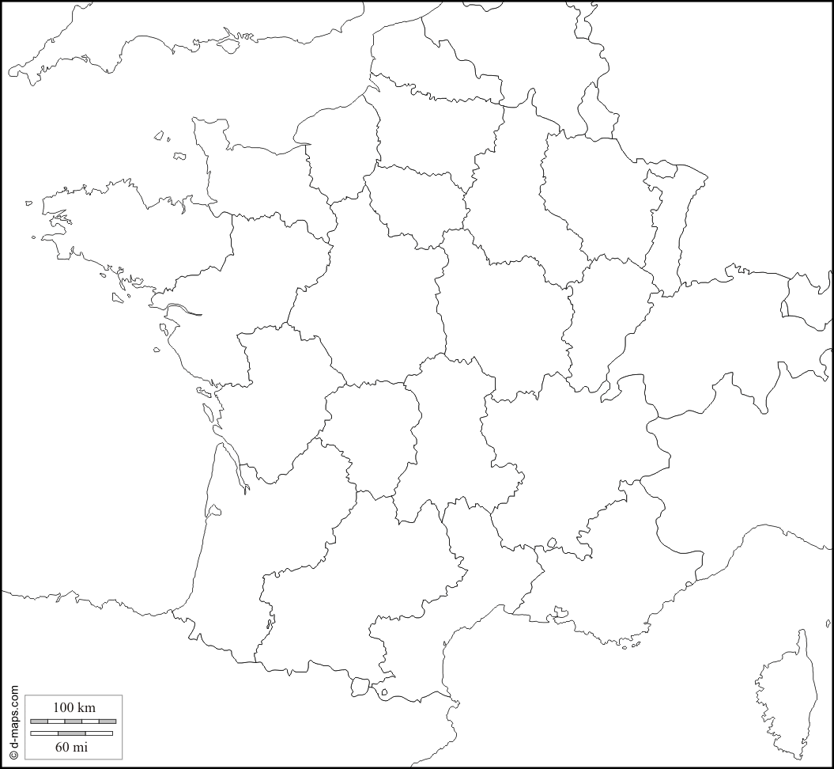

Slide 3
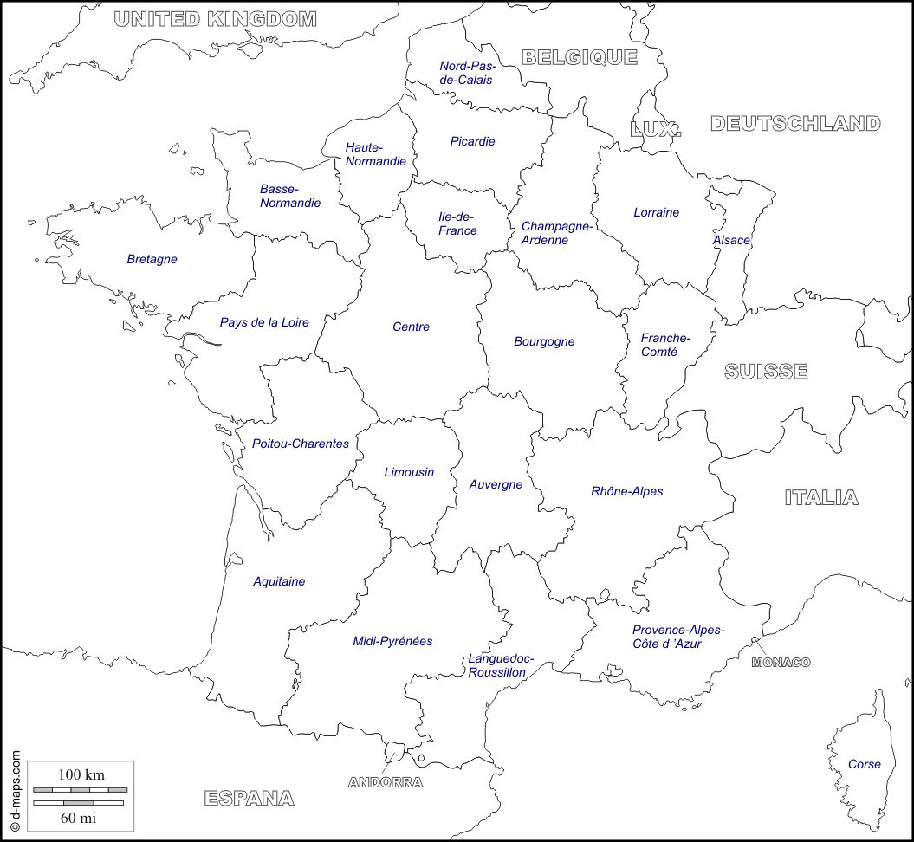
Photocopiable/digital resources may only be copied by the purchasing institution on a single site and for their own use

Slide 5
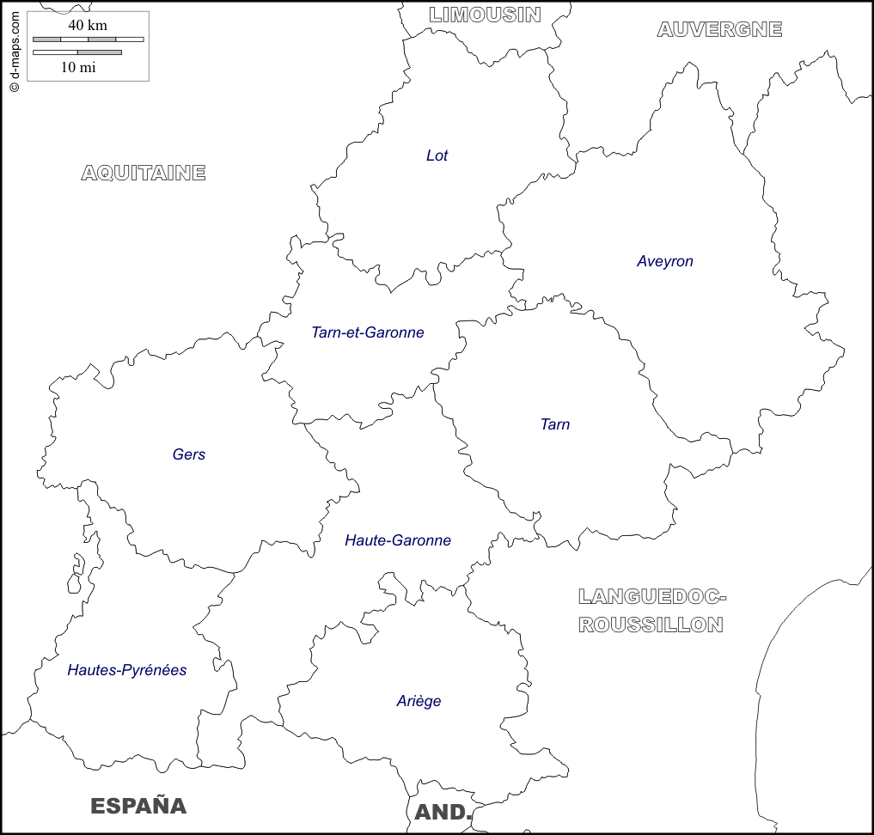

Slide 6
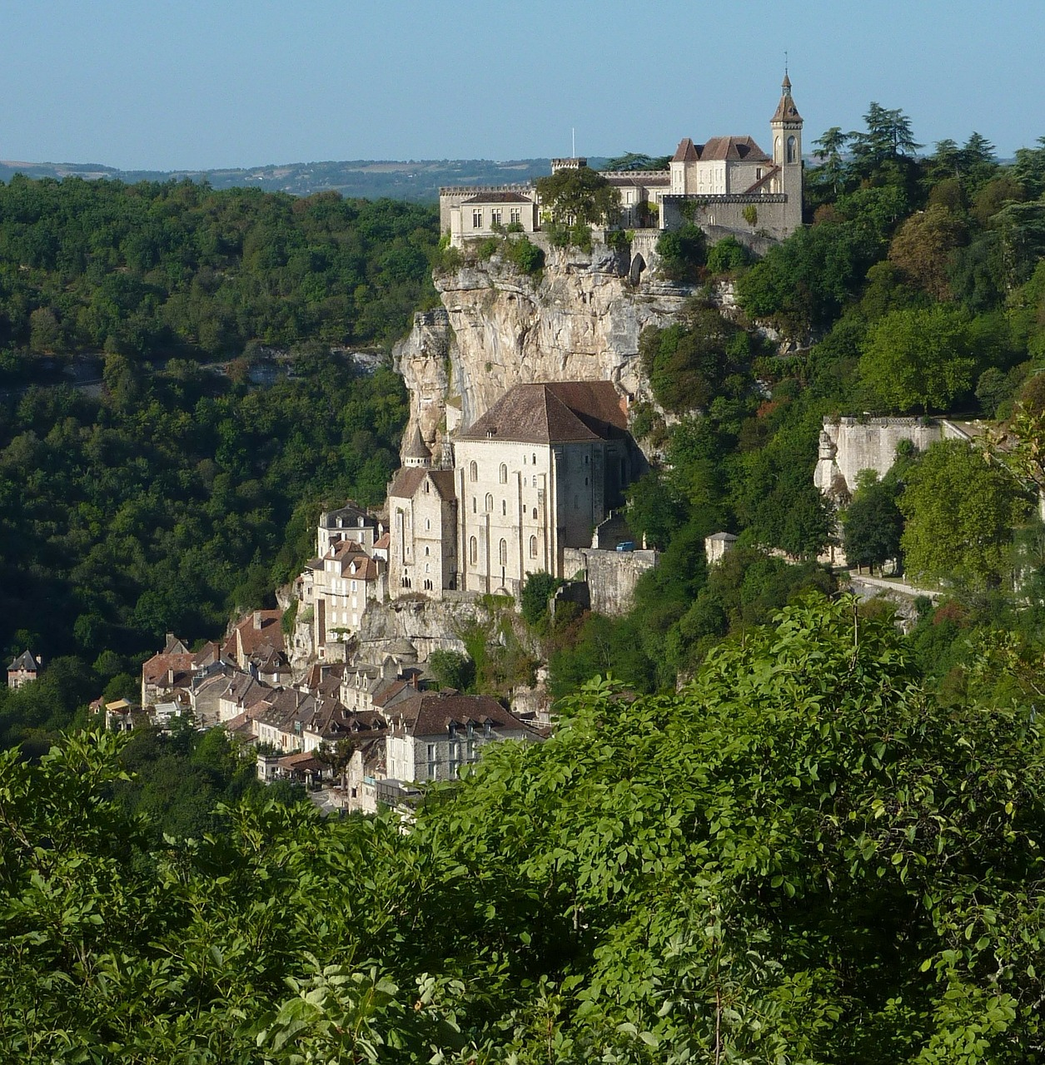
Rocamadour

Slide 7
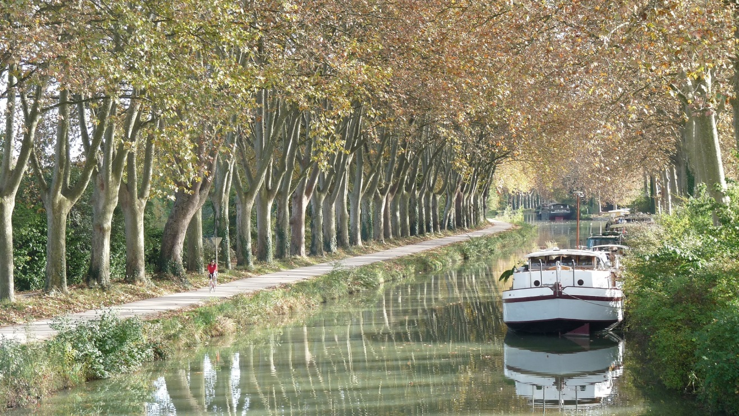
Le canal du Midi

Slide 8
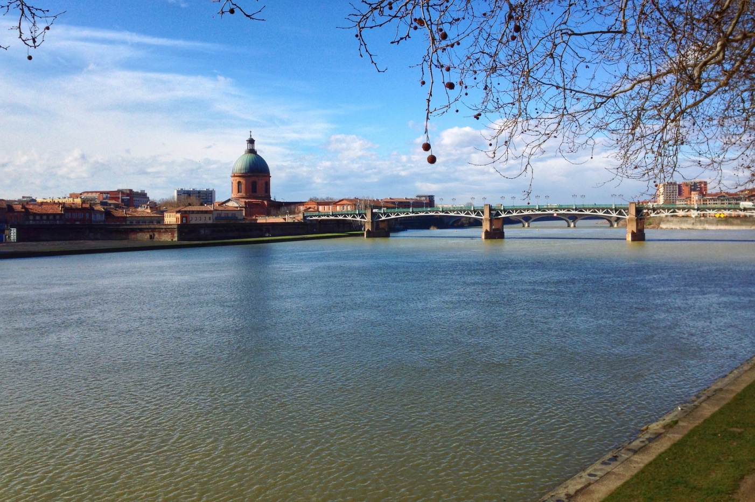
Toulouse

Slide 9

Station de ski dans les Pyrénées

Slide 10
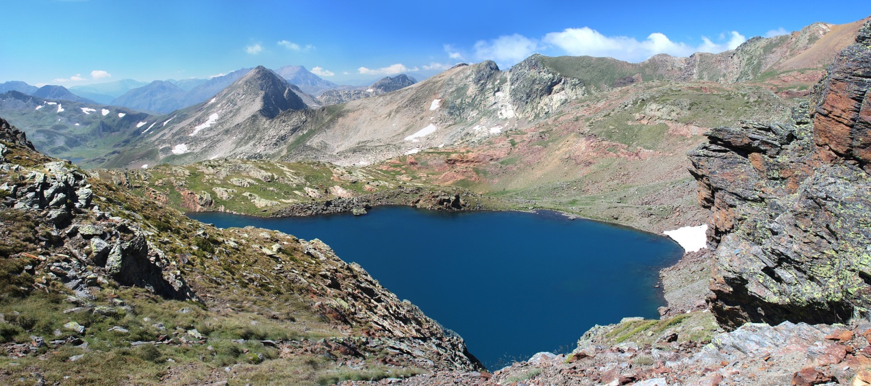
Lac des Pyrénées

Slide 11
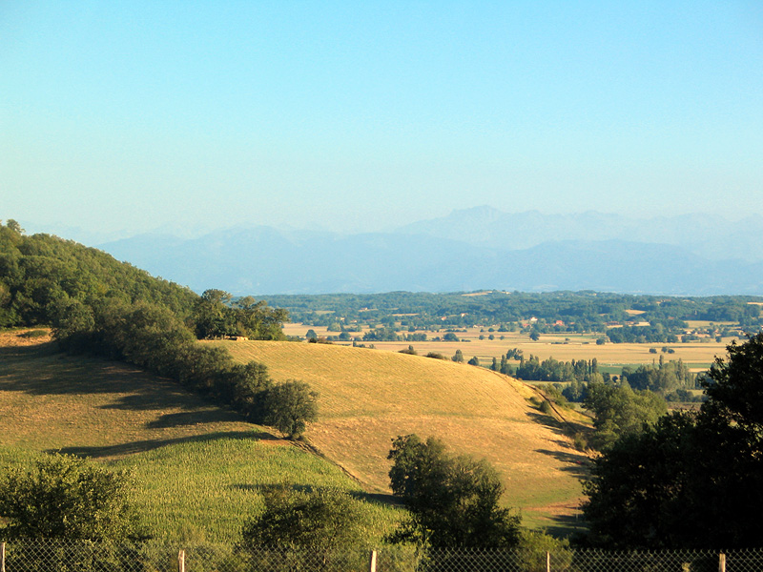
Campagne du Gers

