Slide 1
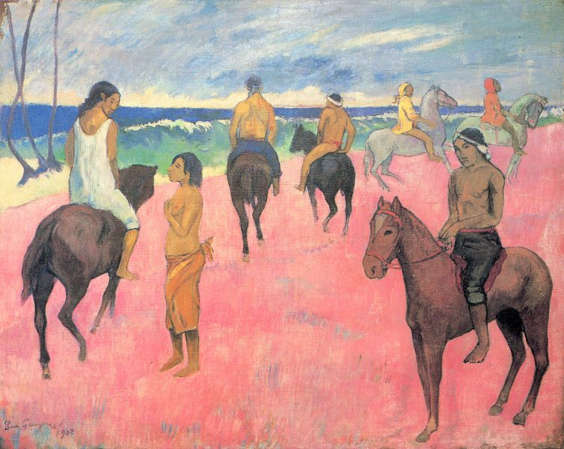
Exploring... Tahiti (Year 7) Lesson 6 – Paul Gauguin An Artist in Love with Tahiti

Slide 2
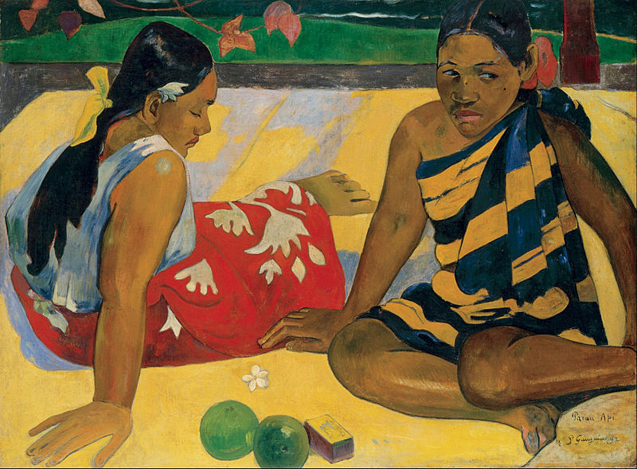
Starter
Painting A
Photocopiable/digital resources may only be copied by the purchasing institution on a single site and for their own use

Slide 3
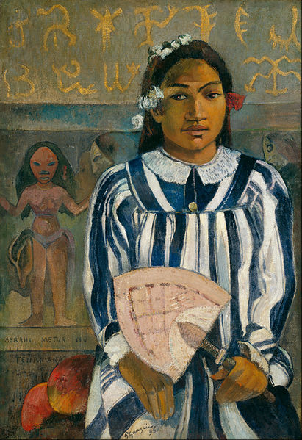
Painting B

Slide 4
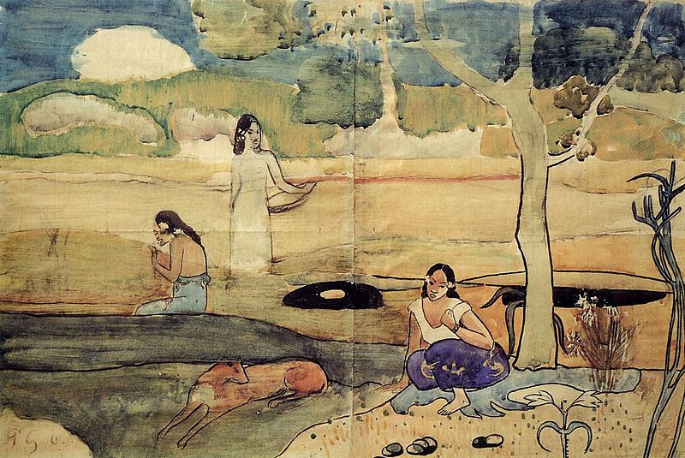
Painting C

Slide 5
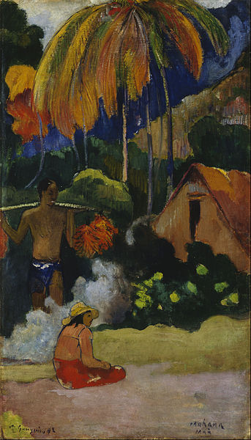
Painting D

Slide 6
Main Activities
Painting 1

Slide 7
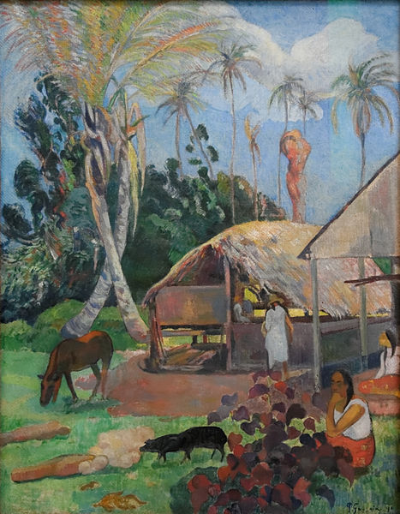
Painting 2

Slide 8
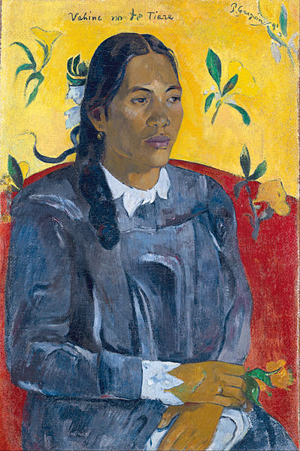
Painting 3

Slide 9
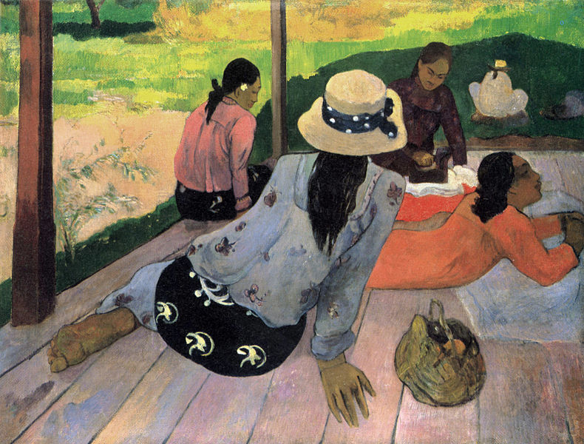
Painting 4

