Slide 1
Culturing Microorganisms
Learning Objectives
The standard growth curve of microorganisms in closed culture
How to maximise the yield of product
How to effectively culture microorganisms
© ZigZag Education, 2020
Notes:
1

Slide 2

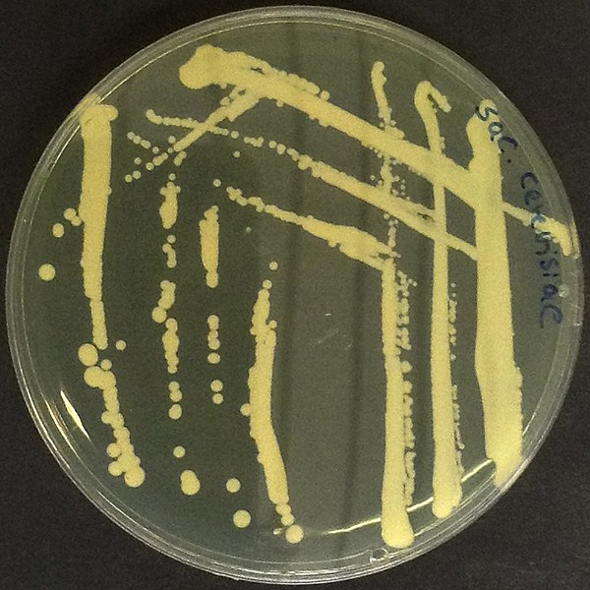

Standard Growth Curve of a Microbe
INSPECTION COPY
Sigmoid growth curve when microbes are introduced into an environment with:
No competitors
No predators
Ample (non-limiting) resources
Nothing added or taken away (closed culture)
Yeast grown in a closed culture with 2 % glucose
In some cases, number of microbes can double every 20–30 minutes
In log phase, number of individuals, N = N₀ × 2^{n}, where N₀ is initial population and n is number of replications
COPYRIGHT
PROTECTED
© ZigZag Education, 2020
Notes:
2

Slide 3
Stages of a Growth Curve
INSPECTION COPY
Lag phase: microbes are coming out of dormancy, manufacturing enzymes and adjusting to conditions
Log/exponential phase: nutrients readily available and wastes not limiting; with a short generation time, reproduction rate is at its maximum for the conditions
Stationary phase: population stable – nutrient shortage and accumulation of toxic wastes, so production of new cells equals death of old cells
Death phase: lack of nutrients and build-up of toxic waste means death exceeds production of new cells and population may drop to zero
COPYRIGHT
PROTECTED
© ZigZag Education, 2020
Notes:
3

Slide 4
INSPECTION COPY
Stationary phase
Population stable – growth = death
Nutrient shortage, toxic wastes accumulate
population size / number of cells
Lag phase
Microbes coming out of dormancy
Manufacturing enzymes
Death phase
Death > growth
Lack of nutrients and build-up of toxic waste
Log/exponential phase
Nutrients readily available and wastes not limiting
Short generation time
Growth > death
Reproduction rate at maximum
COPYRIGHT
PROTECTED
time after inoculation / hours
© ZigZag Education, 2020
Notes:
4

Slide 5
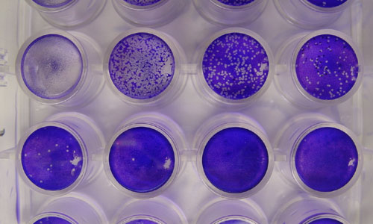
Serial Dilutions
INSPECTION COPY
It can be impossible to count colonies in a broth that is too concentrated
Serial dilutions are used to make it easier to count the number of colonies in order to determine rate of growth
Repeated dilutions by a factor of 10 (adding 9 cm³ distilled water to a sample of 1 cm³ broth) eventually produce a culture easy to count
Can be used to investigate the effect of factors on growth – by changing temperature, pH, etc.
Serial dilution of viral plaque growths
COPYRIGHT
PROTECTED
© ZigZag Education, 2020
Notes:
5

Slide 6
Fermentation
INSPECTION COPY
Industrially, microbes are grown in fermentation tanks or fermenters (sometimes called bioreactors)
The process of growing them is called fermentation irrespective of whether fermentation in its biological meaning is actually occurring
Fermentation traditionally used to describe anaerobic growth and ethanol production from anaerobic respiration
Now generally used for the culture of any microbe, whether it is aerobic or anaerobic
It is possible to grow microbes in batch culture, fed-batch culture and continuous culture
COPYRIGHT
PROTECTED
© ZigZag Education, 2020
Notes:
6

Slide 7
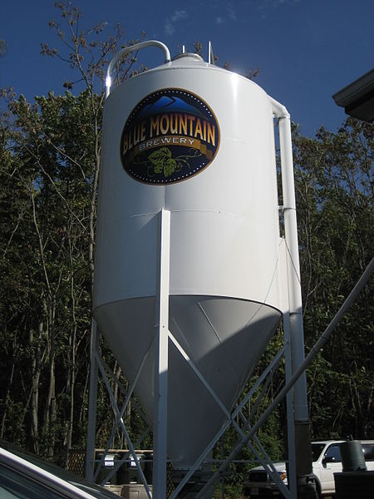
Batch Culture
INSPECTION COPY
A starter culture containing actively growing cells is added to nutrient medium in a fermenter and allowed to grow
Nutrients not added during the fermentation, though conditions may be adjusted, e.g. pH and oxygen
Want to reach the stationary phase as rapidly as possible to start producing secondary metabolites
After a fixed fermentation period (4–10 days) the tank is emptied and the products extracted
Examples: wine, beer, dairy production
Fermentation tank
COPYRIGHT
PROTECTED
© ZigZag Education, 2020
Notes:
7

Slide 8
Fed-batch Culture
INSPECTION COPY
Sometimes not possible to add all the nutrients that are needed during the course of the fermentation at the start
Concentration may be so great that osmotic stress might limit the fermentation or even prevent it from happening
Sometimes necessary to top up nutrients if long fermentation is required, e.g. with penicillin production
Penicillin is a secondary metabolite only made by an ageing Penicillium culture
If nutrients are topped up like this, the fermentation is a ‘fed-batch culture’
COPYRIGHT
PROTECTED
© ZigZag Education, 2020
Notes:
8

Slide 9
Entry port for medium and starter culture
INSPECTION COPY
Motor to turn the paddle blades
Entry port for pH and nutrient adjustment
Paddle or impellor blades
Water jacket outlet
Monitoring array for pH, temperature, etc.
Filter or steam steriliser for air
Water jacket inlet
COPYRIGHT
PROTECTED
Sparge pipe to aerate and mix
Drain valve to empty tank at end
Batch fermenter, typical of that used in culture of Penicillium for antibiotic manufacture
© ZigZag Education, 2020
Notes:
9

Slide 10
Continuous Culture
INSPECTION COPY
The microbe is cultured for extended periods of time (many weeks to months)
Throughout, nutrients are added and products are removed
Want to hold the log/exponential growth stage so that products keep being produced rapidly
Examples of continuous culture include:
Human insulin production
Growth of Fusarium graminearum
COPYRIGHT
PROTECTED
© ZigZag Education, 2020
Notes:
10

Slide 11
Excess gas and waste CO₂ removed
INSPECTION COPY
Degassed medium loses buoyancy and falls
Air aerates and provides uplift to mix medium and fungus
Nutrient medium added to replace that removed; must be sterile
Sterile air
COPYRIGHT
PROTECTED
Medium removed and fungus extracted; fungal filaments further processed
Heating or cooling coil
Pressure cycle fermenter used in the culture of Fusarium for mycoprotein manufacture
© ZigZag Education, 2020
Notes:
11

Slide 12
Fusarium Culture
INSPECTION COPY
Fusarium has relatively simple nutrient requirements
Feedstock is corn steep liquor, which is rich in sugars
Nitrogen, phosphate and trace elements are added so the fungus can make the carbohydrates, protein and nucleic acids it needs for growth
Fusarium is aerobic, and sterile air is used to provide the oxygen and the lift to mix the medium
Conditions (temperature, pH, waste and nutrient levels) are monitored and adjusted as required
Spent medium and fungus are removed continuously
Fungus is separated and processed, reducing the nucleic acid (RNA) content and improving texturing and flavouring
COPYRIGHT
PROTECTED
© ZigZag Education, 2020
Notes:
12

Slide 13
INSPECTION COPY
 | Batch culture | Continuous culture
Type of metabolite | Generally secondary | Primary or biomass
Addition of nutrients | All added at the start of the fermentation | Added continuously to the fermenter
Removal of products | All removed (extracted) at the end of the fermentation | Extracted continuously from the fermenter
Growth | Aim to get through the exponential phase quickly | Aim to keep in the exponential phase throughout
Efficiency | Product only made towards end of fermentation; down time | Product made continuously for extended periods of time
Example | Wine, beer, dairy, penicillin (fed-batch) | Quorn™ and human insulin
Advantages | Relatively easy to control; can obtain secondary metabolites | Extended fermentation period; less down time
Disadvantages | Fermenters are large; waste accumulates | Controlling conditions and maintaining sterility
COPYRIGHT
PROTECTED
© ZigZag Education, 2020
Notes:
13

Slide 14
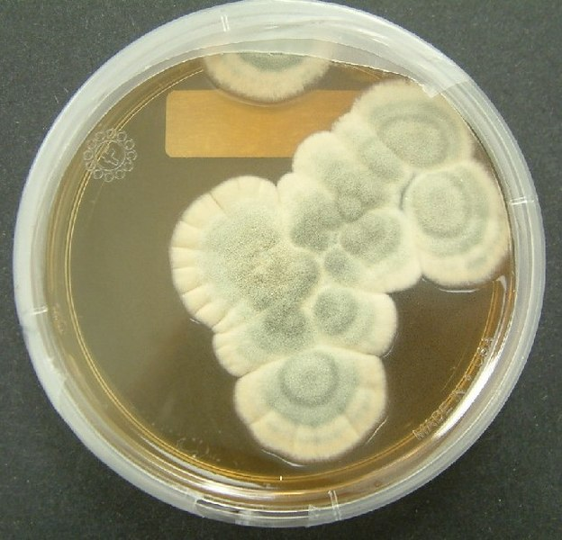
Primary and Secondary Metabolites
INSPECTION COPY
Primary metabolites are substances made by a cell during its normal growth
e.g. proteins, carbohydrates, lipids and wastes routinely made by cells
Secondary metabolites are usually produced in the later stages of growth by microbes
e.g. penicillin and other antibiotics are produced by ageing cultures when nutrients are in short supply
COPYRIGHT
PROTECTED
Penicillium mould
© ZigZag Education, 2020
Notes:
14

Slide 15
INSPECTION COPY
Relationship between growth and yield of product
Primary metabolite, e.g. ethanol
Secondary metabolite, e.g. penicillin
growth / cell number
yield / % ethanol
dry mass / g dm^{–3}
yield / international units
yeast
Penicillium
ethanol
penicillin
COPYRIGHT
PROTECTED
time/days
time/days
Secondary metabolites are only produced in significant quantities in the stationary phase as they are made by an ageing culture
Yield matches the growth curve – primary metabolites are made as a result of normal growth
© ZigZag Education, 2020
Notes:
15

Slide 16
Maximising Yield
INSPECTION COPY
Industrialists want to get the best possible yield, for the least cost or effort
Achieved by manipulating and maintaining growing conditions in the fermenter
Control technology associated with fermenters manages factors such as:
Temperature – increased temperature increases growth to a certain point; exceeding optimum may denature enzymes
O₂ – needed for aerobic conditions
pH – enzyme activity affected away from optimum
Nutrient concentration – nutrients needed for growth; when in short supply, secondary metabolites may be produced
COPYRIGHT
PROTECTED
© ZigZag Education, 2020
Notes:
16

Slide 17
Asepsis
INSPECTION COPY
Means a culture contains no microbes other than those that are being cultured, i.e. there is no contamination
Essentially aseptic technique involves:
Sterilising all equipment and media (before and after use)
Wearing clean, protective clothing (to prevent contamination of the culture and the operative)
On a small scale in the laboratory, or in the production of starter cultures, this is relatively simple
Important to avoid:
Potential harm
Loss of a complete batch or product run, which can be very costly
COPYRIGHT
PROTECTED
© ZigZag Education, 2020
Notes:
17

Slide 18
Importance of Asepsis
INSPECTION COPY
Minimise potential risk to operatives:
Avoid culturing pathogens inadvertently
Avoid infection by intentionally produced pathogens, e.g. during vaccine manufacture
Minimise potential risk to consumers:
Avoid pathogens or contaminants that produce harmful metabolites if the product is used as a medicine or for food
Avoid spoiling the product:
Contaminating microbe may produce different metabolites
Could reduce profit – might require more downstream processing to remove the unwanted metabolites, and whole batch might be unusable and have to be disposed of
Avoid yield reduction, which reduces profitability
COPYRIGHT
PROTECTED
© ZigZag Education, 2020
Notes:
18

Slide 19
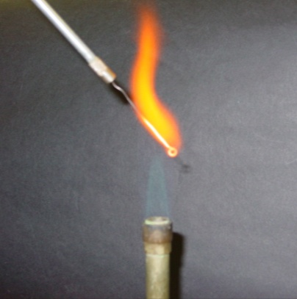
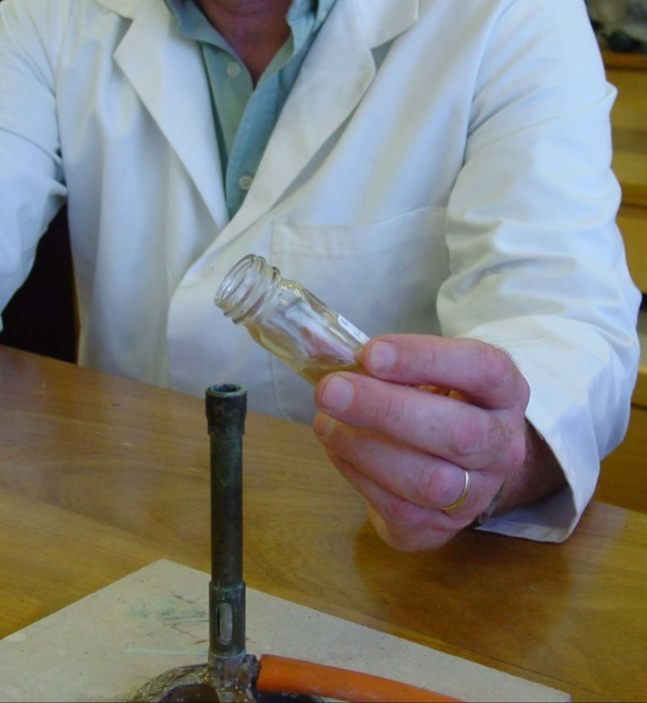
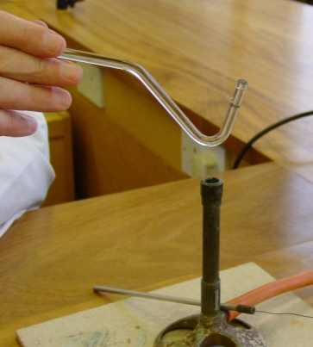
Sterilisation
INSPECTION COPY
Autoclaving at 120 °C for 20 minutes:
Kills all pathogens and their resistant spores, like a giant pressure cooker
Used for media and glassware and can be used on disposable equipment, e.g. plastic Petri dishes and syringes after use
Flaming:
Inoculating loops before and after use
Necks of culture bottles before dispensing the culture
Dipping in alcohol and flaming, e.g. glass spreaders
COPYRIGHT
PROTECTED
© ZigZag Education, 2020
Notes:
19

Slide 20
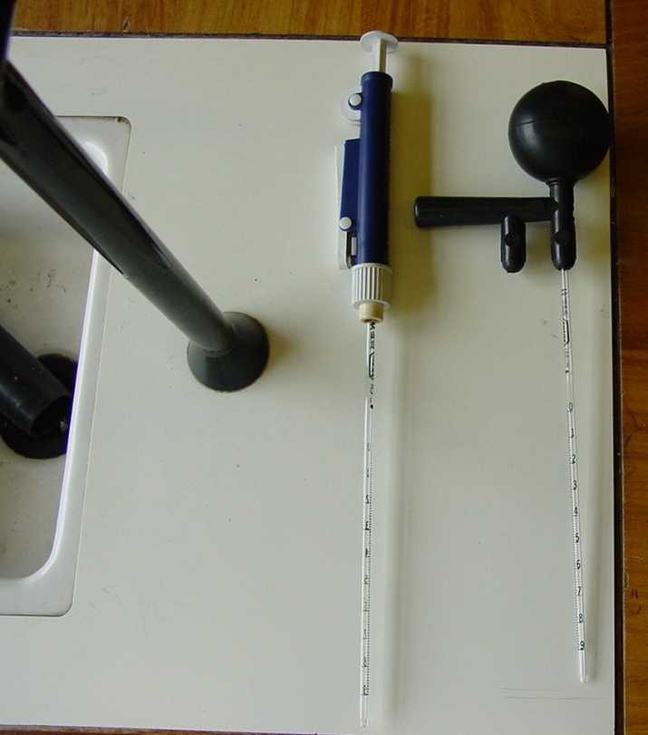
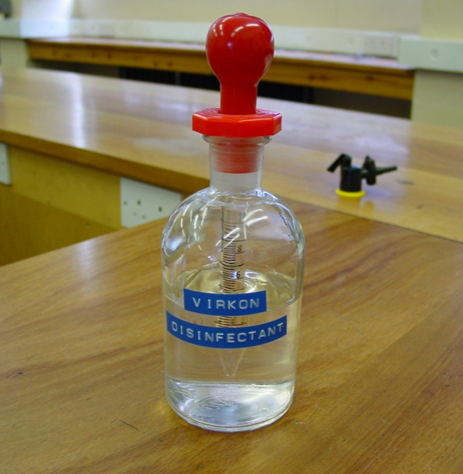
INSPECTION COPY
Other Key Elements
Using disposable sterile equipment, e.g. swabs, Petri dishes, syringes, pipettes
Using safety fillers / dispensers for pipettes
Placing used equipment in a suitable discard container, before appropriate disposal
Inoculating media and transferring cultures in a special inoculating hood or in a fume cupboard
Cleaning all surfaces before and after use with a suitable disinfectant such as VirKon™ or an alternative, e.g. 10 % sodium chlorate (I)
Wearing clean laboratory coat, latex gloves, hairnet and face mask as appropriate
COPYRIGHT
PROTECTED
© ZigZag Education, 2020
Notes:
20

Slide 21
INSPECTION COPY
Asepsis on an Industrial Scale
Sterilising media and equipment is more difficult on a large scale and generally includes:
Using high-pressure steam to clean and sterilise fermenters and feed pipes just before use
Making fermenters and feed pipes out of stainless steel – the smooth surface doesn’t hold residues and is not affected by harsh sterilisation techniques (steam and/or chemicals)
Sterilising media, nutrients and gases before introduction into the fermenter by passing through a steam steriliser or microbiological filter to remove contaminating microbes
Positive air pressure from the fermenter room to the outside
Wearing protective clothing, e.g. overalls and overboots, latex gloves, hairnet and face mask as appropriate
COPYRIGHT
PROTECTED
© ZigZag Education, 2020
Notes:
21

Slide 22
INSPECTION COPY
Questions
Q. State the difference between primary metabolites and secondary metabolites.
Q. Suggest why Penicillium produces penicillin when it is in an ageing culture and nutrients are in short supply.
COPYRIGHT
PROTECTED
© ZigZag Education, 2020
Notes:
22

Slide 23
INSPECTION COPY
Answers
Q. State the difference between primary metabolites and secondary metabolites.
A. Primary metabolites are produced by cells during their normal growth, whereas secondary metabolites are produced in the later stages of growth by ageing cultures.
Q. Suggest why Penicillium produces penicillin when it is in an ageing culture and nutrients are in short supply.
A. Penicillin inhibits the growth of competitors when nutrients are in short supply.
COPYRIGHT
PROTECTED
© ZigZag Education, 2020
Notes:
23

Slide 24
Preview presentation ends here
This is a limited inspection copy.
For more details, and to purchase the resource, please visit zigzageducation.co.uk
COPYRIGHT
PROTECTED

