Slide 1
Receptors and Neurons
Learning Objectives
Mammalian receptors convert stimuli into nervous impulses
The structure of sensory, relay and motor neurons
The functions of sensory, relay and motor neurons
© ZigZag Education, 2020
Notes:
1

Slide 2


Mammalian coordination
INSPECTION COPY
Mammals have two means by which they can coordinate their behaviour.
The endocrine system:
Releases hormones into the blood.
Carries them through the body to target organs or glands where they have their effect.
Generally slow and long-lasting.
The nervous system:
Transmission of electrical impulses along specialised nerve cells or neurons.
Faster and more precise than the endocrine system.
COPYRIGHT
PROTECTED
© ZigZag Education, 2020
Notes:
2

Slide 3
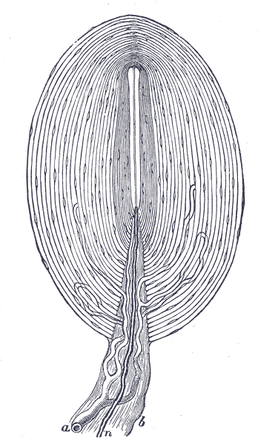
Sensory receptors
INSPECTION COPY
Receptor cells respond to stimuli and start an action potential.
Often found in sense organs.
e.g. light receptors (rods and cones) are found in the eye
Generate an action potential (nerve impulse) and send it to a sensory neuron.
In some receptors, such as pressure receptors or Pacinian corpuscles in the skin, the receptor is the end of a sensory neuron.
Changes in pressure deform the connective tissue surrounding the neuron.
COPYRIGHT
PROTECTED
Pacinian corpuscle
© ZigZag Education, 2020
Notes:
3

Slide 4
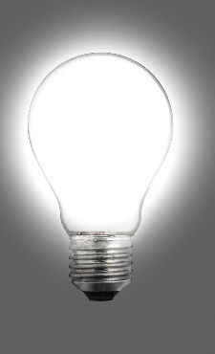



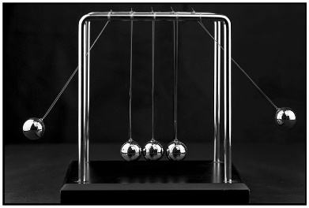
Transducers
INSPECTION COPY
Receptors are really transducers, which convert one form of energy into another.
Energy may be received as light, sound, chemical energy or kinetic energy.
The second form of energy is always electrical energy of the action potential / nerve impulse.
COPYRIGHT
PROTECTED
© ZigZag Education, 2020
Notes:
4

Slide 5
Receptor | Sense | Form in which energy is received
Rods and cones in retina | Sight | Light – electromagnetic radiation in the visible part of the spectrum (400–700 nm)
Organ of Corti (sensory hair cells) in the cochlea | Hearing | Sound waves – waves of compression in the air, transmitted to waves in fluid of the ear
Gustatory cells in taste buds of tongue | Taste | Chemical energy
Olfactory cells in the olfactory lobe of the nose | Smell | Chemical energy
Touch receptors in skin | Touch | Kinetic energy
INSPECTION COPY
COPYRIGHT
PROTECTED
© ZigZag Education, 2020
Notes:
5

Slide 6
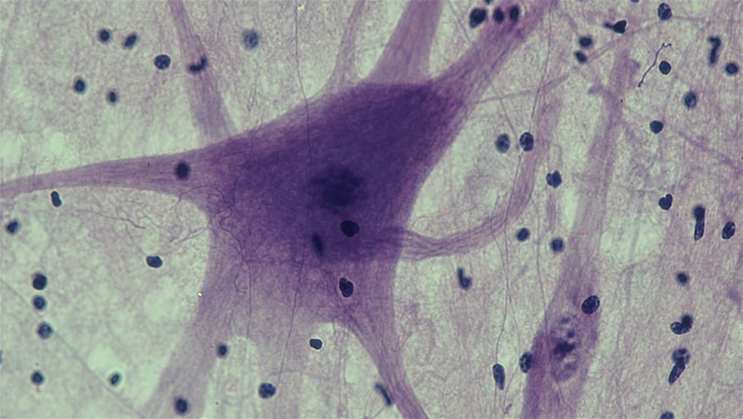
Neurons
INSPECTION COPY
There are three basic types of neurones:
Motor neurons carry impulses from the central nervous system to muscles or glands.
Sensory neurons transmit impulses to the central nervous system from sense organs or receptors.
Intermediate/connector/relay neurons are found in the central nervous system relaying impulses between neurons.
Motor neuron of a rat
COPYRIGHT
PROTECTED
© ZigZag Education, 2020
Notes:
6

Slide 7
Dendron with dendrites
Take impulses towards the cell body.
Cytoplasm
Contains numerous mitochondria and rER.
Motor neuron
INSPECTION COPY
Nucleus
Controls the activity of the cell.
Motor nerve ending
Also known as synaptic knob.
Schwann cell
Wraps around the axon and insulates it, forming the myelin sheath.
Node of Ranvier
Gap between adjacent Schwann cells.
COPYRIGHT
PROTECTED
Cell body of neuron
This is situated in the CNS.
Axon
Takes impulses away from the cell body to a muscle or gland. In motor neurons it can be very long.
© ZigZag Education, 2020
Notes:
7

Slide 8
Neuron structure
INSPECTION COPY
The motor neuron takes messages from the central nervous system to muscles and glands.
The cell body, situated in the CNS, is rich in rough endoplasmic reticulum (rER) and mitochondria.
There are many cytoplasmic processes (dendrons and even finer dendrites) extending from the cell body, most of which are relatively short.
These conduct impulses towards the cell body.
The longer axon carries impulses away from the cell body.
At the end of the axon are branches that terminate in a muscle or gland.
Terminal buttons (knobs) contain many vesicles with transmitter substance.
COPYRIGHT
PROTECTED
© ZigZag Education, 2020
Notes:
8

Slide 9
Motor neuron
INSPECTION COPY
Short dendrons to carry impulses towards the cell body.
A long axon to carry impulses away from the cell body.
The cell body is large and is found in the CNS.
The axon may be myelinated.
Function:
Carries action potentials (nerve impulses) from the CNS to an effector muscle or gland.
COPYRIGHT
PROTECTED
© ZigZag Education, 2020
Notes:
9

Slide 10
Sensory neuron
INSPECTION COPY
Long dendron takes impulses towards the cell body.
Relatively short axon takes impulses away from the cell body.
The cell body is found in a swelling or ganglion close to the CNS.
Dendron and axon may be myelinated.
Function:
Carries action potentials from a sense organ or receptor to the CNS.
COPYRIGHT
PROTECTED
© ZigZag Education, 2020
Notes:
10

Slide 11
Relay neuron
INSPECTION COPY
There are different types of relay neuron:
Unipolar neurons have a single prominent process from the cell body.
Bipolar neurons have two prominent processes (as here) from the cell body.
Multipolar neurons have many processes from the cell body.
None of the processes is myelinated.
Function:
Carries action potentials between neurons within the CNS.
Involved in reflexes.
COPYRIGHT
PROTECTED
© ZigZag Education, 2020
Notes:
11

Slide 12
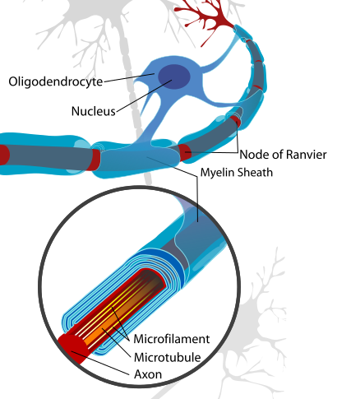
Myelinated nerves
INSPECTION COPY
Specialised Schwann cells are wrapped around the neuron to produce the myelin sheath.
The cytoplasm of the Schwann cells is rich in lipid and acts as electrical insulation.
There are gaps between adjacent Schwann cells, known as nodes of Ranvier.
Conduction of nerve impulses is sped up by the presence of the myelin sheath.
Sheath is not present around all neurons.
Only 1/3 of motor and sensory neurons in humans.
COPYRIGHT
PROTECTED
© ZigZag Education, 2020
Notes:
12

Slide 13
INSPECTION COPY
Schwann cell nucleus
Contains chromosomes.
Neuron
Cytoplasm rich in lipid
Helps insulate and ensures that depolarisation occurs only at the node of Ranvier.
COPYRIGHT
PROTECTED
© ZigZag Education, 2020
Notes:
13

Slide 14
Saltatory conduction
INSPECTION COPY
In humans, myelinated neurons conduct impulses at up to 100 ms^{–1}, whereas non-myelinated neurons may be as slow as 0.5 ms^{–1}.
The myelin sheath wrapped around the neuron prevents movement of ions.
Local circuits, i.e. the flow of Na⁺ from the positive regions to the negatively charged regions, can only flow between adjacent nodes of Ranvier.
Depolarisation and the action potential/impulse effectively jumps from node to node.
Saltatory conduction is much faster than non-myelinated conduction.
Latin: saltare = to jump
COPYRIGHT
PROTECTED
© ZigZag Education, 2020
Notes:
14

Slide 15
INSPECTION COPY
Direction of action potential
+
+
-
+
+
-
-
+
-
-
+
+
-
+
+
At resting potential – capable of stimulation
Refractory period – cannot be stimulated
Action potential – node is depolarised
PD starting to reduce; site of next AP
At resting potential – capable of stimulation
COPYRIGHT
PROTECTED
© ZigZag Education, 2020
Notes:
15

Slide 16
Non-myelinated neurons
INSPECTION COPY
A local circuit is set up between adjacent areas of membrane, so it takes longer to travel the same distance in a non-myelinated nerve.
Impulses travel faster in neurons with a large diameter.
Invertebrates lack myelinated nerves and have giant axons of large diameter which transmit impulses for escape reflexes, e.g. squid and earthworm.
Large fibres offer less resistance to local currents and adjacent regions of membrane reach threshold sooner.
COPYRIGHT
PROTECTED
© ZigZag Education, 2020
Notes:
16

Slide 17
conduction speed / ms⁻¹
125
INSPECTION COPY
The graph shows the relationship between axon diameter and speed of nerve transmission in myelinated and non-myelinated neurons.
As diameter increases, conduction speed increases.
The increase is more marked in myelinated neurons, which are about 5× faster.
100
myelinated nerve
75
50
COPYRIGHT
PROTECTED
25
non-myelinated nerve
5
10
15
20
axon diameter / µm
Data source: Rushton. W.A.H. (1951) J. Physiol.115: 101–122
© ZigZag Education, 2020
Notes:
17

Slide 18
 | Myelinated neuron | Non-myelinated neuron
Structure
Association with Schwann cell | Schwann cell wrapped around neuron to form myelin sheath –80 % lipid, 20 % protein. Insulates neuron so that depolarisation is only possible at gaps between cell, i.e. at the nodes of Ranvier. | Loose association with many neurons and the Schwann cell. No insulation, so depolarisation spreads along neuron membrane (like a Mexican wave).
Location | Peripheral nervous system where rapid conduction of impulses is important. | Peripheral nervous system where slower conduction is acceptable, e.g. controlling digestion.
Speed of conduction | Rapid, between 25 and 100 ms^{–1}. | Slower, between 5 and 25 ms^{–1}.
Type of conduction | Saltatory, i.e. only get depolarisation and action potential at the nodes of Ranvier. | Depolarisation and action potential as a self-propagating wave along the neuron.
INSPECTION COPY
Nucleus
Nucleus
Schwann cell
Schwann cell
Axon
Axon
COPYRIGHT
PROTECTED
© ZigZag Education, 2020
Notes:
18

Slide 19
INSPECTION COPY
Questions
Q. Which type of neuron (myelinated or non-myelinated) has the fastest speed of nervous transmission? Explain.
Q. Motor neurons transmit impulses from the CNS to an effector muscle or gland. True or false? Explain.
COPYRIGHT
PROTECTED
© ZigZag Education, 2020
Notes:
19

Slide 20
INSPECTION COPY
Answers
Q. Which type of neuron (myelinated or non-myelinated) has the fastest speed of nervous transmission? Explain.
A. Myelinated neurons, as Schwann cells insulate the axon and depolarisation is only possible at the nodes of Ranvier.
Q. Motor neurons transmit impulses from the CNS to an effector muscle or gland. True or false? Explain.
A. True – these impulses are received from sensory or relay neurons.
COPYRIGHT
PROTECTED
© ZigZag Education, 2020
Notes:
20

Slide 21

Preview presentation ends here
This is a limited inspection copy.
For more details, and to purchase the resource, please visit zigzageducation.co.uk
COPYRIGHT
PROTECTED

