Slide 1
T Level Oxon Games Order Processing Module Lesson 1
This resource may only be copied by the purchasing institution on a single site and for their own use © ZigZag Education, 2025

Slide 2


Agenda
INSPECTION COPY
Introducing your scenario
Starting your solution design
Reflection
COPYRIGHT
PROTECTED
© ZigZag Education, 2025

Slide 3
Introducing your scenario
INSPECTION COPY
COPYRIGHT
PROTECTED
© ZigZag Education, 2025

Slide 4
Introducing Oxon Games
INSPECTION COPY
Scenario
You work for a software development company. The company has been offered the contract to develop the new digital solution for Oxon Games.
Oxon Games is a new company that supplies computer games in your area. After reviewing its current systems, Games Store has decided that it needs to develop a new digital solution.
Modules
Order processing – allows Oxon Games staff to place orders
Customer orders – allows customers to place orders
Business dashboard – allows Oxon Games management to review orders, etc.
COPYRIGHT
PROTECTED
© ZigZag Education, 2025

Slide 5
Schedule
INSPECTION COPY
Project | Assignment set | Assignment due date
Order processing | [add date] | [add date]
Customer orders | [add date] | [add date]
Business dashboard | [add date] | [add date]
COPYRIGHT
PROTECTED
© ZigZag Education, 2025

Slide 6
Oxon Games Module 1: Order processing
INSPECTION COPY
Assignment 1: due [insert date here]
User requirements
be able to view catalogue of games available
add customer orders for games
see an itemised bill for each customer order
Must be written in Python 3.5x
COPYRIGHT
PROTECTED
© ZigZag Education, 2025

Slide 7
Activity: Discussion – What’s involved in this application?
INSPECTION COPY
What are the key elements?
How will they work together?
COPYRIGHT
PROTECTED
© ZigZag Education, 2025

Slide 8
Starting your module design
INSPECTION COPY
COPYRIGHT
PROTECTED
© ZigZag Education, 2025

Slide 9
Solution design overview
INSPECTION COPY
Assume that you are designing your solution for someone else to code. This means that your design should be:
Detailed and comprehensive
Easily understood and clear
Independent of a specific programming language
Key steps
Step 1: Decomposition
Step 2: Flowchart
COPYRIGHT
PROTECTED
© ZigZag Education, 2025

Slide 10
Solution design – step 1
INSPECTION COPY
Step 1 is to decompose the whole solution.
1a: Split up the solution into modules
1b: Identify the key elements of each module, i.e.
Inputs
Outputs
Processes
COPYRIGHT
PROTECTED
© ZigZag Education, 2025

Slide 11
Example decomposition diagram
INSPECTION COPY
Main menu
Order Processing
Delivery
Sales and marketing
Admin
Display menu of pizzas
Customer selects pizza
etc
COPYRIGHT
PROTECTED
© ZigZag Education, 2025

Slide 12
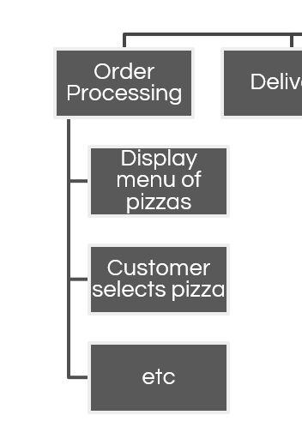
Activity: create a decomposition diagram for the Orders module
INSPECTION COPY
Identify the key:
Inputs
Processes
Outputs
COPYRIGHT
PROTECTED
© ZigZag Education, 2025

Slide 13
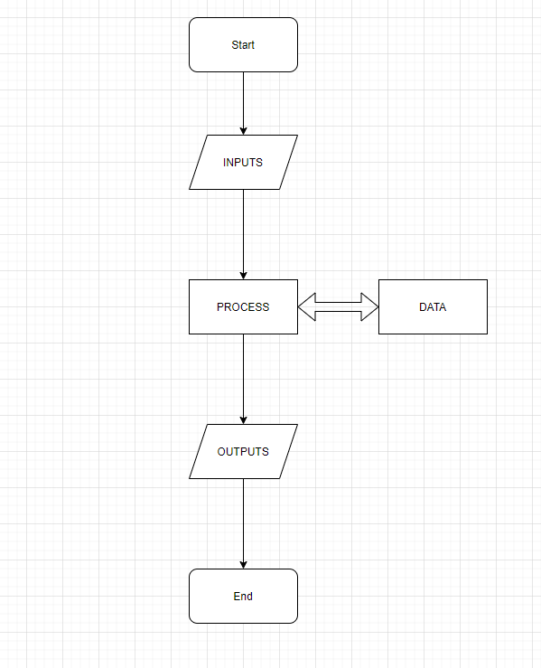
Solution design – step 2
INSPECTION COPY
Step 2 is to create a flowchart for each module
Convert the inputs, processes and outputs into a flowchart
Flowchart needs to explain in more detail:
How the module works
How to calculate the processes
e.g. total price = quantity * price
COPYRIGHT
PROTECTED
© ZigZag Education, 2025

Slide 14
Activity
INSPECTION COPY
Create a folder for your work. Make sure you can easily find this as you will be working on this solution over the coming weeks.
Start working on your solution design:
Decomposition
Flowchart for the Orders module
Worksheet: Oxon Games
Order Processing 1: Task 1
COPYRIGHT
PROTECTED
© ZigZag Education, 2025

Slide 15
Activity : coding your solution
INSPECTION COPY
Load the sample code and make sure you understand it
Key things:
KISS – better to get something that works than to be over-ambitious!
Comments
Naming conventions – be consistent!
Worksheet: Oxon Games
Order Processing 1: Task 2
COPYRIGHT
PROTECTED
© ZigZag Education, 2025

Slide 16
Summary
INSPECTION COPY
Introduce your scenario
Start your solution design
Make sure you have saved all of your work to a folder. Think about how you will organise your work.
COPYRIGHT
PROTECTED
© ZigZag Education, 2025

Slide 17
Preview presentation ends here
This is a limited inspection copy.
For more details, and to purchase the resource, please visit zigzageducation.co.uk
COPYRIGHT
PROTECTED

